Slide 1
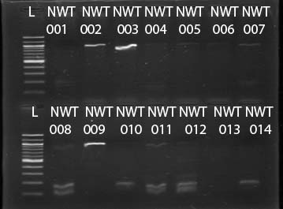
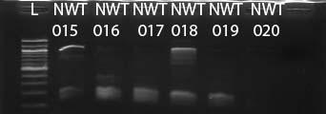
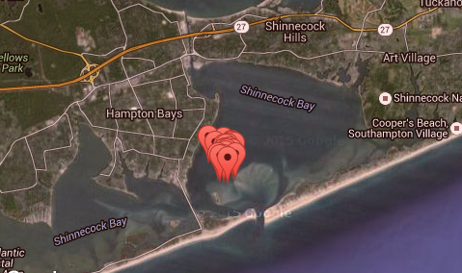
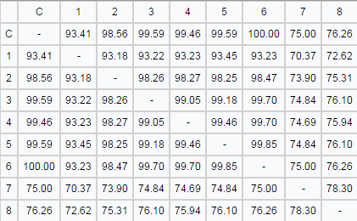
DNA Barcoding of Shinnecock Bay Crabs
Abstract
Genetic variation is the differences in genes in a species. This project planned to measure the genetic variation of Shinnecock bay crabs.It is vital for these crab species to have gnetic variation because they play a key role in the Shinecock bay ecosystem. These crabs eat decaying organisms in the bay, which in turn helps to keep the bay “clean”. Of the samples we collected, It was discovered that the Dyspanopeus sayi samples are 98.4% similar in the CO1 gene. This leads to the conclusion that the species has little genetic variation. But it is difficult to tell with one gene and future studies may include the use of the ITS gene.
Authors: Cassandra Shore, Haley Minnear, Liam McGevna, Thomas Cassar
Teacher: Robert Bolen, James Ostensen
Eastport South Manor Junior-Senior High School
Discussion
If the desired results are not achieved with the CO1 gene, the ITS gene may also be used in this project.
It was discovered that there is little genetic variation between the crab species that was barcoded. This means that the gene that was selected has little variation: however in future studies, if there was an additional gene selected for sequencing, one would be able to determine if there was another overlooked variation within the species.
When the DNA was first sent back from sequencing after PCR, many of the the sequences were not acceptable or were not crab DNA. The samples were sent back for resequencing. When the sequences came back, it was discovered that the species of crabs were Dyspanopeus sayi. After analysing the results, there was little to no genetic variation among the crab samples in the
Shinnecock Bay area.
Results
Introduction
Genetic variation is vital to every ecosystem and species because it makes them stable and prosperous. Without genetic variation one simple change to the environment could destroy a whole population.
Crabs are necessary to most aquatic ecosystems. They feed on decomposing plants, algae and bacteria which keeps the water quality in a healthy range. In this experiment, the question that is being asked is: What is the genetic variation of the crab samples that were extracted from Shinnecock Bay?
During the past couple of years the Shinnecock Bay has had multiple issues with water quality. These issues are caused by multiple occurrences such as nutrient loading and algal blooms.
DNA Barcoding is used to determine the DNA sequences in an organism. With the information from DNA Barcoding it is possible to compare the biodiversity of different organisms in a population accurately.
Figures 1 & 2: Gel Results of PCR. The most prominent sample are numbers: 2, 3, 9, 15, 18. These samples were then sent to DNA subway to be sequenced.
References
"NOAA'sNational Ocean Service." NOAA's National Ocean Service. National Ocean Service, 3 Sept. 2014. Web. 12 Nov. 2015.
Jaffe, D., & McDonough, C. (2012). Indicator species. Retrieved from -http://www.eoearth.org/view/article/153801
inbreeding. (n.d.). The American Heritage® Science Dictionary. Retrieved November 12, 2015, from Dictionary.com website: http://dictionary.reference.com/browse/inbreeding
About the Brown Tide." NY Sea Grant. N.p., n.d. Web -www.seagrant.sunysb.edu/articles/r/1118
Identifying Species with DNA Barcoding « Barcode of Life." Identifying Species with DNA Barcoding « Barcode of Life. N.p., n.d. Web. 12 Nov. 2015. -http://barcoding.si.edu/whatis.html
"NOAA's National Ocean Service." NOAA's National Ocean Service. N.p., n.d. Web. 12 Nov. 2015.-www.oceanservice.noaa.gov
"What Is DNA Barcoding?" « Barcode of Life. N.p., n.d. Web. Oct.-Nov. 2015. http://www.barcodeoflife.org/content/about/what-dna-barcoding
Figure 3: These pins represent the
areas where the samples were collected (40.8521244935°N,72.4887371063°W)
Figure 4: Similarities of DNA sequences for listed species in Figure 7.
Methods
Twenty crab samples were collected from the Shinnecock Bay estuary in October of 2015. The samples were obtained by trolling, or pulling a large fish net behind a boat.
The samples were stored in freezers at ESM for a few weeks.
In January of 2016, standard DNA extraction protocol was conducted with procedure and equipment provided by CSHL.
In order to amplify a specific gene sequence, PCR was performed at BNL, using protocol by CSHL, in March of 2016.
After sequencing, the five crab crab samples that had the best sequencing were uploaded onto DNA subway and were compared to one another to indicate the species of the crabs and if there was any genetic diversity.
Figure 5: Results revealed a lack of genetic variation in this species, Dyspanopeus sayi, in the Shinnecock bay area.
Acknowledgments
Dr. Sharon Pepenella at Cold Spring Harbor Lab for guidance during the entire process; Dr. Aleida Perez and Mr. Daniel Williams for support at the BNL Open Labs; Dr. Daniel Moloney at SUNY Stony Brook for his support at the Open Labs; Mr. Michael Doyle for printing our posters at the school, Our teacher mentors: Mr. Bolen, Mr. Hughes, Mr. Ostensen, Dr. Spata
Figure 7: Dyspanopeus sayi
Figure 6: The species DNA are about 98% similar to local Dragonfly and Mayfly species in the area.

