Slide 1
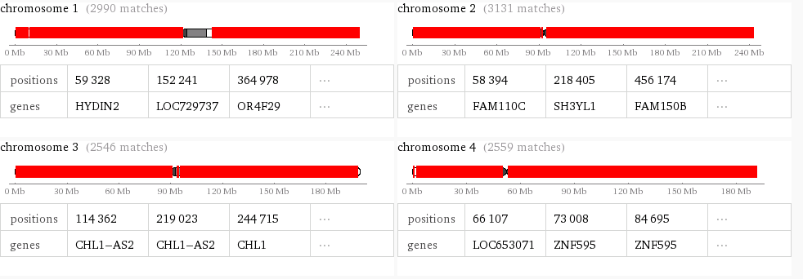
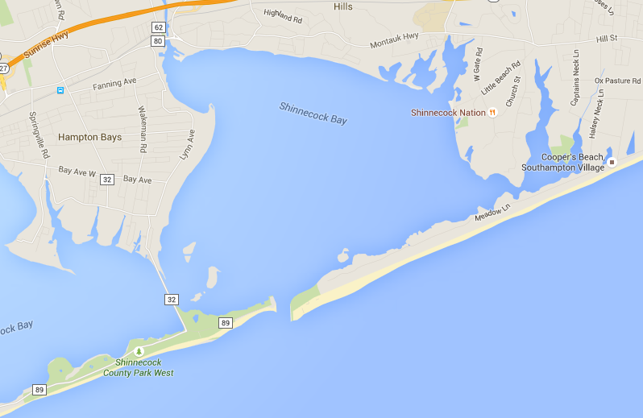
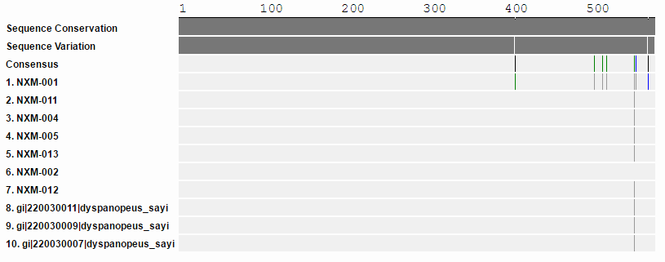
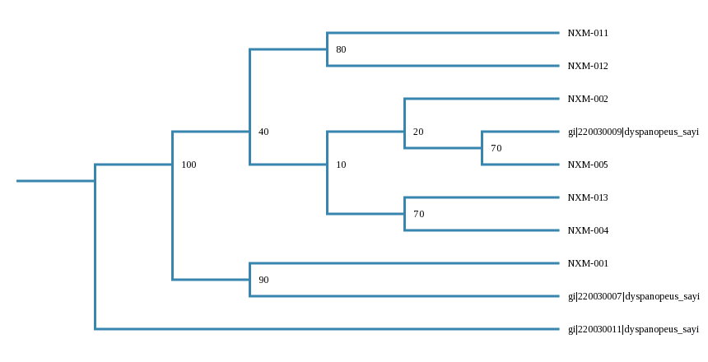
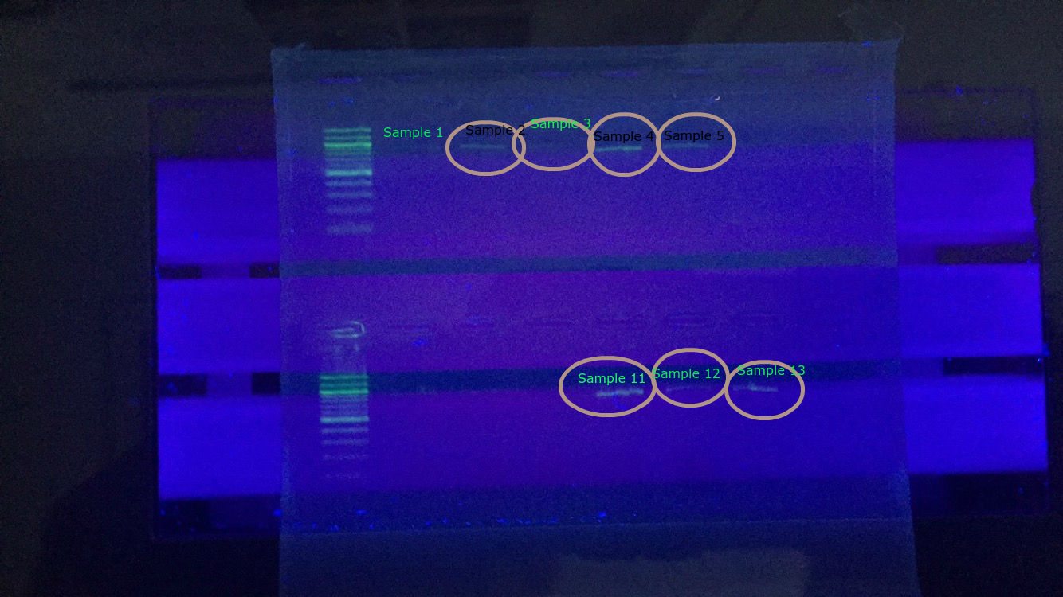
Shinnecock Bay Crabs
and Biodiversity
Discussion:
With these crabs we will figure out whether the crabs in Shinnecock are genetically diverse or similar, whether or not these crabs are invasive and whether or not they significantly help or hurt our environment, along with the food chain .
Methods
Collect the crabs: On October …….2015 my team went out to the peconic river and using the Stony Brook research vessel, troweled to get 13 crabs. Obtaining DNA: with the help of BNL. the DNA from the crabs was sampled through PCR and gel electrophoresis. PCR was used to multiply a specific gene and the gel electrophoresis was used to show specific strands of DNA and RNA. Processing the results: After the gel was processed by experts, the data was compared with other known species on DNA Subway. The results were that the species of crab is the common mud crab
References:
-"Gel Electrophoresis | Biotech Learning Hub." Biotechnology Learning Hub RSS. N.p., n.d. Web. 23 May 2016. -” PCR: How We Copy DNA ." What Is PCR? N.p., n.d. Web. 23 May 2016. -Https://www.dnalc.org
Abstract:
The birth of this project of an exploration in biodiversity began on an excursion to the Shinnecock Bay to collect samples of the organisms that happen to inhabit that region of Long Island. The question that was the birthing factor for the meticulous research done towards the development of this project was “Are the current residents of the Shinnecock bay biodiverse in their microecosystem?” From this, the objectives of the projects were based: Barcode the crab specimens collected in Shinnecock bay and compare them to previously barcoded crabs in the Shinnecock bay area to determine, approximately, an idea of the biodiversity of the region.
Introduction
Shinnecock Bay contains a vast variety of many different species of crabs. Whether they are greatly or only slightly different is a mystery. Biodiversity is the variety of life in a habitat or ecosystem. Two perceptively similar looking crabs may be completely different species, and two crabs that appear different from one another could be the same species. The current objective is to see if the specimens are diverse in regards to the similarity of their genetic makeup to each other and other crabs in the area. If it is determined that they are indeed diverse than an approximate representation of the biodiversity of the Shinnecock bay area can be made.
Objectives
Barcode the crab specimens we have collected in Shinnecock bay and compare them to previously barcoded crabs in the Shinnecock bay area to determine the biodiversity.
School: Eastport South Manor Junior-senior High School¹
Authors: Ian Fabricatore¹, Mark Pace¹, Eric Moran¹
Teacher: James Ostensen¹, Robert Bolen¹
RESULTS
40.8426° N, 72.4762° W
Figure 1 contains the results from a program developed by the group to analyze the genomes of the crabs. These results are exact reference matches to the human genome and are indicative of common ancestry as it shows genetic relationship between crabs and humans which has been deduced to be result
Figure 2, containing the geographic coordinates of the area explored, is were the samples were obtained
Figure 3 is a barcode comparison of the sequenced samples and information in the BLAST database which shows no novel differences in o between the samples
Sample 1,2,3,4,
11,12,13
Figure 4 is the results of our gel electrophoresis under UV light.
Figure 5 is the result of the PHYLIP NJ phylogenetic tree as enumerated and graphed by DNA Subway’s online tools for genetic sequence analysis.

