Slide 1
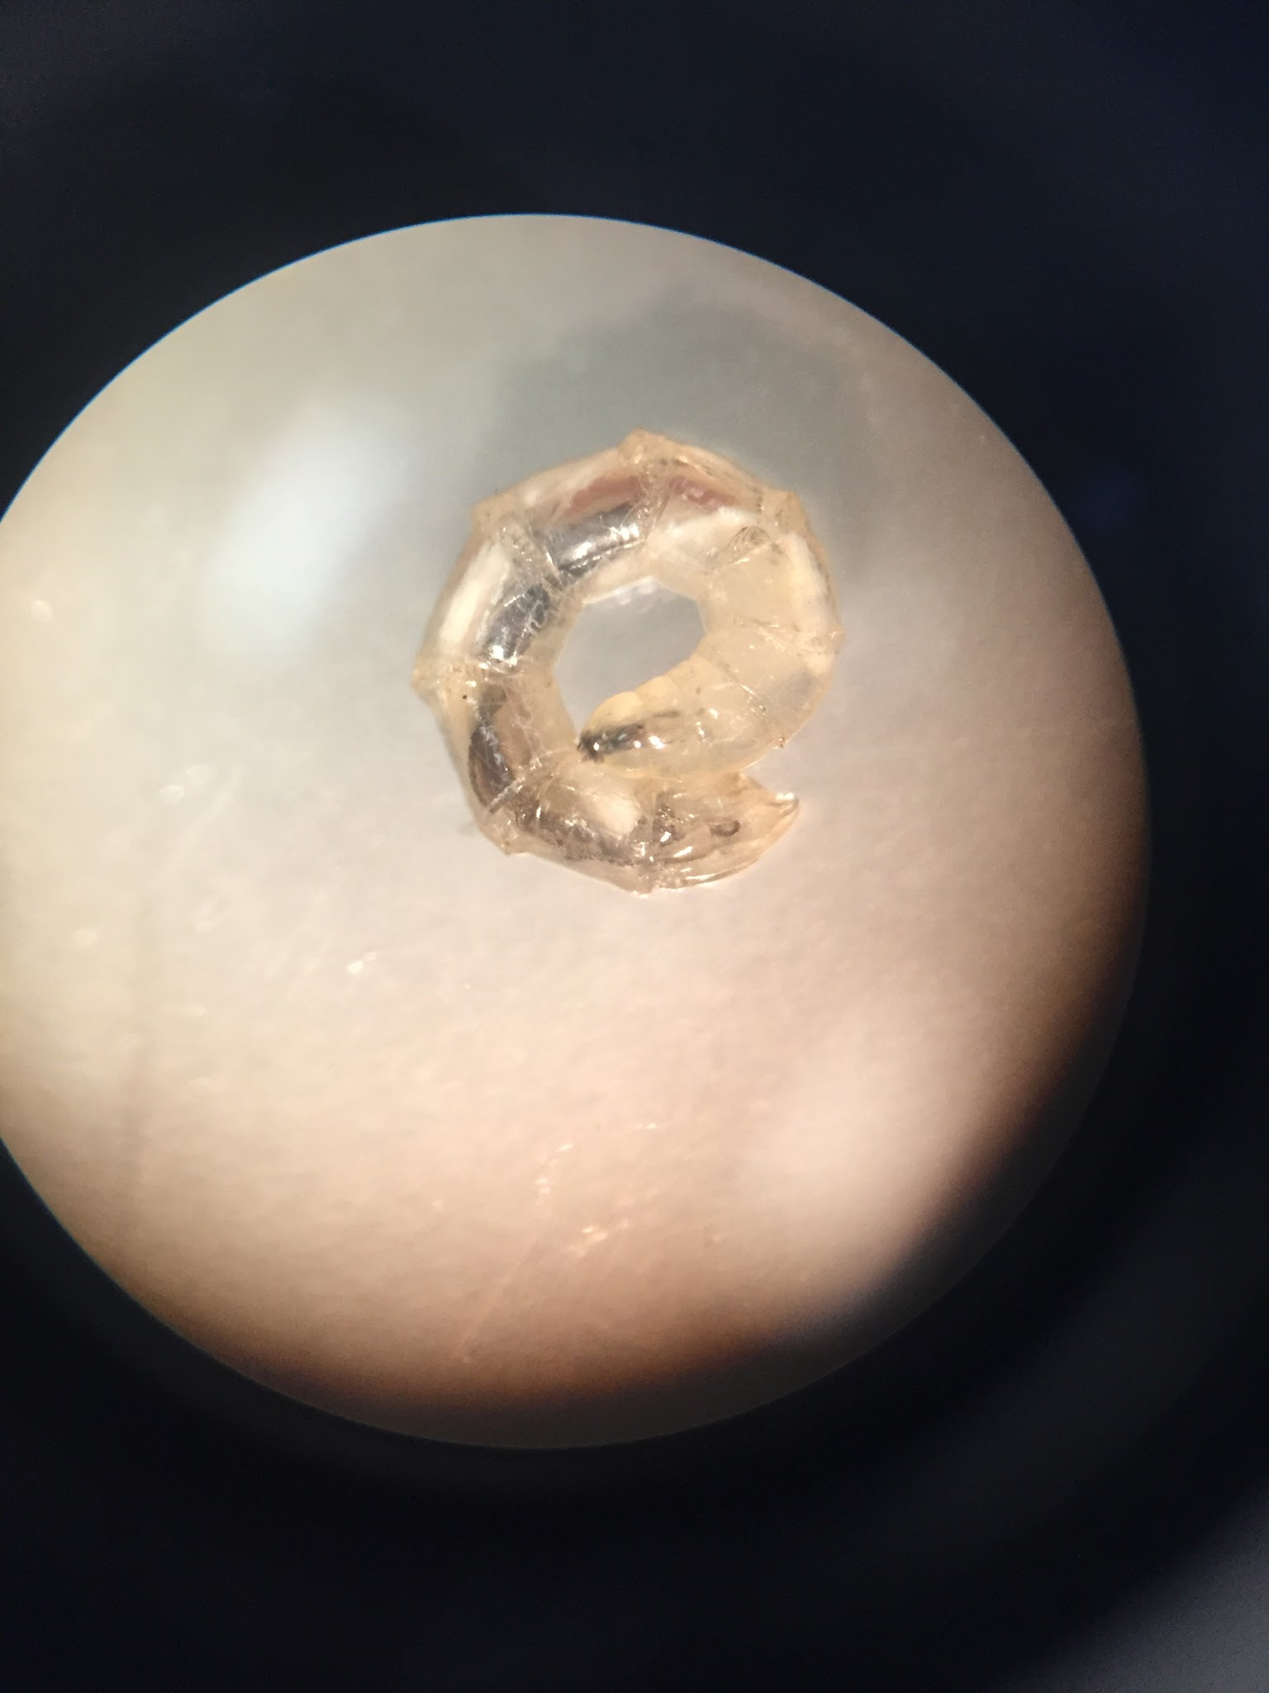
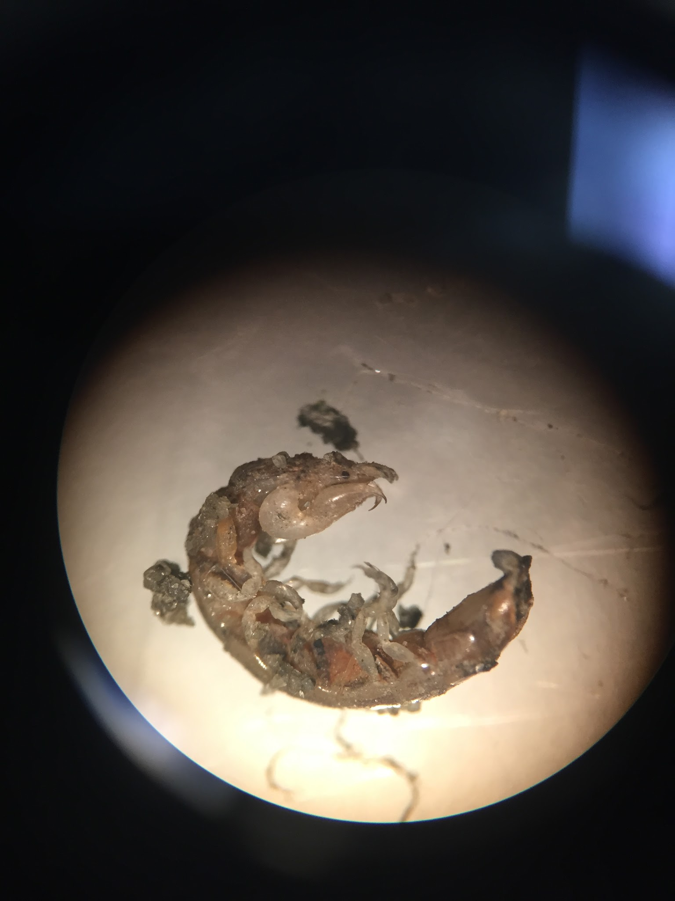
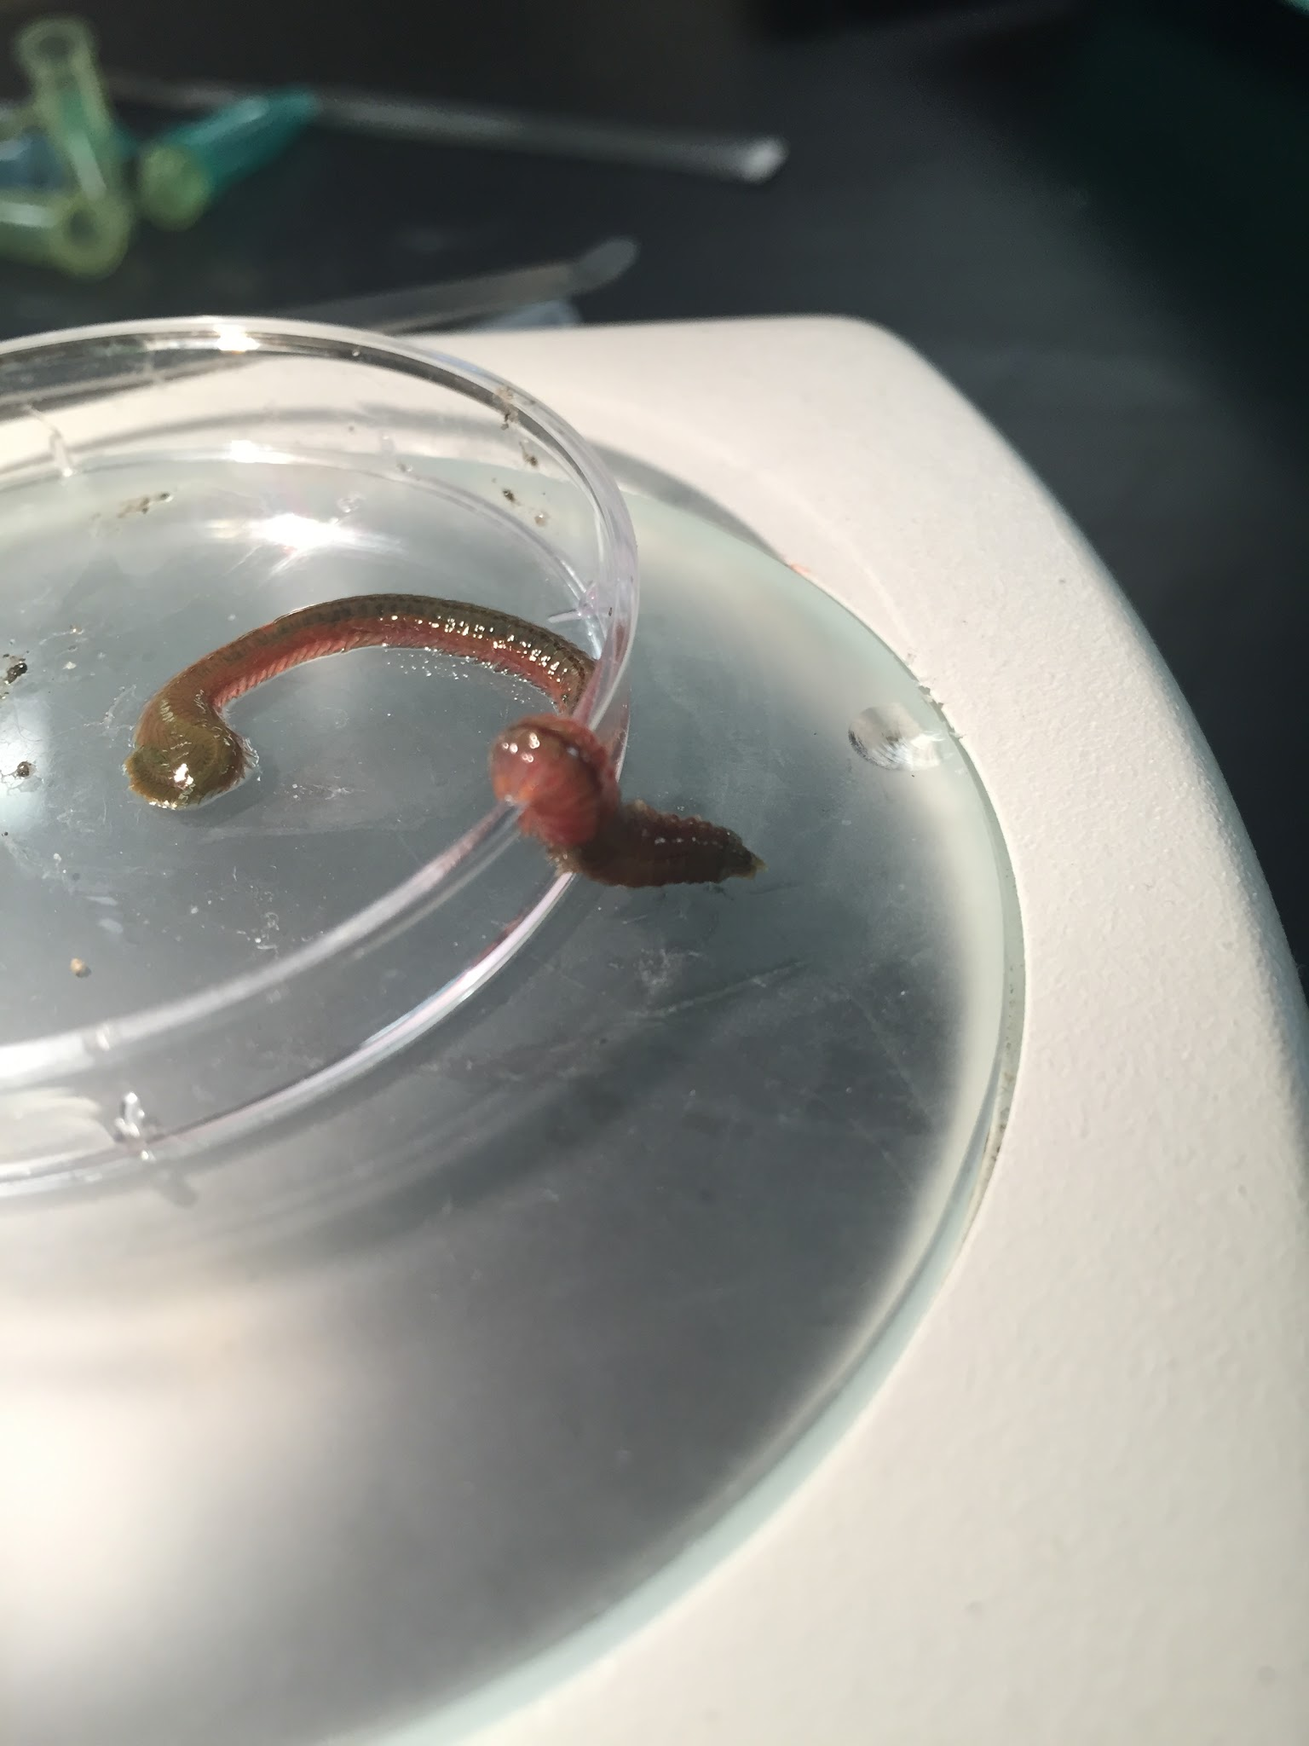
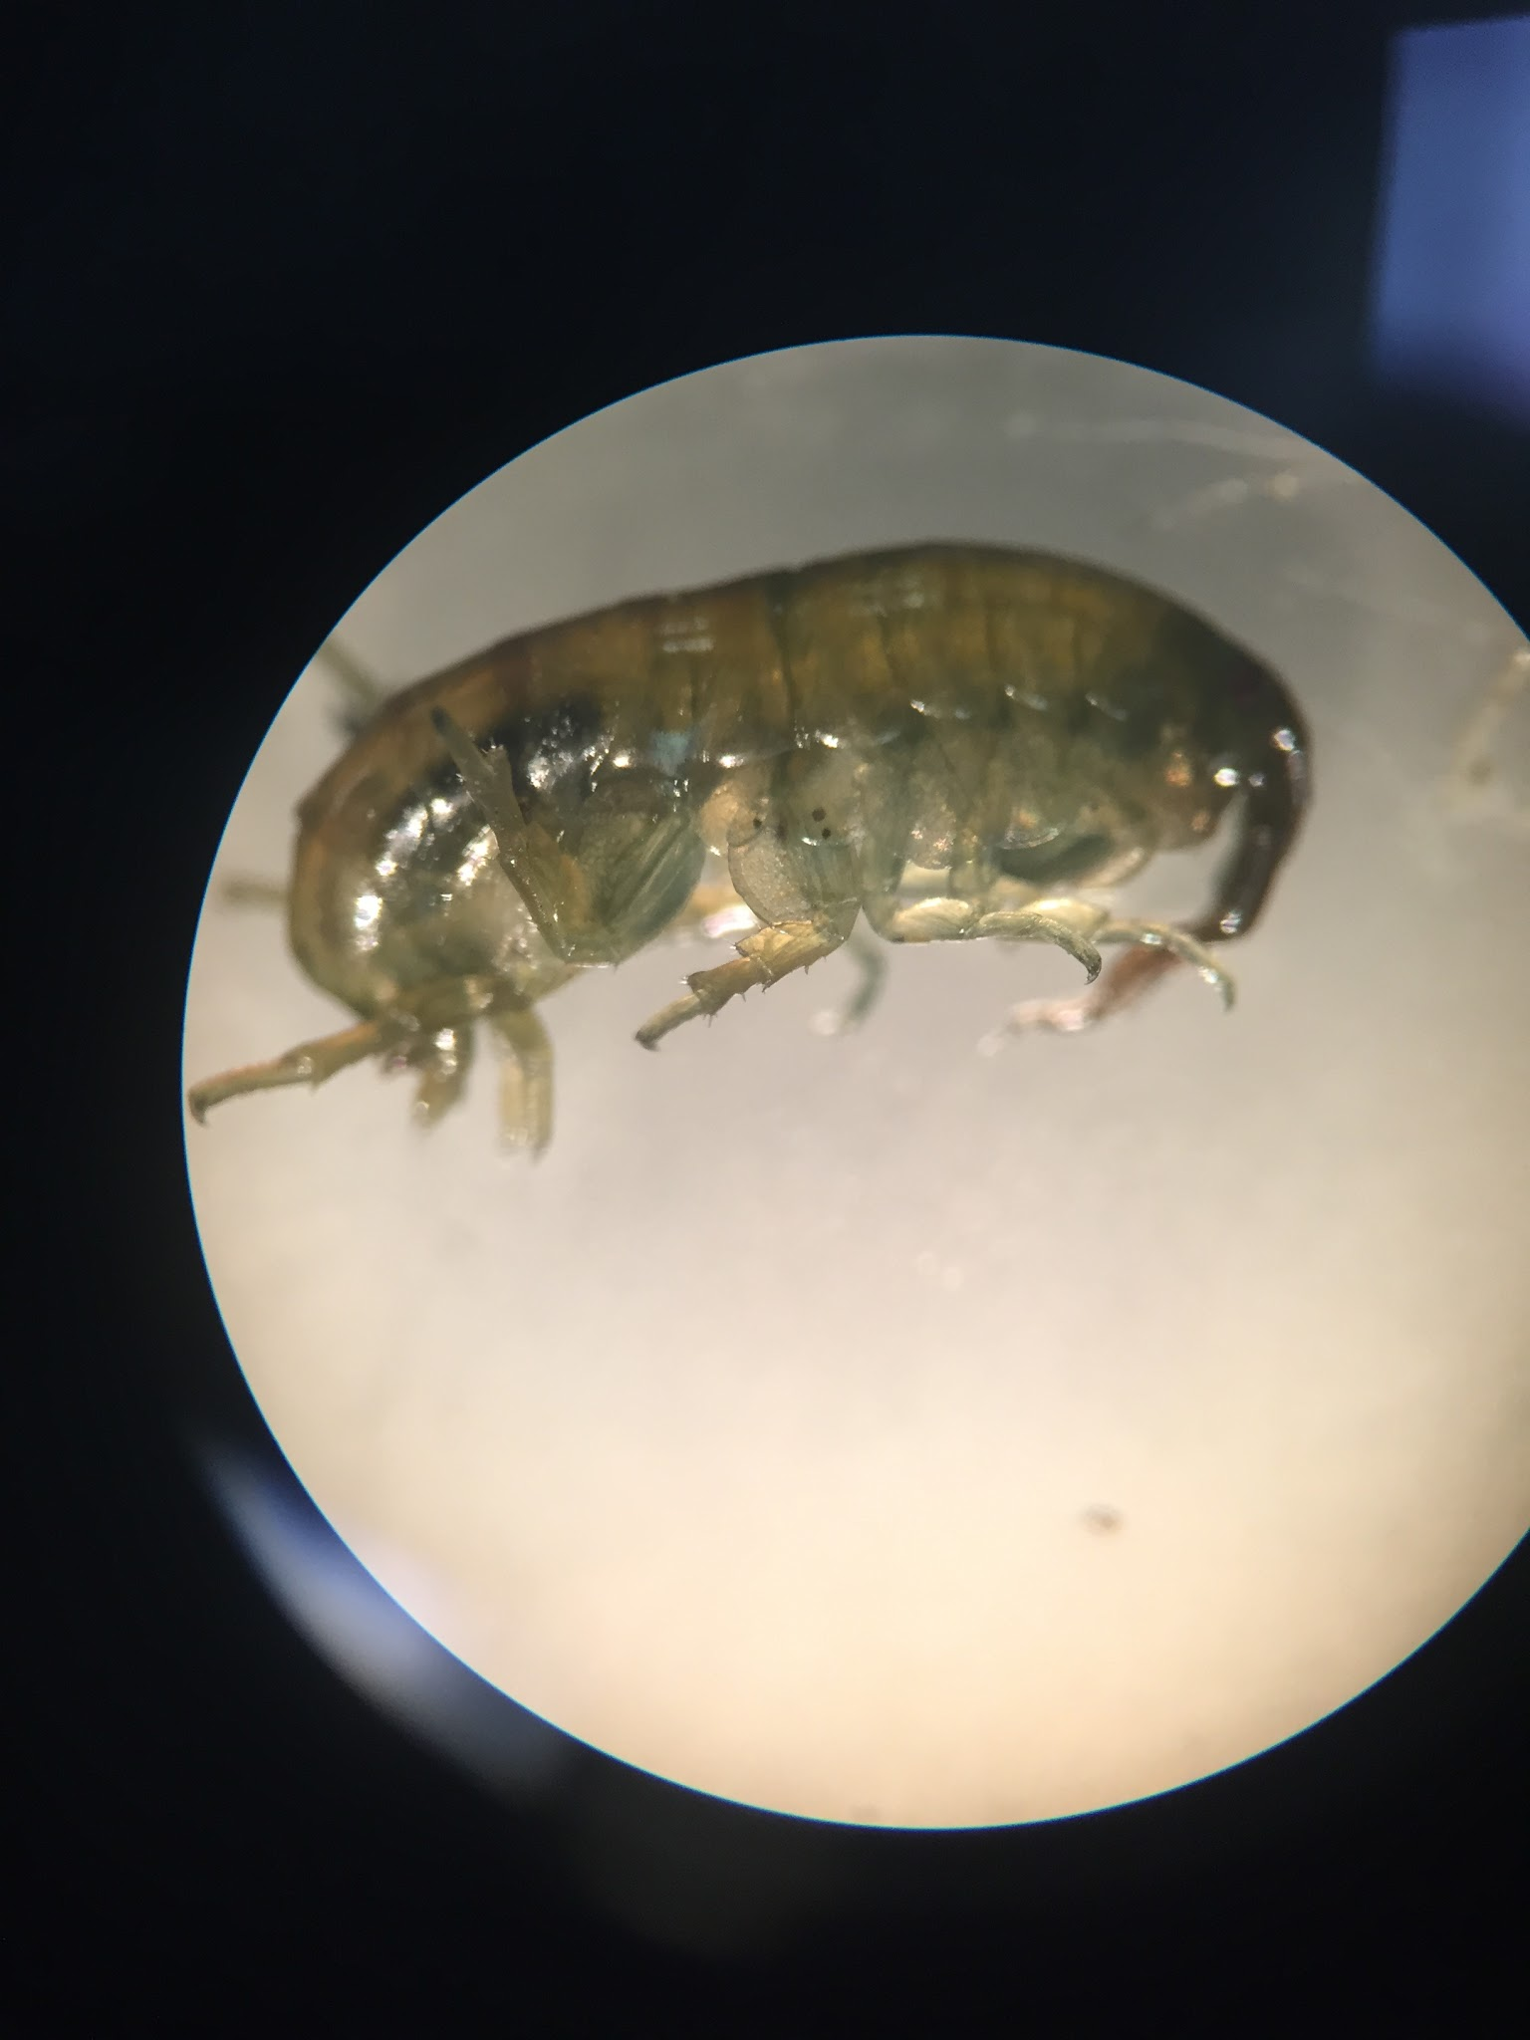
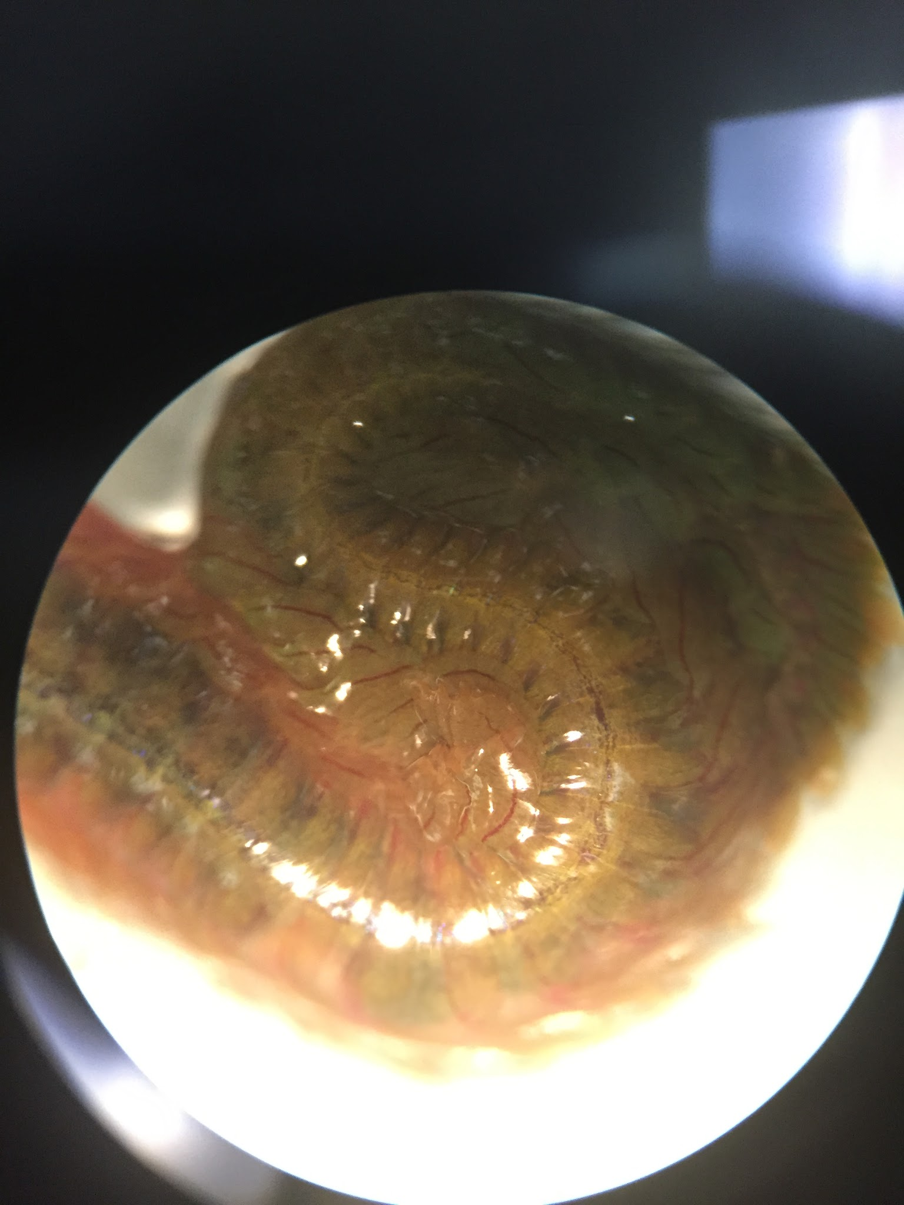
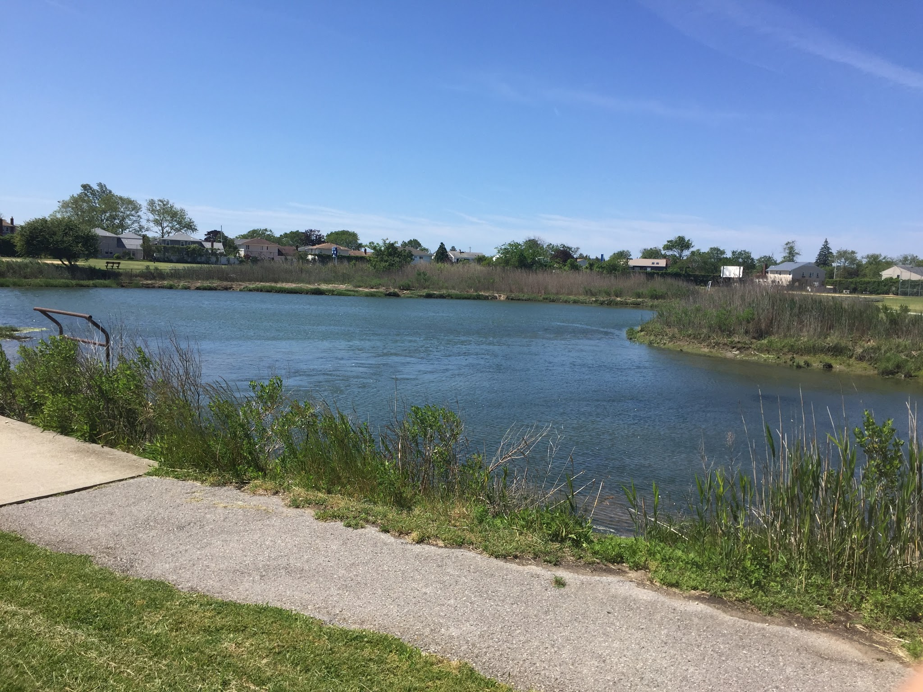
Examining the Benthic Macroinvertebrate Community in a Nutrient Loaded Estuary
Eddie Perez & Brett Weiner | Mentor: Cody Onufrock
Long Beach High School
Figures 2-1,2,3,4,5 show various organisms that were collected by researchers. All photos taken by researchers.
ID | Genus | Species | Location Found | Description
A1 |  |  | On rock sample | Large and brown colored
A2 |  |  | On rock sample | Small and orange colored
A3 |  |  | On rock sample | Small and white/yellow colored
A4 |  |  | On rock sample | Small and white colored
A5 |  |  | On rock sample | Small and white colored
B1 | Eualus | pusiolus | In sediment sample | Large and white colored
B2 |  |  | In sediment sample | Small and white colored
B3 |  |  | In sediment sample | Tiny and white colored
B4 | Hyalella | azteca | In sediment sample | Small and white colored
W1 |  |  | On rock sample | Huge and brown colored
W2 |  |  | On rock sample | Tiny and brown colored
W3 |  |  | On rock sample | Small and red/brown colored
Abstract
High concentrations of nitrogen are found in the marine ecosystems surrounding Long Beach, NY. Not only does it pollute the water, but it can also lead to eutrophication, which can be deadly to other organisms in our waters. Some organisms have the potential to be misplaced, or harmed by this. Our goal was to identify some of the different species of benthic macroinvertebrates that can be found. We collected, and documented benthic macroinvertebrates found in our local tidal pond. We them identified them by means of dichotomus key, and by DNA barcoding. We found there to be a moderate benthic macroinvertebrate biodiversity in Reynolds Channel. This means that the excess anthropogenic input of nitrogen has a slight effect on the benthic macroinvertebrate biodiversity.
Introduction
Baseline constructed on which benthic macroinvertebrates survive with excess anthropogenic input of nitrogen.
Benthic macroinvertebrates are essential to coastal marine ecosystems.
They’re involved in filtering phytoplankton (Tagliapietra, 253)
Structure and oxygenate sediment on the bottom by reworking sediments, and play a fundamental role in bacterial remineralization (Tagliapietra, 253).
They act as a food source for larger organisms, i.e. clams, worms (Tagliapietra, 253).
They act as biological indicators, pointing of environmental conditions. Do so due to the sensitivity of a single species, or because of a general feature that makes them integrate environmental signals over a long period of time, i.e. coral reefs (Tagliapietra, 254).
Most nitrogen are from the Sewage Treatment Plants that pump seventy five million gallons of treated sewage into our waters.
Materials & Methods
Tide schedule was researched for Lido Beach, NY (-40°35'38.82"N, 73°38'0.77"W).
Tide schedule was consulted for optimal conditions while collecting.
Collecting took place three times, twice in November 2015, and once in May 2016.
Visible organisms, sediment samples, and small habitats were taken from the estuary by use of one small gardening shovel, and one large shovel.
All organisms were documented by means of photography and writing after collected.
Boots and gloves were worn while collecting to protect both the species living in the estuary, and ourselves.
All sedimentary deposits were sieved using four sieves, each decreasing in size (Martiri, 256).
All organisms collected were stored on campus.
All small organisms were placed in 1.5 mL centrifuge tubes and labeled with an appropriate ID number.
All large organisms were placed in a 10 gallon tank.
Organisms were examined under a dissecting microscope and some were identified by use of dichotomous key.
Organisms not identifiable underwent the DNA Barcoding Process.
DNA was isolated from the various benthic macroinvertebrates.
DNA was amplified by means of PCR.
PCR products were analyzed.
PCR products were sequenced.
Results were analyzed by a bioinformatic tool known as a DNA Subway.
Results
Multiple organisms were barcoded.
Moderately wide diversity of benthic macroinvertebrates can be found in the Reynolds Channel ecosystem.
Sample Y1 Sample Z4
W4 |  |  | On rock sample | Tiny and brown colored
W5 | Gracilaria | tikvahiae | Separate sample | Large and red colored
Y1 |  |  | Plomo shoe | Worm-like, transparent
Y2 | G. | oceanicus | Plomo shoe | Brown colored
Y3 |  |  | Plomo shoe | Maggot-like, yellow segments
Y4 |  |  | Plomo shoe | Clam-like, has shell
Y5 |  |  | Plomo shoe | Isopod, brown colored
Z1 |  |  | On rock sample | Long, worm-like, tiny legs
Z2 |  |  | On rock sample | Long, worm-like, tiny legs
Z3 |  |  | On rock sample | Green, antennae, tiny legs
Z4 |  |  | On rock sample | Hook tail, tiny legs, brown colored
Z5 |  |  | On rock sample | Brown colored, largemouth, tiny legs
Sample Z2 Sample Z3
Sample Z1
Discussion
Used as a baseline for Benthic macroinvertebrates biodiversity in Reynolds Channel.
The development of the marine life throughout our study was surprising.
The majority were found encrusted on, and/or living on rocks or cement.
Shows the importance of artificial structure, the potential to increase productivity, and restore ocean species using artificial reefs.
References
S. maritima Plantations Enhance the Macroinvertebrate Community in European Salt Marshes? Estuaries and Coasts, 37(3), 589-601. doi:10.1007/s12237-013-9713-1
Do Spartina Maritima Plantations Enhance the Macroinvertebrate Community in European Salt Marshes?, Ap. 1095, 41080, 590-601. (2013).
Rivetti I, Fraschetti S, Lionello P, Zambianchi E, Boero F (2014) Global Warming and Mass Mortalities of Benthic Invertebrates in the Mediterranean Sea. PLoS ONE 9(12): e115655. doi:10.1371/journal.pone.0115655
Tidal Information Long Beach (Inside), Hempstead Bay. (2015). Retrieved October 27, 2015, from http://www.weatherforyou.com/reports/index.php?locid=534&forecast=tides&zipcode=&pands=&place=&state=&country=us&alt=tides&smon=10&syear=2015
Tagliapietra, D., & Sigovini, M. (2010). Benthic fauna: Collection and identification of macrobenthic invertebrates. Benthic Fauna: Collection and Identification of Macrobenthic Invertebrates, 88.(9), 1-1. doi:253–261
Acknowledgements
Mr. Cody Onufrock, Mr. Daniel Lerner, Mrs. Karen Bloom, Jarrod Pine, Andrew D’Alessandro, Dmytro Vremenko
Figure 1-1 shows the various organisms that were collected.
Figure 3-1 is an image of the tidal ond organism were collected from.

