Slide 1
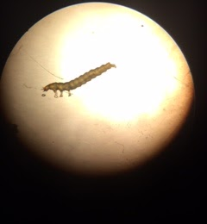
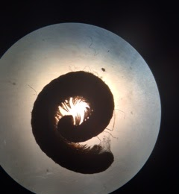
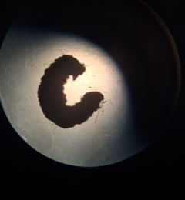
Diversity of Organisms in Compost and Soil
Lauren Bulik and Alexa Coffin
Mentor: Cody Onufrock Long Beach High School
n n-1 n(n-1)
n n-1 n(n-1)
Species A | 12 | 11 | 132
Species B | 1 | 0 | 0
Species C | 8 (Pill Bugs) | 7 | 56
Species D | 5 | 4 | 20
Species E | 1 | 0 | 0
Species F | 3 | 2 | 6
Earthworm | 11 | 10 | 110
Species G | 1 | 0 | 0
Species H | 1 | 0 | 0
Species I | 1 | 0 | 0
Species A | 4 | 3 | 12
Species B | 3 | 2 | 6
Species C | 3 | 2 | 6
Species D | 2 | 1 | 2
Species E | 2 | 1 | 2
Earthworm | 4 | 3 | 12
Abstract
Soil is a natural resource consisting of minerals that come from rocks, organic matter, and living biota. Compost forms when soil organisms consume organic material and break it down into a form that plants can absorb. The objective of the project was to compare the diversity of organisms in samples of compost and soil. It was hypothesized that the compost would have more insect diversity than the soil because it has more organic matter available for the organisms to grow and reproduce. Samples were collected by digging through nearby compost pile and lawn. The Simpson’s Index was used to determine which was more diverse. The soil was more diverse than compost. It’s diversity index was closer to zero. Compost had a diversity of 0.171247357 and the soil had a diversity of 0.130718954.
Introduction
How does the biodiversity of macroinvertebrates in the compost and soil differ?
Soil is the basis for growing plants, containing minerals from rocks, organic matter and plant and animal remains.
Farmers grow crops in soil due to the essential nutrients including nitrogen, phosphorus, and potassium.
Diversity within the soil community is essential to this process.
Compost is a natural plant fertilizer made of decayed organic material that may consist of leaves, shreds of grass, some topsoil, food wastes, and other organic “wastes”.
Compost adds an abundance of nutrients to soil without the use of manmade chemicals.
The diversity of the macroinvertebrate community contributes to thestability and productivity. Higher diversity increases the critical variables in soil.
Materials & Methods
Dig approximately 4 inches deep with a hand shovel into Oak Tree Leaf Compost and nearby lawn soil in Long Beach to acquire macroinvertebrate samples.
Sift through soil and compost samples in a shifter to locate organisms.
View the organisms using their quantity in a journal.
Document located organisms and their quantity in a journal.
Use the Simpson’s Index to calculate the biodiversity of the tested compost and soil.
DNA Barcode samples following the DNA barcoding procedure.
Results
Organisms Anisodactylus rusticus, Erigone aletris and Lasius neoniger were identified by DNA barcoding.
Soil had more diversity than compost, as shown by using the Simpson’s Index.
Soil diversity through calculation of Simpson’s Index = 0.130718954
Compost diversity through calculation of Simpson’s Index = 0.171247357
Simpson’s Index variables from soil
Simpson’s Index variables from compost
Discussion
The hypothesis was rejected, the Simpson’s Index showing soil had a greater diversity than compost.
The compost had low species evenness, dominated by two species; Species A and earthworm
The soil had species evenness where no one species was dominant over another.
One possible explanation is that Oak Tree Leaf compost may have a high concentration of tannins.
Tannins are chemicals secreted by leaves and work to deter insect colonization.
It can also be concluded that soil ecosystems are more stable due to the greater biodiversity.
Organisms found include earthworms, beetles, isotopes, centipedes and spiders.
Earthworms increase air and water availability by breaking down organic matter.
Beetles, such as Anisodactylus rusticus, which was found in compost, eats a large variety of organisms.
Erigone aletris and Lasius neoniger are types of spiders found in soil, and are often the first organisms to appear in the environment.
References
soil for schools. (n.d.). Retrieved December 9, 2015, from www.soil-net.com
website: https://www.soil-net.com/legacy/schools/what_is_soil1.htm
Simpson's Diversity Index. (2015, December 12). Retrieved January 7, 2016, from http://geographyfieldwork.com/SimpsonsDiversityIndex.htm
Bug guide. (n.d). Retrieved June 1, 2016, from buggiude.com
http://bugguide.net/node/view/50568/bgpage
"Components of Soil - Geology For Kids - By KidsGeo.com." Components of Soil - Geology For Kids - By KidsGeo.com. Web. 05 June 2016.
Acknowledgements
Mr. Cody Onufrock, Mr. Daniel Lerner, and Mrs. Karen Bloom
DNA barcode sequence (COI) of captured Erigone Aletris
ACAAAATCATTAAAGATANTGNAATTTATATATTATTTTTTGGTCACCCTGTACTTTAGTCGGAACAGCTTCCAATAAGTTTATTAAGACATCATAATGAAGATCAGACTAAAAGATTTTTAGGGGACCCTCAATTTTATAATATTATTG

