Slide 1
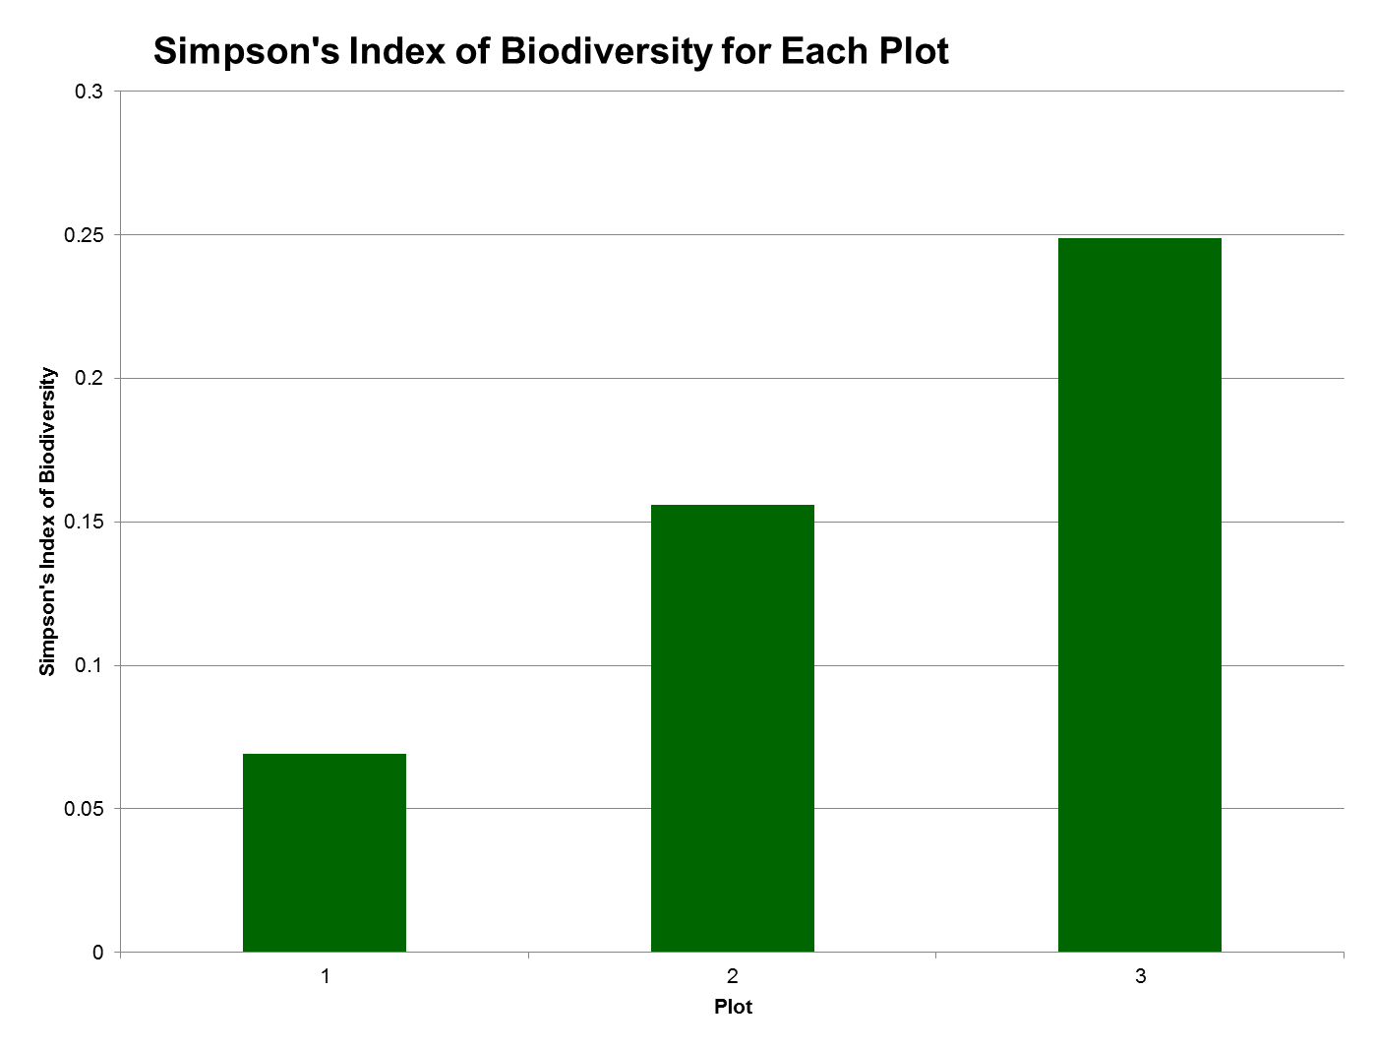
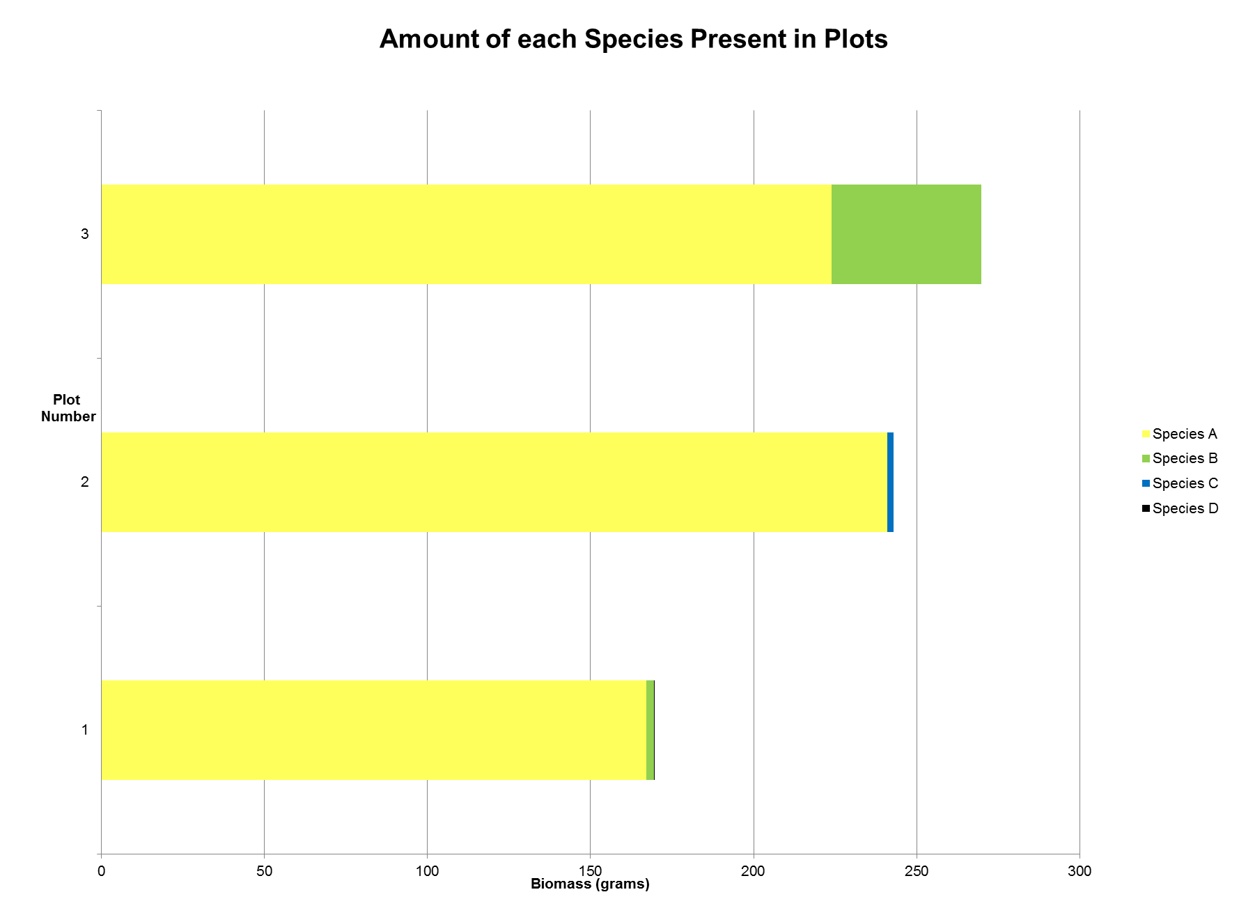
CGCCAGTATGTCACCACAAACAGAGACTAAAGCAAGTGTTGGATTTAAAGCTGGTGTTAAAGATTACAAATTGACTTATTATACTCCTGAGTATGAAACCCTGGATACGGATATCTTGGCAGCATTCCGAGTAAGTCCTCAACCCGGAGTTCCACCCGAAGAAGCAGGGGCCGCAGTAGC
Rewilding: Floral Biodiversity and Productivity Response in a Unique Environmental Setting
Mashiyat Ahmed, Kelly DiResto, Jessica Marcote
Mentored by Cody Onufrock
Long Beach High School
Abstract
Rewilding is a conservation strategy that restores and protects natural processes. Through rewilding, different species revisit their natural habitat and restore the ecosystem diversity that was originally lost from human influence. In this study, area that was intentionally fallowed was allowed to rewild. Areas of the rewilded land were uprooted, and the biodiversity and primary productivity of each area was examined. Biodiversity was measured using the Simpson’s Index. Primary productivity was measured by finding the dry biomass of each species in each area. As a result of rewilding, biomass and diversity increased, as expected. The average biomass increase was from 0 to 227.5 g per 2500 cm² plot. A possible correlation between plant biomass and level of biodiversity was observed. The Simpson’s Index of Biodiversity values for the rewilded area were also compared to the surrounding area of land. Although there was not as much biodiversity in the experimental areas, the secondary succession of that area is still in its early stages. The species we identified using DNA barcoding include: Stellaria media, Veronica nivea, Plantago lanceolata, Trifolium pratense.
Introduction
Rewilding occurs during the process of secondary succession, when species reestablish themselves in an area that was temporarily disturbed. Rewilding is a conservation strategy that restores and protects natural processes.
The Simpson’s Index of Diversity is an equation that takes into account both the variety of species and abundance of each species to quantify diversity of an area. The greater the value of the Simpson’s Index of Diversity, the greater the diversity of the area.
This study attempts to establish a basis for what types of species thrive in a specific area during the early stages of secondary succession as well as their level of diversity. The plots are located in a suburban area on a barrier island adjacent to the bay. The climax successional ecosystem of this area is typically a “maritime forest”.
In addition to measuring the biodiversity, we also measured the productivity of the area by finding the dry biomass of the uprooted plants from each quadrat.
Letting previously abandoned and fallow plots rewild was expected to result in an increase in productivity and biodiversity in the area.
Materials & Methods
The plants that were present in the plots were uprooted. Succession was allowed to occur, undisturbed, in the area.
After six months, the species that occupied the area were uprooted as completely as possible and split up by their identities based on appearance.
Species collected were used to measure the level of biodiversity in the plot using the Simpson’s Index of Diversity, which takes into account the number of species in the quadrat and the number of each species as well.
We also measured plant biomass in quadrats 50 cm by 50 cm (2500 cm²).
We followed DNA barcoding protocol to identify various species in the land that we collected, but not the species that were used to calculate the Simpson’s Index.
Results
The calculated Simpson’s Index of Diversity was compared to the Simpson’s Index of Diversity calculated for the surrounding area.
We identified species in the same area as the experimental plots using barcoding protocol.The species we identified were Stellaria media, Veronica nivea, Plantago lanceolata, Trifolium pratense.
Plot | 1 | 2 | 3
Simpson’s Index of Biodiversity (1-D) | 0.069 | 0.156 | 0.249
Plot | 1 | 2 | 3
Simpson’s Reciprocal Index (1/D) | 1.074 | 1.185 | 1.331
TGAAAGAGATAAATTGAACAAGTATGGCCGTCCCCTATTGGGATGCACCATTAAACCGAAATTAGGGTTATCCGCTAAAAACTATGGTCGCGCAGTTTATGAATGTCTTCGCGGTG
Discussion
The Simpson’s Index was calculated using two different formats, however the reciprocal index value is comparable to the accepted Simpson’s index value of the surrounding area, which was 2.87.
There is a possible correlation between plant biomass and biodiversity. This could be because with more biodiversity, more niches in the environment can be fulfilled, this promotes more productivity and thus increased biomass.
We performed a t-test to see if the difference in the biodiversity of the rewilded plots and the surrounding area was significant. The t-test resulted in a p-value of 4.76X10⁻⁸. Since the p-value is less than the alpha level of 0.05, the null hypothesis is rejected. The alternate hypothesis that the Simpson’s Index of Diversity value will be lower for the “rewilded” area compared to the surrounding area is supported.
Also, as shown by data tables 1 and 2, the plot with the greatest level of biodiversity (Plot 3) also has the greatest amount of biomass among the three experimental plots. This suggests a possible correlation between plant biomass and level of biodiversity.
Since it was shown that the level of biodiversity was lower in the experimental plots than in the surrounding area, it leads us to conclude that not enough time had passed for the previously fallowed land to accumulate as much plant biodiversity.
References
Horn, H. S.. (1974). The Ecology of Secondary Succession. Annual Review of Ecology and Systematics, 5, 25–37. Retrieved from http://www.jstor.org/stable/2096878
Rewilding North America: A Vision for Conservation in the 21st Century by Dave Foreman (Island Press 2004).
In Simpson's Diversity Index. Retrieved Nov. 15, 2015, from http://www.countrysideinfo.co.uk/simpsons.htm
“Plant Identification”. “Plant Identification”. The Coleopterists Bulletin 1.4/5 (1947): 39–39. Web…
Erickson, David L. et al.. “DNA Barcoding in Land Plants: Developing Standards to Quantify and Maximize Success”. Taxon 57.4 (2008): 1304–1316. Web...
Acknowledgements
Cody Onufrock, Cynthia Kenny, Karen Bloom, Daniel Lerner, Jared Starman
The sequence shown on the board is the species Stellaria media barcode rBCL sequence.
GCCGAATCCTCGACTGGTACATGGACAACTGTATGGACCGACGGACTTACCAGTCTTGATCGTTACAAAGGACGATGCTACCACATCGAGCCCGTTGCTGGAGAAGAAAATCAATATA
TTTGTTATGTAGCTTACCCCTTAGACCTTTTTGAGGAAGGCTCTGTTACTAACATGTTTACTTCCATTGTGGGTAATGTATTTGGGTTCAAAGCCTTGCGTGCTCTACGCTTGGAAGATTTGCGAATTCCTGTTGCTTATATAAAAACTTTCCAAGGCCCGCCTCACGGTATCCAAGT

