Slide 1
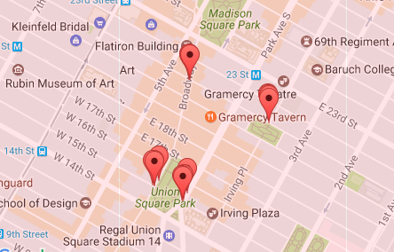
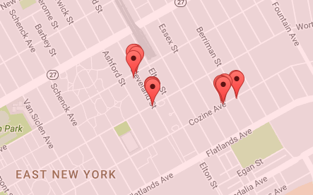
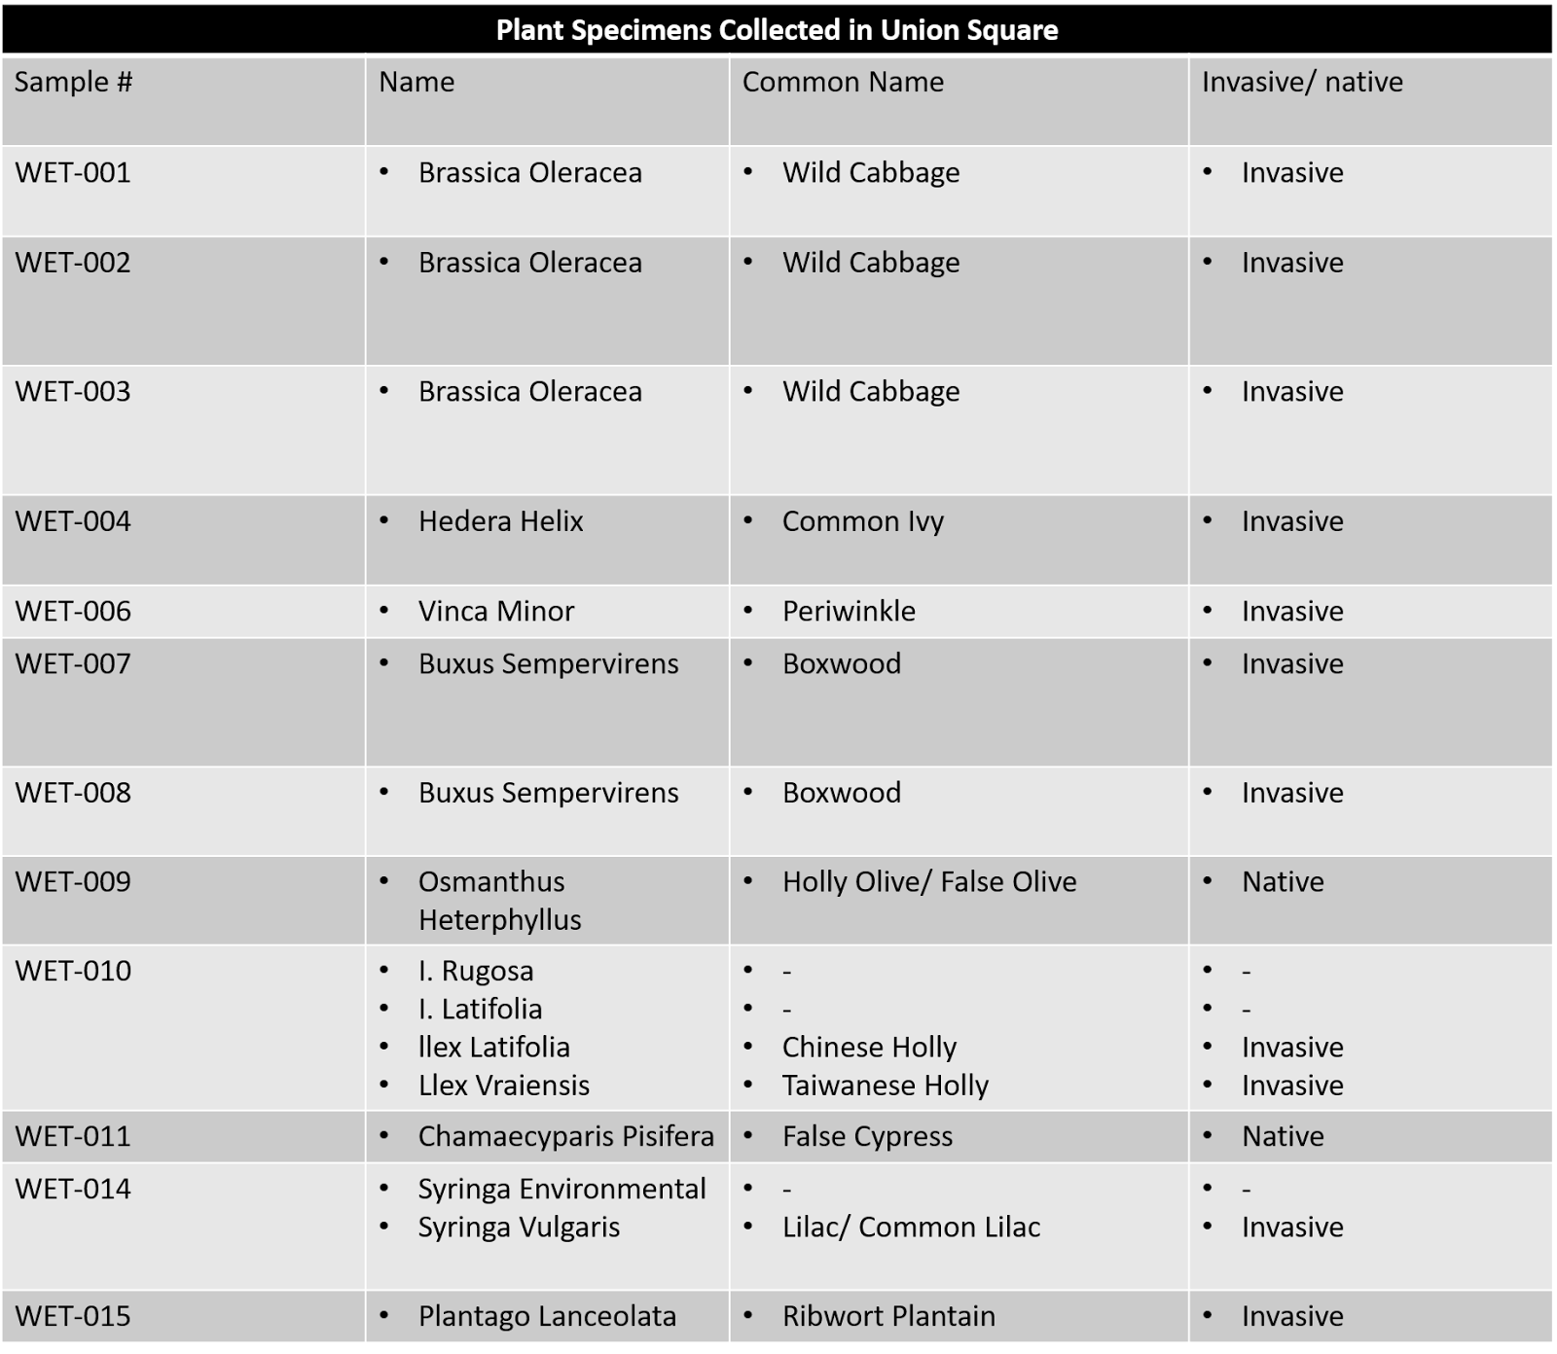
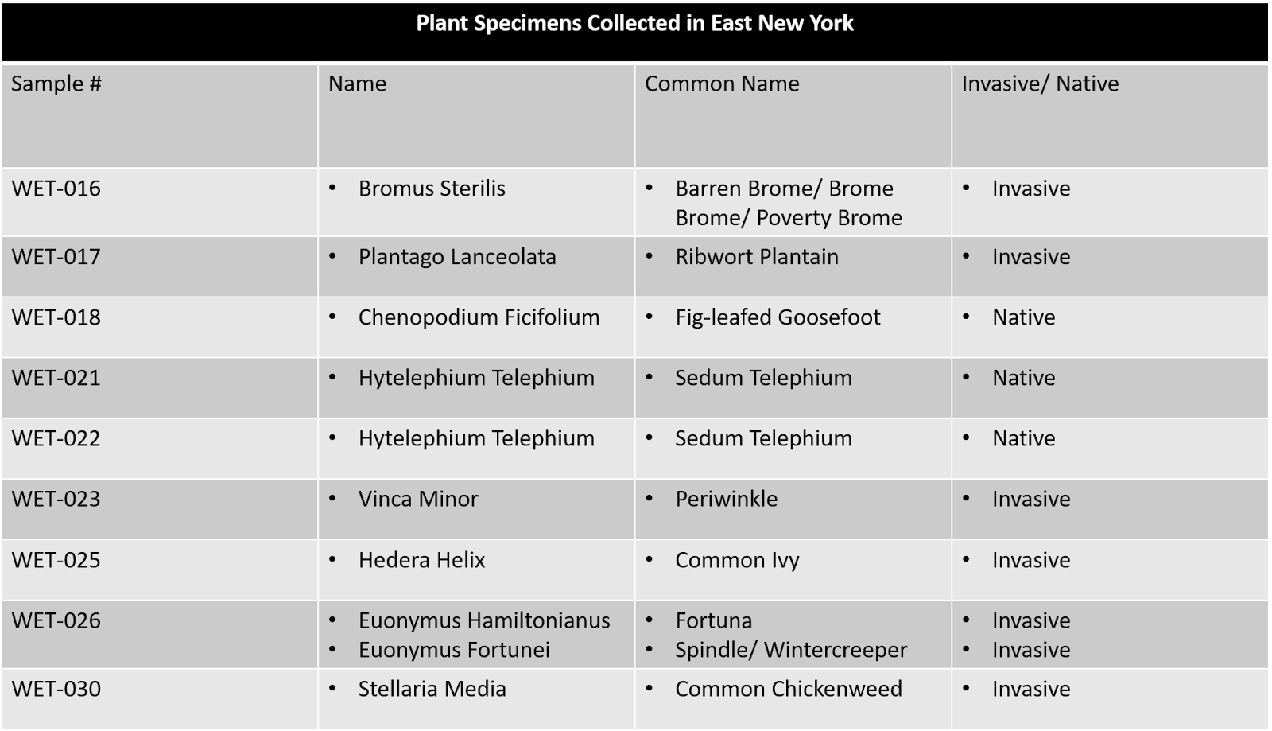
Proportion of Native and Non-native Plants in the
City Center vs. Urban Fringe of NYC
Authors: Crystal Arnold, Sarah Bacchus, Kai Hutton, Harold Miller; Mentor: Sabrina Miller
Funded by the
Thompson Family Foundation
Academy for Young Writers
Abstract
With a globalized society, the introduction of invasive species into local ecosystems has become a common problem. Various studies^{[2][3][4]} have found invasive species are already at large in New York, forcing native plant species to the brink of extinction. This only highlights the importance of taxonomy. To monitor where invasive species thrive, we sampled and compared the biodiversity of an urban center to a city fringe, aiming to see how the proportion of native and invasive species varies among differing human population densities. With samples from East New York and Union Square, we extracted DNA and used PCR to amplify the rbcL gene in our plants, then we sent these DNA samples for sequencing to identify the plants’ species. In our findings, 75 percent of species in East NY and 77.8 percent in Union Square were invasive, which is astonishingly high. However, contrary to what our team expected, the two locations hardly differed in their ratios between native and nonnative plants. This brings up the global question as to how humanity is supporting the spread and maintenance of invasive species. Despite differences in human population size, the effect of human impact can be seen in neighborhoods across New York City.
Introduction
Environmental and ecosystem stability are rooted in biodiversity, a measure of the number of different species and the abundance of those species in a given area. The greater the biodiversity, the more stable the ecosystem. This is especially true with plants since greater plant biodiversity leads to greater primary production.^{[1]} As a result of human intervention, there is selection for organisms that can survive harsh urban environments with lots of pollution and human interference. This limits the number of species that can survive in these environments and decreases biodiversity in urban areas.^{[2]} Human impact in the form of global trading has also led to the introduction of invasive species that wreak havoc on local ecosystems.
According to the Department of Environmental Conservation (DEC), rates of extinction in the last century due to human impact have exceeded those of past mass extinction events.^{[3]} Despite conservation attempts, when the Brooklyn Botanic Garden (BBG) released an article in 2010 detailing a study titled the New York Metropolitan Flora Project, their results found that a minimum of fifty plant species in the area are nearing extinction at the fault of invasive species.^{[4]} In addition to native species declining, they also found that “some non-native cultivated plants, such as Japanese barberry, can escape from cultivated landscapes and overrun natural areas, where they thrive and spread, crowding out more fragile plants.” ^{[4]} The study was conducted recently--within the last twenty years--which indicates that city ecosystems even today must be continuously monitored to identify beneficial or detrimental species.
By participating in the Urban Barcode Project, we collected plant samples in order to assess the biodiversity of plants in the city center vs. the urban fringe. For the city center, we collected plant samples from Union Square, an area with high human population density and a central hub for public transportation. In Union Square, the population is over 150 people per acre^{[5]} and there are multiple subway lines, including the 4, 5, 6, L, N, Q, and R trains, that service the neighborhood. For the urban fringe, we collected plant samples from East New York, an area with a lower human population density and less access to the NYC subway system. East New York is less populated than Union Square--it has a population density of 25 to 49 people per acre and is relatively quiet.^{[5]} Our school, Academy for Young Writers, is located in East New York. It is at least twenty minutes away from the Long Island Railroad Station and 15 minutes from the closest subway station at New Lots. Given the higher population density and human traffic in Union Square, we predict that Union Square will have a higher proportion of invasive species compared to East New York.
Materials & Methods
For our research project, we identified two sampling locations: Union Square and East New York. In order to assess the biodiversity of the two sampling areas, we collected our plant specimens at random. Using Google Maps we zoomed in on half-mile radius in Union Square and East New York to identify possible locations where plants could be found. Each block within this radius was numbered and three streets were randomly selected using a random-number generator. On each randomly selected street, we tossed a quadrat (a 2’ x 2’ sampling square made of PVC pipe) and collected plants from within its boundaries. We collected five plant samples from each street for a total of 15 samples from each sampling location. One leaf from each plant was selected and placed in a Ziplock bag labeled with the sample number. The location of each sample and time of collection was then documented in a notebook. The samples were collected from Union Square (Figure 1) on 12/17/16, and the samples were collected from East New York (Figure 2) on 12/19/16 and 1/9/17.
We extracted DNA from the leaves of each plant sample and then amplified its rbcL gene by PCR. We used this gene because the rbcL gene is highly conserved across plant species, so it could be used for identification. We used e-gels to determine if the DNA extractions and PCR were successful. If a band was present in the lane, this indicates a positive result and those samples were sent out for sequencing.
The DNA sequences were uploaded to DNA subway and analyzed using BLAST to identify the species of each sample collected. We determined which species are non-native to NYC using the Invasiveness Assessment Scores and Ranks for 183 Nonnative Plant Species in NYS^{[6]} and the New York Metropolitan Flora Project.^{[7]}
Results
We collected fifteen samples each, from both sampling locations. Of the 15 samples collected in East New York, we successfully extracted DNA from nine of them. Twelve of the 15 samples DNA were successfully extracted from Union Square. Of the extracted samples from East New York, only eight appeared as unique samples. Out of the extracted samples from Union Square, only nine appeared as unique. We found our samples in both areas to be mostly invasive 75% of the samples extracted from the plants in East New York are invasive while 77.8% of the plants collected in Union Square were found to be invasive.
Tables & Figures
Discussion
The purpose of our research was to prove that there are more invasive species in Union Square than in East New York. Of the successful extractions 75% of the species collected in East New York were invasive species and 77.88% were invasive of those collected in Union Square. This data does not support our hypothesis since the proportion of invasive species in both sampling locations were similar. However, this data does suggest that the proportion of invasive to native species in both areas is high. There are multiple repercussions to having invasive species in our community. Invasive species are detrimental to native plants because they can outcompete them. This can result in multiple issues that are ultimately related to less food and resources in the environment for consumers. Changes in plant biodiversity can cause a change in the local food web, which can have a domino effect where more organisms in the ecosystem are affected. Another issue to be faced is the change in the habitat. Organisms that would naturally live in an area that contains native plants best suited for their lifestyle may no longer be able to thrive in an environment taken over by invasive species.
To increase the accuracy of our results, we would like to collect our samples earlier in about September so we have a larger variety of species to test. We could have also collected more samples. Instead of collecting 15 samples per sampling location, we would like to collect 30 or more samples per location to increase to the reliability of our data. We believe that continuing to study plant biodiversity, especially in urban ecosystems, is an important task. As Scot Medbury, president of the BBG, recognizes, “studying the vegetation changes in highly populated areas is critical to understanding the future of biodiversity in our rapidly urbanizing world.” ^{[4]}
References
[1] Cleland, E. E. (2011). Biodiversity and Ecosystem Stability. Nature Education Knowledge 3(10):14. Retrieved from http://www.nature.com/scitable/knowledge/library/biodiversity- and-ecosystem-stability-17059965
[2] Palmer, M. (2012). Discovering Urban Biodiversity. The Nature of Cities. Retrieved from http://www.thenatureofcities.com/2012/08/14/discovering-urban-biodiversity/
[3] Biodiversity and Species Conservation. Department of Environmental Conservation. Retrieved from http://www.dec.ny.gov/animals/279.html
[4] (2010). Some Plants Native to NYC Area Have Become Locally Extinct As New Flora Has Moved In. Brooklyn Botanic Garden. Retrieved from http://www.bbg.org/press/nymf
[5] (2010). Population Density by Neighborhood Tabulation Area New York City. Retrieved from https://www1.nyc.gov/assets/planning/download/pdf/data-maps/nyc-population/ census2010/m_pl_p2_nta.pdf
[6] (2013). Invasiveness Assessment Scores and Ranks for 183 Nonnative Plant Species in NYS. Retrieved from http://nyis.info/pdf/NYS%20INVASIVE%20PLANT%20RANKS_ March%202013.pdf
[7] (2015). New York Metropolitan Flora Project. Brooklyn Botanic Garden. Retrieved from http://nymf.bbg.org/contents.asp
Acknowledgements
Thanks to the Harlem DNA Lab for lab resources and support, especially to Christine Marizzi, Melissa Lee, and Alison Cucco for facilitating Saturday open labs and answering countless questions via e-mail. Thanks also to our principal and custodial staff for allowing us to work at school on weekends and during breaks.
Figure 1: Sampling areas near Union Square.
Figure 2: Sampling areas in East New York.

