Slide 1
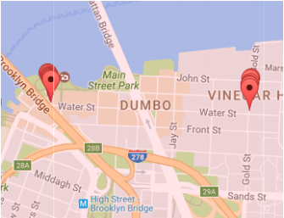
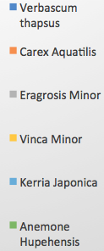
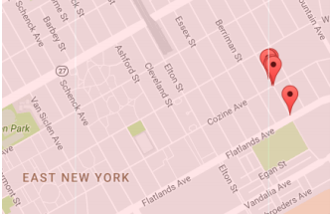
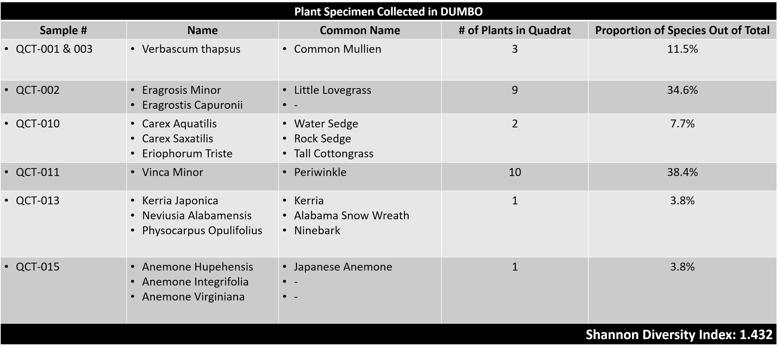
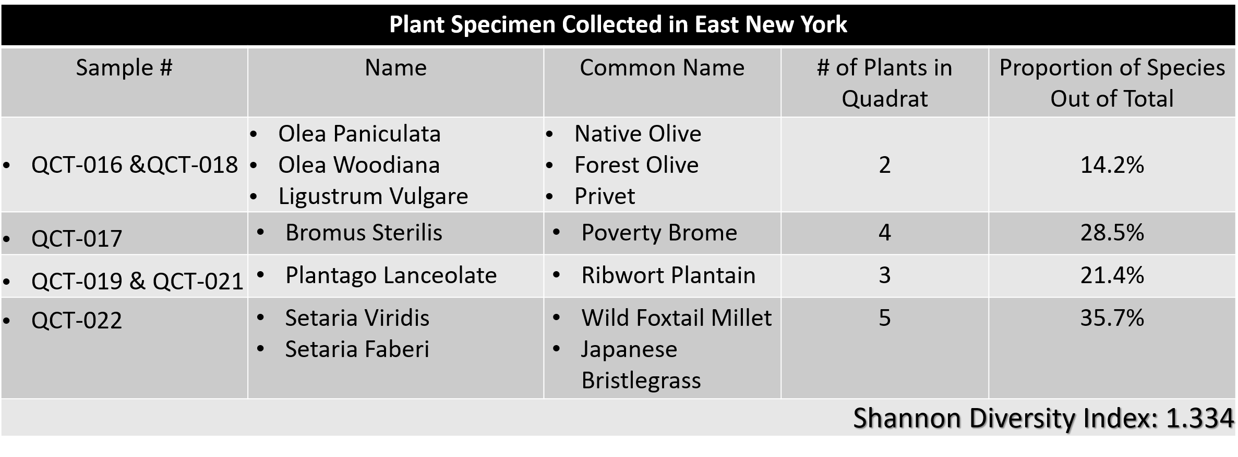
A Comparison of Biodiversity Across NYC Neighborhoods of Different Socioeconomic Status
Elizabeth Barrett, Leah Goodwin; Mentor: Sabrina Miller
Funded by the
Thompson Family Foundation
Academy for Young Writers
Abstract
Our research was conducted in order to find out how differences in human socioeconomic status affect plant biodiversity among urban communities. A quadrat was tossed in order to randomly select plant specimens. Then we extracted DNA from the plants, used PCR to amplify the rbcL gene, and sent the PCR products to Genewiz for sequencing. The DNA sequences were uploaded to DNA Subway and BLAST was used for identification of species. During this study, we found that a neighborhood of high socioeconomic status contain a higher amount of biodiversity compared to a neighborhood of low socioeconomic status. Based on our calculations the Shannon Diversity Index for DUMBO was 1.432, while for East New York it was 1.334. This conclusion confirms that higher income environments with more green spaces have greater plant biodiversity.
Introduction
Green space is distributed differently across neighborhoods of different socioeconomic status. Neighborhoods with wealthier residents tend to have more green spaces, especially parks, compared to neighborhoods with low-income residents. As stated in the research, “In the United States, people of color and low-income earners typically occupy the urban core and/or low-income inner ring suburbs where green space is either scarce or poorly maintained. Wealthier households often reside on the suburban periphery where green space is abundant, well-serviced, and well maintained.” ^{[1]} According to our research, the reasons why green space is distributed differently varies, but may include differences in “the philosophy of park design, history of land development, evolving ideas about leisure and recreation, and histories of class and ethno-racial inequality and state oppression.” ^{[1]}
By participating in the Urban Barcode Project, we aimed to answer the question: How do differences in human socioeconomic status affect plant biodiversity among urban communities? To answer this question, we collected and analyzed plant samples in NYC neighborhoods of different socioeconomic statuses. We sampled plants from DUMBO, an area that has an income level of between one-hundred fifty thousand to two hundred thousand dollar income, and from East New York, an area with a lower income level of about twenty-five to fifty thousand dollars, as documented by the U.S. Census Bureau through a median income map of NYC. ^{[2]} We predicted that having more green spaces should increase the biodiversity of plants, so we predicted that DUMBO would have great plant biodiversity compared to East New York.
Materials & Methods
For our research project, we identified two sampling locations: DUMBO and East New York. In order to assess the biodiversity of the two sampling areas, we collected our plant specimens at random. Using Google Maps we zoomed in on half-mile radius in DUMBO and East New York to identify possible locations where plants could be found. Each block within this radius was numbered and two streets were randomly selected using a random-number generator. On each randomly selected street, we tossed a quadrat (a 2’ x 2’ sampling square made of PVC pipe) and collected plants from within its boundaries. We collected plant samples from each street for a total of 15 samples from each sampling location. One leaf from each plant was selected and placed in a Ziplock bag labeled with the sample number. The location of each sample and time of collection was then documented in a notebook. The samples were collected from Union Square (Figure 1) on 12/17/16, and the samples were collected from East New York (Figure 2) on 12/19/16.
We extracted DNA from the leaves of each plant sample and then amplified its rbcL gene by PCR. We used this gene because the rbcL gene is highly conserved across plant species, so it could be used for identification. We used e-gels to determine if the DNA extractions and PCR were successful. If a band was present in the lane, this indicates a positive result and those samples were sent out for sequencing.
To determine species richness, we identified the number of different plant species collected by uploading the DNA sequences to DNA subway and using BLAST for identification. To determine species abundance, we counted the total number of plants of each species found in our quadrat. This gave us an estimate of the abundance of plants in the areas sampled. Since biodiversity takes into account both species richness and species abundance, we used the Shannon diversity index to calculate the biodiversity of our sampling areas in DUMBO and in East New York. The equation for the Shannon diversity index is: H = ∑(P_{i}*lnP_{i}) where P_{i} is the relative abundance of each species. The sampling area with a higher Shannon diversity index value has more biodiversity.
Results
The employment of the Shannon Diversity Index calculation allowed us to compare the diversity between the sampling areas. According to our study, the Shannon Diversity Index for DUMBO is 1.432 while the Shannon Diversity Index for East New York is 1.334. Because the Shannon Diversity Index is higher for DUMBO, this indicates that biodiversity is higher in DUMBO compared to East New York.
Discussion
Our results indicate that a wealthier neighborhood in NYC has higher biodiversity compared to a lower income neighborhood in the city. This difference in plant diversity is not only important to local ecosystems, we believe it is a social justice issue as well. As cities become more crowded and polluted, access to green space becomes increasingly important. In the United States, less than one third of children and less than one half of adults get enough exercise, but green spaces could help with this problem. Green spaces are “viewed as a principal key to enhancing health and well-being” ^{[3]} of residents by promoting physical activity and improving mental health.
Under Mayor Bill DeBlasio, the NYC Parks department planted over one million trees in NYC to increase green spaces for New Yorkers across the city. ^{[4]} While we acknowledge that this effort has increased biodiversity across neighborhoods in New York City, our results indicate that there is still lower plant biodiversity in one of the poorest NYC neighborhoods compared to one of its wealthiest.
To improve our study, we would’ve collected a larger sample set and also went earlier in the school year around September. An issue that caused us to struggle was finding samples after it just recently snowed. We expected to have more samples extracted compared to our actual results.
References
[1] Wolch, J. R., Byrne, J., and Newell, J. P. (2014). Urban green space, public health, and environmental justice: The challenge of making cities ‘just green enough.’ Landscape and Urban Planning. (125) 234–244. Retrieved from http://ced.berkeley.edu/downloads/ research/LUP.parks.pdf
23] (2012). Median Income Across the US. WNYC. Retrieved from https://project.wnyc.org/ median-income-nation/#4/38.63/-95.89
[3] Wen, M., Zhang, X., Harris, C. D., Holt, J. B. & Croft, J.B. (2013) Spatial Disparities in the Distribution of Parks and Green Spaces in the USA. Annals of Behavioral Medicine : A Publication of the Society of Behavioral Medicine. U.S. National Library of Medicine. Web.
[4] (2015). About Million Trees NYC. Million Trees NYC. Retrieved from https://www.nycgovparks.org/ parks/joyce-kilmer-park/dailyplant/23507
Acknowledgements
Thanks to the Harlem DNA Lab for lab resources and support, especially to Christine Marizzi, Melissa Lee, and Alison Cucco for facilitating Saturday open labs and answering countless questions via e-mail. Thanks also to our principal and custodial staff for allowing us to work at school on weekends and during breaks.
Figure 1: Sampling areas in DUMBO.
Figure 2: Sampling areas in East New York.

