Slide 1
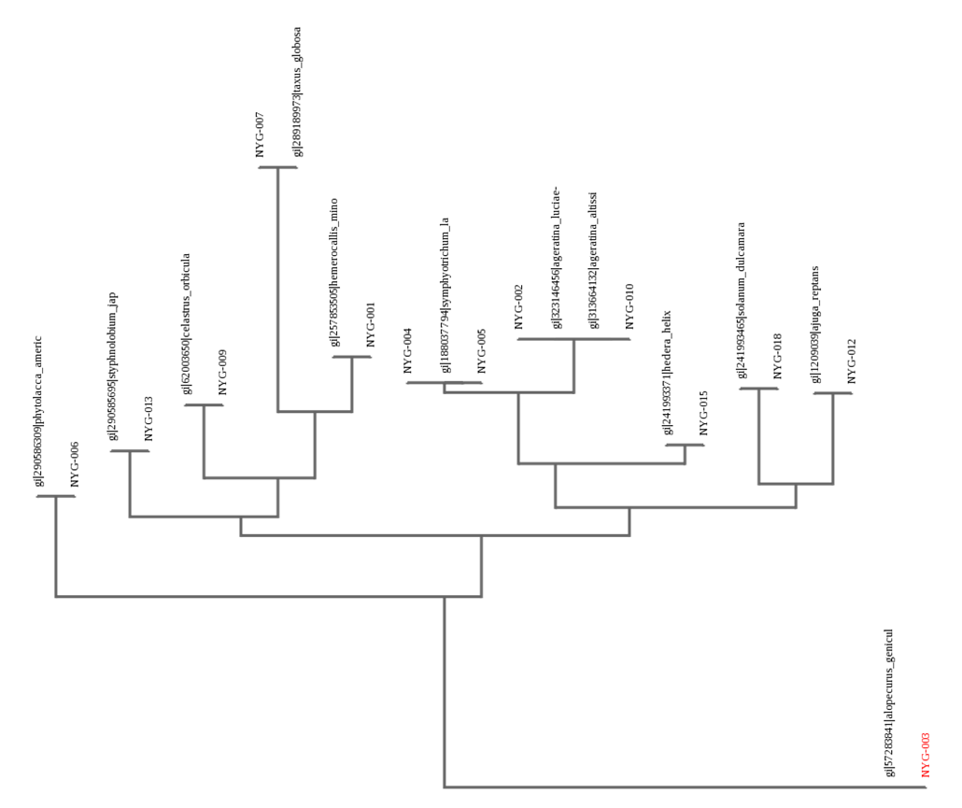
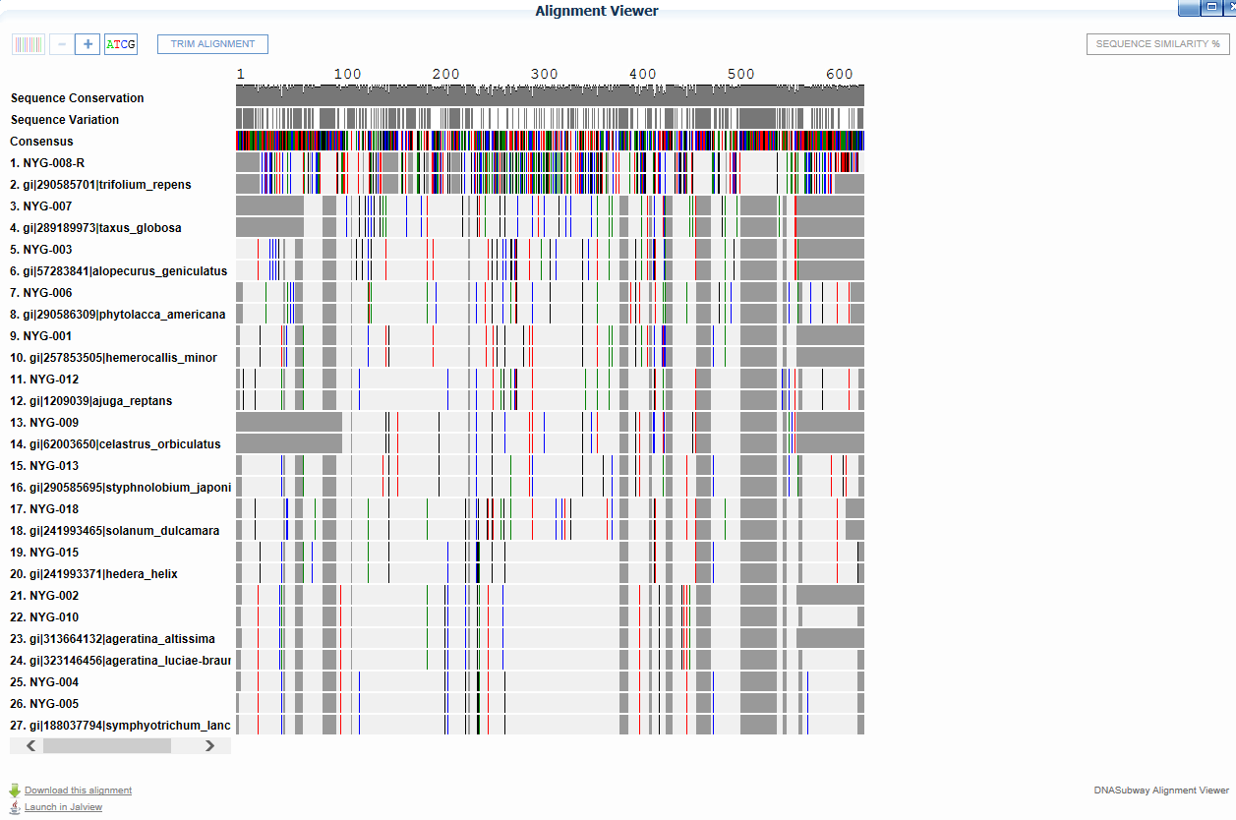
Abstract
Diesel trains emit substances like polycyclic aromatic hydrocarbons and heavy metals, which may impact surrounding vegetation. Locomotive emissions may be mutagenic to exposed vegetation, which can affect diversity. Diversity can be studied via DNA analysis of the rbcL region of the chloroplast gene in plants. This study intends to determine identities of plants close to a railway as opposed to farther away. This experiment was carried out by collecting plant samples, isolating, amplifying, and analyzing DNA through polymerase chain reaction and gel electrophoresis. From most to least evolved, the phylogenetic tree indicated: NYG-007, NYG-002 and NYG-010, NYG-001, NYG-004 and NYG-005, NYG-018, NYG-012, NYG-009, NYG-015, NYG-013, NYG-006, NYG-003. Samples exposed to train emissions appeared more diverse; non-train samples appeared more analogous. The hypothesis is supported; plants exposed to locomotive emissions are more diverse than those that are not. Consequently, railroads have altered the diversity of Long Island’s naturally occurring plant life.
The Effect of Locomotive Emissions on Long Island Plant Diversity:
DNA Barcodes of Two Different Areas in Mineola
Authors: Elizabeth C. Ryan,¹ Erica Sze-Tu¹
Mentor: ¹ Ellen McGlade-McCulloh
¹ Mineola High School
Introduction
Locomotive means of transporting goods and people are very efficient and popular. However, diesel trains emit organic and inorganic substances that may have a significant impact on the surrounding area's air quality, soil content, and vegetation (California Environmental Protection Agency 2015). This study seeks to determine the effect of these contaminants on the assortment and identity of vegetation in close proximity to Long Island diesel railways as opposed to vegetation farther away.
Diesel train emissions are composed of a variety of substances, including typical combustion gases such as nitrogen, oxygen, carbon dioxide, and water vapor in addition to air pollutants such as carbon monoxide, sulfur and nitrogen oxides, volatile organics, aldehydes (such as formaldehyde and 1,2 butadiene), and polycyclic aromatic hydrocarbons (PAHs) and PAH derivatives (California Environmental Protection Agency 2015). Likewise, heavy metals─such as lead, copper, zinc, mercury, iron, and cobalt─.are emitted by locomotives only to be deposited into the soil through dry and wet deposition, leading to plant contamination (Wiłkomirski and others 2011). However, PAHs are found in higher concentrations around railway tracks than heavy metals (Wiłkomirski and others 2011). Besides high toxicity, such high concentrations of PAHs, in particular, have carcinogenic and mutagenic effects on living organisms (Wiłkomirski and others 2011, California Environmental Protection Agency 2015). Such effects may very well impact the identities of the plants found close to the tracks. Since PAHs are found in remarkably high levels in close proximity to railways (Wiłkomirski and others 2011), it is possible that the carcinogenic and mutagenic effects would alter the types of vegetation and/or the DNA sequences (and subsequent identities) of neighboring vegetation. Diesel particulate matter (DPM) and airborne coal dust is known to pollute the atmosphere in areas close in proximity to railways (Jaffe and others 2014). Since DPMs are considered carcinogenic to humans (Jaffe and others 2014), it is very likely they are carcinogenic to plant life as well. Thus, there is a great chance that locomotive emissions are carcinogenic and mutagenic on the vegetation that is exposed, leading to effects on diversity in affected areas.
The study of diversity in a particular area is particularly important in this day and age; people have become cognizant of the enormous impact on the environment, particularly plant life, and seek to amend the wrongs of the past. Thus, Long Island has a great need for studies on biodiversity, between the density of population and historic environmentally-unfriendly practices, Long Islanders have affected their surroundings. A 1898 study produced a general outline of Long Island’s fauna and flora, creating a basis for further studies of Long Island (Davenport 1898). With new technology comes new capabilities, and DNA barcoding has opened up endless possibilities for studying life (DeSalle and others 2005). Today, DNA “barcoding” enables scientists to avoid the frequent misidentifications experienced when taxonomy─classification of organisms purely by description─was the only method of distinguishing species (DeSalle and others 2005). Likewise, through “barcoding,” researchers are capable to isolating particular traits in an effort to determine evolutionary relationships (DeSalle and others 2005). In animals, the mitochondrial gene cytochrome c oxidase I (COI) can serve across the board for bioidentification (Hebert and others 2003). There are analogous genes in plants, namely the rbcL region of the chloroplast gene. This study will compare the rbcL region of the samples' chloroplast genes with known sequences to determine the identities of plants in close proximity to a railway as opposed to farther away. Because Long Island is webbed in railroad tracks, the effect of locomotive traffic on plant diversity and individual identity is a legitimate concern.
Figure 1- The alignment viewer demonstrating the sequencing of each of the samples and their subsequent identifications in barcode form.
Figure 2- The phylogenetic tree, which illustrates the evolutionary connections between all of the samples based off the least evolutionarily evolved sample NYG-003.
Discussion
It appears that the train samples (NYG-001, NYG-002, NYG-003, NYG-004, NYG-005, NYG-006, NYG-007, NYG-009) are more evolutionarily diverse. The non-train samples (NYG-010, NYG-012, NYG-013, NYG-015, NYG-018) are more evolutionarily analogous. An area adjacent to railroad tracks and an area farther away were chosen because trains emit materials that affect the environment. Railroads have altered the diversity of naturally occurring plant life on Long Island. Because the data indicated that the samples exposed to diesel emissions are more divergent in terms of evolution and the non-train samples are less varied, then the hypothesis is supported. Diesel emissions have been known to be carcinogenic, resulting in the exposed samples being more diverse. Due to the loss of DNA during the isolation process, a handful of sample from the non-train area could not be utilized. One sample, NYG-008, could not be fully analyzed because only the reverse sequence registered. Consequently, because Long Island is webbed in diesel train tracks, the natural Long Island plant life may have been altered over time, as seen in these results. This study could be expanded upon and benefit from more extensive research. A study with more drastic difference between the train and non-train areas could help augment this study, as the areas used in this experiment were relatively close in proximity to each other.
References
Davenport, C. 1898. A Report on the Fauna and Flora at Cold Spring Harbor. The Library of the New York Botanical Garden. 2-10
DeSalle, R., Egan, M.G., Siddall, M. 2005. The unholy trinity: taxonomy, species delimitation and DNA barcoding. Philosophical Transactions of the Royal Society. Vol 360: 1905-1916
Hebert, P.D.N., Cywinska, A., Ball, S.L., deWaard, J.R. 2003. Biological identifications through DNA barcodes. Proceedings of the Royal Society of London B. Vol 270: 313-321
Jaffe, D.A., Hof, G., Malashanka, S., Putz, J., Thayer, J., Fry, J.L., Ayres, B., Pierce, J.R. 2014. Diesel particulate matter emission factors and air quality implications from in-service rail in Washington State, USA. Atmospheric Pollution Research. Vol 5: 344-351
California Environmental Protection Agency. 2015. The Report on Diesel Exhaust.
Wiłkomirski, B., Sudnik-Wójcikowska, B., Galera, H., Wierzbicka, M., Malawska, M. 2011. Railway transportation as a serious source of organic and inorganic pollution. Water Air Soil Pollut. Vol 218: 333-345
Materials and Methods
Nineteen plant samples were collected, documented, and labeled in October 2015. Ten samples from the non-train area and nine from the train area, 1.28 kilometers apart, were placed and labelled in bags and test tubes to be frozen. In order to isolate DNA: Lysis solution was added to tissue samples (about 1 cm). Samples were grinded, incubated, and centrifuged. The supernatant was removed and transferred into new tubes. Silica resin was added, and solution was mixed, incubated, and centrifuged. Supernatant was removed, wash buffer was added, solution was mixed and centrifuged. Most of the supernatant was removed, mixture was then centrifuged, and the remaining supernatant was removed. Distilled water was added to resin pellet, and solution was mixed, incubated, and centrifuged. To amplify DNA by PCR: primer mix was added to PCR beads, DNA from the samples was added to PCR reagents, and samples were amplified in thermal cycles. To analyze PCR products by gel electrophoresis: agarose gel was poured in gel-casting trays and set aside to solidify for 20 minutes. Gel was loaded into electrophoresis chamber and covered with buffer solution. The rBCL ladder, PCR products, and DNA stain were loaded into assigned wells. The gels were electrophoresed for 30 minutes with 130 volts, and then viewed with UV transillumination and photographed. Afterwards, the samples were sent to Genewiz for sequencing.
Results
As per the phylogenetic tree, sample NYG-007, Taxus globosa, is the most evolved plant of this group. The next most evolved species were samples NYG-002 and NYG-010, which are Ageratina luciae-brauniae and Ageratina altissima, respectively. Then, NYG-001, Hemerocallis minor. Following are NYG-004 and NYG-005, Symphyotrichum lanceolatum. After comes sample NYG-018, Solanum dulcamara, and closely related is NYG-012, Ajuga reptans. Subsequently, NYG-009, Celastrus orbiculatus, then sample NYG-015 and NYG-013, Hedera helix and Styphnolobium japonicum. Next, NYG-006, Phytolacca americana. The least evolved plant of this group is NYG-003, Alopecurus geniculatus.
Acknowledgements
We would like to thank Dr. Ellen McGlade-McCulloh and Mr. Garry Desire for their confidence and guidance during this process. We are also grateful to Dr. Sharon Pepenella and Dr. Christina Fernandez-Marco for their assistance and advice, and the Barcode Long Island Team at Cold Spring Harbor Laboratory for providing us with this opportunity and experience. Additionally, we are appreciative of our parents’ support and encouragement.

