Slide 1
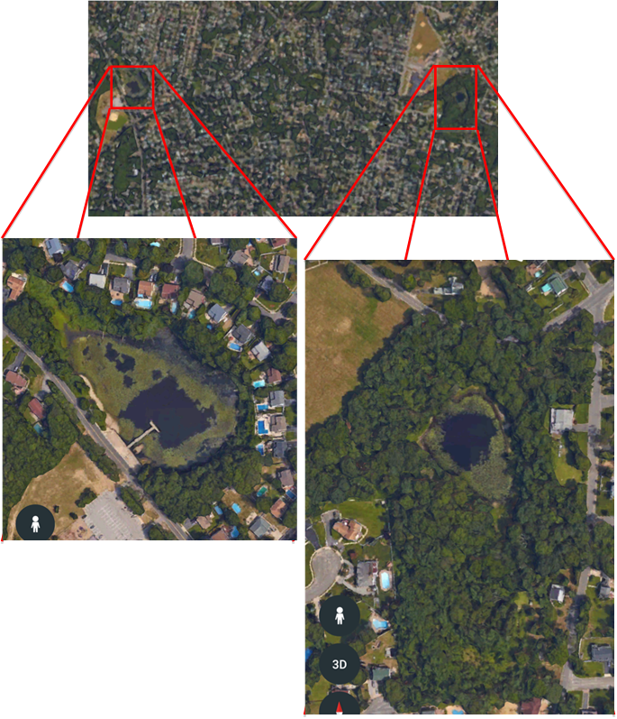
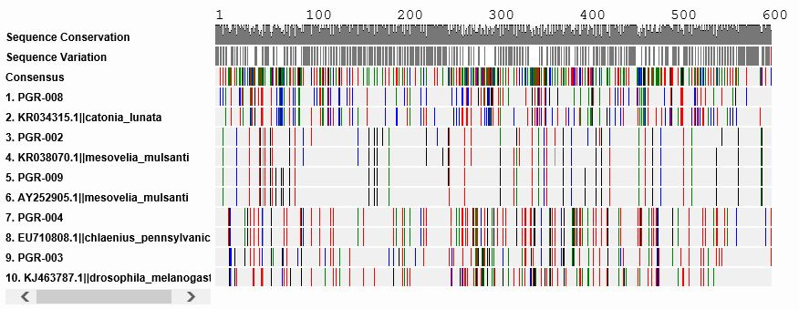
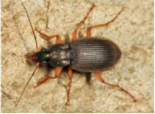
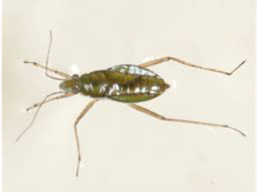
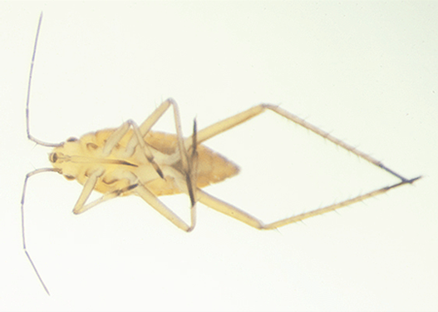
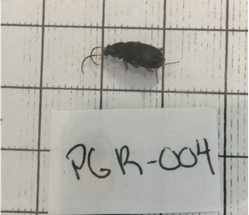
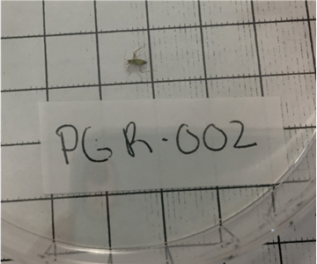
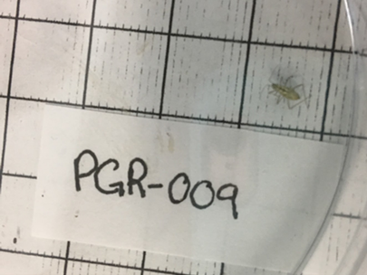
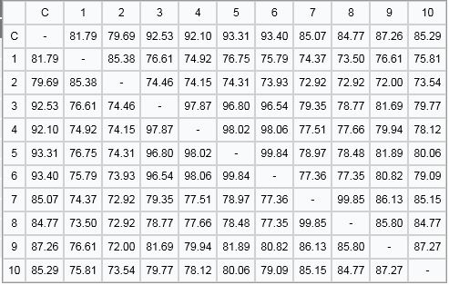
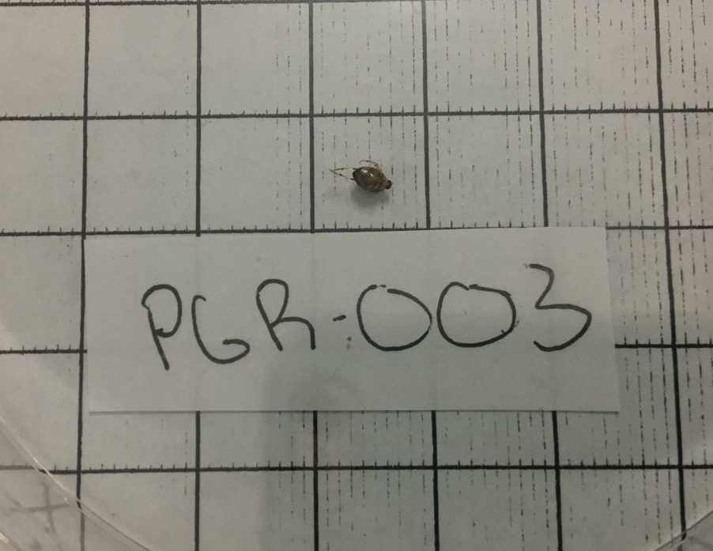
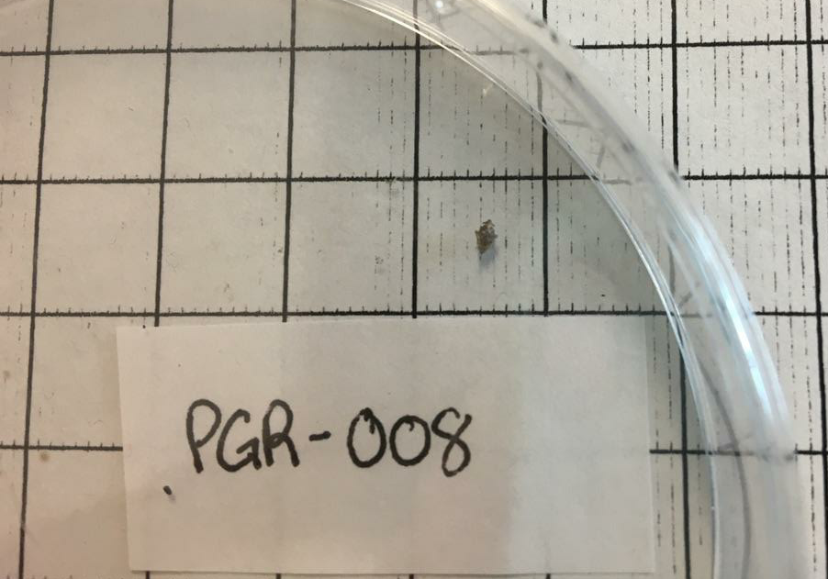
The Effect of Vegetated Buffer Zones on Aquatic Biodiversity
Kaya Manolt, Caitlin Tucker, and Madison Tutone
Mentor: Monica Marlowe ~ Sachem North High School
Abstract
Water quality is known to have a direct correlation with biodiversity. Good water quality usually has lower nitrates and phosphates, a neutral pH, and increased dissolved oxygen in the water. These parameters promote biodiversity and attract organisms that are indicators of good water quality. The presence of a buffer zone can seriously affect the water quality of a wetland by reducing nitrates and phosphates. We hypothesized that Pond 1, which has a buffer zone, would have better water quality and increased biodiversity, while Pond 2, with no buffer zone, would have poor water quality and less biodiversity. Our goal was to show that buffer zones have an impact on water quality and biodiversity in wetlands. We collected approximately ten invertebrate specimen from each pond for DNA sequencing. Our results show an overall higher biodiversity in Pond 1. We discovered that Pond 2 had higher nitrate levels than Pond 1. Also, we found two dragonfly larvae, which are indicators of good water quality, in only Pond 1. Pond 1 has a buffer zone to filter out suburban runoff, so water quality remains relatively high. On the other hand, Pond 2 is adjacent to a street and baseball field with no buffer vegetation, therefore suburban runoff has affected the pond negatively. Using the results from our research we can conclude that buffer zones do positively affect water quality and biodiversity..
Introduction
If there’s one thing we know about biodiversity, it’s that it can be found everywhere. Identifying and preserving the biodiversity of Long Island is very important, however, only about half of these species are thought of as safe from extinction (LI 2016). Invasive species, pollution, climate change, and habitat loss are greatly affecting these unique environments (New York State Department of Environmental Conservation 2005) and there may be many organisms on Long Island yet to even be discovered.
According to the State of Washington’s Department of Ecology’s article, Wetlands: Nature’s sponges, Nurseries, and Water Filters (2008), freshwater wetlands are important for many reasons and we need to protect them. For example, wetlands improve water quality by trapping sediments, filtering out pollutants, and absorbing nutrients that would otherwise result in poor water quality. Also, wetlands prevent flooding by holding in water like a sponge. By doing so, wetlands help keep river levels normal and prevent flooding events for human communities. Wetlands produce great volumes of food that attract many animal species, therefore can provide homes for an immense diversity of plants, amphibians, reptiles, mammals, and migrating waterfowl. Some wetlands also serve as a source of groundwater recharge. Moreover, 43% of threatened or endangered species in the U.S. live in or depend on wetlands (WSU 2008). According to Costanza et al. (1997), freshwater wetlands are among the most valuable systems based on these ecosystem services they provide.
There are many abiotic factors that can influence the biodiversity found in wetland areas. Nitrate, pH, dissolved oxygen, turbidity, and phosphate levels in the water have a major impact on the types of life found within an aquatic ecosystem. High or low pH levels can put stress on aquatic life and reduce the hatching of their young (FEM 2016). High levels of nitrate and phosphate can also be problematic. Algae feeds on the excess nutrients, the abundance of algae will cause eutrophication, a condition where the dissolved oxygen is depleted in the water causing fish kills (WRC 2014, WRIG 2010). Furthermore, sometimes the algae blooms themselves can be harmful, toxic to both humans and aquatic organisms.
Abiotic factors can be influenced by buffer zones. Riparian buffer zones are areas of natural vegetation that can protect or isolate a wetland ecosystem from harmful pollutants, like nitrogen and phosphorus (NRCS 2003). Our study investigated the effect of buffer zones on water quality and biodiversity of isolated freshwater wetlands on Long Island.
We collected specimens from two ponds. Since Pond 2 has no buffer zone, we predicted that it would have greater impacts from the surrounding suburban community. Specifically, we predicted that nitrate and phosphate levels would be higher in Pond 2 than Pond 1, which has a forested riparian buffer zone. Since we predicted that the nitrate and phosphate levels would be higher in Pond 2, we also hypothesized that dissolved oxygen levels would be lower. With these water quality issues, we predicted that the Pond with no buffer would also would have less biodiversity. Also, we hypothesized that a buffer zone may help prevent the spread of invasive plants. The buffer zone will present a boundary between humans and the wetland. This will provide fewer opportunities for invasive plant seeds to be planted/dispersed.
Results
Pond 1 showed increased water quality and biodiversity of indicator species compared to Pond 2. For example, at Pond 1 we found dragonfly larvae, which is an indicator of good water quality. Also, we found that in Pond 2 there were increased levels of nitrates. However, both ponds showed presence of nitrates and phosphates, as well as exhibited low dissolved oxygen at 2 pmm (Table 1).
After we extracted our DNA and put it through the PCR, seven of our samples could be sent out for sequencing. Two samples, PGR-006 and PGR-011 were too short to accurately identify the species. We were able to identify three of our specimens (Figure 2 and Figure 3). PGR-004 is Chlaenius Pennsylvanicus or the common ground beetle. PGR-002 and PGR-009 are both Mesovelia mulsanti or Mulsant’s Water Treaders.
Two of the samples, PGR-003 and PGR-008, were novel (Figure 4). Sample PGR-003 had 90 mismatches with its most similar species and PGR-008 had 95 mismatches (Table 3). From the MUSCLE, they both had a similarity percentage of approximately 85% to the species most closely related to them (Table 2).
Discussion
Protection of wetland should be a priority for managers because of all the ecosystem services they provide (Costanza et al 1997, WSU 2008). It has been shown that vegetated buffer zones will reduce runoff and pollutants from reaching adjacent wetlands. In buffer zones, there is a need for different species of vegetation to grow to fulfill different jobs. For example, grasses allow for channelization of runoff and larger plants absorb more of the excess nutrients (NRCS 2001). Pond 1 has a buffer that has a variety of vegetation, including cattails and the surrounding wooded area, which serves to filter out suburban runoff. On the other hand, Pond 2 is adjacent to a street and baseball field with no buffer vegetation, therefore suburban runoff has affected the pond negatively.
High nitrate and phosphate levels are a large problem on Long Island because of the many residential areas that use a lot of fertilizer. Furthermore, on Long Island, cesspools are very common. The excess nutrients can get into bodies of water and throw off the environment’s balance. Eutrophication happens and the ecosystem becomes overpopulated with algae, blocking light from submerged vegetation, promoting decomposers, and ultimately a low dissolved oxygen. This chain reaction leads to fish kills. At Pond 2, the amount of algae and think mats of floating macroalgae was obvious, when compared with Pond 1, which had much less algae. If Long Island continues to destroy buffer zones, there will be a huge decline in the amount of biodiversity. From our results, we were able to see that the area with a buffer zone had more indicator species present. This means that the buffer is doing its job and keeping the water quality and biodiversity higher than that of a pond without a buffer.
At the laboratory, seven of our samples were able to be sent out for sequencing. Of the seven samples sent out for sequencing, two of the sequences that came back were too short to read. PGR-002 and PGR-009, although found in different ponds, were the same species. This is evidence that the are similar environments. As you see in Figure 2 and Table 2, their sequence similarity is high. An exciting result, is that we found two novel species!
Future Research
Our sample size was relatively low, since we were only able to go out and sample once. In the future, we would like to go collect multiple times in the year. It will be interesting to see the changes in the organisms we find, specifically in Pond 1, which recently saw much of the buffer zone removed. Next year, we hope to collect more samples and apply the skills we learned throughout the year to get more accurate results. Aside from an increased amount of organism sample events, we would like to take multiple water quality tests throughout the year. Water quality provides data that show the effect of buffer zones on the abiotic environment. Those results then can be extrapolated to the presence or absence of indicator species. After having two novel sequences, one in either pond, it will be interesting if we find them again next year. The new, altered environment at Pond 1 may have an impact on the types of invertebrates present.
References
Cold Spring Harbor DNA Learning Center (CSH). 2014. Using DNA Barcodes to Identify and Classify Living Things.
Fundamental of Environmental Measurements (FEM). 2016. pH of Water.
Gallant, Micah. 2010. Nitrates and Their Effect on Water Quality. Wheatley River Improvement Group (WRIG).
LongIsland.com (LI). 2016. About Long Island.
National Ocean Service (NOS). 2016. Harmful Algal Blooms.
Natural Resources Conservation Service (NRCS). 2001. Riparian Forest Buffer. USDA Wildlife Job Sheet. https://efotg.sc.egov.usda.gov/references/public/IL/ripairian.pdf
New York State Department of Environmental Conservation (NYSDEC). 2005. Natural History of New York.
Oram, Brian. 2014. Phosphates in the Environment. Water Research Center (WRC)
Robert Costanza et al. 1997. The value of the world's ecosystem services and natural capital. Nature. 387. 253 – 260
Washington State Department of Ecology (WSU). 2008. Functions and values of Wetlands: Nature’s sponges, Nurseries, and Water Filters.
Acknowledgements
We would like to thank Cold Spring Harbor Laboratory, Brook haven National Laboratory, our parents, our mentor, Mrs. Marlowe, the Barcoding Long Island faculty and staff, Suffolk County Legislator Leslie Kennedy, her Chief of Staff, Ali Nazir, and the Sachem Central School District.
Table 1: Water Quality results measured using a LaMotte water quality testing kit.
Table 1: Water Quality results measured using a LaMotte water quality testing kit.
 | Pond 1 | Pond 2
Salinity (ppt) | 0 | 0
Temperature (ºC) | 18.0 | 17.5
Turbidity (JTU) | 25 | 30
pH | 7.25 | 6.75
Nitrate (ppm) | 2.25 | 3.13
Phosphate (ppm) | 0.36 | 0.28
Dissolved Oxygen (ppm) | 2 | 2
 | Pond 1 | Pond 2
Salinity (ppt) | 0 | 0
Temperature (ºC) | 18.0 | 17.5
Turbidity (JTU) | 25 | 30
pH | 7.25 | 6.75
Nitrate (ppm) | 2.25 | 3.13
Phosphate (ppm) | 0.36 | 0.28
Dissolved Oxygen (ppm) | 2 | 2
Pond 2
Pond 1
Table 3: BLAST results with closest match using the cytochrome oxidase subunit 1 (COI) gene
Figure 1: Aerial photographs of Pond 1 and Pond 2. Pond 1 has a forested buffer zone, while Pond 2 does not have a forested buffer from the surrounding suburban matrix.
Sample | Closest species | Aln. Length | Bit Score | Mis-matches
PGR-002 | Mesovelia mulsanti | 658 | 1126 | 14
PGR-003 | Drosophila melanogaster | 708 | 865 | 90
PGR-004 | Chlaenius pennsylvanicus | 684 | 1222 | 1
PGR-008 | Catonia lunata | 650 | 744 | 95
PGR-009 | Mesovelia mulsanti | 636 | 1142 | 1
Figure 1: Aerial photographs of Pond 1 and Pond 2. Pond 1 has a forested buffer zone, while Pond 2 does not have a forested buffer from the surrounding suburban matrix.
PGR-004
Scientific name:
Chlaenius Pennsylvanicus
Common name:
Ground Beetle
PGR-002 and PGR-009
Scientific name:
Mesovelia mulsanti
Common name:
Mulsant’s Water Treader
Figure 2: Visual of MUSCLE showing each PGR sample with the closest match according to DNA Subway BLAST.
Table 2: Sequence similarity report for MUSCLE shown in Figure 2
Figure 3: Photographs of known specimen PGR-004, PGR-002, and PGR-009.
Figure 4: Photographs of potential novel specimen PGR-003 and PGR-008.

