Slide 1
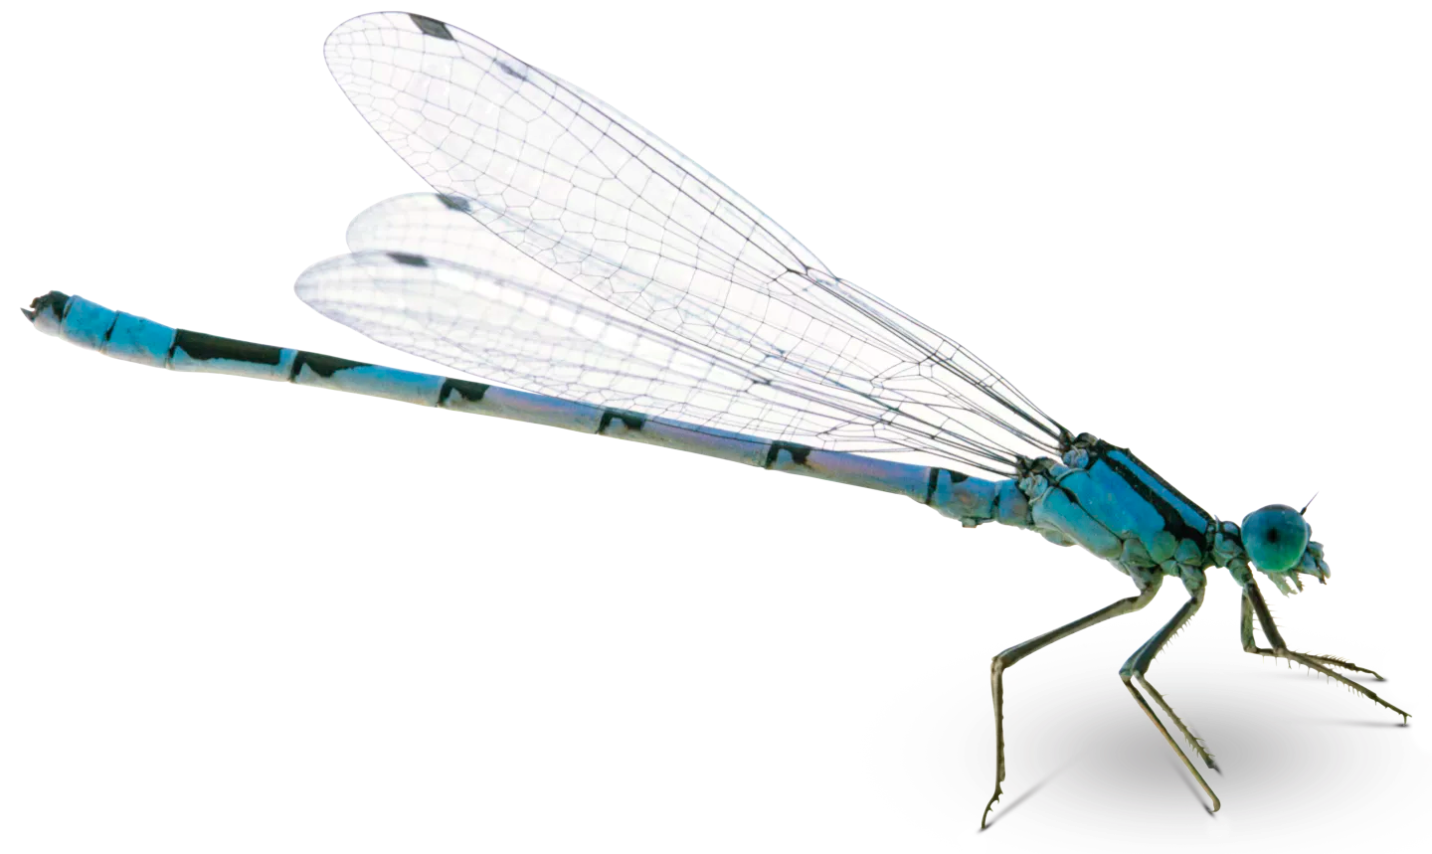
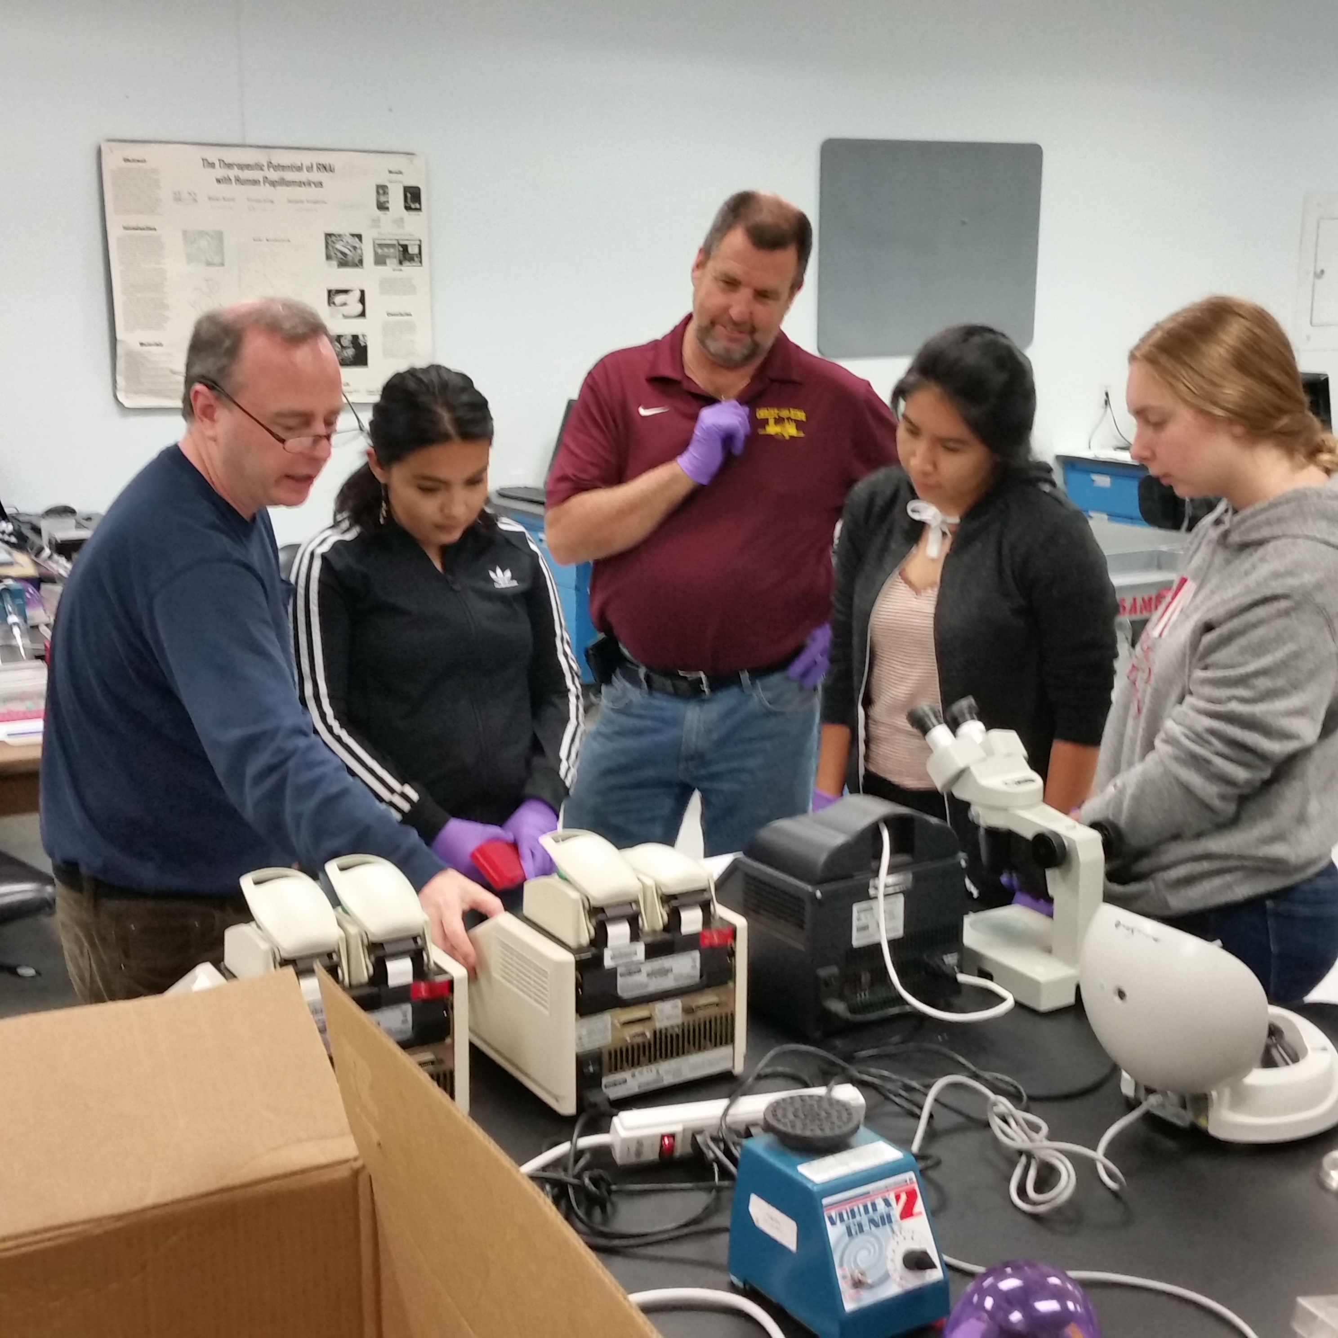
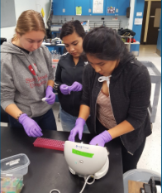
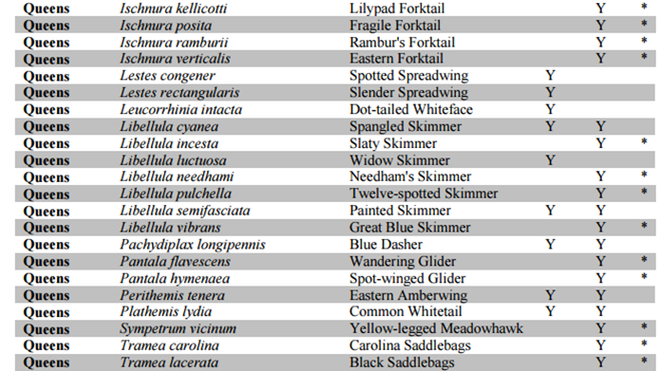
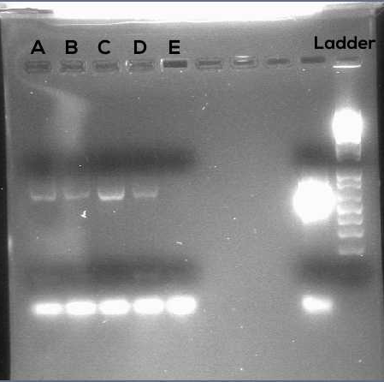
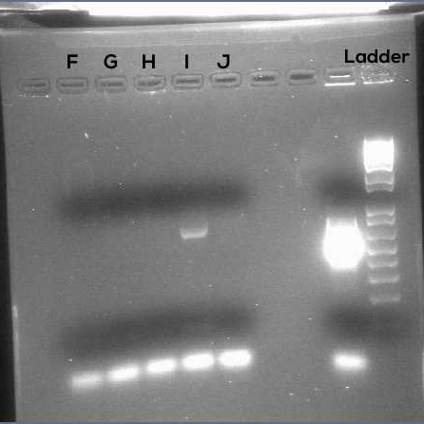
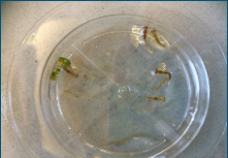
DNA Barcoding of Damselfly Nymphs
Laura Jans, Heather Paniagua, and Angeles Paucar; Mentor: Mr. Bob Mackey
Christ the King Regional High School and Stony Brook University
Abstract
According to Encyclopedia Britannica, Damselflies are found mainly near shallow, freshwater habitats and are graceful fliers with slender bodies and long, filmy, net-veined wings. We used a taxonomic key to identify damselfly nymphs in the sump behind our school located at 68-02 Metropolitan Ave, Middle Village, NY 11379. Our objective was to identify which species of damselfly was living in this sump.
Introduction
According to 105 damselfly surveys conducted by the New York Department of Environmental Conservation between the years of 2005- 2009, there are 33 detected damselfly species in Queens, New York. They expect to have identified about 89% of the total species in Queens. Our goal in this experiment was to use DNA barcoding protocol to identify which type of damselfly lives behind Christ the King High School. We also wanted to find out whether the species had been previously identified since 11% of the total damselfly species in Queens remain unidentified.
Materials & Methods
To conduct our research we collected specimens, extracted DNA from each sample’s leg, and used it to follow DNA barcoding protocol at a laboratory provided by Stony Brook University. The protocol included isolating the DNA from our samples, amplifying that DNA by PCR (polymerase chain reaction) and analyzing the PCR products by gel electrophoresis.
Results
After sending our results for sequencing, we were able to match the DNA of two of our samples to a genus. Through DNA Subway, we identified the genus as Ischnura. They are also known as forktails and are in the family Coenagrionidae. The reverse read was used rather than the forward read because it had a better quality to work with.
Tables & Figures
Figures 4 and 5 The team at a lab at Stony Brook University.
Figure 1 Some species that reside in the Queens area.
Figures 2 and 3 Images of the damselfly and nymph samples.
Figures 6 and 7 Gel Electrophoresis results. Samples A trough C are adult damselflies and samples D through J are nymphs.
Discussion
At first, the results from the DNA amplification were too weak to used. It was a challenge we faced because it would greatly affect our results. However, it turns out that two samples were able to be used and unexpectedly we got a genus. Ischnura is a common type of damselfly found in the Queens area. We’ve learned that for future experiments we could take greater precautions and be aware of the methods we take.
References
Allen, Katherine (2009). The ecology and conservation of threatened damselflies. The Environment Agency. "Dragonfly and Damselfly Colonization and Recolonization of a Large, Semi-Permanent Pennsylvania Pond." BioOne. N.p., n.d. Web. 17 Feb. 2017. http://www.bioone.org/doi/abs/10.1656/045.021.0414.
Saux, Corrie, Chris Simon, and Greg S. Spicer. "Phylogeny of the Dragonfly and Damselfly Order Odonata as Inferred by Mitochondrial 12S Ribosomal RNA Sequences." Annals of the Entomological Society of America 96.6 (2003): 693-99. Web.
The Editors of Encyclopædia Britannica. "Damselfly." Encyclopædia Britannica. Encyclopædia Britannica, Inc., 29 Mar. 2007. Web. 17 Feb. 2017. https://www.britannica.com/animal/damselfly.
"DAMSELFLY." DAMSELFLY. N.p., n.d. Web. 17 Feb. 2017. http://beneficialbugs.org/bugs/damselfly/damselfly.html. N.p., n.d. Web
Acknowledgements
We would like to thank Stony Brook University for providing us with the laboratory space and necessary materials to complete all of the steps of DNA barcoding and Dr. Daniel Maloney for teaching us proper lab techniques and supervising our. Lastly, we would like to thank our mentor Mr. Bob Mackey for helping us develop our project and being our guide throughout the entire process.

