Slide 1
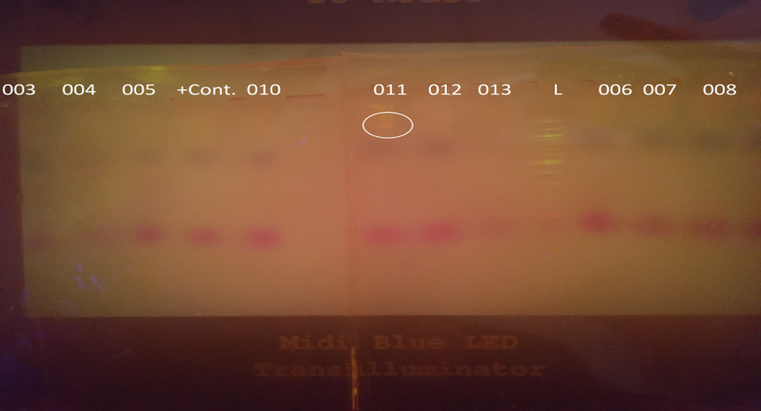
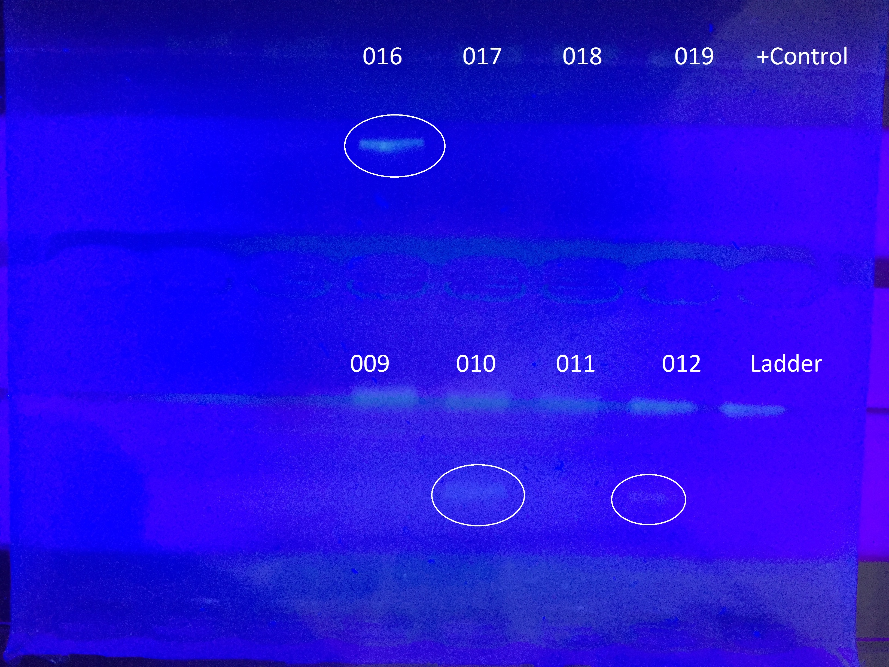
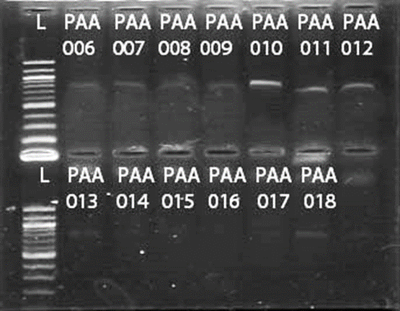
Using DNA Barcoding to Identify Freshwater Algae in Two Bodies of Water
Lauren Cottral, Shweta Karmakar, Janalyce Torres
Islip High School
Abstract
This experiment was performed to evaluate biodiversity and what it says about the health of an ecosystem. The experiment shows which algae species are present in the environment of Pardees Pond and Athasca Lake. Samples of algae were collected from Pardees Pond and Athasca Lake; they were then monocultured using the dilution method. After they were confirmed as monocultures the silica resin method and multiple primers (rbcl, tufA, and ITS) were used in an attempt to amplify the DNA. These samples were then sent to Cold Spring Harbor Laboratory for DNA sequencing. Once sequenced, DNA Subway could then be used to identify the specific algae collected. If the identity of the algae could be determined, the overall health of the bodies of water could be assessed.
Introduction
There are two bodies of water on the Islip school property: Athasca Lake and Pardees Pond. Pardees Pond is the northern most body of water and is connected to Athasca Lake by a small and narrow channel (Figure 1). The presence of certain organisms can indicate the water quality by their ability to tolerate chemicals or conditions (Dokulil, M.T., 2003), which are called "bioindicators." Our goal was to isolate the DNA from freshwater algae species living in Pardees Pond and in Athasca Lake, then to use DNA Barcoding to positively identify up to twenty species. Once identified, the presence or absence of some species could be used to evaluate and compare the health of the two ecosystems.
Materials & Methods
Algae samples were collected the week of September 8, 2015 using Depth collection, Plankton Tow and Scooping Methods. Depth Collection is a process where a tube, that can be closed both ends, is submerged to the bottom of shallow water and filled. The tube is sealed under water and pulled out, where the contents are emptied into a container. This step was repeated twice. Plankton Tow is a fine mesh screen with a small removable tube at the bottom that is connected to a pole. The Plankton Tow is pulled along the surface of the water then the mesh and tube was emptied into the container; this step was repeated twice. Scooping is a process where scooping net were immersed in the water just under the surface and is pulled towards us where the contents were then into the container with other samples. This step was repeated twice.
After distinguishing algae from debris in the samples, the algae samples were cultured over a period of 3 months in a Climatarium. The samples were then monocultured using the dilution method, when a sample is divided, then each portion is isolated in their own test tube full of distilled water and Algal Grow (Hoff & Snell, 1999). These samples then were put back in the Climatarium to continue to grow as monocultures. After the samples had accumulated enough biomass, they were analyzed microscopically. Once finding a pure sample, they were dried overnight in an open glass petri dish placed in a drying oven. When they were completely dry, the dish was scraped with a razor and the dried cells were added to an Eppendorf tube. The next steps were to follow the Silica Resin method (Figure 2). Extracted DNA was treated with three different PCR primers: rbcL, tufA and ITS (Fernadez-Marco, 2016).
Acknowledgements
We would like to thank Cold Spring Harbor Laboratories for all their time and assistance with this project. Their help in giving us the necessary materials and the answers to all our questions. Also we would like to thank our mentors Dr. Christiansen and Mrs. Mackey for support in our experiment and their ability to help us with our experiment.
Results
We were successfully able to microscopically identify the algae and isolate the DNA of the samples but the various primers caused only certain samples to react and amplify. Monocultures made it possible to microscopically identify the algae species. Isolating the DNA was successful as shown in the Gel from our Gel electrophoresis test. The test is to see how much DNA is extracted from a sample. The primer rbcl was able to amplify sample IHS-011 identified as nanochlorsis, while the primer tufa was able to amplified
Tables & Figures
Figure 1: rbcL primer
Figure 2: tufa primer
Figure 3: ITS primer
Discussion
What does this experiment tell us about our community’s health? How does the water algae compare to other ponds? Algae density? Algae Types? What does the specific algae tell us about the chemicals in these bodies of water? Too much phosphorus? These question are ways of further looking into our experiment and figuring out what certain algae species can do for us.
References
-Dokulil MT. 2003. Algae as ecological bio-indicators. Trace Metals and other Contaminants in the Environment. p 285-327.
-Fernadez-Marco C. 2016, January 1. Using DNA barcoding to identify and classify living things. Available from: http://www.dnabarcoding101.org/files/using-dna-barcodes.pdf
-Hoff FH, Snell, TW. 1999. Plankton cultural manual (5th ed.). Dade City, FL: Florida Aqua Farms.
-Lavoie I, Vincent W, Pienitz R, Painchaud J, 2004. Benthic algae as bioindicators of agricultural pollution in the streams and rivers of southern Quebec (Canada). Aquat Ecosyst Health Manag, 7 (1): 43-58.
-Vasquez JA, Guerra N 2007. The use of seaweeds as bioindicators of natural and anthropogenic contaminants in northern Chile. Hydrobiologia. (1): 326-327.

