Slide 1
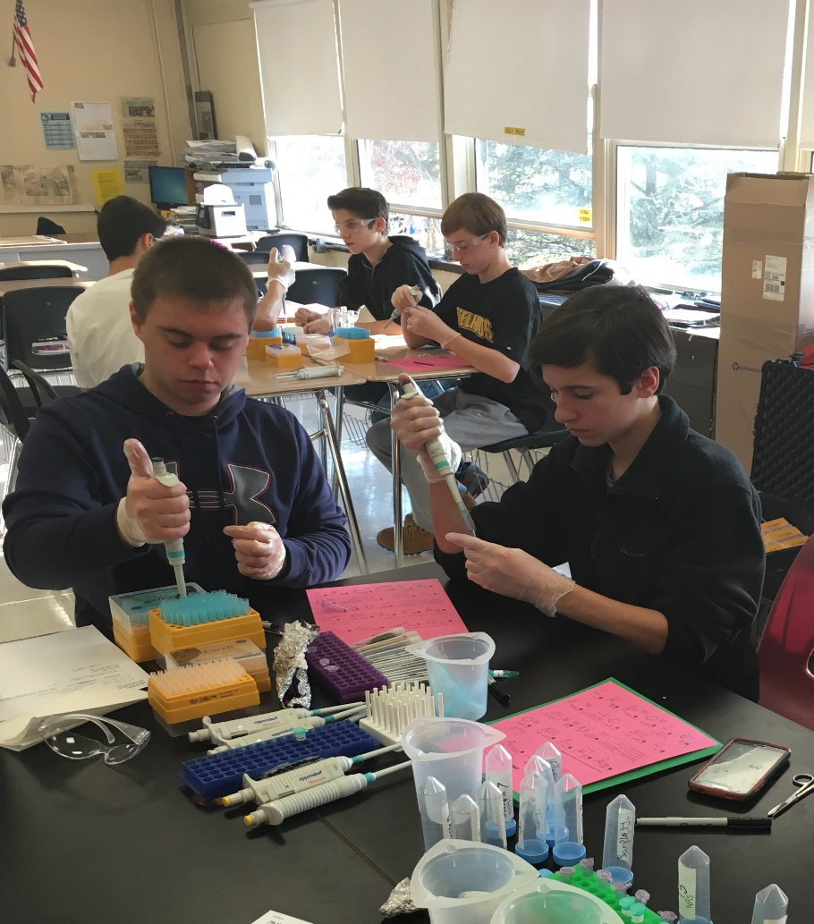
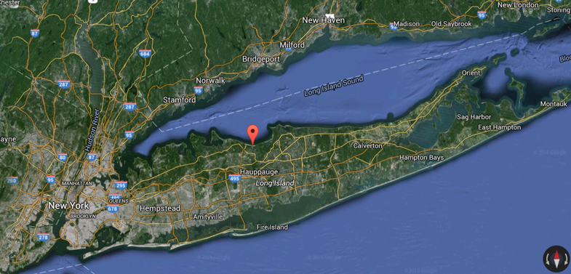
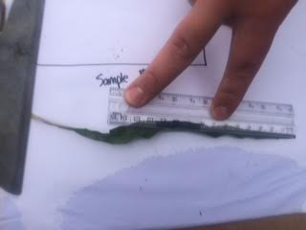
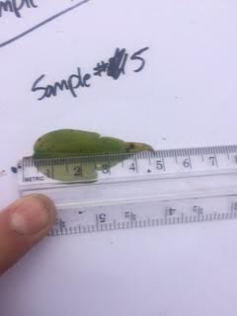
Comparing the Biodiversity of Freshwater and Saltwater Tidal Plants
Michael Hennig and Ryan McCarty
Abstract
Materials
Conclusions
Biodiversity is the variety of plants, animals, and other organisms found in an area. It is a necessary factor in every ecosystem and can be affected by many variables. In this project we studied the effect of salinity on the biodiversity of tidal plants located on the Nissequogue River in Smithtown, New York. We began our experiment by collecting plant samples and other abiotic data from three different locations along the river; a freshwater, a brackish, and a saltwater location. After collecting our samples, we used equipment from Cold Spring Harbor Laboratory to extract and sequence DNA from our samples. This allowed us to identify the species of plants we collected. Our hypothesis was that a change in salinity, from freshwater to saltwater, would result in different tidal plant species. The experimental data we collected supported our hypothesis by showing a difference in the tidal plant species from each location we collected from. The data we collected also helped us generate a reason that could account for the difference in biodiversity.
Salinity kit
Soil testing kits
pH test (water and soil)
Thermometer
Micropipettes
Hot water bath
Centrifuge
Rulers
Tweezers
Pestles
Gel Electrophoresis Apparatus
Buffer
Our hypothesis was that if there is a change from freshwater to saltwater, then the tidal plant species in each area will differ. The data collected from our experiment helped support our hypothesis. In our findings we saw that in the freshwater location, there was a greater amount of biodiversity and the plants were generally larger. On the other hand, we saw that in the saltwater location, the banks had less biodiversity and consisted with only Phragmites. One explanation for this is for the fact that the abundance of freshwater in the freshwater location allowed for a large variety of large plants to live in this area. However, only a thin layer of freshwater on the surface of the water was present at the saltwater location, which minimized the diversity of plant life that could live in this area. This minimized the competition in this area, allowing it to be overrun by Phragmites plants.
Background
Procedure
The Nissequogue River is an 8.3 mile river that is a New York State Park in Smithtown, NY.
Its source, Stump Pond in Caleb Smith State Park Preserve, is freshwater and it ends as saltwater, emptying into the Long Island Sound.
It contains the largest coastal wetlands in North Shore Long Island.
It is a tidal river, so the tides greatly affect the flow, level, and salinity of the river. The tides create a freshwater location located near the source, a saltwater location near its mouth, and a large area in the middle with brackish water that experiences varying salinity levels depending on the tide.
You can find tidal mudflats, both salt and freshwater marshes, and a wide variety of plants and animals.
Coastal plants are commonly found on the banks of the river and are crucial for maintaining the stability of the ecosystem. For example, they are the first organisms to inhabit the river’s banks, their roots stabilize the soil, and they provide shelter and protection for other organisms.
These coastal plants allow many organisms to live along the banks of the river, increasing biodiversity.
A greater amount of biodiversity increases the stability of the ecosystem by giving it a greater chance of surviving natural disasters.
We obtained permission from Belmont Lake State Park to take samples from the Nissequogue River.
We canoed down the Nissequogue River and stopped at three different locations with varying salinities to collect plant samples and other abiotic data.
We isolated and amplified DNA from our plant samples using equipment from Cold Spring Harbor Laboratory.
We performed gel electrophoresis to determine which DNA sequences could be sent away to Cold Spring Harbor Laboratory to be sequenced.
After receiving the sequences of our samples’ DNA, we compared the DNA sequence of our plant samples with the DNA sequences of species with known sequences on the online database, DNA Subway, to determine the species of our samples.
After determining the species of each of our samples, we compared and analyzed the data we collected to help show the difference in biodiversity between the tidal plants in the freshwater, brackish, and saltwater locations.
Future Research
Question
The detrimental effects of pollution on plant species living in the polluted areas.
The difference in competition along the banks of the Nissequogue River.
Does a change in water salinity affect the biodiversity of tidal plants living along the banks of the Nissequogue River?
Hypothesis
If there is a change from freshwater to saltwater, then the tidal plant species in each area will differ.
Objective
Comparing the biodiversity of freshwater and saltwater tidal plants
Salinities effect on biodiversity
Data
Sample # | Latitude/ Longitude | EL (ft.) | Water Salinity | Water pH | Water Temp. | Soil pH | Soil Temp | Soil K | Soil P | Soil N | Air Temp | Date Collected | Sample Name
2 | 40°51’36”N 73°12’34”W | 6ft | 3 | 6 | 56℉ | 6.5 | 56℉ | Medium | Low | Low | 60℉ | 11/1/2015 | Amaranthus tricolor
5 | 40°51’36”N 73°12’34”W | 6ft | 3 | 6 | 56℉ | 6.5 | 56℉ | Medium | Low | Low | 60℉ | 11/1/2015 | Clematis virginiana
6 | 40°51’50”N 73°12’ 2” W | 15ft | 10 | 6 | 56℉ | 6 | 56℉ | High | Low | Low | 60℉ | 11/1/2015 | Amaranthus hypochondriacus
7 | 40°51’50”N 73°12’ 2” W | 15ft | 10 | 6 | 56℉ | 6 | 56℉ | High | Low | Low | 60℉ | 11/1/2015 | Grindelia squarrosa
13 | 40°52’8’’N 73°11’44’’W | 4ft | 12 | 7 | 56℉ | 6 | 56℉ | High | Low | Low | 60℉ | 11/1/2015 | Phragmites australis

