Slide 1
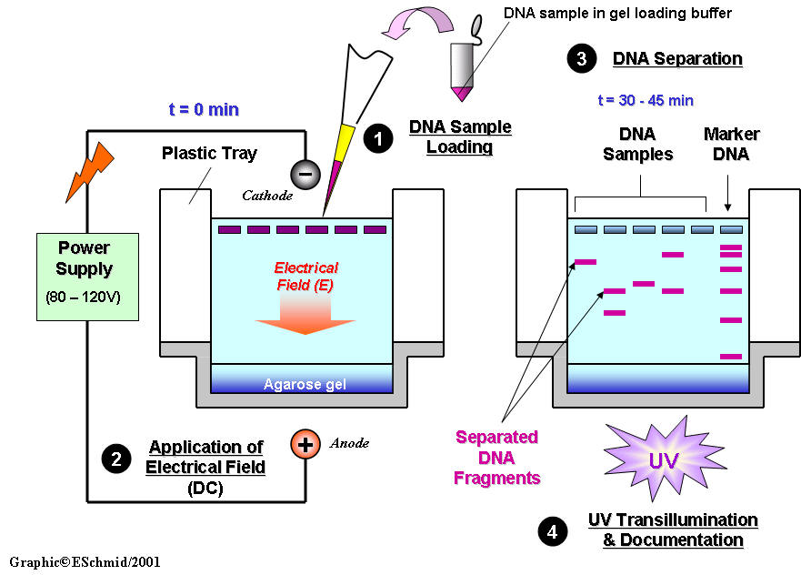
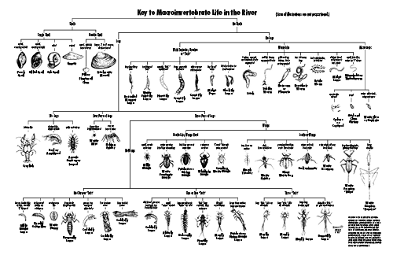
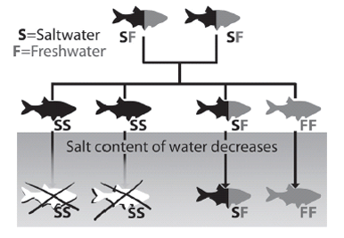
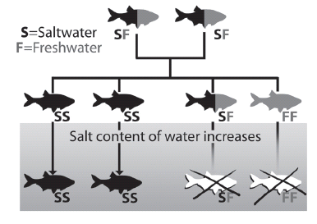
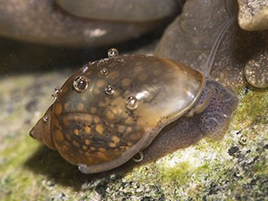
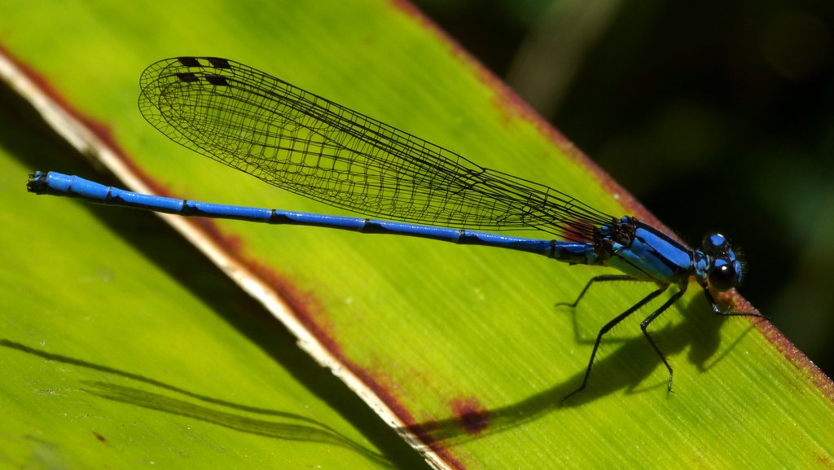
The Biodiversity of Invertebrates in Saltwater and Freshwater Wetlands
By: Nina Inayan, Faith Francioso and Jaclyn Corbin
Abstract
Materials and Methods
Conclusions
Samples were collected in a saltwater and freshwater area at Caumsett State Park during the fall
A total of 19 samples were collected
Collaborated with Cold Spring Harbor Laboratory by participating in their DNA Barcoding Program
11 out of our 19 samples were eligible to be sent to the laboratory and have their DNA identified
DNA amplified through PCR in order to be studied
Gel electrophoresis was used to amplify the successful samples
The DNA sequences were blasted forward and reverse
Species of the samples was then found out
No crossover of species was apparent
Based on research we can conclude that there is a distinct difference between invertebrates inhabiting freshwater environments versus saltwater environments
Clearly showed no similar organisms found in both environments
Insects and insect larvae found at the fresh water site
Crustaceans found at the saltwater site
Salinity plays a role in what organisms are present
Materials:
Sampling equipment
Nets
Quadrant
Water tests
Soil tests
DNA Isolation Kit
Centrifuge
PCR
Gel electrophoresis
Methods :
Samples were collected from both sites using the proper equipment needed
Abiotic factors were recorder from each site
Samples were preserved in ethyl alcohol until DNA from each organism needed to be isolated
DNA was isolated and primer specific to invertebrates was added
Samples were placed in various hot water baths and put in a centrifuge
PCR and gel electrophoresis used to amplify DNA
Samples within 700 base pairs were eligible to be blasted through DNA Subway to identify the species
Future Directions
Hypothesis
We plan to try and determine whether there is a crossover of organisms that can survive in both salt and freshwater.
Determine the differences in characteristics of the organisms that inhabit saltwater, and those that inhabit freshwater
What allows these organisms to tolerate high or low levels of salinity ?
Can organisms survive changes in their environments level of salinity
How does salinity affect the invertebrates present in wetland environments?
Species Found at Freshwater Site:
proasellus sp
liceolus hardeni
coenagrionidae sp
coenagrionidae larvae
Species Found at Saltwater Site:
physella acuta
mytilus trossulus
geukensia demissa
urosalpinx cinerea
Most of the species found at the saltwater location were enclosed in a hard shell for protection
From the environment and predators
Organisms found in freshwater were found buried in the mud or on the surface of the water
Their difference in appearance shows what unique structures and abilities the different invertebrates
Need to survive in their environment
Results
Background
Abiotic Factors:
Freshwater:
Date Collected: 12/2/15
Time Collected: 10:48 am
Location: Caumsett State Park
Salinity: 0
Water Temperature: 11 degrees Celsius
Air Temperature: 12 degrees Celsius
Latitude: 40 57’55”N
Longitude:73 15’58”W
Soil pH: 5
Water pH: 7
Dissolved Oxygen: 8 ppm
Water Nitrate Level: 5 ppm
Water Phosphate: 1 ppm
Soil Nitrogen: low
Soil Phosphorous: low
Saltwater:
Date Collected: 12/2/15
Time Collected: 9:54 am
Location: Caumsett State Park
Salinity: 23
Water Temperature: 10 degrees Celsius
Air Temperature: 11 degrees Celsius
Latitude: 40 56’17”N
Longitude: 73 27’31”W
Soil pH: 7
Water pH: 7
Dissolved Oxygen: 4 ppm
Water Nitrate Level: 5 ppm
Water Phosphate: 1 ppm
Soil Nitrogen: low
Soil Phosphorous: low
Questions :
“Will the same invertebrates be found in freshwater as those in saltwater? If not, what types of invertebrates will be found in each environment?”
“What characteristics allow them to survive in that level of salinity?”
Prior Research
Researched environments with the necessary conditions
Two areas need to be strictly salt or freshwater, not a mix
The freshwater area would contain more stagnant water than the saltwater location
Expected to find insects at the freshwater site
Expected to find crustaceans at the saltwater site
Predicted that there would be little to no crossover between the species found at each site
Likely that the invertebrates found at the freshwater site would be located in the mud at the floor of the lake
The invertebrates found at the saltwater site would be found on or underneath rocks at the shore to avoid being swept away by the current.

