Slide 1
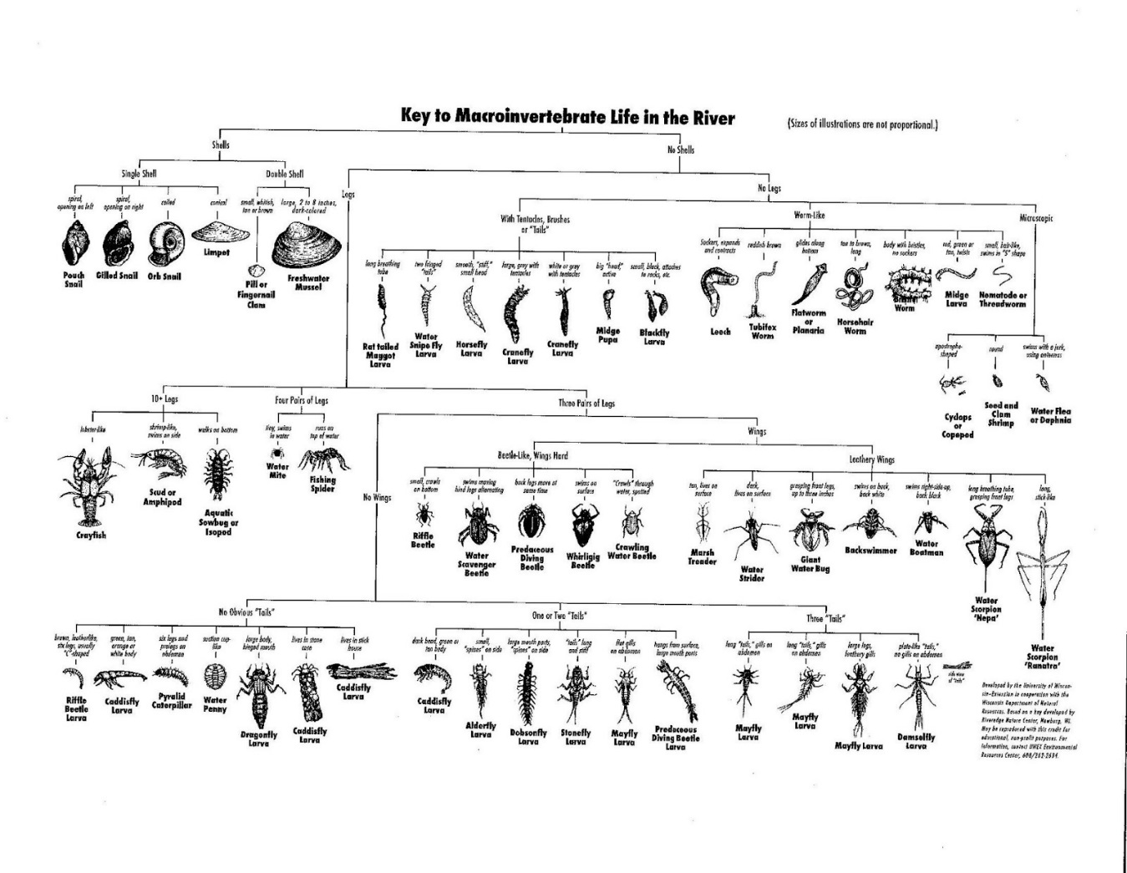
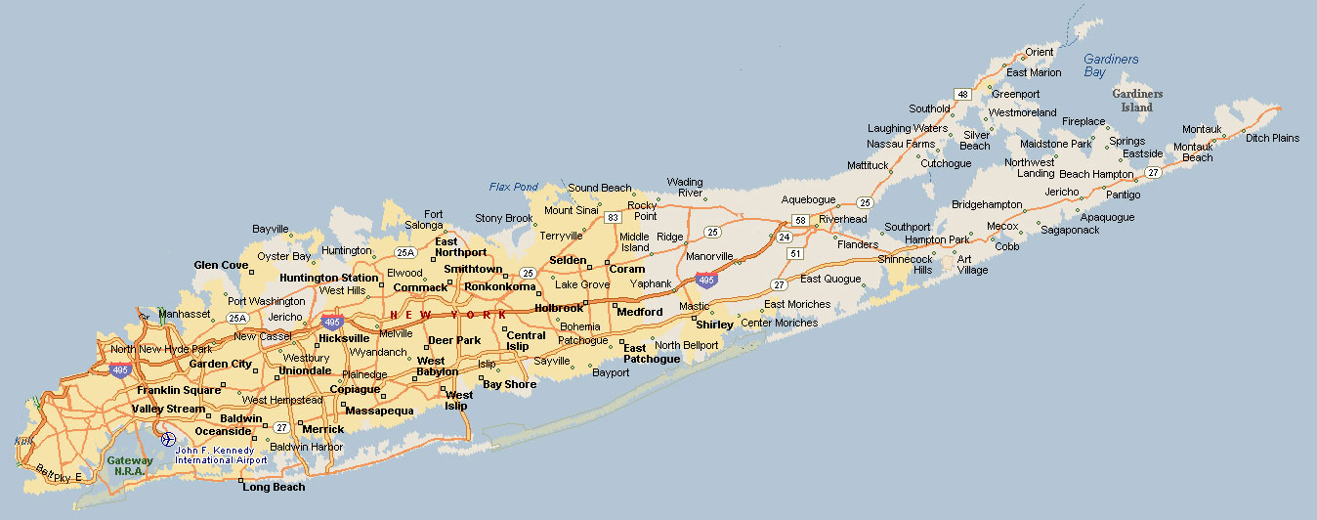
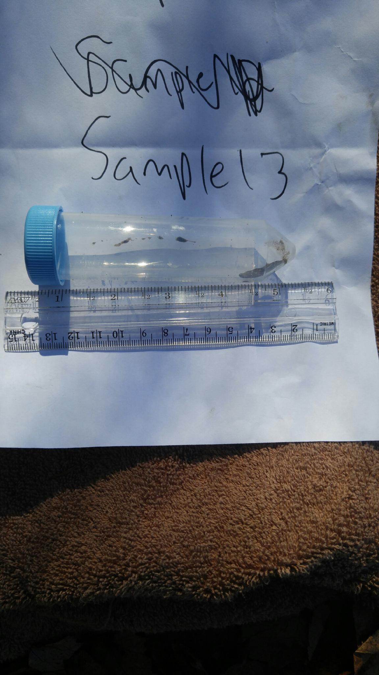
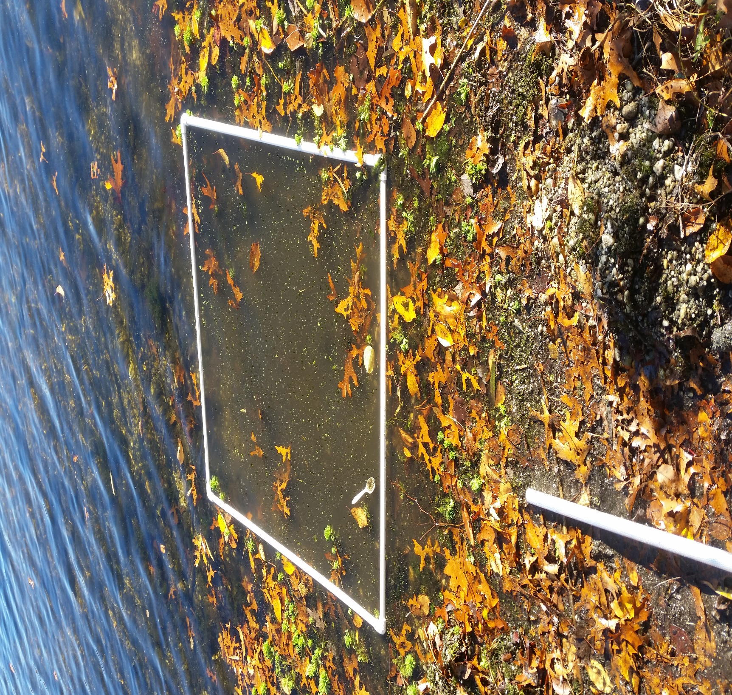
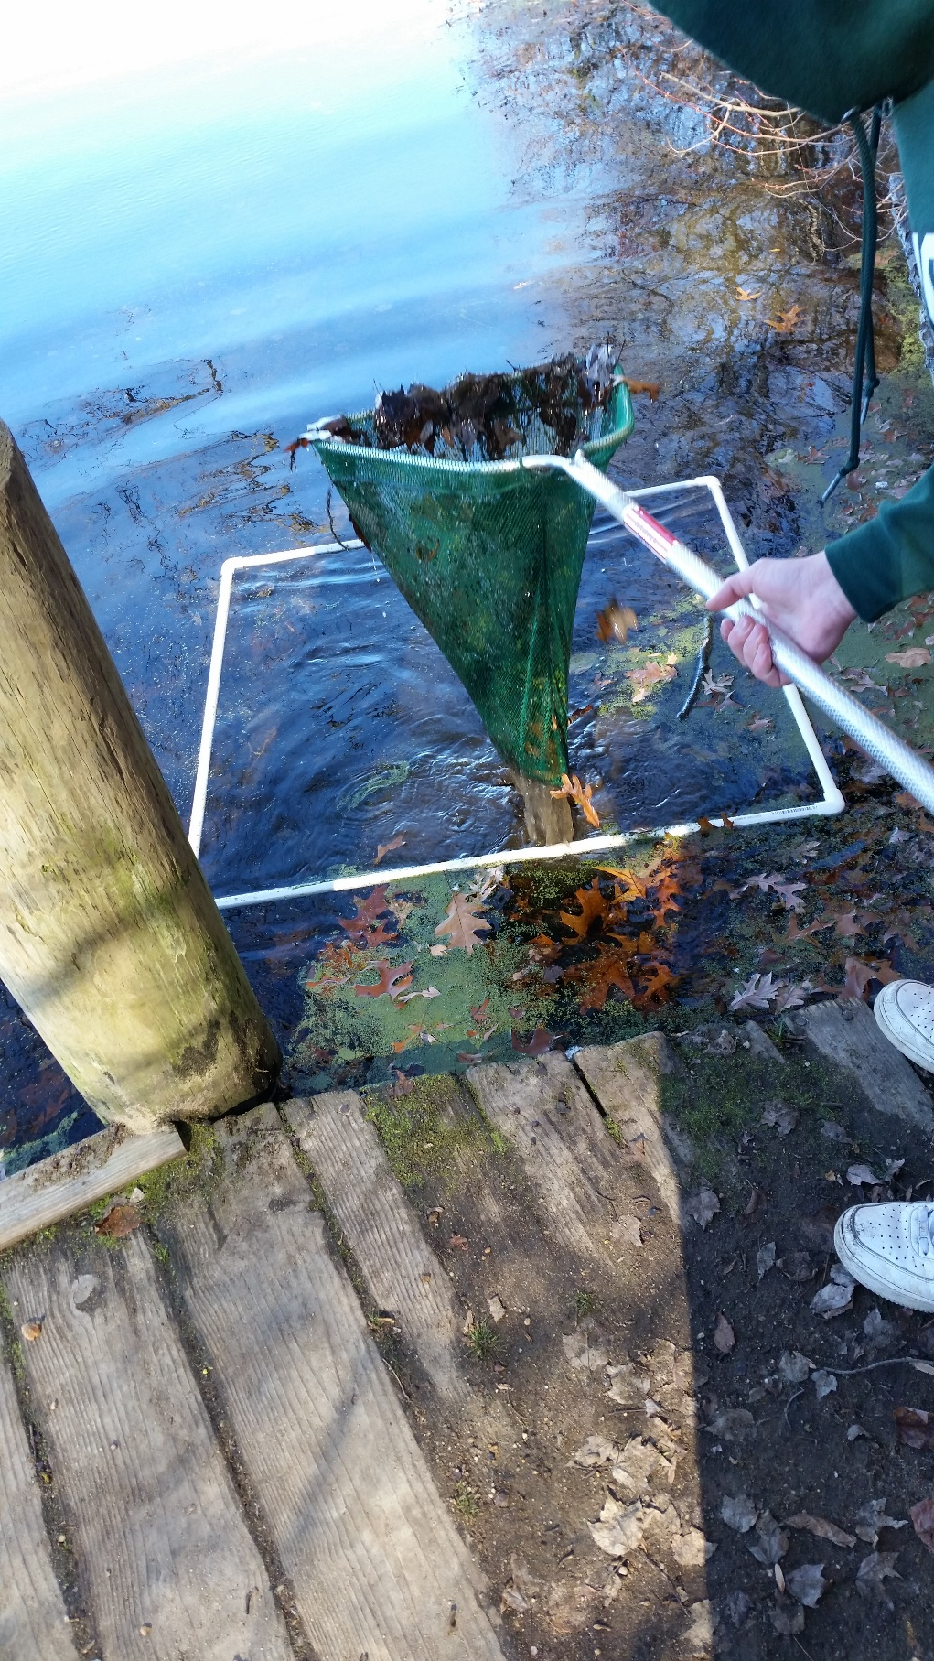
Comparing the Biodiversities of the North and
South Shores of Long Island
Benjamin Schablin
Wantagh High School
Introduction
Procedure
Conclusion
The different species in various areas have a great impact on the environmental conditions of that area, and Long Island is a very diverse place. Because of this observation, I decided to try and see how diverse the two shores of Long Island are, in terms of their aquatic environments. I collected samples from one location on each shore of Long Island, Massapequa Preserve on the South Shore and Blydenburgh Park on the North Shore. At these locations, I collected samples of Invertebrates that I later identified using DNA Barcoding through Cold Spring Harbor Laboratories and by Taxonomy Key.
On the morning on November 8th, 2015, I went out to the Massapequa Preserve and Blydenburgh Park to collect samples. At both locations I measured the abiotic factors of Water pH, Soil, pH, Air and Water Temperature, Dissolved Oxygen, Water Nitrates, Water Phosphates, Soil Nitrates, Soil Phosphates, Soil Potassium, Salinity, and Weather Conditions. I used pH strips to test the pH of the water. I used soil pH tablets, and putting them in water with the soil, to determine soil pH. I used a thermometer to measure water and air temperature. I used dissolved oxygen testing tablets to determine the water’s dissolved oxygen content. I used testing tablets for Nitrate and Phosphate levels in the water. I used testing tablets to determine Nitrate, Phosphate, and Potassium levels in the soil. I used a hydrometer to measure water salinity. I recorded the weather conditions I observed as well as checking the forecast reports from the National Weather Service.
To collect the samples, I scooped dirt from the bottom of the lake with a net. I dug through the dirt until I found a specimen. I then took pictures, collected, and recorded the specimen. I did this for approximately an hour at each location and found 8 usable samples at Massapequa Preserve and 4 usable samples at Blydenburgh Park. I stored the samples in large plastic tubes with ethyl alcohol and later removed the ethyl alcohol and froze them.
I later Isolated and Extracted the DNA from each sample along with the help of my science research teacher and our Mentor from Cold Spring Harbor. Once extracted, I used the DNA to run gel electrophoresis. I then sent pictures of the Gel banding to Brookhaven Labs which then ran the barcoding sequence for those samples that were approved to be run. I then compared the samples to taxonomy keys to identify the remaining samples
After conducting my experiment I do not feel that I have enough evidence to support my claim that there is a great biodiversity between the North and South shores of Long Island. My sample sizes were too small, and from what I did collect the majority of samples in both locations were the same with each other, and the few discrepancies could have been caused purely by the small sample sizes. Also, the abiotic factors were very similar to each other and there are not many conditions that would be able to tell the few discrepancies saw.
Objectives
Ideas for Future Research
Question
Do the geographical differences of the North and South Shores of Long Island have any effect on the biodiversity of the two areas?
Variables
Independent Variables: Water pH, Soil pH, Air Temperature, Water Temperature, Dissolved Oxygen, Water Nitrates, Water Phosphates, Soil Nitrates, Soil Phosphates, Soil Potassium, Water Salinity, Weather
Dependent Variables: Location, Samples, Biodiversity
Hypothesis
If there is a large difference in the abiotic factors in the 2 regions then there will be a difference in the biodiversity.
Background Research
Long Island’s different regions have different geographic features, which is caused by a variety of past occurrences, with the formation of Long Island being caused by the Wisconsin Glaciation period. Two glacial moraines formed the northern shore and mid-section of Long Island, the Harbor Hill and Ronkonkoma moraines, this area is commonly known as the “North Shore”. The areas of Long Island south of these moraines, generally the areas south of Interstate 495, is the outwash plain of the glacier. This area is commonly known as the “South Shore”.
The glacial moraines and the outwash plain have resulted in different topographies along the North and South shores of Long Island. The moraines cause the sediments the glacier carries to “drop” in place. This causes the sediment left by the moraines to be unsorted, unlayered, and therefore rocky. The sediment in the outwash plain was carried outward from the end moraine by running water, this causes the sediment to be sorted and layered. The differences in these deposits is what has caused the contrasting topography on the different shores, with rocky beaches and larger glacial deposits on the North Shore, to smaller, grainier deposits on the South Shore.
Because of this difference between the two shores, the way of life of not only various types of wildlife and plants, but also humans, vary between the individuals on the North and South shores. Because of this we have chosen two parks on Long Island. The Massapequa Preserve, which is located on the South Shore of Long Island in Massapequa, and Blydenburgh Park, which is located on the North Shore of Long Island in Smithtown. Both parks have aquatic environments that house various invertebrates along the shores of their bodies of water.
In the future, I would like to expand on my project by collecting more samples from each location. I would like to go out and take more samples in more warm weather, possibly in the spring or summer, when the environments are at their peak of organism population sizes and I would get more accurate results as to which organisms live in the environment.
I would also like to look more into the effect on Soil Potassium on these environments, as it was the only major difference I saw between the two locations. After online research I discovered that it has a major influence on the life of plants, I would like to see if the plant species in the different areas are different and if that could have an effect on the invertebrates living in the two locations.
Results
References
Massapequa Preserve - South Shore
NRS - 001 - Isopod
NRS – 002 - Helobdella lineata
NRS - 003 - Corbicula sp.
NRS - 005 - Corbicula sp.
NRS – 006 - Helobdella lineata
NRS – 007 - Fingernail Clam
NRS – 008 - Helobdella lineata
Blydenburgh Park - North Shore
NRS – 009 - Threadworm
NRS – 010 - Helobdella Lineata
NRS – 011 - Helobdella Lineata
NRS – 012 - Planaria
I identified the following samples at the two locations. As can be seen, there are similarities and differences between the two locations, but the sample sizes in both locations are different sizes, and those sizes are so small that it does not accurately represent the complete biodiversity of these two locations. The abiotic factors were also similar and I do not believe that these abiotic factors alone could contribute to biodiversity between these two areas because of their similarity
“Blydenburgh County Park.” Suffolk County Government. N.p., n.d. Web. 25 June 2015. <http://www.suffolkcountyny.gov/departments/parks/parks/blydenburghcountypark.aspx>.
“Glaciation.” CLIMAP. N.p., n.d. Web. 25 June 2015. <http://climap.net/glaciation>.
“Peter J. Schmitt Massapequa Preserve.” Nassau County, Long Island New York. N.p., n.d. Web. 25 June 2015. <http://www.nassaucountyny.gov/2905/Peter-J-Schmitt-Massapequa-Preserve>.
Using DNA Barcodes to Identify and Classify Living Things: Footlocker Protocol, Planning and Preparation, Answers to Questions. N.p.: Cold Spring Harbor Laboratory DNA Learning Center, 2015. Print.
Using DNA Barcodes to Identify and Classify Living Things: Footlocker Protocol. N.p.: Cold Spring Harbor Laboratory DNA Learning Center, 2015. Print
Location: Blydenburgh Park, Smithtown
Air Temperature: 54'F, 12'C
Water Temperature: 56'F, 13'C
Soil Nitrates: Low
Soil Potassium: High
Soil Phosphates: Low
Soil pH: 7
Water pH: 4
Dissolved O2: 8ppm
Water Salinity: 6ppt
Water Nitrates: 5ppm
Water Phosphates: 4ppm
Weather: Cool, Low Humidity, Gusty, Sunny (collection site under shady trees).
Location: Massapequa Preserve
Water pH: 5
Soil pH: 7
Air Temperature: 62'F, 16.6'C
Water Temperature: 60'F, 15.5'C
Dissolved O2: 4ppm
Water Nitrates: 5ppm
Water Phosphates: 0ppm
Soil Nitrates: Low
Soil Phosphates: Low
Soil Potassium: Low
Salinity: 0ppt
Weather: Sunny, Area is in direct sunlight, cool. windy,

