Slide 1
Diversity of Ants, Beetles and Bees of Kissena Park, Gramercy Park, NY and Central Park, NY
Student Team Members: Sarah Aninye, Zheng Chen, Ian Fernandez, and Ridwan Kouanda
Mentor: Alfred Lwin
School: Manhattan Comprehensive Night and Day High School

Slide 2
Our research focus...

Slide 3
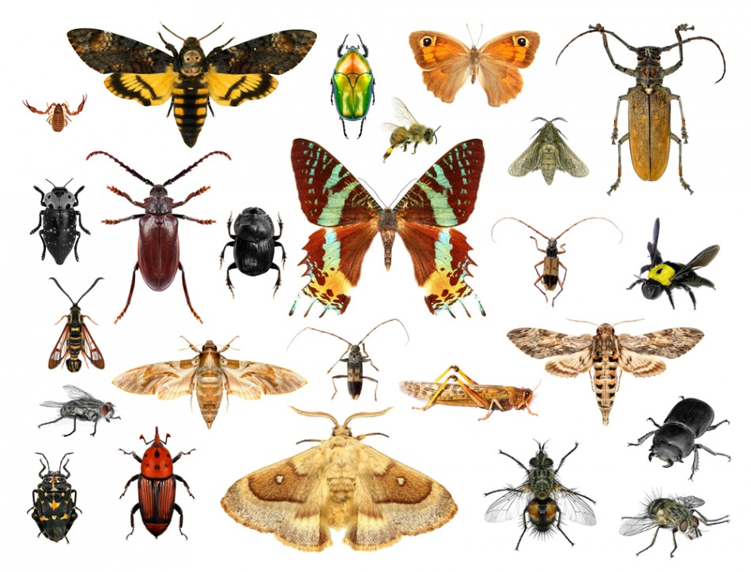
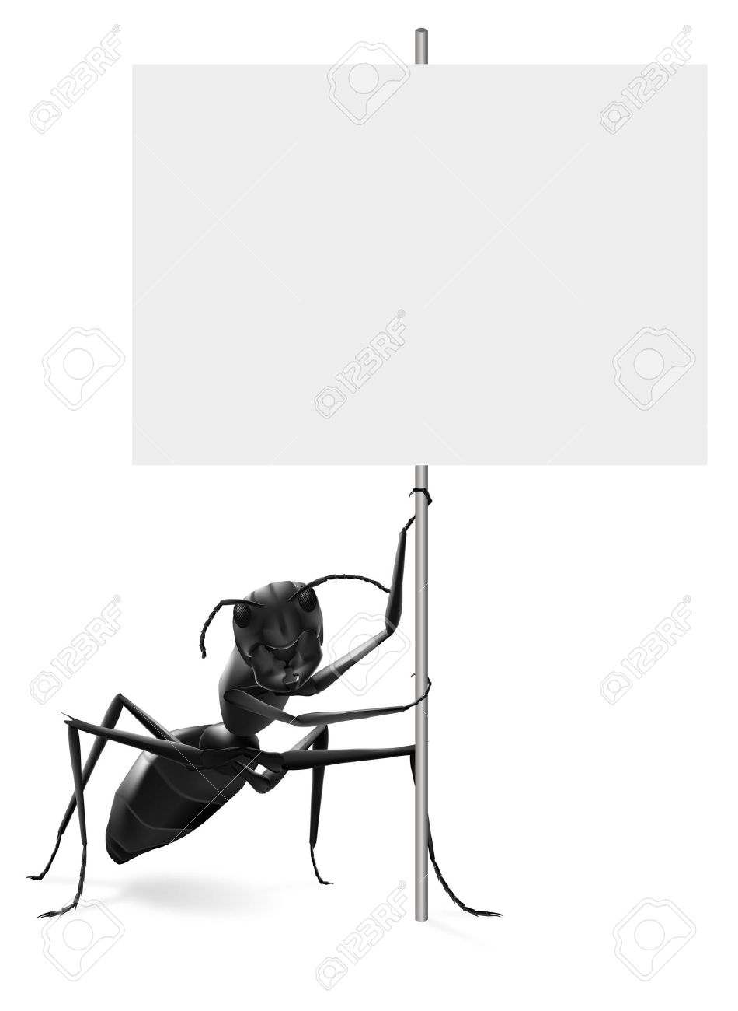
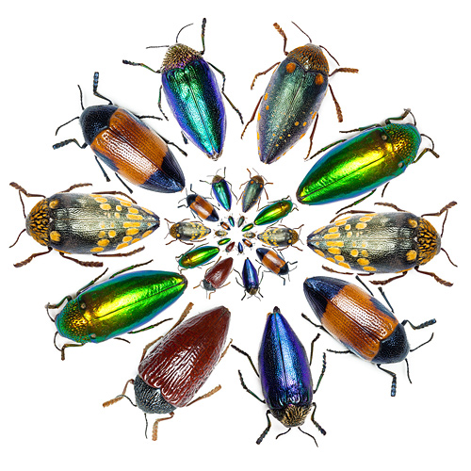
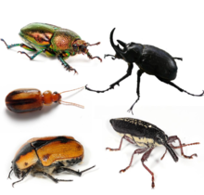
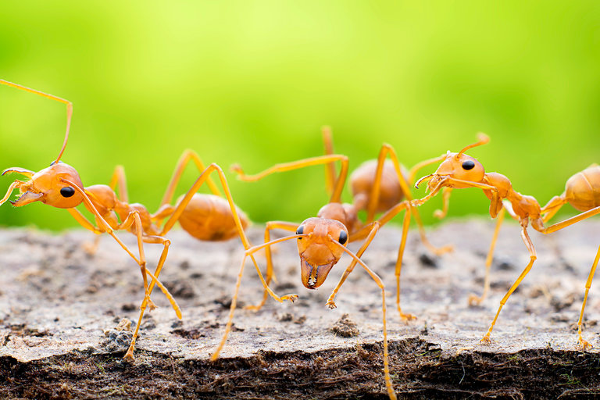
Ants!
Beetles!

Slide 4
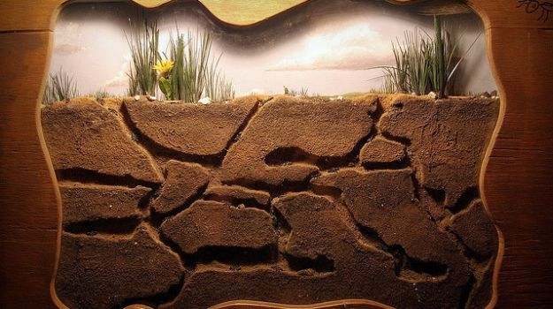
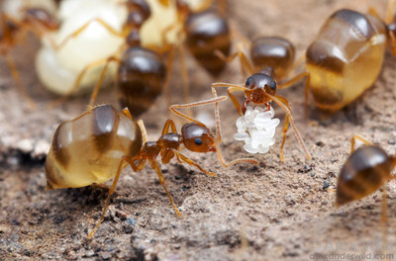
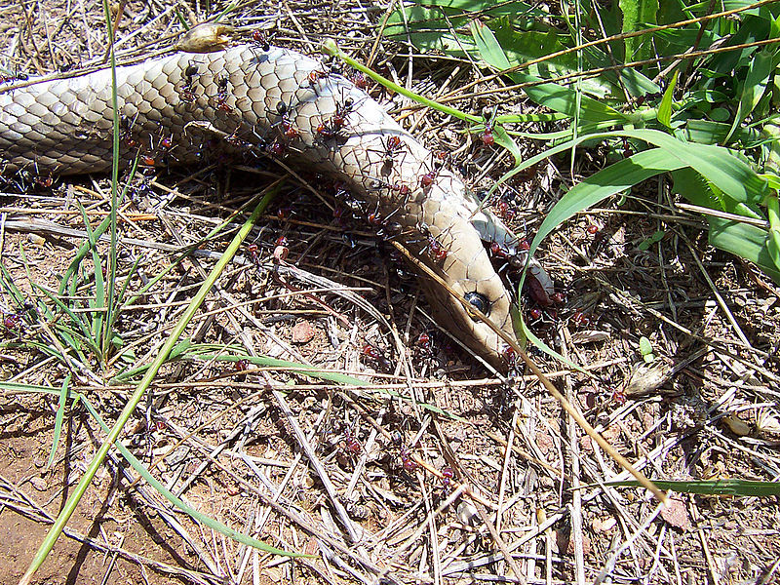
Why are we interested in ants and beetles of NYC parks?
Prenolepis imparis

Slide 5
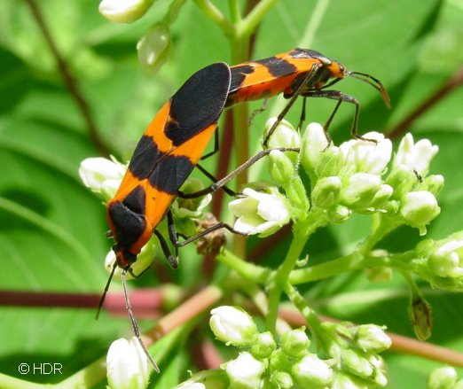
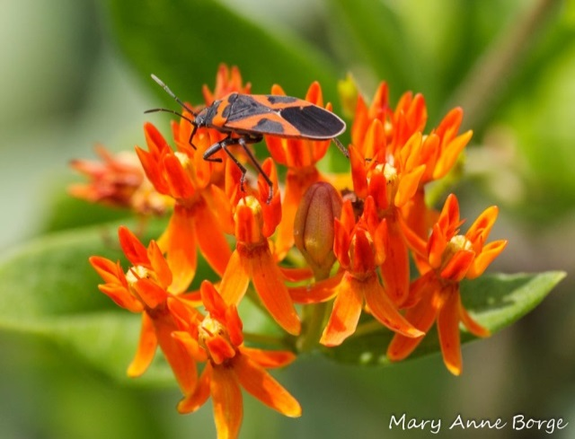
Lygaeus turcicus

Slide 6
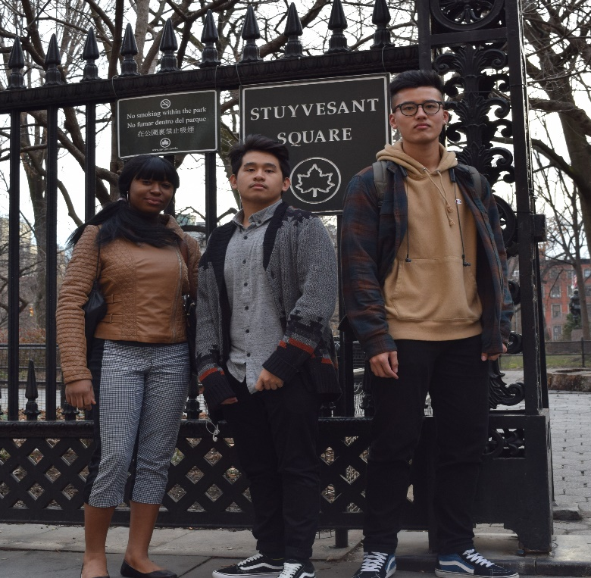
Gramercy Park (40.7339° N, 73.9841° W)
Kissena Park (40.7461° N, 73.8076° W)
Central Park (40.7829° N, 73.9654° W)

Slide 7
Abstract:
Insects are one of the most abundant and diverse groups of invertebrates in the world and can be found anywhere in the world. It is estimated that so far 900,000 different species of insects have been identified. However majority of insects are still waiting to be discovered in the US and all over the world. Among the insects, ants are ubiquitous, and more than 10, 000 different species have been identified all over the world. As regards to beetles, there are 25, 000 different species of beetles known in North America. Our research focused on identifying diversity of ants, bees, and beetles in NYC parks.

Slide 8
Introduction:
According to the Insect Identification database, “there are a total of 336 bugs and other insects from the State of New York.” However, we believe that New York can host more than 336 different types of insects because New York City is a city of diversity where people from all over the world come to stay and some of the insect species may have come with them travelling in and out of New York.
Research Questions: Are there many unknown species of ants, beetles, and bees that have not been identified yet?
Are there any invasive or introduced species of ants and beetles in NYC parks?
Hypothesis: We hypothesized that aside from the native insect species, some of these invertebrates could have been introduced to New York State accidentally or intentionally.

Slide 9
Materials and Methods:
In order to avoid insect hibernation time, our team started collecting in October of 2016, samples of ants and beetles from Kissena Park in Queens and Gramercy Park in Manhattan even before submitting our proposal. On our first trip, we were able to collect 8 ants samples from Kissena Park in Queens, and on our 2nd trip, we collected 7 beetles from Gramercy Park, Manhattan, NY. In collecting these samples, we could not find any ants above ground, therefore we dug ant holes, and collected and put them in Ziploc bags, documented the collection sites and samples, photographed them, and then carefully stored the fragile samples, in 70% alcohol with proper labelling. Later on, we took this samples to Harlem DNA Learning Lab for DNA extraction. In barcoding the DNA of the ant and beetle samples, we used the DNA barcoding protocol provided by the DNA Learning Center. Then we amplified the DNA samples using universal invertebrate’s primers and new DMI primers. Then we analyzed the PCR products by running Gel electrophoresis. After the analysis, we sent the samples to the Sequencing Department. When we had the sequence results, we uploaded them in the DNA Subway site, wherein we trimmed, pairbuilt, and used BLAST to see which sequences matched with which specie in the database, then analyzed the BLAST results to find out if the results supported our hypothesis or not.

Slide 10
Our Ant and Beetle Samples

Slide 11
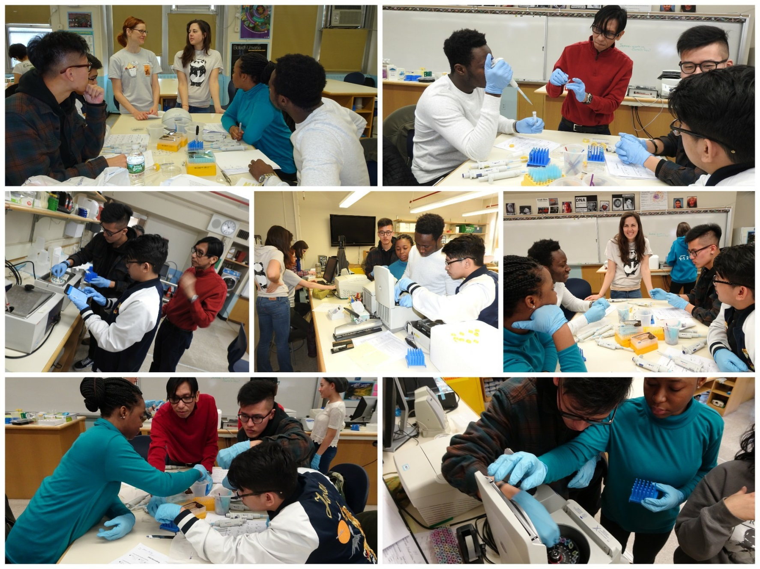
DNA EXTRACTION WITH QIAGEN KITS...

Slide 12
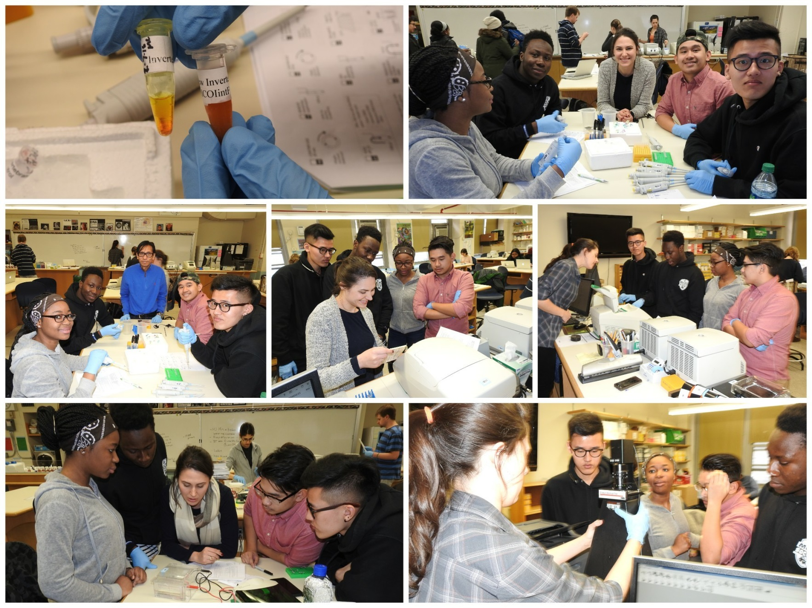
6
PCR,
AND
GEL ELECTRO-PHORESIS...

Slide 13
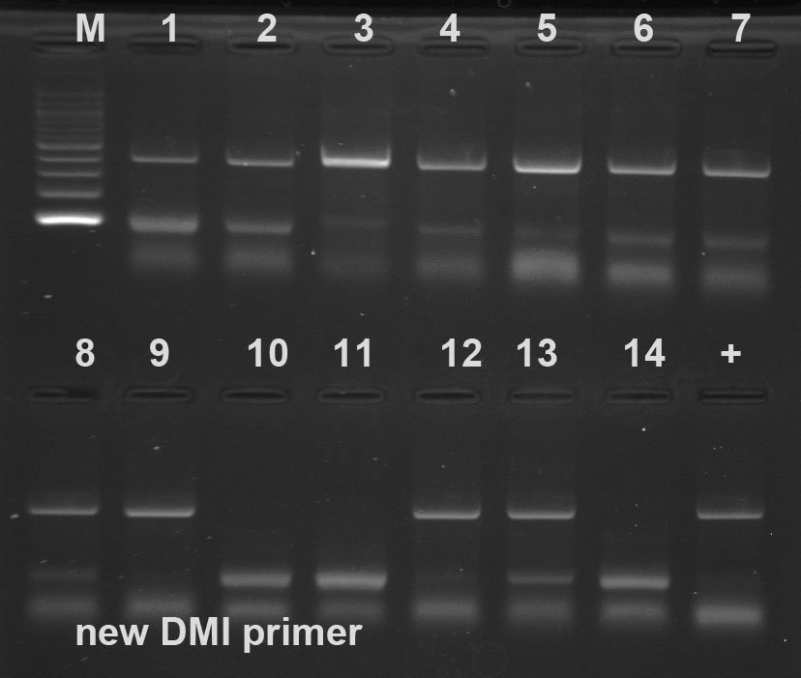
Gel Electrophoresis result from PCR products
Universal Invertebrate Primers
New DMI Primers

Slide 14
Results:
Our research results showed that all of our ant samples belong to Prenolepis imparis (common name: Winter Ant or False Honey Ant) and that some of the beetle samples belong to one specie called Lygaeus turcicus (common name: False Milkweed Bug).

Slide 15
SEQUENCE VIEWER
SEQUENCE TRIMMER

Slide 16
PAIR BUILDER
ALIGNMENT VIEWER ( MUSCLE)

Slide 17
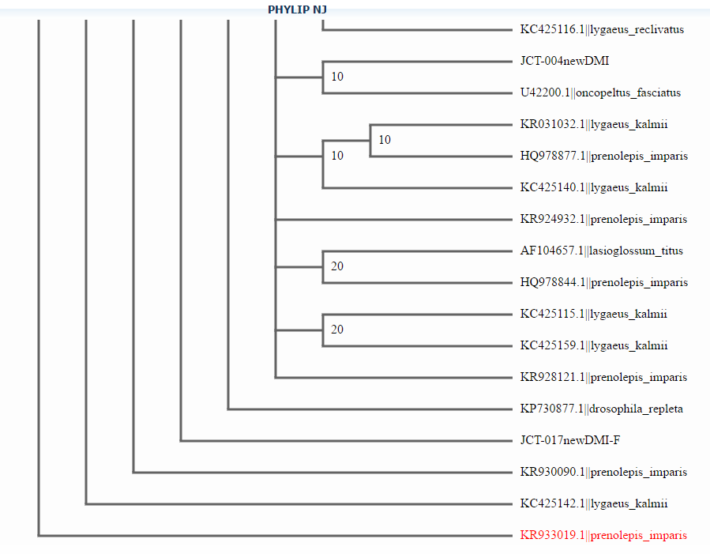
PHYLIP NJ
PHYLIP ML

Slide 18
Discussion:
Our analysis of the result of the gel run with universal invertebrate’s primer showed good DNA banding patterns for all samples except for sample No. 3, 6, 9, 13, 14, and 15 while the gel results of the new primer PCR products also indicated good DNA banding pattern for all samples except for sample No. 10, 11, 14, and 15.
The reason we did not get the results for those samples was mainly because of errors in our DNA isolation and partly because of the type of DNA extraction kit.
Our research result did not support nor refute our hypothesis that there are diversity of ants and beetles in New York City parks, and that there may be unknown and introduced species because the results were inconclusive and sample size was too small. Since we had time and resource constraints for our barcoding project, we could not extract as many samples as we wanted to determine the diversity of ants and beetle samples.
We recommend that further research on ants and beetles in wider scale be conducted in the future. Nevertheless, it was a great opportunity for us to participate in this NYC Urban Barcode Project and we have gained immense knowledge on conducting a research project while working with scientists from Urban Barcode Project. We hope our research result will at least contribute a small scale on ants and beetles specie to the NYC insect database.

Slide 19
Acknowledgements:
First of all, our Ants and Beetles Team would like to extend our thanks to Cold Spring Harbor Laboratory, Harlem DNA Learning Lab, and New York Academy of Medicine to give us the oppurtunity to participate in the project.
We also like to express heartfelt thanks to Dr. Christine Merizzi, Dr. Melissa Lee, Dr. Alison Cucco, Dr. Janet, and the rest of the UBP team for all their help and advice during during our DNA barcode project.
We too are also grateful to our principal, Michael Toise, Asst. principal (Science) Mark Testa and MCNDHS staff, Ms. Margaret Aylward, and CDI staffs for their generous support.
We are greatly indebted to our science teacher and mentor Alfred A. Lwin for his leadership, guidance, support and encouragement during DNA project.

Slide 20
References:
Smithsonian. Bug Information. Numbers of Insects (Species and Individuals) [Internet]. Smithsonian website. [accessed on 2016 Oct.19] . Available from:https://www.si.edu/Encyclopedia_SI/nmnh/buginfo/bugnos.htm
National Geographic Society, 2015-2016. Ants (Formicidae). [Internet]. National Geographic Society website. [accessed 2016 Nov 9].Available from: http://animals.nationalgeographic.com/animals/bugs/ant/
InsectIdentification.org, 2015-16. Bugs and Other Insects from the State of New York. [Internet]. InsectIdentification.org website. [accessed 2016 Nov 3].Available from http://www.insectidentification.org/insects-by-state.asp?thisState=New%20York
Food and Agriculture Organization [Date unknown]. Biodiversity for a world without hunger: Pollinators. [Internet] Food and Agriculture Organization of the United Nations website. [accessed 2016 Oct 26]. Available from: http://www.fao.org/biodiversity/components/pollinators/en/
InsectIdentification.org, 2015-2016. Beetles of New York. [Internet]. InsectIdentification.org website. [accessed 2016 Nov 18].Available from: http://www.insectidentification.org/insects-by-type-and-region.asp?thisState=New%20York&thisType=Beetle
Savage, Amy, Dunn, Rob, and Shipman, Matt, 2014. Inhabit(ants) of New York City: High Diversity Underfoot in Urban Environment. [Internet]. NC State University website. [accessed 2016 Nov 16].Available from: https://news.ncsu.edu/2014/11/savage-nyc-diversity/
InsectIdentification.org, 2015-2016. Beetles of New York. [Internet]. InsectIdentification.org website. [accessed 2016 Nov 18].Available from: http://www.insectidentification.org/insects-by-type-and-region.asp?thisState=New%20York&thisType=Beetle
Spice, Eleanor Rice, 2014. Dr. Eleanors Book of Ants of New York. [Internet].Yourwildlife.org website. [accessed 2016 Nov 3].Available from http://www.yourwildlife.org/wp-content/uploads/2014/02/Ants_of_NYC.pdf
Fabricius 1803. Bug guide: Species Lygaeus turcicus - False Milkweed Bug. [Internet]. bugguide.net website. [accessed 2016 Nov 3]. Available from: http://bugguide.net/node/view/102855

Slide 21
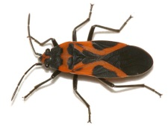
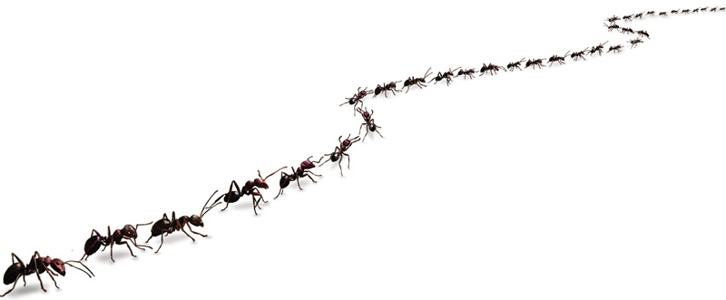
Zheng Chen, Mr. Lwin, Ridwan Kouanda, Sarah Aninye, and Ian Fernandez Insect Diversity Team Manhattan Comprehensive Night and Day High School

