Slide 1
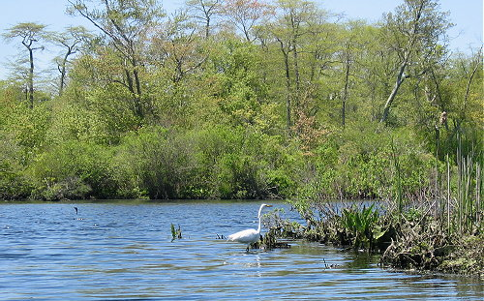
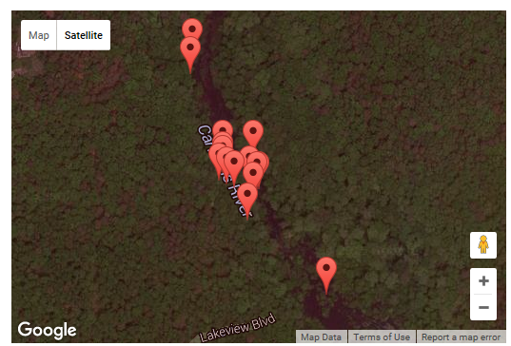
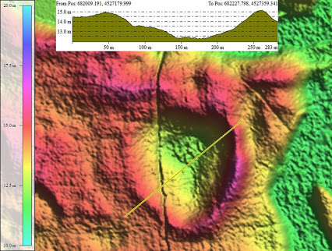
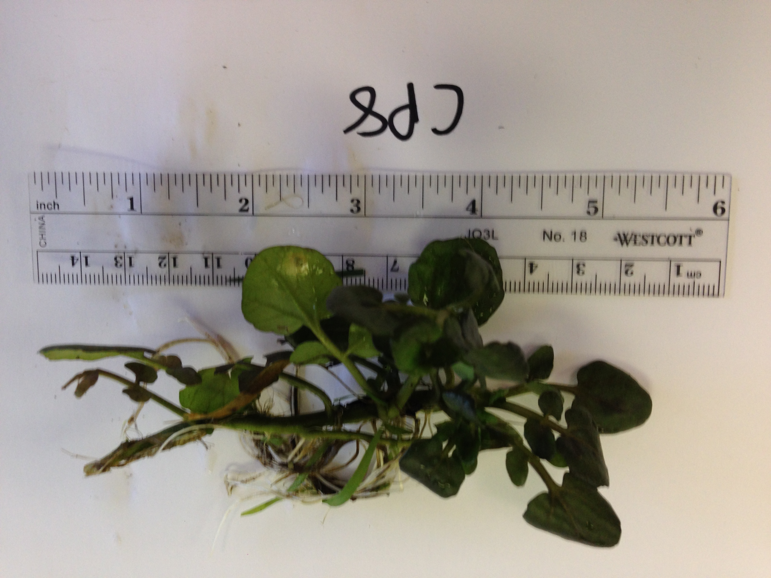
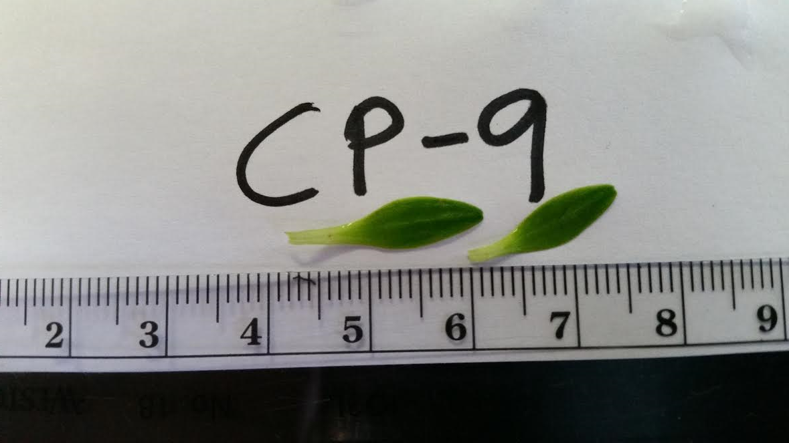
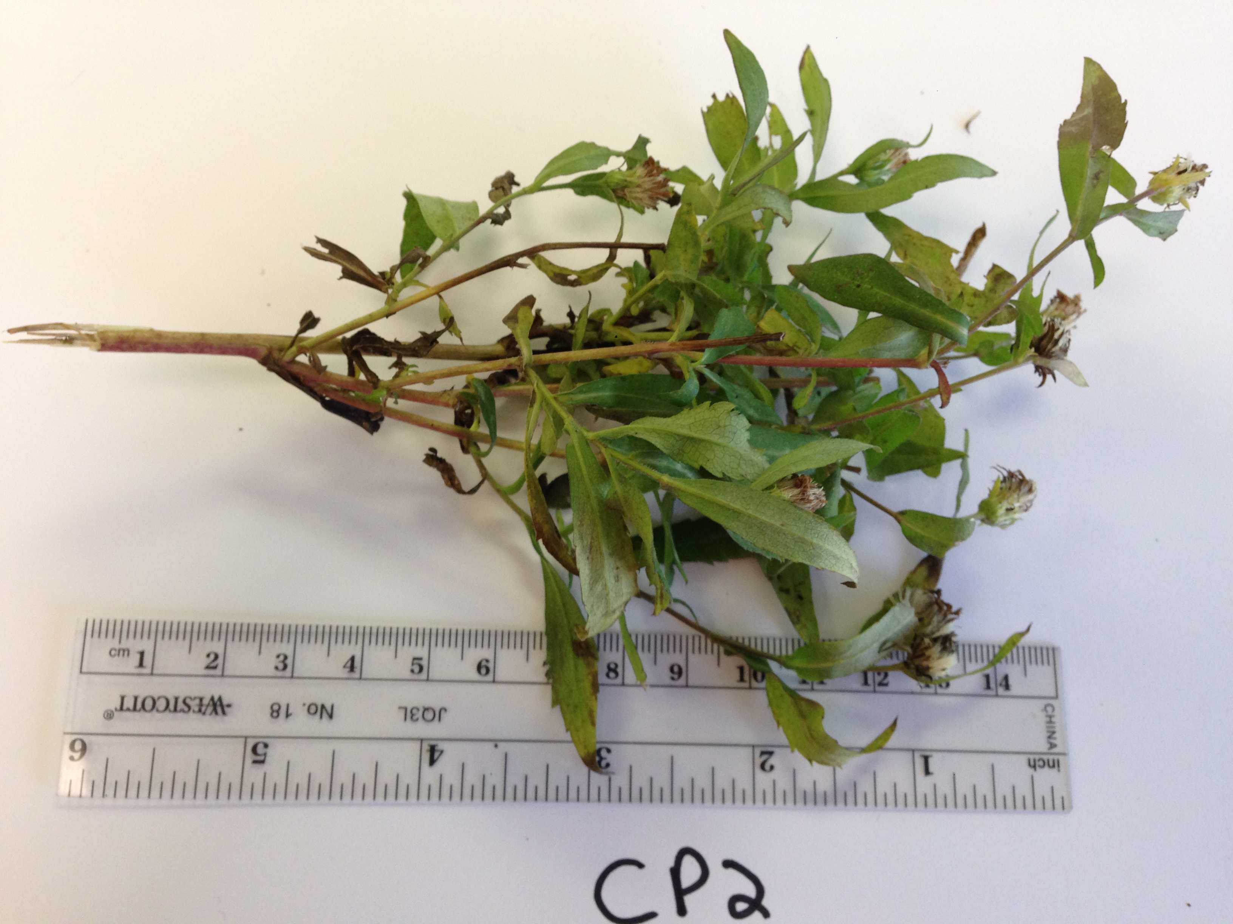
Carmans River DNA Barcodes: Correlation to Species Commonly Found in Carolina Bays Aquatic Microhabitats
Authors: Emily Burrage, Samantha DeQuarto, Robert Peterson, Amanda Ress-Liere
Mentor: Lucinda Hemmick
Longwood High School
Abstract
Longwood High School students have been involved for many years in a number of projects involving the natural history and biodiversity of the Carmans River near our school. We also have research interests in the geological history and environment of local Carolina bays, shallow depressions now believed to be secondary impact craters from a major strike near Quebec about 10,900 YBP, associated with the extinction of North American megafauna and the rapid decline of the Clovis culture (1-4). Longwood research students have a long-standing interest in the Carolina bays, since many students participated in an archaeology project several years ago that involved building a special exhibit at the Southold Indian Museum detailing the comet theory of megafauna extinction. This project builds on that interest by exploring whether the species found at the headwaters of the Carmans River (located in a Carolina bay) match those commonly found at similar aquatic Carolina bays microhabitats along the Eastern seaboard. Our major objective is to test the concept that the Carolina bays located near our school represent unique microhabitats that tend to attract certain species due to some special characteristics of the bays. Plant and invertebrate samples were collected from the headwaters located above a Carolina bay, and were used to provide DNA samples that were sequenced in collaboration with the Cold Spring Harbor DNA Learning Center. Identified samples were then compared to species inhabiting other aquatic Carolina bays microhabitats. Our results indicate that the plants we identified through DNA analysis are all typically found in marshy, boggy, or shallow aquatic habitats, consistent with their appearance in the Carolina bays headwaters region.
Introduction
Students from our school have been heavily involved for many years in analyzing the natural history and biodiversity of the Carmans River, which borders our school district. The headwaters of the Carmans River are quite close to the high school campus, and mapping of the Carolina bays indicates that a large bay region underlies the headwaters region (5,6). We also have a long-standing interest in the Carolina bays as evidence of an impact event linked to megafauna extinction in North America. The DNA Barcoding Project allowed us an opportunity to combine these interests by investigating whether samples collected from the headwaters might be species commonly located in other well-studied aquatic Carolina bays along the Eastern seaboard. The Carolina bays have been closely examined regarding their microhabitat features, particularly in North and South Carolina, and many articles are available detailing the flora and fauna found in these bays (7-11). After identifying our samples, our goal was to attempt to match them to similar species found in other aquatic Carolina bays microhabitats.
Materials and Methods
All samples were collected from the headwaters of the Carmans River, a region which overlies a Carolina bay according to LIDAR mapping (5,6). Fifteen samples, including plants and insects, were collected. The samples were photographed, and the insects were euthanized using ethanol fumes. Samples were kept frozen until analysis. For analysis, DNA was collected using protocols developed by the Barcoding project leaders. Briefly, small portions of the samples were pulverized in extraction solution, and the DNA was recovered from the supernatant using DNA-binding silica. The DNA was eluted from the silica and then PCR was performed using the appropriate primers for the plants (rbcL), fungi (ITS) or insects (COI). PCR products were run on agarose gels to check the size and quality of the amplified DNA as a quality control for identifying candidates for sequencing. If the size of the amplified band was correct, and there was sufficient quantity of DNA, samples were submitted to GENEWIZ for sequencing. The sequenced samples were analyzed using the DNA Subway routine, in which the genus and species of each sample was identified. Our pictures of the original samples were used to confirm the likelihood of a correct match, and also the Bit scores and number of mismatches across the longest region of DNA were taken into consideration for identification.
Results
While we collected both plant and insect samples, the insect samples that were processed failed to yield enough DNA to be sequenced, so we concentrated our analysis efforts on examining the links between these plant species and a Carolina bays microhabitat. Figure 1 summarizes our DNA identification results. Plants were identified after DNA analysis by comparing our photographs of the original plant samples to those available from the top matches in the DNA Subway database, as well as selecting matches with high Bit scores. Two of our samples did not have exactly matching photographs, but it is possible that the samples we collected were in a different growth cycle compared to the available images through Subway. After identifying the samples, we searched the internet for their most common habitats. All of the samples had some common habitat features to typical aquatic Carolina bays. Callitriche stagnalis (common name, pond water-starwort) is typically found in boggy wetlands (9). Symphyotrichum novae-angliae (a species of aster, a flowering plant) is commonly found in marshy areas (11). Nasturtium officinale (known as water-cress, an invasive species) has been located in many bay type areas (10).
Carmans River
Google Map of Carmans River Samples
LIDAR Image of Carolina Bay on Long Island
Nasturtium officinale
Callitriche stagnalis
Symphyotrichum novae-angliae
Discussion
Our results indicate that the plant species that were found in the Carmans River headwaters, an area known to overlie a Carolina bay on Long Island, all prefer habitats common to aquatic Carolina bays along the Eastern seaboard. These conditions typically include habitats that are boggy, marshy, sometimes sandy, shallow regions. Our data are consistent with the hypothesis that the Carolina bays might represent a microhabitat that leads to the appearance of a select group of plants and animals. We plan to extend our investigation in the future by collecting soil samples from the same region where the plants were collected. Our hope is to gain access to an electron microscope, which can be used to identify tiny features in the pebbly loess (such as nanodiamonds and glassy spherules) at a depth consistent with the impact event that created the bays (approximately 3 feet (5,6)). Being able to detect the appearance of these features in the “black mat” region of the soil underneath the Carolina bays will add to the growing evidence of an extraterrestrial event being the cause of the North American megafauna extinction and the near-extinction of the Clovis culture (1-5).
References
1. Firestone, R.B., et al. 2007 October 9. “Evidence for an extraterrestrial impact 12,900 years ago that contributed to the megafaunal extinctions and the younger Dryas cooling.” PNAS Vol. 104 (41), 16016-16021.
2. Wittke, J.H., et al. 2013. “Evidence for deposition of 10 million tonnes of impact spherules across four continents 12,800 y ago.” PNAS E2088–E2097, doi: 10.1073/pnas.1301760110.
3. Petaev, M. I., et al. 2013. “Large Pt anomaly in the Greenland ice core points to a cataclysm at the onset of Younger Dryas”. PNAS Vol. 110 no. 32, 12917–12920, doi: 10.1073/pnas.1303924110.
4. Israde-Alcantara, I., et al. 2012. “Evidence from central Mexico supporting the Younger Dryas extraterrestrial impact hypothesis.” PNAS vol. 109 no 13, E738–E747, doi: 10.1073/pnas.1110614109.
5. Tvelia, S. “Structure of Long Island’s Carolina Bays and Their Potential Relationship to the Proposed Younger Dryas Impact Event”. Available from: www.Geo.sunysb.edu/lig/Conferences/abstracts 15.
6. Gill, G. “Documenting the Occurrence of Carolina Bays on Long Island”. Available from: Pbisotopes.ess.sunysb.edu/lig/Conferences/abstract 13.
7. Sharitz, R. R. 2003 September. “Carolina bay wetlands: Unique habitats of the southeastern United States.” Wetlands, Vol. 23, pgs. 550-562.
8. De Steven, D. 2007. “Local and Landscape Influences on the Plant Communities of Carolina Bays”. Southeastern Section, 56th Annual Meeting, Paper No. 2-9.
9. “Flora of the Carolinas, Virginia, and Georgia, Working Draft of 10 June 2005.” Available from: http://www.herbarium.unc.edu/Flora062005/Part5.pdf.
10. “Summary Report of Nonindigenous Aquatic Species in U.S. Fish and Wildlife Service Region 5.” Available from: https://nas.er.usgs.gov/publications/R5finalreport.pdf.
11. “The Journal of the South Carolina Native Plant Society”. 2014 March. Available from: http://scnps.org/wp-content/uploads/2012/05/SCNPS-March-2014-Web.pdf.

