Slide 1
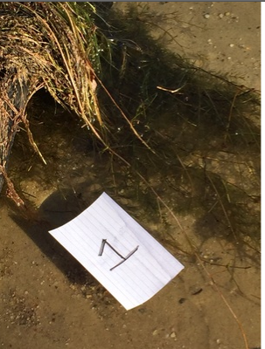
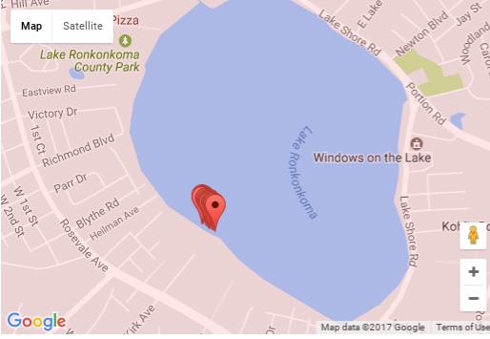
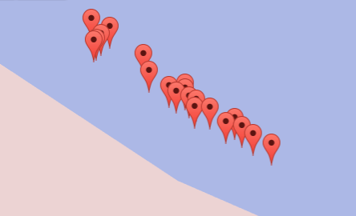
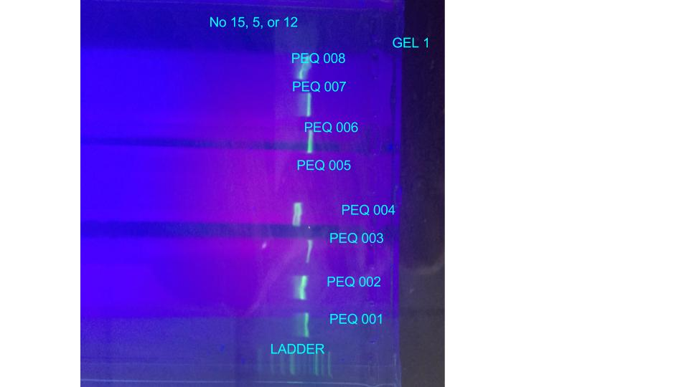
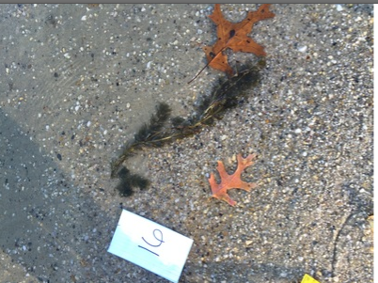
Evidence of Two Invasive Aquatic Species in Lake Ronkonkoma
Abstract
Barcoding is a new and inexpensive way to identify species using DNA. We collected 20 samples of plants from the shore of Lake Ronkonkoma and barcoded each sample. The results were then processed on blue line of DNA Subway. During this experiment, we found Myriophyllum sibiricum and Hydrilla verticillata, which are two different types of aquatic invasive species. These invasive species can cause harm to the environment. We are exploring methods of expanding DNA barcoding to monitor the presence of aquatic invasive species in local waters.
Lauren Kennedy¹, Emma McKean¹, Kaitlyn Mills¹, Alexis Smith¹, Mentor: John Halloran¹
¹Connetquot High School
Introduction
DNA Barcoding is a fairly new and efficient way to identify all kinds of species [1].DNA barcoding uses a short genetic marker in an organism's DNA to identify it as belonging to a particular species [2]. Traditional ways of plant identification were solely based on external structures, such as dichotomous keys or guides[4]. For our project, we used DNA barcoding to help identify the various species of plants in Lake Ronkonkoma. Our goal was to identify native and invasive species that inhabit the lake. Invasive species are species that not native to a specific region and reproduces at such an uncontrolled rate that the animal, plant, fungus or other species is seen as harmful to the environment [3]
Figure 3
Figure 2 Close up of sample locations
Figure 5: sample gel results
Figure 1: GPS Location of samples
Discussion
All of the plants that we found in the lake are belonged to two species of aquatic plants. We found Myriophyllum sibiricum and Hydrilla verticillata, which are two different types of water-plant species but are both labeled as invasive species. Myriophyllum sibiricum is found in Canada, the northwestern parts of the US, and Norway. It is native to Russia, China, and much of North America. It provides cover for fish and invertebrates and supports insects and other small animals and water flow occasionally eating the fruit and foliage. Hydrilla verticillata is found in India and the US. It was introduced to the United States in the 1950s. Hydrilla also interferes with boating and fishing, and increases the risk of drowning. [7] Heavy hydrilla infestations decrease fishing stocks, and, along with the impact on boating, thereby reduce recreational opportunities and the economies they support. [7] Because of its rapid and dense growth, it shades out all other plant species, including natives, reducing diversity to a single species. [7] Dense hydrilla infestations increase daily swings in dissolved oxygen and pH, which influences habitat quality.[7] The negative effects of Myriophyllum sibiricum is most evident when high biomass and matting on the surface occur. 8] Many recreational activities such as swimming, boating, fishing, and water skiing are inhibited by watermilfoil growth. [8] Eurasian watermilfoil also impacts power generation and irrigation by clogging dam trash racks and intake pipe. [8]Eurasian watermilfoil is characterized by its rapid growth, unique methods of reproduction, and highly competitive nature.[8] We also discovered that one of the species has a tendency to hybridize with other neighboring plants.​This​ ​means​ ​that​ ​genetically​ ​half​ ​of​ ​the​ ​plants​ ​genes​ ​come​ ​from​ ​one species​ ​while​ ​the​ ​other​ comes​ ​from​ another​ ​species.
References
https://drive.google.com/file/d/0BzbkMe-byTPrOHVUV1A1cHZ5ZVk/view
https://sampledb.dnalc.org/barcoding/project/884/sample/PEQ-016
https://nas.er.usgs.gov/queries/greatlakes/FactSheet.aspx?SpeciesID=237
http://www.ecy.wa.gov/programs/wq/plants/plantid2/descriptions/myrsib.html
https://plants.usda.gov/core/profile?symbol=MYSI
https://en.wikipedia.org/wiki/Myriophyllum_sibiricum
www.cdfa.ca.gov%2Fplant%2Fipc%2Fhydrilla%2Fpdfs%2Fwhy_hydrilla_is_bad.pdf
Acknowledgements
Thank you to LI Barcode, Connetquot High School and Cold Spring Harbor Laboratory for supplying all the materials and reagents to help carry out this experiment. Also, we would like to thank Mr. John Halloran, our teacher, for continuing to inspire us during the duration of this project and for giving help when help was needed.
Materials & Methods
We collected 20 samples of plants from the shore of Lake Ronkonkoma (Figure 1 & 2 ). Each sample was photographed at mid range and close up with a phone with its GPS on (Figure 3 & 4). We did DNA extraction and used the silica based protocol that Cold Spring Harbor Laboratory provided us. We did PCR using PCR ready to go beads and RBCL primers. Gel electrophoresis was performed to check for presence of a PCR product. Bands were photographed and sent to Cold Spring Harbor Laboratory for confirmation. Confirmed samples were the sent to Genewiz for Sanger sequencing. The results were then processed on blue line of DNA Subway.
Figure 4
Results
Gel electrophoresis confirmed PCR amplification for all samples except PEQ-005, PEQ-012, and PEQ-015 (Figure 5). The 17 samples that showed PCR amplification were sent for sequencing and all were returned with good results based on Phred scores (figure 6). A Phred score is a measure of the quality of the identification of the nucleobases generated by automated DNA sequencing. Our Phred scores were all over twenty. A Phred score that of 20 equals one error in 100 or 99% accuracy Most of the samples returned were Hydrilla, as seen by the Table 1. Some of the samples had identical matches for Hydrilla and Myriophyllum, though none of them were off. There was no mi-matches and the bit scores were great.
Table 1
During this experiment, we found Myriophyllum sibiricum and Hydrilla verticillata, which are two different types of aquatic invasive species.
Figure 6: Sequence with Phred scores

