Slide 1
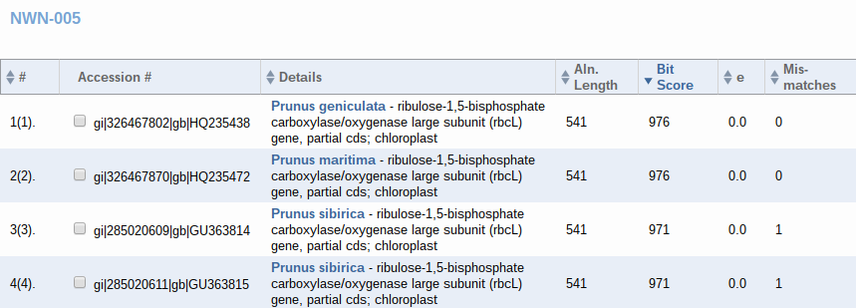
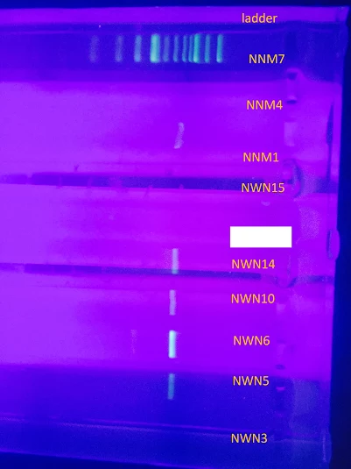
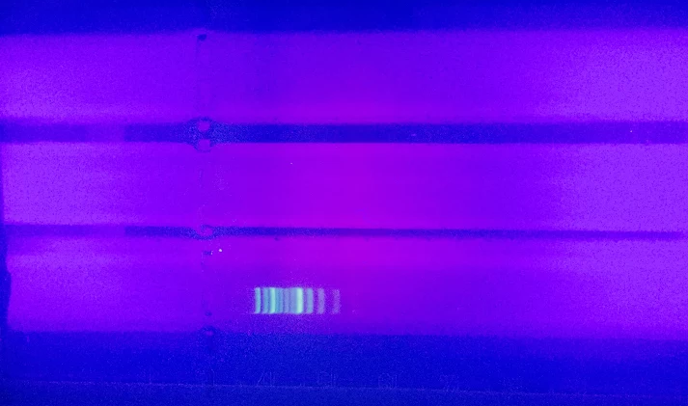
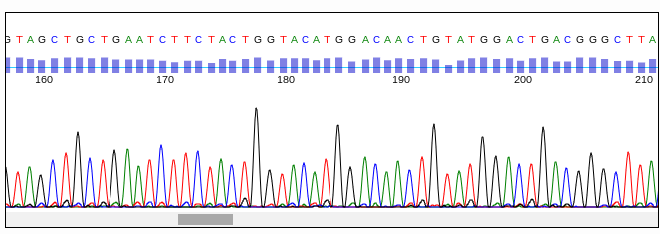
Fire Island Dunes Barcoding
Authors: Kelsie Naldrett¹ and Caitlyn Ryan¹
¹Connetquot High School
Abstract
Fire Island consists of an abundant amount of plant species. With in our collection area of the dunes there was a possibility of a numerous amount of different species. We hypothesised that there is an abundant amount of biodiversity through out Fire Island. The objective of this project was to measure the biodiversity of Fire Island. The materials used for collection were labeled in zip lock baggies. The rest of the essential materials were for DNA extraction such as micro pipettes, test tubes, a microcentrifuge and additional supplies. Our results after gel electrophoresis were mixed, but did yield four pcr products after a second extraction attempt. DNA sequencing and analysis showed interesting and ambiguous results.
Introduction
Adding to the report of NPS Vegetation Mapping Project at Fire Island Seashore we will, in class groups, barcode various vegetations from different areas on Fire Island National Seashore. Using this information we could observe any changes in the environment post hurricane Sandy, after comparing to reports of earlier surveys. Barcoding is a relatively new technique that enables you to choose a tissue, and isolate a certain section of DNA sequence. Then using that, compare it to a database that has already been created. In this case, we would target the plant chloroplast gene rbcL which is for RuBisCo a large subunit, used during photosynthesis. We chose the Maritime dunes at Fire Island because of its biodiversity. The Maritime dunes have to date 45 classified species of herbs. Subsequently, with safety precautions (in relevance to poisonous and endangered species) we will pick 20 samples that we will be choosing to barcode (we do not know what these species are). Collecting samples of herbs at set intervals, we hope to possibly find a new or a previously non barcoded species since the last time they surveyed the area. The intervals will be spaced along the dunes at specific distances and at 2 different “depths” on the dunes. Collection will respect all posted signs regarding walking on dunes.
Materials & Methods
We will be following a method to collect samples and later on process them to produce barcodes. We will be collecting samples from the Maritime dunes at Fire Island. The reason we’ve chose this location is because of its biodiversity. While collecting our samples, we will be sure to not disturb any species of animals or plants that may be endangered. Also, we will watch out for poison ivy. Before collecting a sample we would take a picture of the organism in its natural habitat next to an object for a scale size such as a coin or ruler. Using an iphone for the picture, we would drop a pin on google map and create a longitude latitude coordinate. We will be sampling herbs based on location, we plan to sample the dune closest to the public beach access first, then traveling along the beach, every 100 yards we will collect another sample. By carrying out this method, we can observe the changes in the herbs as we move along the dune and away from the the most populated beach areas. We would use an electronic measuring wheel to measure fifty meters accurately. To keep track of the organisms we would place them in separate ziplock bags, label them with their location and place them in a cooler to stay preserved before more work is to be done. Back at the classroom we will start the barcoding process according to the Cold Spring Harbor protocol ². The first step would be to isolate the the DNA from the plant sample this is done by grinding with a micropestle and adding a lysis buffer to protect the DNA. Centrifuge the sample to separate the contents based on weight and incubate to speed up the reaction. Next, silica resin is added to bind and isolate the DNA. After several washes are done to remove impurities, distilled water will be used to release DNA. (we only have a certain amount of time in school so we will do pcr the following day, freeze overnight). In order to pcr the target plant gene, we will add a specific primer mix according to the type of sample. In this case it would rcbl (rubisco) for plants, amplification is done using a thermal cycler which beats and cools the sample allowing it to bind the primers and then be copied by Taq polymers. The protocol has proper times based on target gene size and composition. After this process store again at -20 degrees celsius. Until we can get confirmation of success by gel electrophoresis the last step would be to analyze the pcr product by gel electrophoresis. this works by separating the DNA by size allowing us to examine the specific genes of the sample. This allows us to find the specific substance of the target size that is present for sequencing. (allows us to see if material of the target size is present for sequencing specifically checking for the band size in the range of 580bp which matches the size of rcbl. DNA sequencing will be performed by Gene Whiz, the results then uploaded to a database. Sequence comparisons will be performed using DNA subway program.
Tables & Figures
Figure 3: BLAST results sample NWN-005
Results
Our first results showed no banding patterns and it didn’t work the first time (figure 1). The second time we barcoded, using the chelex method by Kwon HwangBo, we saw 4 banding patterns (figure 2). The wells labeled NWN(number) is our group, the others are other groups representing different areas of Fire Island. Our two best results, NWN-005 and NWN-005 have the exact same alignment length, bit score, and zero mismatches.
Discussion
Out of the 4 results sent for sequencing, 2 had the same dna sequences but are shown as different species in the database of DNA Subway. These were NWN-005 and NWN-14. NWN-005 is a Prunus geniculata, which is only found in Florida while NWN-14 is a Prunus maritima. We feel confident that both samples are Prunus maritima, and have the same sequence because of the close relation. We find it unlikely that a rare species from Florida would be found in Fire Island. Another result was NWN-006 which was a poor result. This could be from sampling a small young sapling, or low DNA yield during extraction. Our last result, NWN-010, was a Prunus serotina. This is also known as a black cherry tree. There were no sightings of any trees or shrubs over 3 feet. This is not common so close to the shore which leads us to believe that a sapling could have traveled from the forest section of fire island and sprouted. Our collection methods were altered from our original plan because our permit required us to remain and collect samples from only designated pathways and boardwalks.
References
Klopfer, Scott D., Adele Olivero, Lesley Sneddon, and Julie Lundgren. Final Report of the NPS Vegetation Mapping Project at Fire Island National Seashore. N.p.: n.p., Apr. 2002. PDF.
Using DNA Barcodes to Identify and Classify Living Things. N.p.: Cold Spring Harbor Laboratory, n.d. PDF.
Collaborative, IPlant. "DNA Subway Blue Line." YouTube. YouTube, 21 Feb. 2014. Web. 18 Nov. 2015.
McElroy, A., M. Benotti, G.Edinger, A. Feldmann, C. O’Connell, G. Stewart, R. L. Swanson, and J. Waldman. 2009. Assessment of natural resource conditions: Fire Island National Seashore. Natural Resource Report NPS/NRPC/NRR--2009/139. National Park Service, Fort Collins, Colorado.
Acknowledgements
Thank you to Coldpring Harbor for providing us with equiptment and reagents, NPS: National Park Service for allowing us to sample Fire Island, and a thank you to Mr.Halloran for guiding us through this project.
Figure 1: First gel
Figure 2: Gel results after Chelex Protocol
Figure 4: Sequence viewer of sample NWN-005 from DNA Subway

