Slide 1
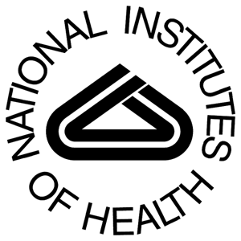
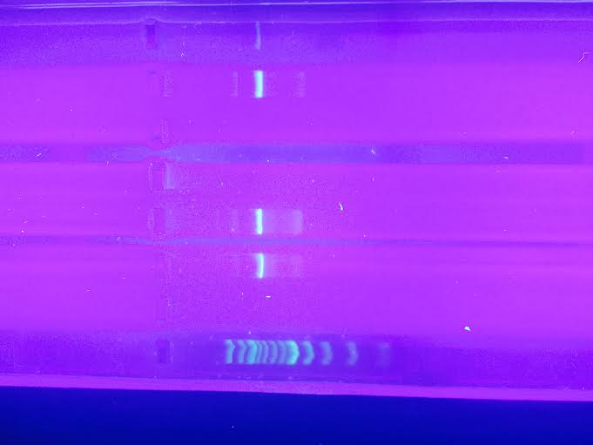
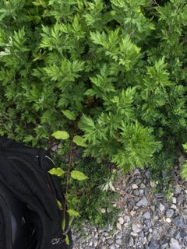
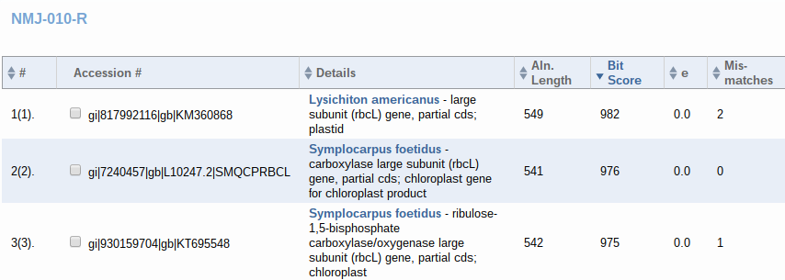
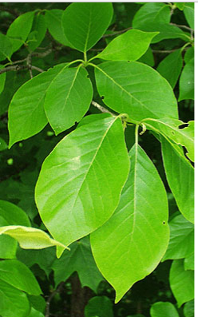
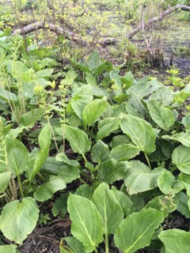
Plants of Wertheim: Barcoding of Long Island Plant Species
Victoria Guevara¹, Natalie Page¹, Michael Vicente¹
¹Connetquot High School
Abstract
As a group, we wanted to further our knowledge on Long Island’s native plant species. Our research group went to Wertheim National Park of Shirley, Long Island, and collected various samples of native plants to test and barcode for DNA. The purpose was to learn about our environment, by dissecting collected samples in order to code the plant specimen for DNA. For this experiment we made use of many materials, including but not limited to a centrifuge, incubator, silica resin, wash buffer, test tubes, micropipettes, a vortex machine, a primer mix, and gel for electrophoresis. First, we collected, documented, and identified our specimens, next, we isolated the DNA from the plant samples, and lastly, we amplified the DNA through PCR and analyzed the PCR products using gel electrophoresis. Our conclusion through the analysis of our results was that our DNA was amplified, and found in visible bands after the completion of electrophoresis. The bands were found in line with that of the DNA ladder, proving that our group did successfully extract DNA from our samples.
Introduction Protection of Long Island’s native plant species also protects biodiversity. The heritage and integrity of these plants is needed, and certain specimens are being grown in containers to restore habitats and revegetation projects. Long Island Native Plant Initiative states, “There is a focus on capturing as much genetic variation as possible when collecting and propagating plant material while minimizing the ecological impacts of harvest.”
Wertheim National Park is a 2,550 acre refuge on the south shore of Long Island. The main purpose of this refuge was to protect the Carmans River that sustains migrating birds (roughly 300 species). This refuge is bisected by the river, which hosts several species (white-tailed deer, osprey, muskrat, fox, turtles, frogs, fish, waterfowl, shorebirds, raptors, songbirds and many more) and is a necessity to this ecosystem. The habitats found here include oak-pine woodlands, grasslands, and fresh, brackish, and saltwater wetlands.Wertheim was an ideal site for the collection of native Long Island plants.
Our objective was to barcode the native plants of Long Island using their DNA in order to expand our knowledge of them and to locate and isolate the rbcL plant gene. We collected various samples to gather a mix and a possible difference in results.
Materials & Methods
Our group collected specimens from different locations and of all sizes and shapes. We went to Wertheim on Saturday, May 21st, 2016. Hoping to not leave a mark on the environment, we cut the leaves off of plants rather than taking the entire plant. We also took the precaution to wear sterile gloves and cut with scissors, then stored each sample in separate plastic bags. We collected a total of 12 samples, which we then extracted DNA from each sample twice, leaving us with 24 total.
We began by taking millimeter sized samples from our larger samples we had collected. From here, we put them into 24 tubes labeled 1A-12A and 1B-12B (using each specimen twice). We then added 300 microliters of lysis solution and used a mortar and pestle to grind and break apart the sample into smaller pieces. DNA could now flow more freely and have a higher chance of binding. After we finished grinding (approximately 2 minutes each sample), we incubated our samples for 10 minutes. We centrifuged twice for one minute each time, first group A and then group B. Without touching the pellet, we removed the floating DNA. Then we added 3 microliters of silica resin, vortexed, incubated, and centrifuged. The supernatant was disposed and the pellet was kept, which now contained the DNA we were hoping to extract. We added 500 microliters of wash buffer in order to clean the DNA. We mixed it and removed the supernatant, then repeated by adding more wash buffer. The second time we added distilled water and mixed by pipetting in and out. We did our 4th and final incubation and mixed up the remaining DNA. We transferred the supernatant to a fresh tube and incubated it in ice. We then took primer and added it with the DNA to new tubes, ready to be amplified in the thermal cycler. We loaded the gel for electrophoresis with the DNA.
Results
Out of all of our samples, only four of them showed clear bands after running the gel. After sending the results to be analyzed, three came back clearly, the fourth had a sequence only when ran in reverse. This sample, sample ten, Symplocarpus foetidus, had a bit score of 976, and no mismatches. Artemisia argyi, our second sample, came through with a result of no mismatches, and a bit score of 980. Our fifth sample had a bit score of 967, with, again, no mismatches, making this sample Smilax rotundifolia. Lastly, our sample numbered twelve, was also run through the DNA subway, and came back as Nyssa sylvatica, with no mismatches and a bit score of 939.
Discussion
The plant we found as sample 10, Symplocarpus foetidus, is commonly found in the wetlands of eastern North America, which corresponds with the location of Wertheim National Reserve. Our sample numbered 2, Artemisia argyi, is found in China, meaning it is an invasive species that was brought into the National Reserve. Sample 5, Smilax rotundifolia, is said to be found in eastern and central North America, which is also in our general vicinity. Lastly, sample 12, Nyssa sylvatica, is a medium-sized deciduous tree native to eastern North America from New England south to central Florida and eastern Texas, as well as Mexico. All of these results, regardless of where they’re from, do make sense being found at the location we chose, because it is a manmade reserve.
References:
1)Ray Corwin, Executive Director, Central Pine Barrens Commission, Dr. Marvin Geller. "1999 Pine Barrens Research Forum - Final Program1999 Pine Barrens Research Forum - Final Program." 1999 Pine Barrens Research Forum - Final Program (1999): 5-30. New York State's Central Pine Barrens. Brookhaven National Laboratory, Central Pine Barrens Joint Planning and Policy Commission, Long Island Groundwater Research Institute at SUNY at Stony Brook, 14 Oct. 1999. Web. 20 Oct. 2015
2)Wertheim National Wildlife Refuge | New York." Web log post. U.S. Fish and Wildlife Service. Web. 1 Nov. 2015. (http://www.fws.gov/refuge/Wertheim)
3)LLC, APN Media. "Wertheim National Wildlife Refuge." Ohranger.com. Friends of Wertheim National Wildlife Refuge, 2013. Web. 12 Nov. 2015. (http://www.ohranger.com/wertheim-nwr)
4)Wertheim. "Wertheim National Wildlife Refuge." Stateparks. Usa.gov, n.d. Web. 12 Nov. 2015. (http://www.stateparks.com/wertheim.html)
5)"Friends of Wertheim NWR - Trail Map." Friends of Wertheim NWR - Trail Map. Wkirell@gmail.com, 4 Oct. 2014. Web. 6 Nov. 2015.(https://friendsofwertheimnwr.wildapricot.org/page-18065)
6)DNA Subway -- Blue Line. YouTube. IPlant Collaborative, 21 Feb. 2014. Web. 5 Nov. 2015(https://www.youtube.com/watch?v=7WF--Ba2P10)
7)GENEWIZ." DNA Sequencing Services. Sanger DNA Sequencing Services, since 1999. Web. 16 Nov. 2015. (http://www.genewiz.com)
8) Watkins, Jermel. DNA Barcoding 101. Home | DNA Barcoding 101. DNA Learning Center, 15 Jan. 2014. Web. 15 Nov. 2015. (www.DNAbarcoding101.org)
9)"Basic Local Alignment Search Tool." BLAST:. National Library of Medicine, n.d. Web. 6 Nov. 2015.(http://blast.ncbi.nlm.nih.gov/Blast.cgi)
10)"Using DNA Barcodes to Identify and Classify Living Things." 001-036 DNA Sci Chap 01 (2014): 0-42. Urbanbarcodeproject.org. Cold Spring Harbor Laboratory DNA Learning Center. Web. 7 Nov. 2015.(http://www.urbanbarcodeproject.org/files/using-dna-barcodes.pdf)
Acknowledgements
A special thanks to Friends of Wertheim, Connetquot High School, and our mentor John Halloran.

