Slide 1
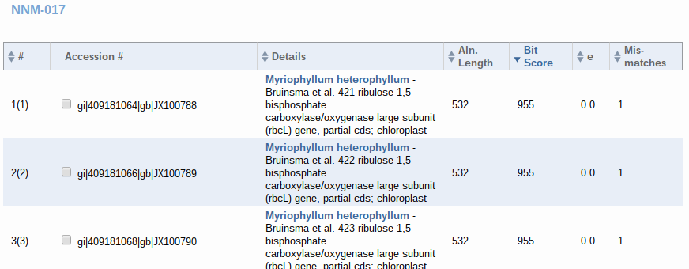
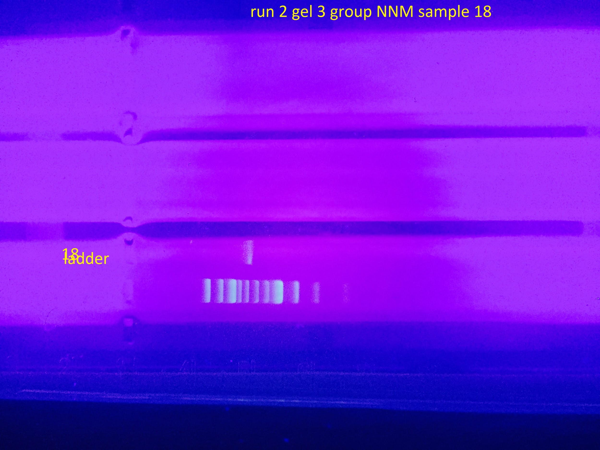
Invasions in the Water: DNA Barcodes of Invasive Species from Lower Yaphank Lake and Others
Alex Corozza¹, Alfredo Delcastillo¹, Preeti Ramesh Kumar¹
Connetquot Highschool¹
Tables & Figures
Abstract
Invasive species have been seen in several bodies of water in Long Island, like the Cabomba in the Yaphank lakes. This brings the question on their origin and how they got to the habitats that they reside in now. It would most likely be due to fishing, or boating in exotic places or possession of these exotic plants in aquariums that end up being dumped inside the lake, which can allow us to look into the origins to find a solution for the invasive problem.
Introduction
The main goal is to find and barcode Cabomba, Variable-Leaf Watermilfoil and several other invasive species from a recent invasion, while also finding ways to get rid of them. We might also compare the species diversity between upper and lower Yaphank lakes. There were remediation efforts done to upper Yaphank, but it halted before lower Yaphank could be done, which is the reason why we would like to compare the areas.
Materials & Methods
We plan to go to the Yaphank Lake and Peconic and Yaphank Rivers, to collect several samples of the invasive species we find to take back to the lab, while also taking photos, taking in and sharing the location of the specimens for data, and comparing the two areas.
Results
For gel electrophoresis, we got bands for samples 4, 14, 10, 6, 5, and 18. The results for the DNA reactions we got were of two samples, sample 4 and sample 17. Blast results indicate the species as Phragmites australis and Myriophyllum heterophyllum.
Figure 1: Single band from first extraction attempt
Figure 2: BLAST results indicating presence of Broadleaf - Water Milfoil
Discussion
From the barcoding, we learned that the Phragmites australis (sample 4) had actually been native in Asia and is named the common reed. Barcoding tells us that the Myriophyllum heterophyllum originated from Australia and is called the Watermilfoil. These exotic plants would seem to be the product of people adding exotic plants to their aquariums and dumping them in bodies of water after they’re done with them, thinking no harm from it and not realizing the consequences
References
Department of Environmental Conservation. Lower Yaphank Lake. [accessed 2015 Dec 16]. http://www.dec.ny.gov/outdoor/24179.html
Watershed Protection: Clean Lakes Case Study - Use of Aquatic Weevils to Control a Nuisance Weed in Lake
Bomoseen, Vermont. EPA. [accessed 2015 Dec 12]. https://www.epa.gov/lakes/watershed-protection-clean-lakes-case-study-use-aquatic-weevils-control-nuisance-weed-lake
Vairable-Leaf Watermilfoil « AQUAPLANT. Vairable-Leaf Watermilfoil « AQUAPLANT. [accessed 2015 Dec 17]. http://aquaplant.tamu.edu/plant-identification/alphabetical-index/variable-leaf-watermilfoil/
Non-Native Invasive Freshwater Plants. Non-native Invasive Freshwater Plants. [accessed 2015 Dec 17]. http://www.ecy.wa.gov/programs/wq/plants/weeds/aqua006.html
Acknowledgements
We thank the always supportive teacher, John Halloran, the institution that provided us the opportunity to reach these scientific goals, Cold Spring Harbor, and the school that allowed us to do these wondorous things, Connetquot High School.

