Slide 1
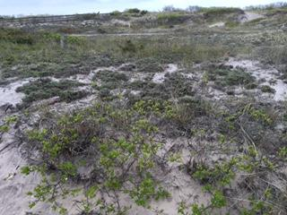
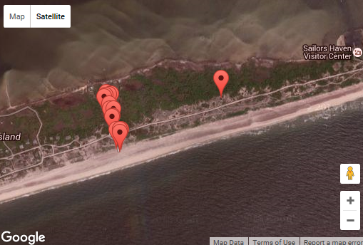
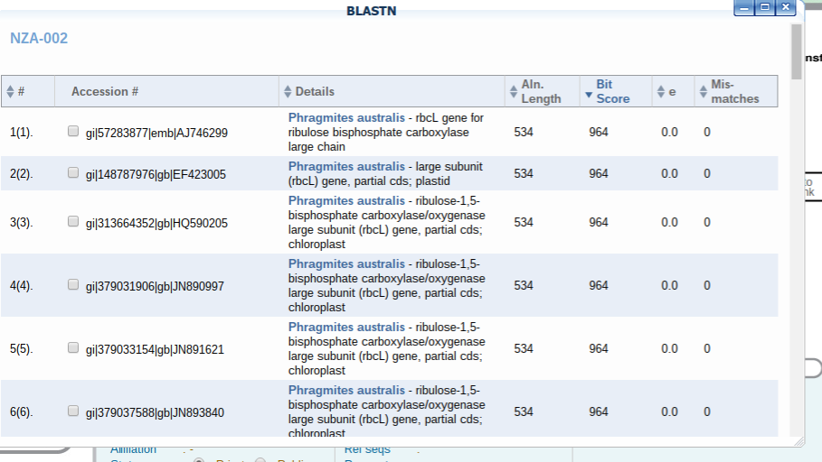
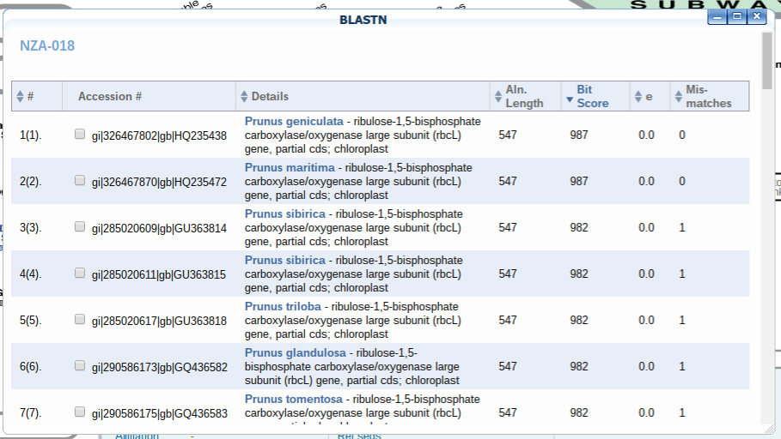
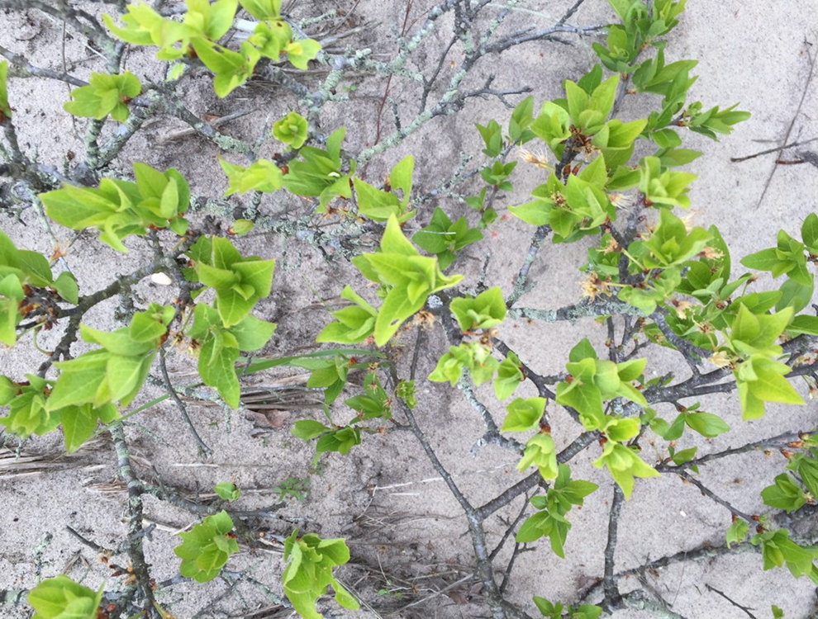
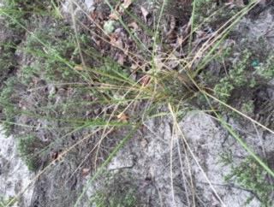
DNA Barcodes of Plants at the Shrublands of Fire Island National Seashore
Chris Picchiello¹, Giavana Prucha¹, Caitlin Randberg¹
¹Connetquot High School
Abstract
The Maritime Shrublands of Fire Island are home to a variety of plant species. The Fire Island National Park ists that certain species inhabit this region. To test the validity of this list of species, 2 group members went out to the Maritime Shrublands to collect common species observed in the habitat. Once the 20+ specimen were collected, the 12 best broken down samples had their DNA extracted and were put through the process of Gel Electrophoresis. Due to the harsh conditions faced by the plants against the Fire Island environment. This has led the plants to develop a higher amount of polysaccharides in the plants, which prohibited successful DNA extraction and interpretation.
Introduction
From the beginning of the project our goal as a group was to learn more about DNA, using technology in the lab, and plant sampling. However, we really hoped to find a new species, or mutations in the species of the shrublands of Sunken Forest at Fire Island. If we came across a new species in our process of barcoding, then we could prove that new species are appearing on Fire Island because our results would show unknown DNA. If we discovered mutations in the plant species which we barcoded, our results would indicate only some matching bands. We picked Fire Island to barcode plant species because of the amount of diversity that the island contains; now that it is a destination for beachgoers and other travellers, it’s important that we know if there are
new species that could be harmful or invasive.
Materials & Methods
Our original intentions were to use a survey method, but after acquiring a permit for Fire Island, we changed our protocol because of some restrictions. When we arrived in Fire Island, we followed the Sunken Forest boardwalk until we reached the Shrublands. Our method for collection was pick a starting point, and collect several samples of the most abundant species in that area. We then walked further and repeated the process of collecting samples. We collected a total of 25 samples and kept them on ice until we used PCR to amplify DNA followed by gel electrophoresis to barcode the DNA. The materials we needed were multiple sized micropipettes, microcentrifuge tubes, vortex, centrifuge, water bath, cooler (for storing), and 20+ shrubland plant samples.
Results
After using gel electrophoresis to determine our results, we concluded that we had one band for sample 10 against the DNA ladder. The process did not work as well as we expected it to work, yet the same thing occured for other groups. The DNA Subway told us about some of the species we barcoded using bitscores created from DNA we implemented into the system.
Discussion
Our group obtained very vague results from gel electrophoresis that may be explained by a few different reasons. Firstly, the plant samples that we collected may have been harder to grind up and separate the DNA from the rest of the sample because the plants on Fire Island may have adapted to survive the harsh wind and sea air of the seashores. This adaptation could have made extracting the DNA much harder in comparison to other plants. In addition, outside research can explain the lack of accurate results because plants tend to contain large amounts of polysaccharides, which in turn can make breaking up the sample with a pestle more difficult. A possible source of error in our results is that we did this experiment with multiple groups, and perhaps the specimens were accidentally switched or cross-contamination occurred.
References
“Island Biodiversity." Island Biodiversity. CBD, 27 Oct. 2015. Web. 10 Nov. 2015.
"DNA Barcoding 101." Cold Spring Harbor Laboratory DNA Learning Center, 2014. Web. 10 Nov. 2015.
McElroy, A., M. Benotti, G. Edinger, A. Feldmann, C. O'Connell, G. Stewart, R. L. Swanson, and J. Waldman.” “Assessment of Natural Resource Conditions: Fire Island National Seashore." National Park Service Natural Resource Report 139 (2009): n. pag. Web. 10 Nov. 2015.
http://www.urbanbarcodeproject.org/files/using-dna-barcodes.pdf
Hwangbo, K., & Son, S. H. (2009, October 28). Rapid and simple method for DNA extraction from plant and algal species suitable for PCR amplification using a chelating resin Chelex 100. Plant Biotechnol Rep Plant Biotechnology Reports, 4(1), 49-52. doi:10.1007/s11816-009-0117-4
Acknowledgements
We would like to thank our teacher, John Halloran, for continuously inspiring us to pursue scientific research, and also for providing us with the necessary materials to make this project happen. We would also like to thank Cold Spring Harbor Laboratory for working in junction with Connetquot High School Science Research and providing us with the opportunity to barcode and learn about DNA.

