Slide 1
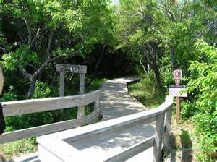
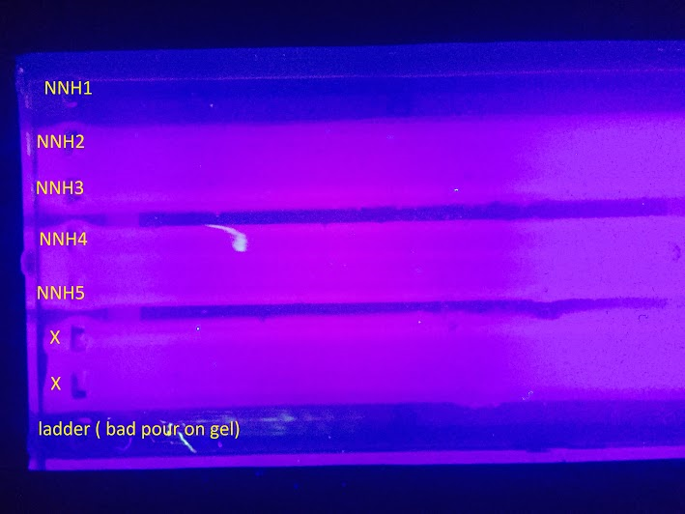
Barcoding the Sunken Maritime Forest of Fire Island
Jacob DeRosa¹, Dogan Okur¹, and James Scarabino¹
¹Connetquot High School
Abstract
Our experiment involved the collection and barcoding of plant species in the area to see what grows on our Southern Shore of Long Island. Lysis solution and a PCR machine were vital to the project. The Lysis solution allowed us to isolate the DNA from the sample, and the PCR machine allowed us to exponentially amplify the DNA to observe it in gel electrophoresis. The results were disappointing due to the fact that only one sample was able to be successfully barcoded. All other samples did not show banding or clear banding.
Introduction
For this barcoding project, we collected our samples from the Sunken Forest area of the Fire Island National Seashore, off the south shore of Long Island, New York. Sunken Forest is located at 40°39'24.2"N 73°06'18.3"W. It’s classified as a maritime forest and is known to contain several species of trees, shrubs, vines, and herbs. The purpose of this project is to collect specimens and to extract its DNA and barcoding. The hope is that we can find some unknown diversity among the organisms and see how closely different species are related in Sunken Forest.
Materials & Methods
To collect the samples we set up a 5x5 ft square from which we took two leaves from the most common plant species. When we found an acceptable sample we also took a photo of it with a smartphone so the GPS could give us the exact coordinates to where it was found.
We mixed a small piece of the sample with lysis solution and grinded it up with a pestle. The mix was incubated at 65 degrees Celsius for 10 minutes. Next, the mix was centrifuged for a minute to separate the crushed leaf and the DNA, which was in the supernatant. Supernatant was added to a new tube along with silica resin. DNA is negatively charged so it will bond to the positively charged silica. This was then incubated for 5 minutes at 57 degrees and then centrifuged for 30 seconds. The pellet at the bottom was the silica and DNA. The supernatant was replaced with wash buffer and then vortexed for 30 seconds and removed again. Following that, we basically cleaned and separated the DNA and needed to remove the supernatant with DNA to a clean tube. This was to put on ice to reduce the speed of decomposition of DNA. The DNA was then amplified through PCR, which created a large enough amount to run gel electrophoresis.
Results
After collecting samples and doing the DNA extraction and PCR procedures from Cold Spring Harbor, we got 0 bands that would be acceptable. None of the 23 samples were able to produce a visible band in the gel. We decided to run a second trial with an altered protocol to see if the procedure itself was at fault. This second trial was barely better, but we were able to get 1 acceptable banding pattern.
Tables & Figures
Discussion
For our first set of results, we did not get any bands of DNA in the gel. The procedure that we used was the procedure suggested to us by Cold Spring Harbor for barcoding. This could mean many things. For one, our procedure could have failed because of the plants themselves. Many plants on Fire Island have a waxy oil coating, like the holly leaf, for example, which could have interfered with the PCR. Another factor that could have caused a problem for us is the fact that the plants and leaves were tough and could not be broken up by the pestel. This could have caused problems for the PCR in that we could not actually extract the DNA. We plan to continue to research and test additional protocols for DNA extraction and amplification by PCR in Maritime Forest Plants.
References
"DNA Subway -- Blue Line." YouTube. YouTube, 21 Feb. 2014. Web. 13 Nov. 2015. <https://www.youtube.com/watch?v=7WF--Ba2P10>.
McElroy, A., M. Benotti, G. Edinger, A. Feldmann, C. O’Connell, G. Stewart, R. L. Swanson,
and J. Waldman. 2009. Assessment of Natural Resource Conditions: Fire Island National Seashore. Natural Resource Report NPS/NRPC/NRR—2009/139. National Park Service, Fort Collins, Colorado.
"DNA Barcoding 101." Cold Spring Harbor Laboratory DNA Learning Center, 2014. Web. 10 Nov. 2015.
Acknowledgements
We would like to thank Brian Aldaba of Hauppauge High School for his help in sample collection. We’d also like to thank Zach Klauber, who was not able to finish the project with us.

