Slide 1
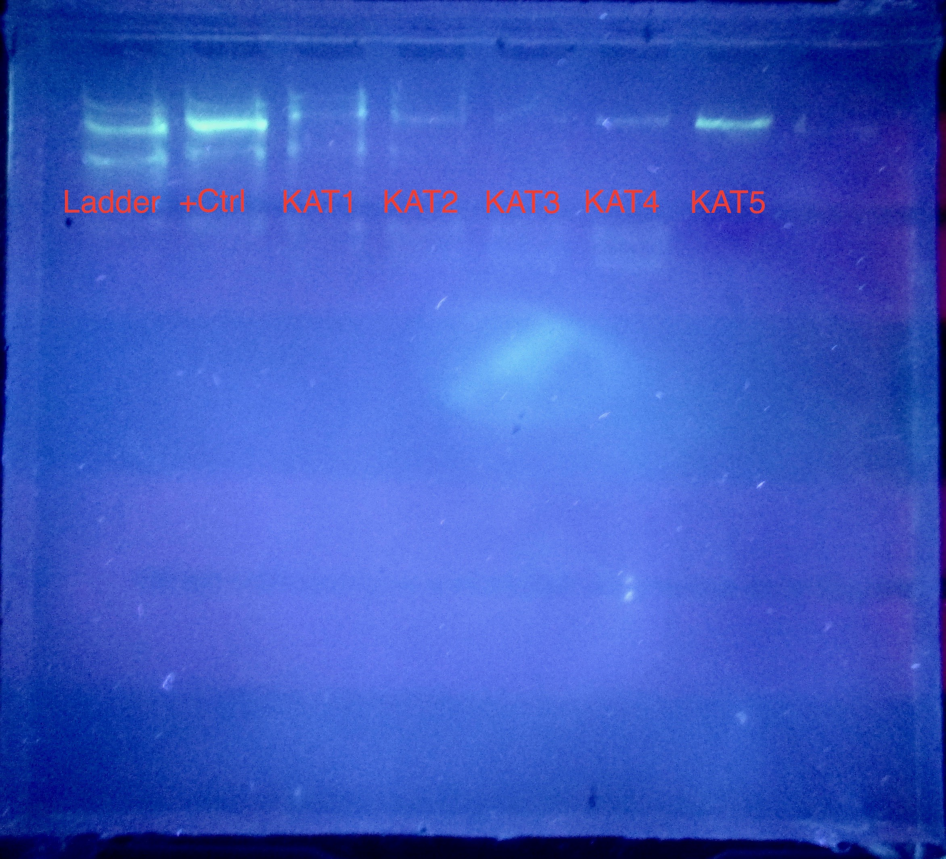
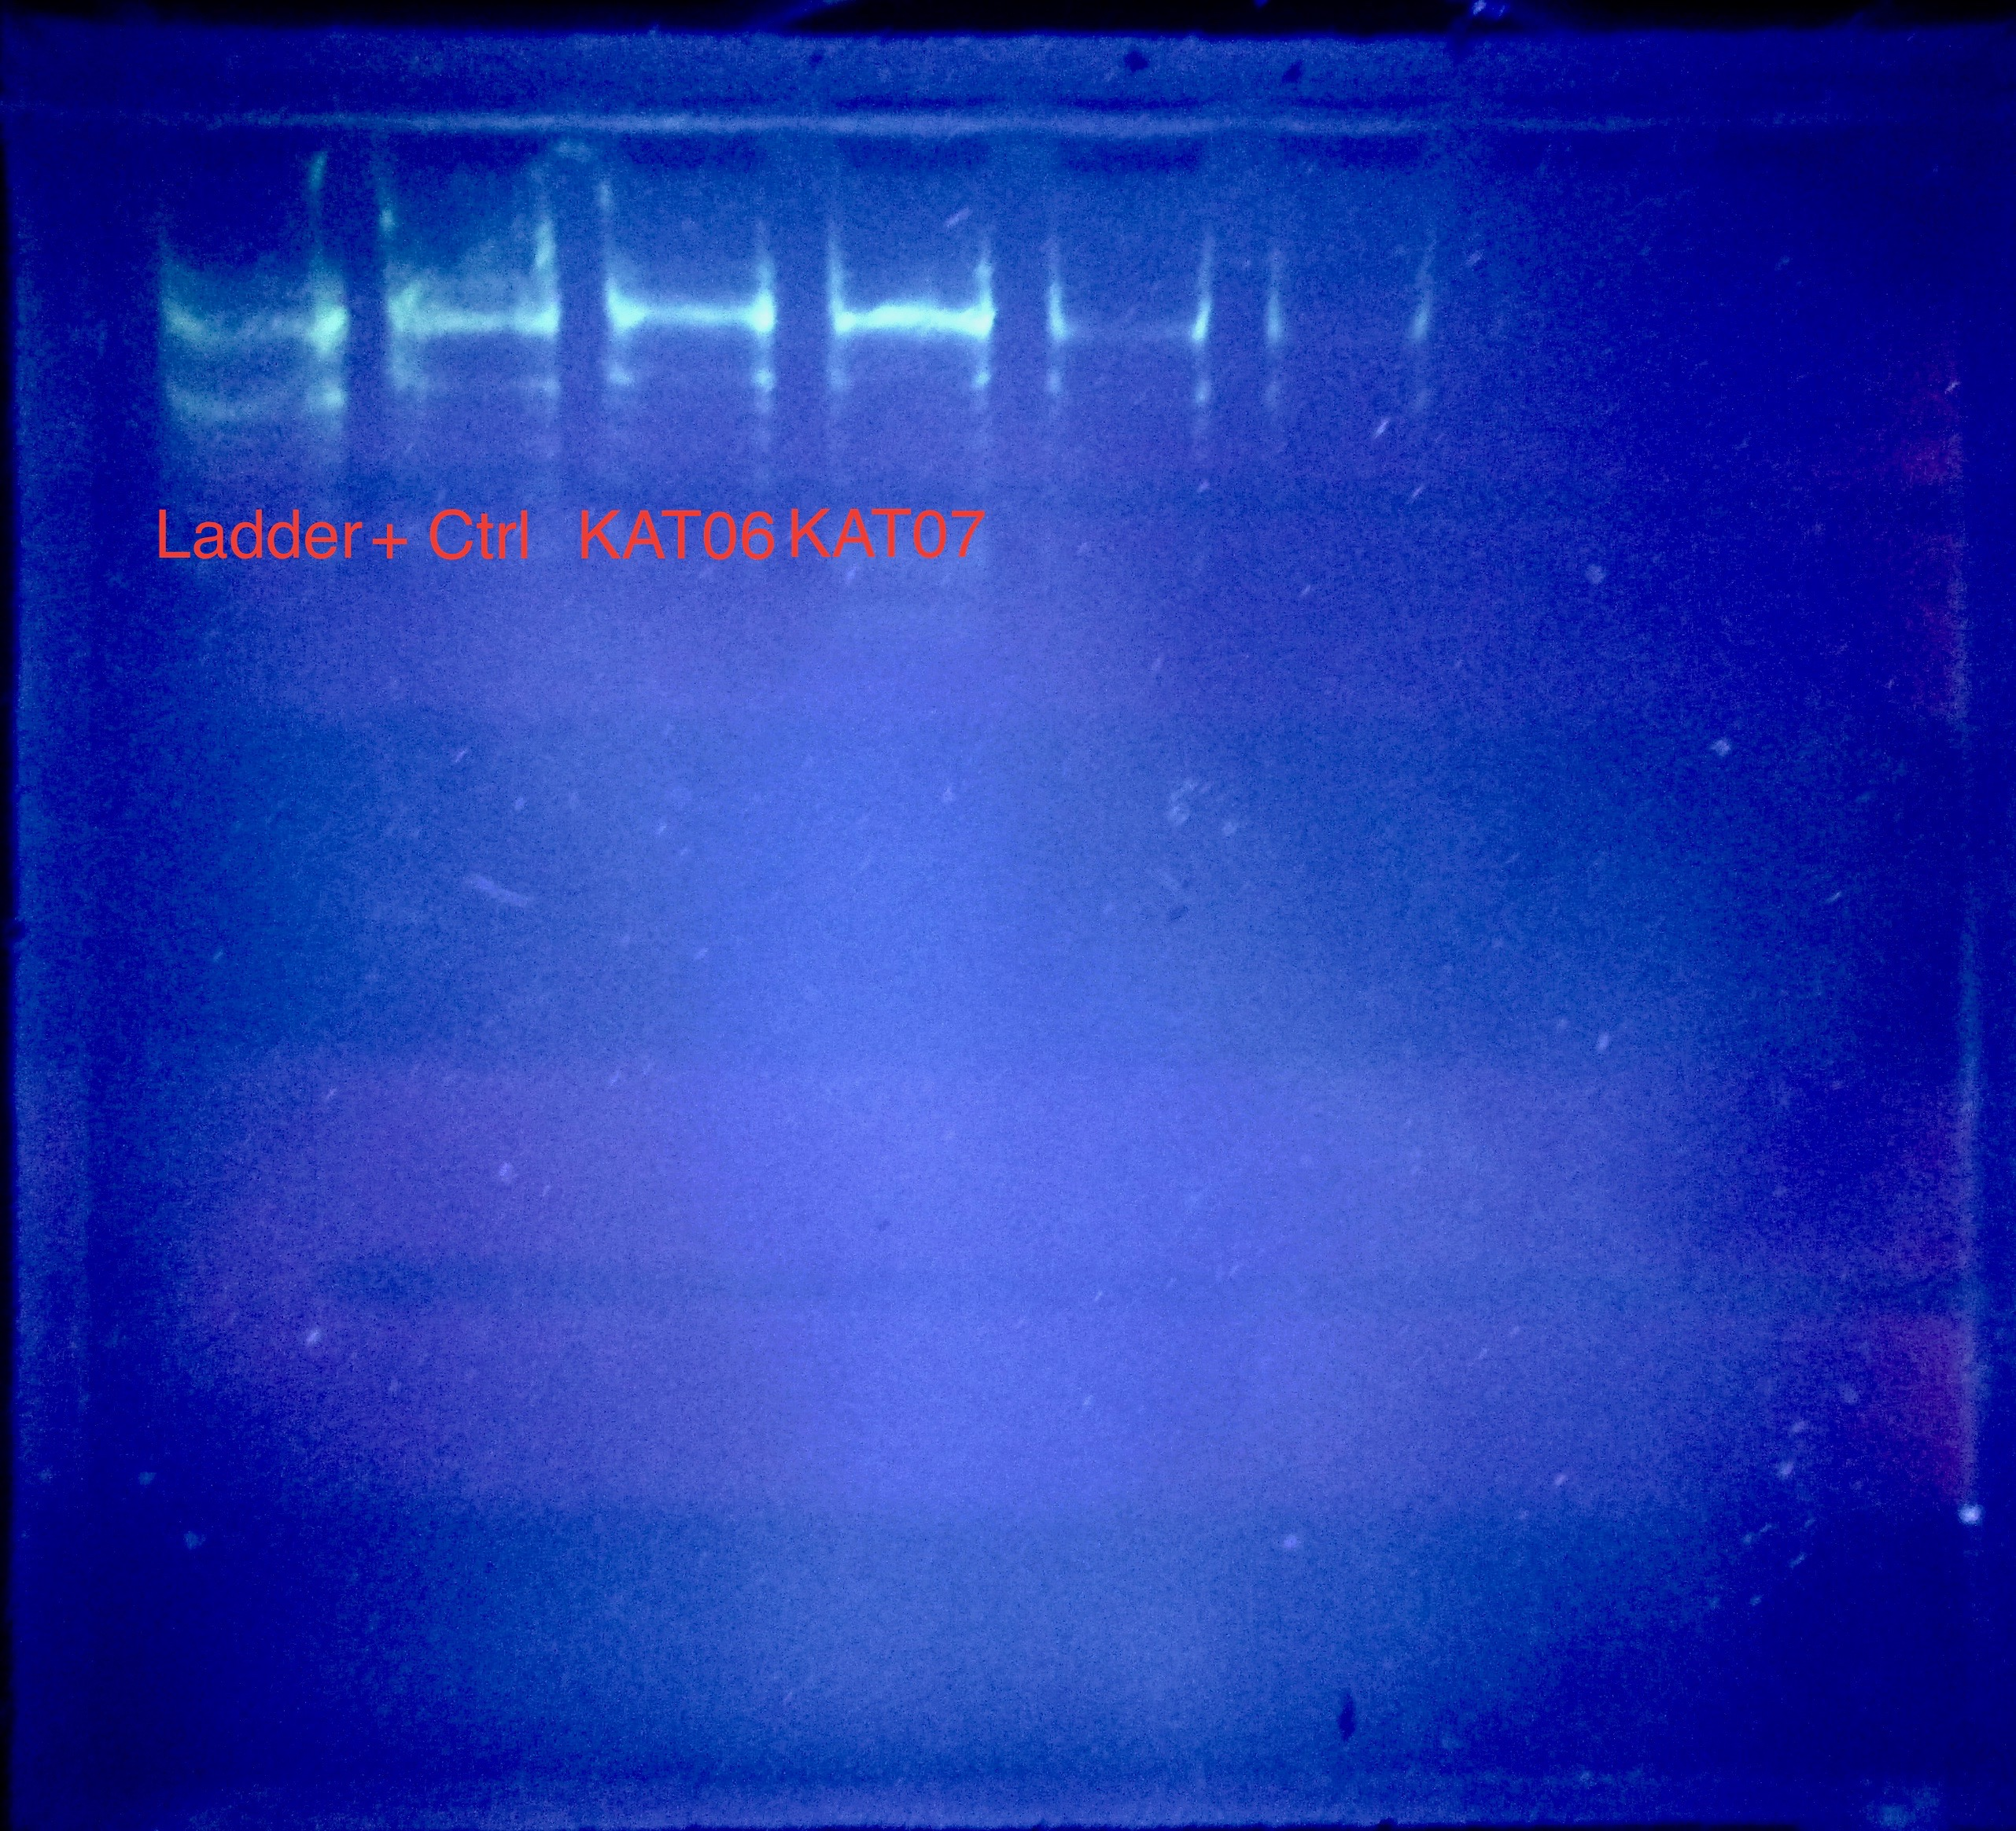
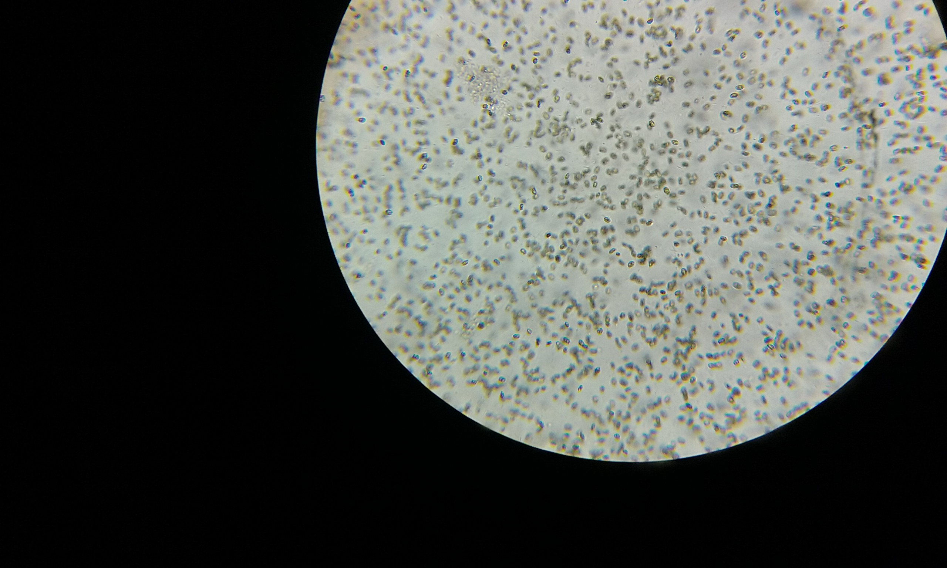
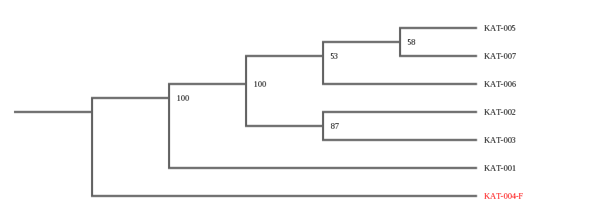
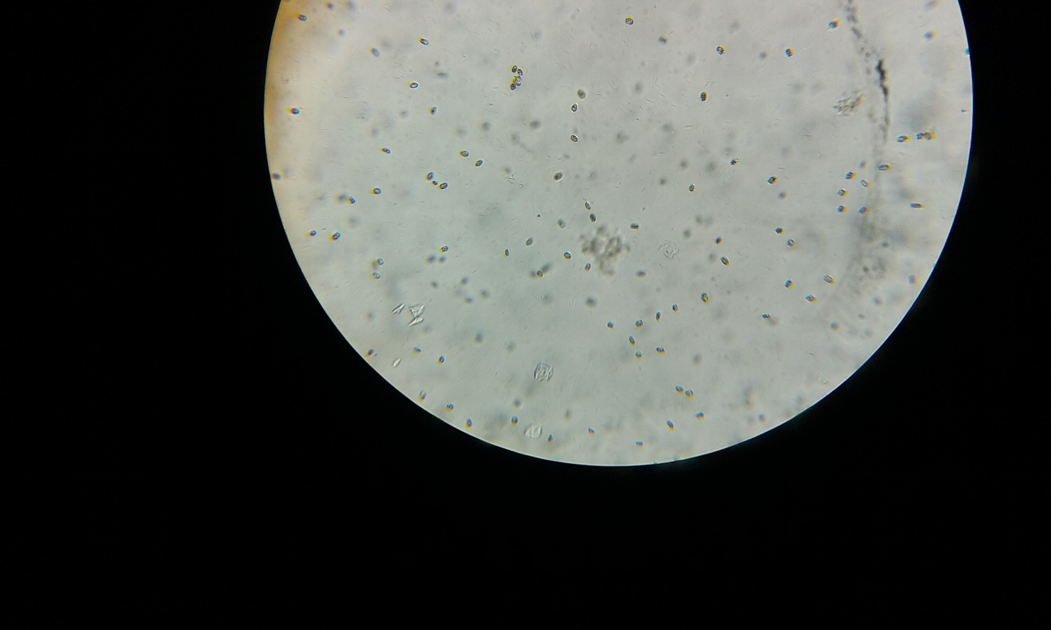
Mystery Plankton, What Are We Growing?
Authors: ¹Nikki Curreri, ¹Angelina Dilbaryan, ¹Amna Zia and ¹Kary Williams
Mentor: ¹Virginia Sullivan
Rachel Carson High School for Coastal Studies
Abstract
Algae blooms made the national news repeatedly this year. Human activities such as pollution and the use of fertilizers that end up in waterways due to runoff are two main causes, but climate change may also be influencing the increased occurrence of algae blooms. Our science research class has been culturing algae to conduct experiments related to algae growth and control. We borrowed a footlocker kit from the Harlem DNA lab and using the DNA Barcoding 101 procedures we sought to identify the species of algae growing in our classroom cultures. The original algae culture contained four species of algae: Nannochloropsis oculata, Tetraselmis chuii, Isochrysis Galbana (T-iso) and Dunaliella tertiolecta. The DNA Subway results mainly revealed that we have Alpha proteobacterium growing in our cultures.
Introduction
Algae blooms made the national news repeatedly this year. In Toledo, Ohio 400,000 residents were warned to avoid drinking tap water due to toxic algae blooms in Lake Erie. And in Florida, a 33 square mile bloom crept over Lake Okeechobee. (Neuhaus, 2016). Environmentalists, as well as angry owners of tourist dependent businesses were two of the most concerned groups in Florida that wanted to find solutions to this problem (Parker, 2016). Algae blooms are a natural occurrence, but why are they increasing in frequency? Most scientists agree that human activities such as pollution and the use of fertilizers that end up in waterways due to runoff are two main causes. But climate change may also be influencing the increased occurrence of algae blooms (Ferris, 2016).
In 2014, a type of macroalgae called ulva or sea lettuce, washed up on the beaches of Fire Island and blanketed the beaches endangering the horseshoe crabs eggs that had been laid there during the mating season. The eggs were essentially smothered by the algae causing death (Barrios, 2014).
Since there is no one single cause for algae blooms, they can be difficult to control. In addition, there are many species of algae and some species are very good competitors, For example some species may survive best in warmer waters and therefore, climate change could be encouraging these blooms (Ferris, 2016).
In general, phycologists agree that algae are unicellular, oxygen-evolving photosynthetic autotrophs (Guiry, 2012). It has been estimated that there can be anywhere from 30,000 to more than one million species of algae (Guiry, 2012). Since our school focuses on marine studies and has been involved with raising and re-nesting horseshoe crabs, these events have been a cause for concern in our school.
In response, the science research classes have decided to culture and investigate algae in multiple ways, Research students have experimented with ways to both increase and decrease algae growth. Overall, students have been successful in determining environmental factors that cause increased growth. Students have also tested natural methods to control growth. Although these studies have been valuable, students agree that the results would be more valuable if they could identify the exact species of algae that they are working with, because the original starting culture was a mixture of four species of algae.
Materials & Methods
The samples of the algae used in this Urban Barcode Project, were selected from multiple algae culture bottles that students created using a starter algae sample called Plankton Delight. The cultures were grown in the classroom. To document the samples, microscopic pictures of the algae cultures were taken. The extractions took place at Rachel Carson High School using the Footlocker kit supplied by the Harlem DNA Lab.
To extract the DNA, the team began by centrifuging individual samples of the algae. The supernatant was removed, allowing pellets of the algae to form at the bottom of the micro centrifuge tube. 300µl lysis solution was added to these concentrated algae samples and using a sterile pestle; the samples were crushed. The samples were then incubated at sixty five degrees Celsius for ten minutes and then the tubes were centrifuged for one minute, allowing the components to separate. The DNA at this step is located in the supernatant. Next, 150µl supernatant was transferred to a new micro centrifuge tube and 3µl silica resin was mixed with the supernatant, this step allowed the DNA to bind to the silica resin. The tubes were then heated to fifty seven degrees Celsius for five minutes, followed by 30 seconds of centrifugation. After removing the supernatant, the silica resin was washed twice with 500µl of cold wash buffer. After the second washing, the tubes were centrifuged and the supernatant was removed. 100µl of distilled water was added to the silica in each tube, allowing the nucleic acids to elute from the silica resin. The distilled water, now containing the DNA, was incubated for five minutes at fifty seven degrees Celsius. The tubes were then centrifuged for 30 seconds and then 90 microliters of the supernatant, containing the DNA was removed and placed in fresh 1.5ml tubes. The tubes were stored on ice until the amplification step.
To amplify the samples we added 23µl of algae specific primer called TufA to PCR beads and then 2µl of DNA was added to each PCR tube. Next, we began thermal cycling, using the appropriate barcode program. After thermal cycling, the PCR products were analyzed by Gel electrophoresis and the samples with observable bands were sent for sequencing. The sequenced samples were analyzed using DNA subway and a BLAST search.
Results
Discussion
Samples five, six and seven had prominent bands on the gel and therefore we expected to get the most accurate information from DNA Subway for these samples. We found our results unexpected, yet interesting. The original algae culture contained four species of algae: Nannochloropsis oculata, Tetraselmis chuii, Isochrysis Galbana (T-iso) and Dunaliella tertiolecta.In class we had experimented with methods of controlling marine algae blooms including exposing the algae to barley straw. Based on our microscopic plankton counts we knew that the overall population of plankton had decreased, but we were hoping to find which species had survived our experimentation. We were hoping that our DNA subway results matched one of the four starting species; however our results showed that most of the algae samples were identified as Alpha proteobacterium. Our team was confused by the results at first and decided to research the relationship between algae and bacteria. Some research has shown that algae often depend on bacteria for vitamins and enzymes. Possibly, there were bacteria in the original cultures which the plankton depend upon and instead of finding the plankton species, we identified the bacteria that these species of algae depend upon for survival. Through our research we also learned about the endosymbiotic theory which explains how eukaryotic cells may have evolved from prokaryotic cells. Symbiosis is a close relationship between two different organisms, and possibly the algae originally found in our culture had a symbiotic relationship with Alpha proteobacterium and evolved over time. Since our starting culture was a mixture of four species, a future investigation could be done to isolate each species before performing the DNA extraction.
References
Barrios, Jennifer. (2014) Macroalgae blanketing Fire Island beaches endangers horseshoe crabs. Retrieved from http://www.newsdday.com/long-island
Ferris, Robert. (2016) Why are there so many toxic algae blooms this year. Retrieved from: http://www.cnbc.com/2016/07/26/
Guiry, M. D. (2012) How many species of algae are there? Journal of Phycology Vol 48, p 1057-1063.
Neuhaus, L. (2016) Miles of Algae and a Multitude of Hazards. Retrieved from http://www.nytimes.com/2016/07/19/science/algae-blooms-beaches.html
Parker, Laura (2016) Slimy Green Beaches May Be Florida’s New Normal. Retrieved from http://news.nationalgeographic.com
Acknowledgements
We would like to thank Melissa Lee and Christine Marizzi from the Harlem DNA lab for helping our team with the supplies and equipment needed to conduct this project.
Algae Culture Samples | Organismal DNA Identified
Sample #1 KAT-001 | Thalassospira australica
Sample #2 KAT-002 | Alpha proteobacterium
Sample #3 KAT-003 | Alpha proteobacterium
Sample #4 KAT-004 | Thalassospira australica
Sample #5 KAT-005 | Alpha proteobacterium
Sample #6 KAT-006 | Alpha proteobacterium
Sample #7 KAT-007 | Alpha proteobacterium
Plankton sample before and after exposure to barley straw

