Slide 1
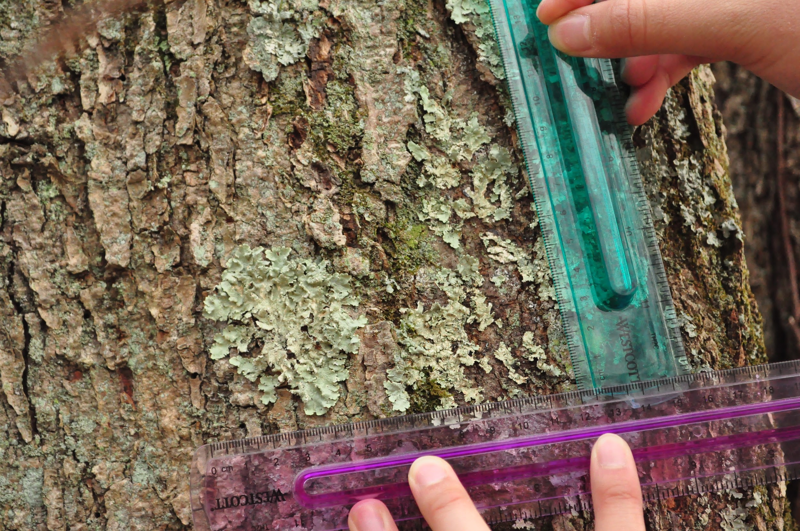
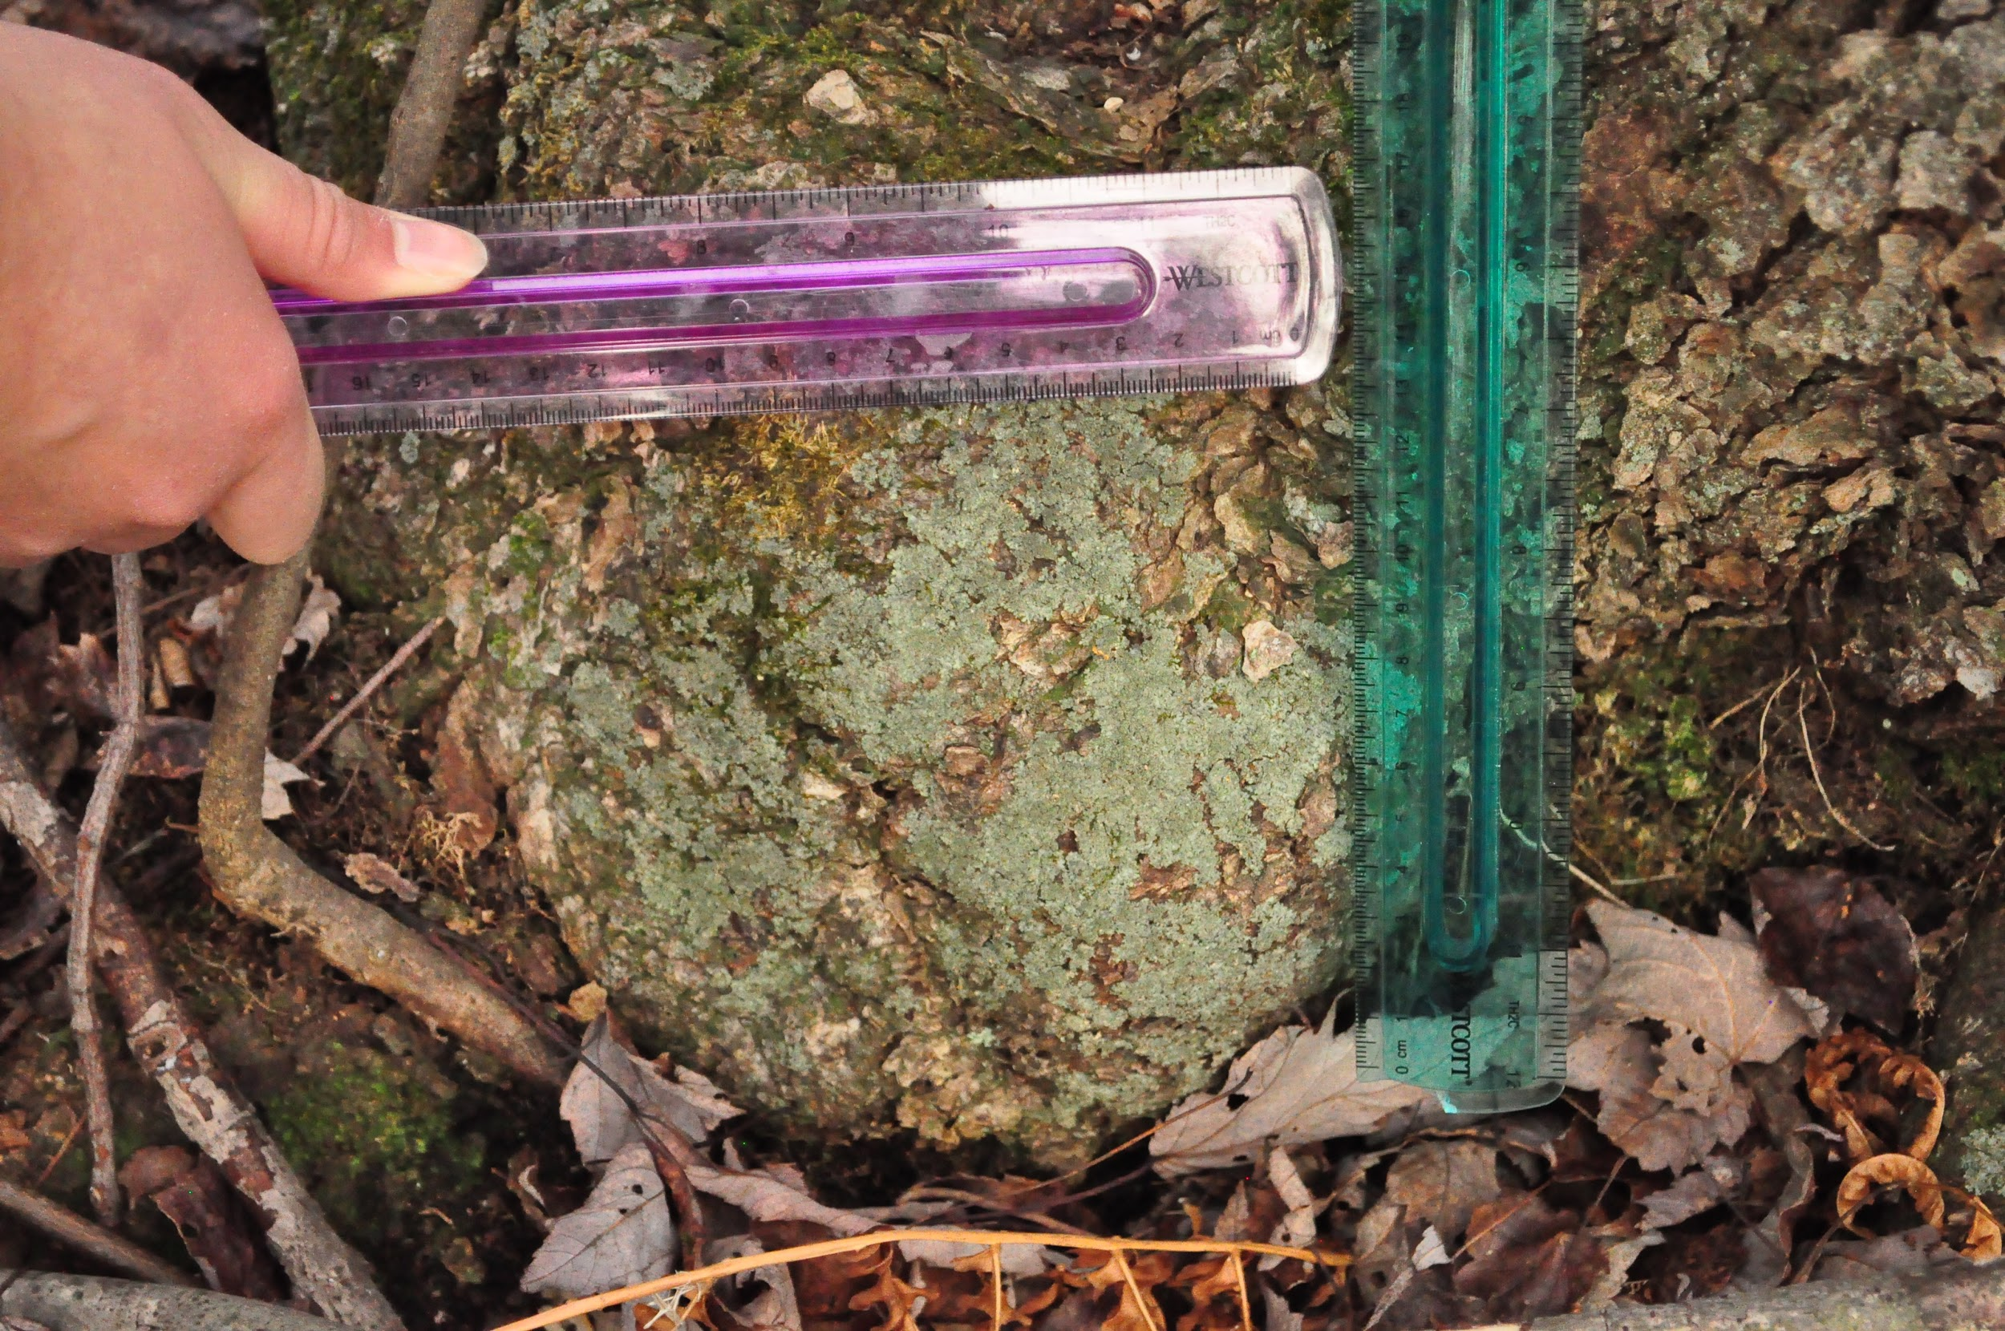
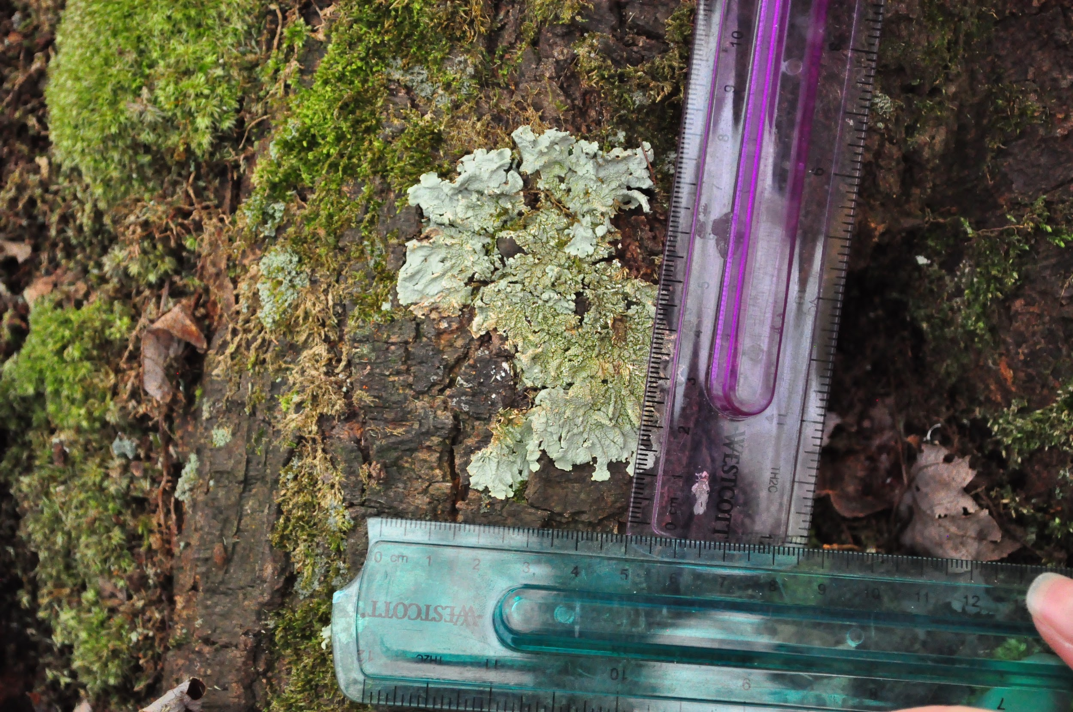
Transformation of Lichen Diversity in Massapequa Preserve in the Last 47 Years
Authors: Kiera Flaherty¹, Michelle Fong¹, Linie Li¹, Michael Lam¹
Mentors: August Eberling¹
¹Massapequa High School
ABSTRACT
MATERIALS
METHODS
DISCUSSION
Lichens are very intriguing organisms. Lichens grow in many places: rocks, tree bark, tree twigs. We collected and barcoded samples of lichens that are currently growing on Long Island and compared them to the lichens described from the 1968 study. In addition to the DNA barcoding, we used descriptive appearance, size, shape and color of the lichen body and the reproductive characteristics to identify them. After collecting the samples and letting them air-dry, we went to Cold Spring Harbor to conduct PCR using two different primers for each sample- both an algal and fungal primer. After obtaining the concentrated samples, we brought them back to our lab and conducted the gel electrophoresis by inserting the samples into wells and letting them travel down the length of the gel using electricity. After 30 minutes, we placed the gel under a UV light to view any possible bands that had appeared and then compare to past identified lichen DNA. Pictures were taken and data was analyzed, determining whether or not the gel run had been successful or not. We are unable to make conclusions at this time due to the fact that our DNA sequencing data hasn’t been received and interpreted yet. We are very hopeful and optimistic that we will yield excellent results.
We used: small chisel (¾ inch), sturdy knife (for digging dirt or scraping off bark), 10x hand lens
large collecting bag, small coin bags, envelopes, small boxes for soil and bark specimens, collection book for looking up lichen specimens, GPS, Compass, map of area if available, tape measure, rubbing alcohol, Polymerase Chain Reaction machine, Algal Primer, Fungal Primer, Agar, Comb, Gel electrophoresis kit, UV radiation
Micropipettes, Pipette tips, Rulers, Camera, Beakers, Timers, Pestle in test tube, Distilled water..
Since lichens recover slowly, we only removed larger samples or samples growing abundantly in the area as we did not want to damage the forest in any way. We brought the tools required. We cleaned the knife with alcohol after collecting each sample to avoid possible contamination of the next sample.
We mapped out the bike path on the Massapequa Preserve using Mapmyhike.com. The path from Merrick Road to Linden Street is 3.46 miles. We started where the path begins on Merrick Road and worked our way north. We stopped approximately every .2 miles and randomly surveyed what lichens we see. We collected samples from tree trunks and tree branches, looking for different variety. Everyplace we stop, we radiated out from that point approximately 1-3 meters for our search for lichens and recorded the coordinates of every tree which a sample was obtained from.
Upon collecting our samples, we used a GPS to document the exact location we took the samples from. We also took pictures to document the appearance of the samples as well as to have them on hand if we needed to further clarify their classification in school.
After collecting the samples and letting them air-dry, we went to Cold Spring Harbor to conduct PCR using two different primers for each sample- both an algal and fungal primer. After obtaining the concentrated samples, we brought them back to our lab and conducted the gel electrophoresis by inserting the samples into wells and letting them travel down the length of the gel using electricity. After 30 minutes, we placed the gel under a UV light to view any possible bands that had appeared and then compare to past identified lichen DNA. Pictures were taken and data was analyzed, determining whether or not the gel run had been successful or not.
Our study may not have turned out as we originally hypothesized because we may not have handled the lichen correctly. For example, while transferring the lichen from the envelop to the tubes, the lichen sample may have become contaminated. Furthermore, the tips may have been contaminated by surrounding floating dust during the process.
When collecting lichens, we had difficulty finding diverse lichens throughout Massapequa Preserve, the physical attributes of the lichens we collected were overall similar. This is a significant change from the lichen diversity since 1968, where the lichen populations found in Massapequa Preserve varied remarkably, however our recent studies noted little diversity. Showing changes to the adaptability of lichens, the changes of diversity are due to modifications of the environment such as air quality, light intensity, temperature, relative humidity, pH value in that place, circumference and direction of the tree, and the difference between the road and the tree these factors. When the results come back from the lab, we can accurately compare the samples and identify the populations and species.
RESULTS
We completed gel electrophoresis and are currently awaiting results for 5 samples from Genewiz. We are hopeful of a promising outcome and would like to find possible matches in the database to the lichens we found, or even find new species of lichens. When the results come back from the lab, we can accurately compare the samples and identify the populations and species.
ABSTRACT
INTRODUCTION
Lichens have been surveyed on Long Island in a study done by Irwin M. Brodo in 1968(1). Lichens grow in many places: rocks, tree bark, tree twigs. We collected and barcoded samples of lichens that are currently growing on Long Island and compared them to the lichens described from the 1968 study. In addition to the DNA barcoding, we used descriptive appearance, size, shape and color of the lichen body and the reproductive characteristics to identify them. We are doing this study because we are looking for the diversity of lichens on Long Island. Once we found the different species, barcoded and identified the lichens we are now capable of using this information for even further research. Some of the questions we included in our conclusion:
How does the type of lichens we find today compare with the lichens recorded in 1968? Are there similarities or differences in the two populations?
REFERENCES
"The Arizona State University Lichen Herbarium Currently Houses over 109,000 Fully Accessioned and Databased Lichen Specimens from All over the World. A Significant Fraction of These Specimens Are Being Revised in the Context of the Greater Sonoran Desert." Arizona State University Lichen Herbarium. Web. 30 May 2015. "Lichens and Air Pollution." Lichens and Air Pollution. N.p., n.d. Web. 30 May 2015.
Irwin M. Brodo, Lichens of Long Island, New York. Albany, State University of New York 1968.
"Lichens as Bioindicators." Lichens as Bioindicators. N.p., n.d. Web. 30 May 2015.
"Lichen Biology and the Environment." Lichen Biology and the Environment. Web. 30 May 2015.
"MapMyHike." Hike Mapping Editor. N.p., n.d. Web. 30 May 2015.
ACKNOWLEDGMENTS
We would like to thank our mentors and the staff members at Cold Spring Harbor. Furthermore, we would like to appreciate our parents for supporting us all the way.
Notes:
‹#›
‹#›

