Slide 1
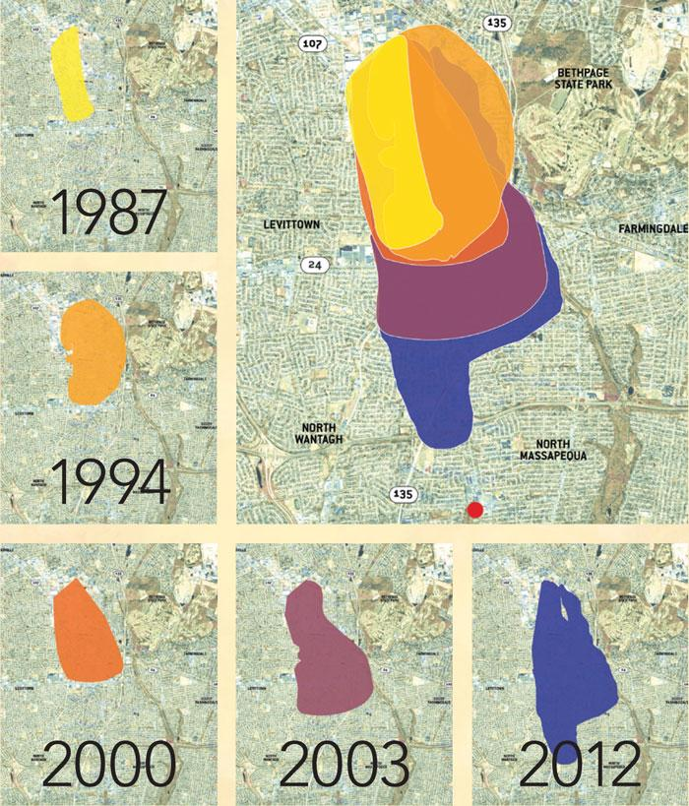
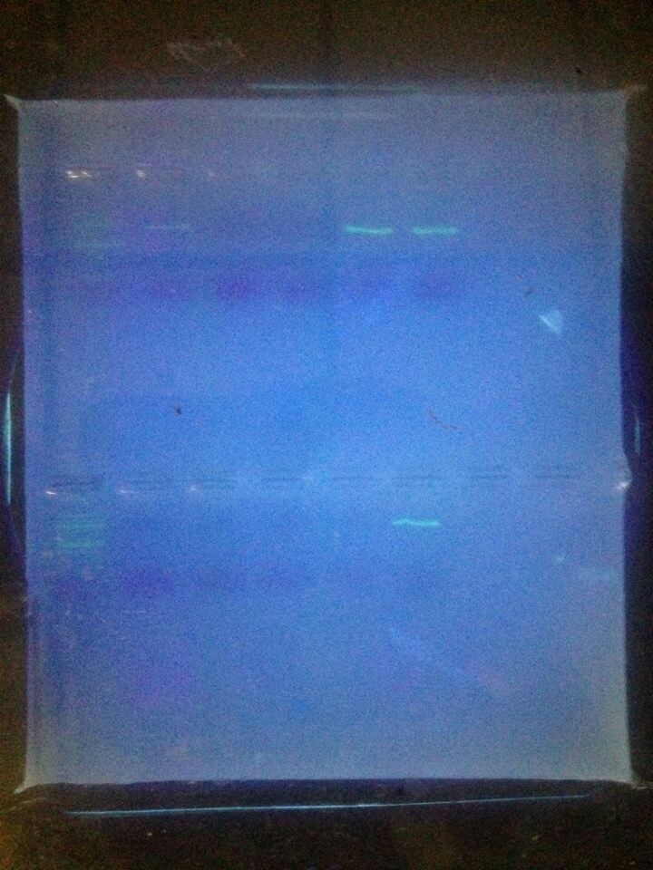
The Effect Of The Toxic Plume On Biodiversity
Authors: Olivia Ferraro
Mentors: August Eberling|
|Massapequa High School
ABSTRACT
The silica is centrifuged, supernatant decanted, and washed with 500uL of EDTA wash buffer three times. The final step to release the DNA from the silica is a 100uL distilled water wash, resuspending the pellet and incubating at 57C for 5 minutes. The Amplification collection tube is centrifuged a final time and the DNA, which is now in the supernatant is collected and stored at -20C.
Amplification
For the PCR amplification use the correct primers for plant rbcL amplification.
Plant cocktail
5'-TGTAAAACGACGGCCAGTATGTCACCACAAACAGA GACTAAAGC-3' (forward primer – rbcLaf-M13)
5'-CAGGAAACAGCTATGACGTAAAATCAAGTCCACCRCG-3' (reverse primer – rbcLa-revM13
Combine the 2uL of DNA, 10.5uL of both primers, and 12.5uL of Taq 2X master mix all together. Once all of this is done follow the CHS procedure for cycling conditions:
Initial denaturation 94C for 1 min
35 cycles of 94C for 15 seconds, 54C for 15 seconds, and 72C for 30 seconds. The first step is the denaturation step which separates the DNA strands and allows the primers to bind. When cooled to the annealing step the primers bind to the now single stranded DNA. During the extension step the Taq polymerase binds to the primers and makes a copy of the DNA.
DNA, 5uL, is then run on a 2% agarose gel. The gel is run at 130V for 30 minutes. The DNA will move to the negative end of the gel. When finished running DNA can be visualized using a UV transilluminator. If bands are of the correct size the corresponding DNA should be sent out for sequencing.
Sequencing
Submit 20 uL of the DNA to GENEWIZ, Inc for sequencing. GENEWIZ will sequence and upload sequences to DNALC’s DNA Subway website.
DISCUSSION
When there was the building of aircrafts the United States dumped the toxic chemicals around the property of now Northrop Grumman. The chemicals then seeped into the groundwater and are currently and are 620 feet into the ground. In 2012 two water wells were closed because of the spill and is currently moving farther south towards Massapequa. Northrop-Grumman has spent 120 million and the navy has spent 80 million since 2014. The Navy is monitoring wells in Farmingdale and Massapequa and have a plan to stop the plumes but the Massapequa water district feels that not enough is being done to stop the plume and more active monitoring should be done by the Navy. The aim of this study is to compare the biological diversity of area known to be contaminated with heavy metals and organic solvents to a native population. For the purpose of this experiment the contaminated area will be an area near the Bethpage State Park that is known to be in the toxic plume and the native population will be the Massapequa Preserve. Further genetic analysis, of all samples, will be conducted through amplification of the RGC sequence and a BLAST search will be performed to determine consensus to known local organisms. The effects of groundwater contamination will be evaluated based on the comparative populations. The end result to the experiment ended with three out of ten samples having bands. But we were unable to sequence them due to the fact that there was not enough to complete the sequencing.
The reason as to why the result were unable to be sequenced was due to the fact that there were not enough samples who needed to be sequenced. There also could have been human error. During the experiment two of the sample(one from each extraction site) opened up while sitting in the water bath. With this human error is even ,more possible than it already is if something doesn't go completely wrong. Even though those two samples were started over there is still the chance that is was human error. How only three bands came up shows that there is some effect of the toxic plume but not as much of an effect as was thought while doing this experiment. It's not a complete failure there were still some results.
HYPOTHESIS
If the biodiversity levels throughout the preserve have an extreme change between the two given areas(whether increased or decreased), then the Toxic Plume had caused an ecological reaction throughout the preserve which not only would affect the biodiversity but the whole entire ecosystem.
MATERIALS
The materials needed for this experiment is plastic zip-lock bags, ten plant samples( five from the contaminated area and five from the non-contaminated one), centrifuge, pestle, mortar, gel electrophoresis, water, beaker, hot plate, lysing solution, guanidine hydrochloride solution, silica resin, EDTA wash buffer, plant cocktail(forward and reverse primer) , agarose gel, and a freezer. All of these materials were used a countless amount of times throughout the experiment. If one of these materials were not here the experiment would not have been possible to do.
WORK CITED
Dooley, Emily C. "Water District to Sue over Contamination That Cost Millions." Newsday. N.p., 18 Nov. 2013.
Twarowski, Christopher. "Bethpage Toxic Plume Creeps Closer To Contaminating More Public Drinking Water Supplies." Long Island Press. N.p., 28 June 2012. Web
New York State Department of Environmental Conservation. "Disclaimer."DEC Announces Consent Order to Remediate Groundwater Plume at Bethpage Grumman Site. New York State Department of Environmental Conservation, 13 May 2015. Web.
Thomas Jefferson National Accelerator Facility - Office of Science Education. "The Element Cadmium." It's Elemental -. Steve Gagnon, n.d. Web.
Lenntech BV. "Water Treatment Solutions." Chromium (Cr). Lenntech BV, 1998. Web.
Morris & Chapman. "Arsenic." : 1. What Is Arsenic? Cogeneris Sprl. Design, 24 Nov. 2015. Web.
"Trichloroethylene." Trichloroethylene. United States Environmental Protection Agency, 10 Sept. 2015. Web
"Tetrachloroethylene (Perchloroethylene)." Tetrachloroethylene (Perchloroethylene). United States Environmental Protection Agency, Dec. 2012. Web.
"Ethylene Dichloride (1,2-Dichloroethane)." Ethylene Dichloride (1,2-Dichloroethane). United States Environmental Protection Agency, Jan. 2000. Web. 01
Cadmium Compounds (A)." Cadmium Compounds. United States Environmental Protection Agency, Jan. 2000
"Chromium Compounds." Chromium Compounds. United States Environmental Protection Agency, Jan. 2000. Web.
INTRODUCTION
PROCEDURE
There is a toxic plume made by the Northrop Grumman company from World War Two. The toxic plume is a combination of harmful chemicals that has been gradually growing over the years. Northrop Grumman is responsible to on site clean up and monitoring on regional groundwater. Off site monitoring and remediation is the responsibility of the U.S. Navy. The DEC has selected an outside contractor, HDR, to evaluate options for remediation. Current recommendations are the use of hydraulic containment, as opposed to well head treatment which is considered a measure of last resort (3).
The aim of this study is to compare the biological diversity of area known to be contaminated with heavy metals and organic solvents to a native population. For the purpose of this experiment the contaminated area will be an area near the Bethpage State Park that is known to be in the toxic plume and the native population will be the Massapequa Preserve. Permission has been obtained from Nassau County to collect plant samples for the purpose of this experiment. Samples will first be identified, to the best of our ability, taxonomically by using a New York State field guide. Further genetic analysis, of all samples, will be conducted through amplification of the RGC sequence and a BLAST search will be performed to determine consus to known local organisms. The effects of groundwater contamination will be evaluated based on the comparative populations.
Collection
In order to collect the samples an area must be found near the toxic plume. Once this area has been identified (3) and location will be verified using GPS coordinates. Five samples, in a one meter quadrant will be collected at each site. While collecting samples make sure to record the exact location. Place the samples are collected they will be placed in a labeled zip-lock bag. Each sample collected has a bag with a number, GPS coordinates, and toxic or nontoxic identifier.
Identification
A picture of the plant out of the bag, with and without a ruler. After photographing place the samples into the freezer until ready for DNA extraction. By using the pictures try to identify the plants by using the field guide before DNA extraction.
Extraction
DNA will be extracted by first lysing a small piece, 10 to 20 mg sample, of the plant material with a pestle in a 6M guanidine hydrochloride solution. The sample is then incubated in a 65C water bath for 10 minutes. The sample is then centrifuged and the supernatant is transferred to a tube containing 3uL of silica resin, then incubated for 5 minutes at 57C.
RESULTS
Of the 10 samples tested three plants produced bands that were usable for sequencing.
Row 1:
100 bp Ladder
NMG 001
NMG 002
NMG 003
NMG 005
NMG 006
Row 2
100 bp Ladder
NMG 007
NMG 008
NMG 009
NMG 011
NMG 012
ACKNOWLEDGEMENTS
I would like to thank Mr.Eberling for helping me throughout this project. He gave me an enormous amount of help and guided me throughout the experiment. By having him help me the experiment went ten times better then it would have.

