Slide 1
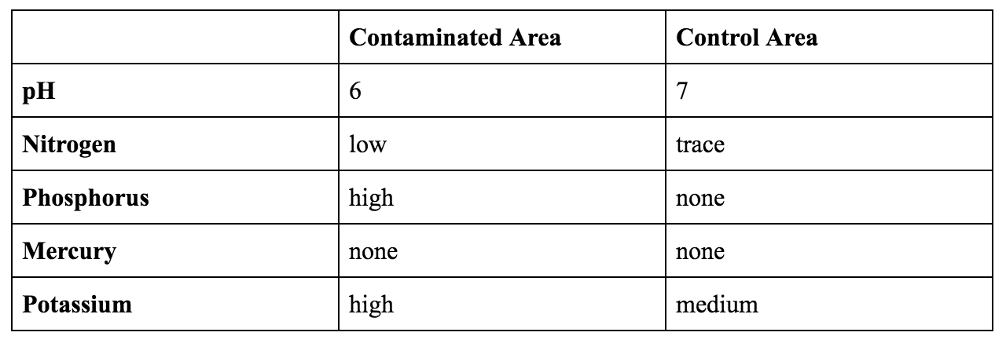
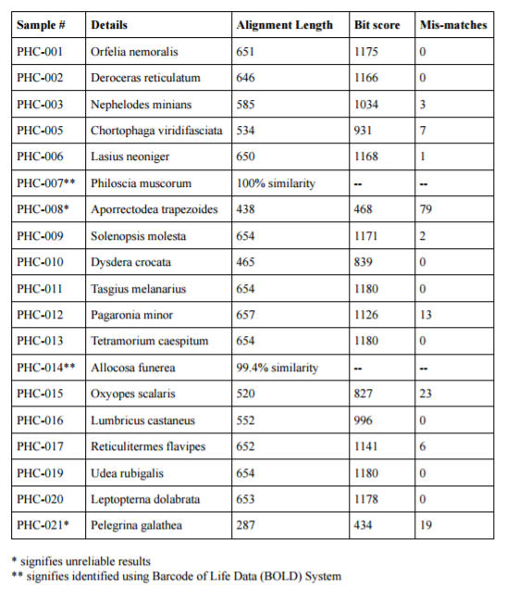
Investigating the Effects of Groundwater Plumes OU2 and OU3 on the Biodiversity and Soil Health of Bethpage, NY
Authors: Kevin Lam¹ and Jeffrey Yu¹
Mentor: Lisa Daniels¹
Roslyn High School; Cold Spring Harbor Laboratory’s DNA Learning Center
Results and Discussion
Soil Contamination
Biodiversity
DNA sequence results were trimmed, the forward and backward sequences paired, and a consensus was met for each sample using the DNA Subway program
Samples PHC-008 and PHC-021 were found to be unreliable, out ruling the potential for them to be novel sequences despite the number of mismatches
Basic Local Alignment Search Tool (BLAST) was used, each sample’s DNA sequence was compared to that of those in the CyVerse database for confidence matches
However, samples PHC-007 and PHC-014 were additionally ran through the Barcode of Life Data (BOLD) System for more precise identification
Although sample PHC-015 had 23 mismatches, this was mainly attributed to the poor PCR performance observed in electrophoresis results.
Based on BLAST sequence results, there were no samples with much significance
All species identified were native to the east coast and did not indicate any potential hazards
A phylogenetic tree did not show any notable patterns between the areas as samples were evenly spread throughout the tree
These results are promising as they do not show any significant difference from the contaminated and control sites, indicating that cleanup efforts at the contaminated site, Bethpage Community Park, have been successful.
High levels of nutrients in the contaminated area can indicate the use of fertilizer.
May be attributed to the soil excavation and replacement efforts.
Can be beneficial to the biodiversity as it helps plants grow and should not pose a problem as long as no harmful chemicals were used in the fertilizer that could seep into the soil and runoff.
We unfortunately were unable to test for such chemicals, but could do so in the future.
Conclusions and Further Studies
In 2013, the Town of Oyster Bay excavated approximately 175,000 cubic yards of soil contaminated with the chlorinated solvents, PCBs, metals and Freon compounds dichlorodifloromethane (R-12) and chlorodifloromethane (R-21) and replaced the materials with clean soil. In addition to the excavation, a groundwater extraction, treatment, and containment system has been set up along with a soil vapor extraction and treatment system (“Northrop”).
Four years after the cleanup process, we can now establish that the topsoil biodiversity is normal compared to that of a control area. Knowing this, it gives us reassurance that the health effects on humans have also been lowered. However, without reference data of biodiversity before and during the contamination period, we can not see how biodiversity has changed.
For further studies, we could test the biodiversity of deeper soil
It is expected that the topsoil to be clean due to replacement efforts; however, soil deeper down may still be contaminated
Monitor plume movements by checking if the plume have moved to the control area
Collect samples from the control site again, allowing for us to compare the biodiversity of the area before and after the contamination.
While this study has shown that cleanup efforts at Bethpage Community Park has worked to maintain a normal level of biodiversity in the topsoil, we must be wary about the other effects the plumes may have had and the future of the plumes

Slide 2
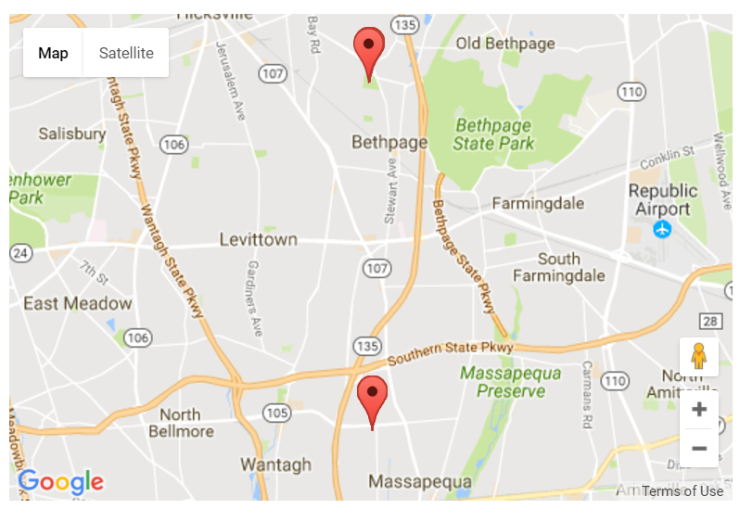
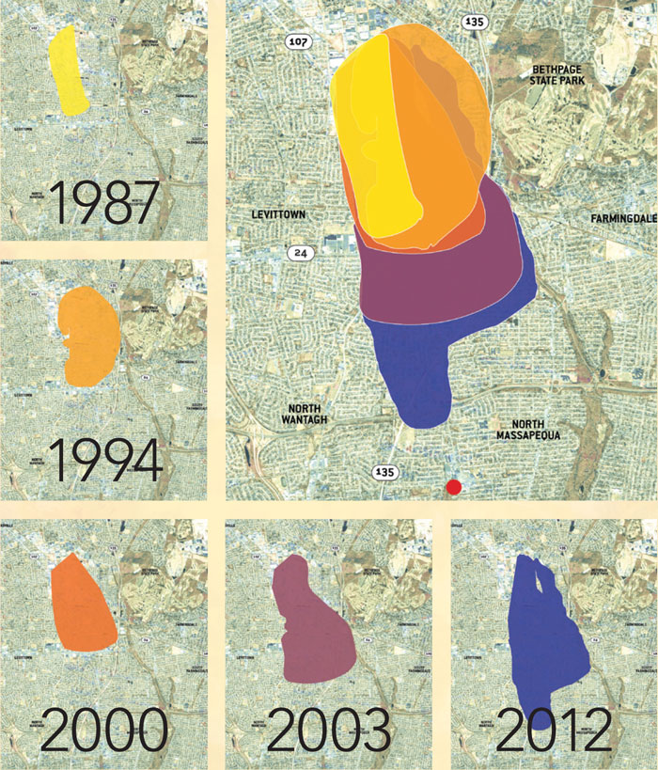
Abstract
Materials and Methods
In the mid-1900s, military industrial plants were established in Bethpage. Subsequent years of unsafe chemical handling led to toxins seeping into the ground. The contaminated soil and water in Bethpage created two major dangerous groundwater plumes. Clean-up efforts were undertaken, but the hazardous chemicals can still be detected today. In the present study, we examined the soil health and biodiversity of a contaminated area compared to an unaffected area. We assessed for biodiversity by collecting insect samples and using DNA analysis techniques. It was found that biodiversity in both areas were similar as shown by phylogenetic trees. This indicates that cleanup efforts have been largely effective at establishing a normal level of biodiversity, despite the area being devastated by industrial waste in the past.
Location
Samples were taken from a contaminated area, Bethpage Community Park, and a control area, Washington Avenue Park.
Currently, Bethpage Park remains at the northern tip of both the OU2 and OU3 plumes
Cleanup efforts have been taken to reverse the effects of the plumes in the park
Site is an ideal location for sampling to see effective cleanup efforts have been and damage done by plume
On the other hand, Washington Avenue Park has not been affected by the plume
However, due to the current southward movement of the plumes, it may be in the future
This allows us to test for biodiversity and soil contamination of the Washington Avenue Park now, and possibly again in the future if the plume moves southward
Data Collection
Multiple samples were collected in each park within a six inch radius at the base of a post
Four soil samples were taken using a one foot soil core sampler from each site in which each sample was approximately ninety degrees from each other around the post
Ten insect samples were taken from each site
Insect samples PHC-001 to PHC-011 were collected from the contaminated site and insect samples PHC-012 to PHC-021 were collected from the control site.
Data Analysis
Samples were documented and frozen for preservation
Portion of soil samples were tested for levels of pH, phosphorus, potassium, and nitrogen
DNA from insects was isolated following procedures outlined on the DNA Barcoding website (“DNA Barcoding”)
DNA was amplified through polymerase chain reaction and analyzed with gel electrophoresis
DNA was then sent to be sequenced in both the forward and backward directions.
Introduction
The soil is home to more than a quarter of all organisms on Earth and as humans and apex predators, we depend on the soil for all of our energy (“Soil Biodiversity”). However, chemical pollution is a major negative factor in soil biodiversity, where harmful substances such as lead and arsenic kill essential organisms.
In the 1930s, the Northrop Grumman Corporation Site, and in 1941, the Naval Weapons Industrial Reserve Plant, were established in Bethpage, NY. The facilities conducted research, testing, and manufacturing operations for the Navy and the National Aeronautics and Space Administration, situated on 605 acres (“Naval”). These facilities had open seepage basins, a type of drainage system where wastewater is disposed into the ground, and sometimes they even dumped into surrounding grounds.
Over years of these unsafe practices, chemicals seeped into the ground, contaminating the soil and water in Bethpage. This created groundwater plumes, a shallow one called the OU2 plume was discovered in 1986, and a larger, deeper one called the OU3 plume was discovered in 2009 (“Northrop Grumman”). Hazardous industrial wastes have been detected in contaminated areas, such as trichloroethylene (TCE), chromium, cadmium, arsenic, and polychlorinated biphenyl (PCB) among various others. Clean-up efforts have been made, but the hazardous chemicals can still be detected today. Currently, the plumes are traveling south and have split into fingers (“Postscript”).
This project aimed to examine the effects these groundwater plumes have had on the biodiversity of Bethpage. By surveying areas affected by the plumes to control areas that have not been affected, we used DNA barcoding techniques to examine differences in biodiversity. Furthermore, we surveyed soil contaminant levels; testing for levels of pH, phosphorus, potassium, nitrogen, and mercury. We predicted that in contaminated areas, the biodiversity will be less than those of non contaminated areas.
References
"Diversity Indices." Diversity Indices. N.p., n.d. Web. 30 Nov. 2016.
"DNA Barcoding." DNA Barcoding 101. N.p., n.d. Web. 30 Nov. 2016.
"Environmental Contaminants Encyclopedia" NPS. N.p., n.d. Web. 30 Nov. 2016.
"Naval Weapons Industrial Reserve Plant and Northrop Grumman Corporation Site." EPA. Environmental Protection Agency, n.d. Web. 30 Nov. 2016.
“Northrop Grumman” Nysdec. Northrop Grumman - Bethpage Facility (OU-3)- Record of Decision (n.d.): n. pag. Web.
"Postscript: Tools for Policy-Makers." Complexity, Institutions and Public Policy (n.d.): n. pag. Web. 30 Nov. 2016.
"Soil Biodiversity." Europa, n.d. Web. 30 Nov. 2016.
"What Are Plumes?" Bethpage Cancer Project. N.p., n.d. Web. 30 Nov. 2016.

