Slide 1
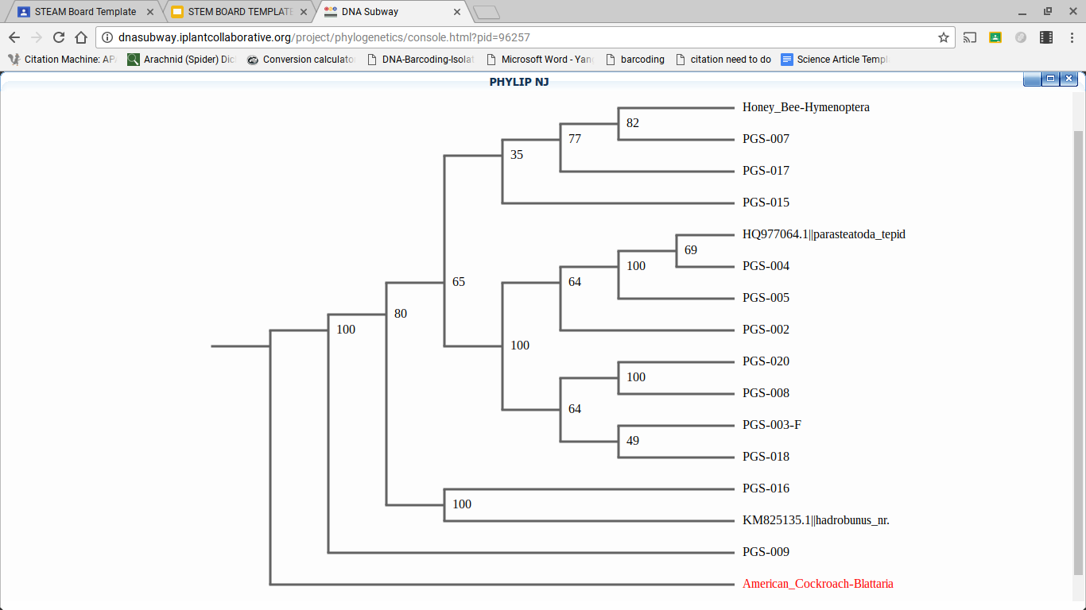
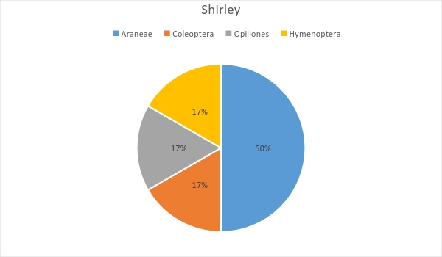
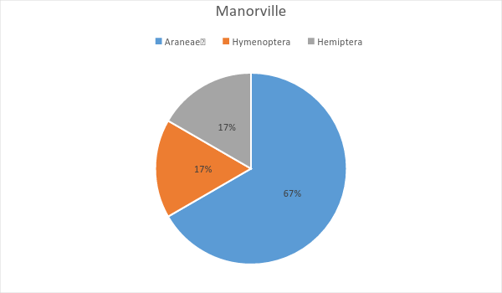
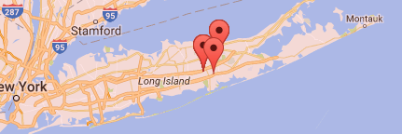
Analyzing the Biodiversity of Predatory Insects and Arachnids using DNA Barcoding from a Forested Region and a Coastline Region on Long Island, NY
C. Meehan, K. La Spisa, G. Ferguson
Victoria D’Ambrosia
William Floyd High School and Cold Spring Harbor’s DNA Learning Center
Abstract
In an ecosystem, biodiversity is the quantity of different species thriving in an environment, and is important due to the reliance species have upon one another. The biodiversity of predatory insects and arachnids were compared between coastal and forested regions because these controls influence the biodiversity of biological vectors. It was hypothesized that coastal regions had a higher biodiversity than forested regions due to their proximity to large bodies of water which provided a surplus of energy. In the coastal environment of Shirley New York, 50% of samples collected here were Araneae, 17% were Coleoptera, 17% were Hymenoptera, and 17% were Opiliones. In a forested environment located of Manorville, New York 67% of the samples that were collected were Araneae, 17% were Hemiptera, and 17% were Hymenoptera. The coastal environment had an overall greater biodiversity which could be attributed to a greater influx of energy entering the terrestrial food web from the aquatic and marine food webs. Additionally, after barcoding, sequences PGS-016 and PGS-017 were found to be potentially novel sequences.
Introduction
Biodiversity is the variety of different species in a given environment. This diversity is essential because a larger diversity assists in stabilizing the environment. This creates more intricate relations among organisms, especially predator and prey interactions (Shah, 2014). Previous research indicates that predatory insects and arachnids act as controls for biological vectors in ecosystems. Without these controls, the pathogen populations would have the potential to increase which could be harmful to a myriad of organisms in the environment (Hawkins et al., 2009). In 2009, the vector Culex pipiens-restuans was discovered to be carrying the West Nile virus in Yaphank, New York, which could lead to an increase in the spread of this disease, which was indicated by previous research (Kitchen, 2016).
A prior research study performed in predatory insect biodiversity, indicates that larger densities of spiders are found on islands. This was attributed to additional energy entering the food chain from the ocean (Polis & Hurd, 1995).
A process called DNA barcoding identifies species by genetic sequence because phenotypic traits vary considerably among organisms. DNA barcoding is a system used for identifying an organism by analyzing and comparing specific genes. To barcode the predatory insects and arachnids, the mitochondrial gene Cytochrome Oxidase subunit 1 was analyzed (Hebert e t al., 2003). The variability of this gene allows for the gene to be compared on a species level. The Cytochrome Oxidase subunit 1 codes for the Cytochrome protein.
Analyzing the biodiversity of predatory insects and arachnids is relevant due to the control predatory controls have over the biodiversity of vectors. This research is essential because it helps control vector population, which helps maintain the stability of the environment. The research question of whether or not the biodiversity of predatory insects and arachnids is more diverse in a forested area or a coastline area on Long Island was posed. It was hypothesized that these controls will be found in greater diversity in the forested regions than the coastal regions due to the higher habitat complexity and presence of a third degree canopy.
Materials & Methods
Samples were collected from the wooded areas of Manorville and from the shoreline areas of Shirley using a Berlese funnel trap. These two locations were chosen to compare the biodiversity near the shoreline and near a wooded area. The Berlese funnel trap was placed within 15 centimeters of a metal pole. After collection samples were preserved in a freezer, in order to prevent the decomposition of the DNA. Organisms near the shoreline were caught within roughly five meters of a major body of water. The samples were documented via microscopic photography, with a ruler present as a reference, and were identified with a dichotomous key based on their phenotypic traits.
The legs of the samples were used for DNA extraction. The legs were ground up in a lysis solution which was used to break down the membrane bound DNA. Silica resin was added to the samples in order to bind the DNA. A wash buffer was added to remove impurities while distilled water was added to further clean the DNA.
DNA was added to a strip tube with PCR beads and primer mix already present. The CO1 gene was amplified using a thermocycler. In order to confirm the DNA was successfully amplified, gel electrophoresis was performed. Samples were then loaded into the gel with SYBR Green, which was covered in TBE buffer. An electrical charge was applied to the samples in order to separate the DNA. Using an illuminator, results were observed and photographed, the pictures progressed to be uploaded to the sample database.
Sequences that were successfully amplified were sent to Genewiz and uploaded onto DNA Subway, a bioinformatic tool used to compare specific genes. This sequence was used to determine the genus and species of the organisms and a barcode was created to compare the organisms to other organisms collected by other researchers, and a phylogenetic tree was created to compare the genetic history of the organisms. Once a clear sequence was derived, it was applied to the BOLD and NCBI databanks in order to determine if it was a novel sequence.
Tables & Figures
Figure 4: This figure demonstrates the barcodes of the samples analyzed and other reference species. The colored bars indicate differences in nucleotides and the grey bars indicate similarities in nucleotides. The percentages indicate similarities between samples and reference insects. Percentages of above 95% indicate that two samples are the same species.
Figure 5: This figure demonstrates the evolutionary relationships between the samples and reference organisms. The data indicates that all of the samples have a common ancestor. It is important to note the unidentified sample, PGS-017 has a bootstrap score of 77 out of 100, therefore it shares a common ancestor with the Honey Bee. Additionally, the other unidentified sample PGS-016 has a bootstrap score of 100 out of 100 with Hadrobunus grandis indicating that they are not the same organism however, they share a common ancestor.
Figure 6: This chart demonstrates the percentage of different organisms of samples categorized by order collected in Shirley, NY within the shoreline. Data indicates that the most common order collected was araneae. This could be attributed to a greater influx of energy from the aquatic food web to the terrestrial food web. Higher population of prey located near the water that is the primary food source of araneae, most notably being gnats and mosquitos.
Figure 7: This chart demonstrates the percentage of different organisms collected in the heavily wooded regions in Manorville, NY. This data indicates that majority of the samples from Manorville were araneae. This can be attributed to the greater diversity among araneae when compared to hemiptera and hymenoptera, which would allow for more species to interact effectively in the environment, effectively increasing their population. This chart also demonstrates the overall diversity of the Manorville region. This data indicates that Manorville has a high diversity of different orders and species, due to the presence of a third degree canopy, which increases habitat complexity in the ecosystem, effectively making it more diverse.
Discussion
The research question posed was whether or not a variety between the biodiversity of predatory insects and arachnids in a shoreline area or a heavily wooded area existed. Previous knowledge suggested that the coastline would have a relatively higher biodiversity than the heavily wooded areas. However in these past studies the environmental factors were much different due to the location of where the study took place. Figure 6 and Figure 7 demonstrate that there was a greater biodiversity discovered on the shoreline region on a species level. This greater biodiversity can be attributed to a greater habitat complexity and a greater influx of energy entering the food web from the aquatic ecosystem. The third dimensional canopy could also have an effect on the diversity of the predatory insects, and is supported by the data collected. The existence of the canopy, such as shrubbery or grasses allows for prey to have more habitat to inhibit or use as cover. This leads to a higher population of prey which in turn could lead to a higher population of predators. Along with the greater level of energy entering from the aquatic ecosystem there would be more chances of survival and reproduction for more species of insects.
The samples PGS-016 and PGS-017 did not have any matches in both the Bold database and the NCBI genbank this shows that these samples have the potential to be novel sequences with the closest Genus to PGS-016 being Leiobunum and the closest species to PGS-017 being Anoplius caviventris. Although both PGS-016 and PGS-017 have a Query cover of less than 95% with both of the closest related organisms showing that they are different species. According the the cladogram PGS-017 may share a common ancestor with the honey bee and PGS-016 shares a common ancestor with the Hadrobunus grandis. Additionally it should be noted that according to the barcode PGS-004 and PGS-005 are very similar if not the same species. Based on figure 6 and figure 7, the Shirley shore appeared to have the potential of having a greater biodiversity but in order to test this the sample size would need to be increased.
Acknowledgements
The following organizations were crucial to the research conducted: The Pine Barrens Commissions, Brookhaven National Laboratory- A Day in the Life, Cold Spring Harbor Laboratory’s Learning Center- more specifically: Dr. Sharon Pepenella, Dr. Bruce Nash, Dr. Cristna Fernandez-Marco, Manor of Saint George, USGS Gauging site, and William Floyd High School’s Victoria D’Ambrosia
References
Shah, A. (2014, January 19). Why Is Biodiversity Important? Who Cares? Author And Page Information. Retrieved October 17, 2016, from http://www.globalissues.org/article/170/why-is-biodiversity-important-who-cares
Kitchen, P. (2016, August 11). West Nile virus found in mosquitoes at 3 Suffolk parks, officials say. Newsday. Retrieved October 17, 2016, from http://www.newsday.com/news/health/west-nile-virus-found-in-mosquitoes-at-3-suffolk-parks-officials-say-1.12164795
Polis, G. A., & Hurd, S. D. (1995, May 9). Extraordinarily high spider densities on islands: Flow of energy from the marine to terrestrial food webs and the absence of predation. Retrieved October 17, 2016, from http://www.pnas.org/content/92/10/4382?tab=author-info
Hebert, P. D., Cywinska, A., Ball, S. L., & DeWaard, J. R. (2003, February 07). Biological identifications through DNA barcodes. Retrieved May 02, 2017, from https://www.ncbi.nlm.nih.gov/pubmed/12614582
Hawkins, S., Sugden, H., Mieszkowska, N., Moore, P., Poloczanska, E., Leaper, R., . . . Burrows, M. T. (2009, December 09). Consequences of climate-driven biodiversity changes for ecosystem functioning of North European rocky shores. Retrieved May 25, 2017, from http://eprints.bournemouth.ac.uk/14238/
Figure 1: This figure demonstrates the sample PGS-016 failed to find a match in both the Bold database and the NCBI database. Data indicates that the barcode of this sample did not match any other species which indicates that this sample may be a novel sequence.
Figure 2: This figure demonstrates the sample PGS-017 does not have any matches in both the Bold database and the NCBI database. Data indicates that the barcode of this sample did not match any other species which indicates that this samples could potentially be a novel sequence.
Figure 3: This map indicates the collected location of the samples used for the analyzation of the biodiversity of predatory insects and arachnids. This can be attributed to the limited number of samples allowed to be collected, rendering a large diversity of regions being uncollectible.

