Slide 1
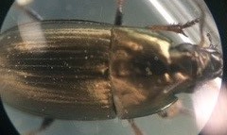
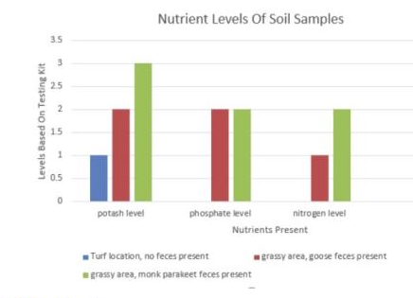
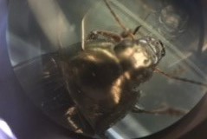
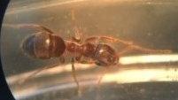
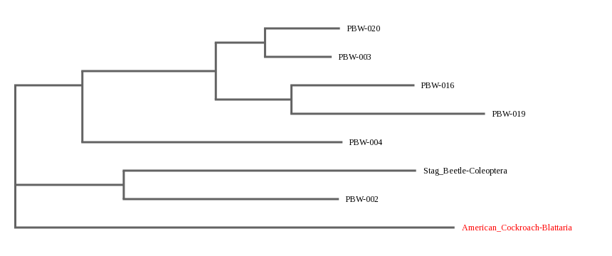
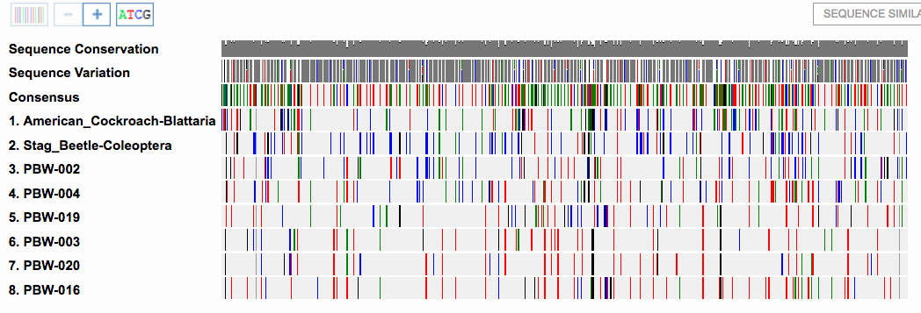
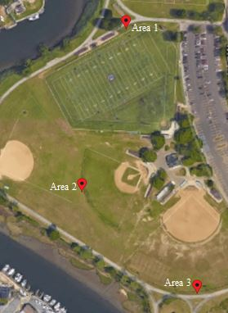
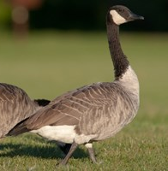
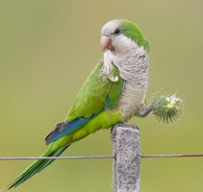
The Effect of Invasive Bird Feces on the Invertebrate Biodiversity of Seaman's Neck Park in Seaford, NY
Abstract
Our group worked toward using DNA barcoding to identify invertebrates in Seaman's Neck Park in Seaford, Long Island. Studies have found that increases in nitrogen, phosphorus, and potassium increases nutrients in the soil composition. It was observed that the species located within a bog changed due to changes in the soil composition. (4) Our objective was to determine was if invasive bird feces (Monk Parakeet and Goose) had an effect on the ecosystem. We had hypothesized three statements: That nutrient levels in the soil would be increased, that there will be a positive effect on vegetation and therefore more species will be dependent on that vegetation, and that there will be a change in the species composition in the areas with and without invasive birds. We used the co1 primer during our PCR to amplify the mitochondrial gene cytochrome c oxidase subunit I. We then ran a gel electrophoresis to confirm we had enough DNA to send out for DNA sequencing. We compared out sequences to known sequences in order to identify our samples. We have come to the conclusion that our hypothesis was partly supported. The presence of bird feces increased the nutrient levels in the soil of both the Goose area and Monk Parakeet area. There did not appear to be a significant difference in the number of different species present in the area without bird feces than the area with bird feces. What does appear significant is that the diversity of species found in the parakeet feces area was not found in the other two areas whereas the other two areas have some species in common. The presence of invasive birds in Seaman’s Neck Park may be contributing towards an increase in the overall biodiversity of invertebrates in the park.
Authors: Melanie Cascio, Darah Daskalakis, Gabrielle Moro, Lindsay Pfaff ​
Mentors: Janine Cupo, Mary Simons​
Seaford High School, NY
Methods and Materials
Collect soil samples and document GPS location
Sift through soil and collect invertebrate samples
Photograph each invertebrate sample individually, place in a test tube and label the tube
Test each soil sample for nitrogen, phosphorus, pH and potash
Isolate DNA
Add specimen tissue sample and lysis solution into a test tube and grind the sample in the solution
Incubate the tube at 65 degrees Celsius for 10 minutes then centrifuge for a minute and transfer supernatant to a fresh tube
Add silica resin to tube, mix, then incubate at 57 degrees Celsius for 10 minutes and after, centrifuge for 30 seconds
Remove the supernatant, add wash buffer, mix, then centrifuge for 30 seconds
Again, remove supernatant, add wash buffer, mix, then centrifuge for 30 seconds
Remove supernatant, centrifuge for 8 seconds, then remove the remaining supernatant
Add dH20 and mix by pipetting in and out, then incubate at 57 degrees Celsius for 5 minutes
Centrifuge for 30 seconds then transfer the supernatant, where the DNA is located, into a fresh tube and chill
PCR using CO1 primer: Add PCR reagents to a fresh tube then transfer DNA to the PCR tube
Amplify in thermal cycler then chill on ice
Perform a gel electrophoresis to ensure DNA is present
Send samples that had DNA present out for sequencing
Analyze the results of the sequences. BLAST the sequences in order to identify the specimens in DNALC’s DNA Subway
If no matches were found, search GENBANK and BOLD directly
Results
Table 3: Species Found in Seaman’s Neck Park
Table 1: Seaman’s Neck Park Collection Details
Sample ID | Area # | COMMON NAME | GENUS SPECIES | BLAST MISMATCHES | BOLD SIMILARITY % | IMAGES
PBW-001 | 1 | Annelid | Fridericia ratzeli | 26 | 99.85 Early-Release
PBW-002 | 1 | Garden Beetle | Maladera castlanea | 78 | 98.31 Early-Release
PBW-003 | 1 | Black Beetle | Cratacanthus dubius | 2 | 99.85 Published
PBW-004 | 1 | Oriental Beetle | Anomala orientalis | 16 | 99.69 Early-Release
PBW-005 | 1 | Pill bug | Armadillidium vulgare | 0 | n/a
PBW-006 | 2 | Pill bug | Armadillidium vulgare | 0 | n/a
PBW-008 | 2 | Earwig | Forticula auriculana – A | 1 | 100 Published
PBW-014 | 2 | Earwig | Forticula auriculana – A | 0 | n/a
PBW-015 | 2 | Earwig | Forticula auriculana – A | 1 | 100 Published
PBW-016 | 3 | Sun beetle | *Amara aenea or Amara siunuosa | 0 0 | 100 Published 100 Published
PBW-017 | 3 | Sun beetle | Amara aenea | 1 | 99.85 Published
PBW-018 | 3 | Ant | Lasius neoniger | 0 | n/a
PBW-019 | 3 | Sun Beetle | Amara torrida | 13 | 98 Published
PBW-020 | 3 | Ground Beetle | Harpalus rubripes | 0 | n/a
Core # | Area | Collector name | Time | Latitude | Longitude | Habitat | Nutrient Analysis
1 | 1 | Gabby Lindsay | April 5 7:20pm April 17 10:09am | 40.6510 | -73.4923 | No feces, grassy area, well maintained, ants present | Potash level: 1 Phosphate level: 0 Nitrogen level: 0 PH level: 6
2 | 2 | Lindsay | April 17 10:22am | 40.6497 | -73.4921 | Grassy area, well maintained with geese feces present, long skinny larva present | Potash level: 2 Phosphate level: 2 Nitrogen level: 1 PH level: 5.5
3 | 3 | Lindsay | April 17 10:28am | 40.6495 | -73.4904 | Grassy area, well maintained with monk parakeet feces present | Potash level: 3 Phosphate level: 2 Nitrogen level: 2 PH level: 6.5 - 7
Discussion ​
Our hypothesis that bird feces increases the amount of essential nutrients in the soil was supported (table 2) The areas containing bird feces, unlike we had hypothesized, did not definitively contain the most biodiversity (table 3). We observed that the area richest in nutrients, the monk parakeet area, had different species than the other two areas. Areas one and two both had pill bugs and earwigs present and area three did not. It had mostly sun beetles. The nutrients present in the soil had changed the soil composition, potentially changing the vegetation in the area and providing a new food source for different invertebrate species. This supports our hypothesis that a change in the composition of the soil would change the species present in that area. ​
Table 2:
Figure 5: Phylogenetic Tree of Beetle Specimen from Seaman’s Neck Park
Ground Beetle
Black Beetle
Sun Beetle
Sun Beetle
Table 4: Sequence Alignment for Beetles Species and Out Group
Oriental Beetle
Seaman’s Neck Park
Garden Beetle
The purpose of this tree was to determine the evolutionary relationship between ground beetles in the Monk Parakeet area and the other locations. The location 3 beetles (Monk Parakeet area) share a more recent common ancestor than the beetles from location 1 and are therefore more closely related.
References
1.All About Birds (2016). All About Birds. Retrieved from The Cornell Lab of Ornithology All About Birds: https://www.allaboutbirds.org/guide/Canada_Goose/id
2. All About Birds. (2016). The Cornell Lab of Ornithology All About Birds. Retrieved from The Cornell Lab of Ornithology All About Birds: https://www.allaboutbirds.org/guide/Monk_Parakeet/id
3.Barcode Long Island. (2016). Suggested Sampling Techniques. Retrieved from Barcode Long Island: https://www.dnabarcoding101.org/programs/bli/
4. Hilde B.M Tomassen, A.J. (2004, March). High-Level Diversity of Dinoflagellates in the Natural Environment, Revealed by Assessment of Mitochondrial cox1 and cob Genes for Dinoflagellate DNA Barcoding. 1279-1290.
5. Senjie Lin, H.Z. (2009, March). High-Level Diversity of Dinoflagellates in the Natural Environment, Revealed by Assessment of Mitochondrial cox1 and cob Genes for Dinoflagellate DNA Barcoding. 1279-1290.
https://www.allaboutbirds.org/guide/Canada_Goose/id
In area one we collected invertebrates that were all different and unrelated to each other. It had the least amount of nutrients present in the soil. In area two we collected invertebrates that were very similar. Three out of the four invertebrates that we collected had identical sequences. It had an adequate amount of nutrients present. In area three we collected potentially five different species of invertebrates. Sample PBW-016 matched with Amara sinuosa and Amara aenea in both the BLAST and BOLD websites. A taxonomic review would need to be conducted in order to determine the species. Three out of the five invertebrates we collected were closely related species.
Google Maps
https://www.allaboutbirds.org/guide/Monk_Parakeet/id

