Slide 1
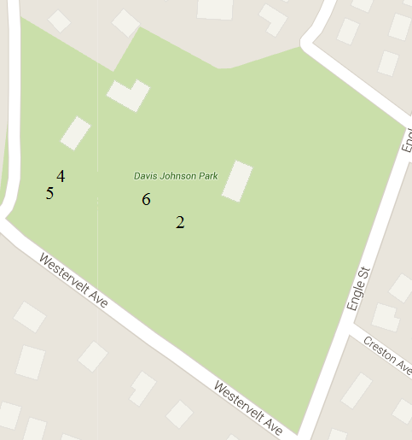
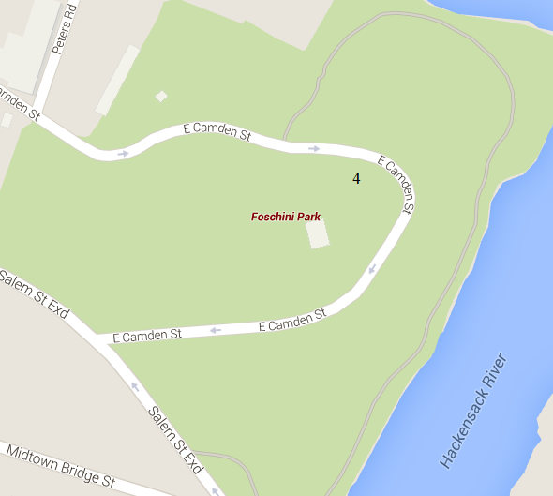
Abstract
Assessing the precision of lichens as index organisms of SO₂ pollution
Discussion
Sulfur dioxide (SO₂) is just one of many harmful pollutants in the atmosphere to humans and animals. It is commonly created by humans from automobile emissions and factory pollution. SO₂ pollution is a problem which is prevalent in many major cities. Lichens are known to be index organisms of SO₂, allowing humans to gauge a rough estimate of the amount of SO₂ in the air. In this project, lichens were taken from three different locations, two with estimated amounts of SO₂ and one with a known amount of SO₂, to test the accuracy and precision of lichens as index organisms of SO₂. It was concluded, due to the close proximity of various lichens exhibiting opposite tolerances, that lichen tolerances can exceed the necessary tolerance needed survival. It was also concluded that lichens that are intolerant to SO₂ are the best index organisms for SO₂.
Bryant Lee, Kengo Kuwama, Jai Yoon Chung
Based on the two lichens found near each other in Tenafly with contrasting SO₂ tolerance levels, it can be concluded that lichens can have tolerance levels over the necessary amount needed to survive.
The lichen from Hackensack could tolerate more SO₂ pollution than was recorded, showing that lichens with high tolerance levels do not grow exclusively in areas with large amounts of SO₂.
Sensitive lichens are better indicators of SO₂ pollution.
Limitation of this study was that 6 samples from Tenafly and 9 samples from Hackensack did not result in successful sequencing and thus the amount of data is not statistically significant to draw a definite conclusion.
Future work can include using an SO₂ sensor to determine an accurate measurement of SO₂ at the location where the lichen sample is collected.
Results
Lichen H4 was found to have a higher than necessary tolerance to SO₂.
2 of the lichens from Tenafly were found next to each other, one of which was tolerant, and the other sensitive.
Lichens from Colorado was sensitive, as predicted.
# | Species and percent match | SO₂ tolerance (ppb)
T2 | Punctelia rudecta 94.11% | Sensitive ~5-15
T4 | Cladonia rei 99.29% | Sensitive ~5-15
T5 | Lepraria finkii 100% | Tolerant 30+
T6 | Lepraria finkii 100% | Tolerant 30+
H4 | Flavoparmelia caperata 94.96% | Tolerant 30+
C1 | Rhizoplaca melanophthalma 96.75% | Sensitive ~5~15
Introduction
Figure 1: Example of lichen- lichen sample T2
Figure 2: Example of lichen- lichen sample T4
SO₂ is a pollutant often released into the atmosphere as a byproduct of the combustion of fossil fuels, making it common in industrial cities.
The SO₂ gas chemically combines with the oxygen in the air, yielding sulfuric acid, one of the main components of acid rain.
SO₂ is harmful to both humans and animals, causing a wide variety of diseases.
Lichens are extremely versatile creatures, and can be found in a wide variety of locations, making them good index organisms for sulfur dioxide.
There are three categories of tolerance levels of lichens species:
Tolerant to SO₂ > 30 ppb (upper safety limit for humans)
Intermediate to tolerant to SO₂: 15 ~ 30 ppb
Sensitive to SO₂ < 15 ppb
Lichens are comprised of two main parts: the photobiont and mycobiont.
The photobiont is the synthetic component, and the mycobiont is the fungal component.
In our previous project, “Assessing the amount of SO₂ in Central Park using lichens as index organisms,” it was found that lichens that were more tolerant to SO₂ pollution were found in the southern part of Central Park, and lichens that were more sensitive to SO₂ pollution were found in the northern part of Central Park. This agreed with the traffic density at those locations. This finding led us to examine the use of lichens as an index organism further.
The U.S. Forest Service Website has a list of lichens species with its associated SO₂ tolerance.
Methodology
Part 1: Collection of lichens
30 lichen samples were collected from Davis Johnson Park, Tenafly, NJ.
10 lichen samples were collected from Foschini Park, Hackensack, NJ.
Two lichen samples were collected from Pikes Peak, Colorado.
Samples were scraped into individual plastic bags with scalpels which were cleaned with alcohol between each sample.
Part 2: Preparation of PCR
Samples were brought to a DNA laboratory.
Lysis solution was added to break down the cell walls and to allow us to access the DNA.
The samples in solution were then incubated for 10 minutes at 65°C.
Silica resin was added to separate the DNA.
The lichens were centrifuged at 13,400 rpm for 1 minute multiple times to separate the DNA from the contaminants.
Wash buffer was added to remove impurities.
The fungal primer, base nucleotides, and Taq polymerase were mixed.
The mixture was placed in the thermal cycler, allowing the DNA to undergo PCR.
Gel electrophoresis was used to determine whether samples had sufficient quality to be sequenced.
Part 3: Sequencing and Determining sequencing results
Successful samples were sent to be sequenced.
DNA Subway was used to trim sequences and form a consensus sequence.
Various gene databases, such as GeneBank and Encyclopedia of Life, helped determine lichen species.
MUSCLE was used to determine the best percent match of nucleotide sequences between sample sequence and its match on the database.
Conclusion
The tolerance level of the lichen can exceed the necessary level to survive.
Lichens that are sensitive to SO₂ are better index organisms than lichens that are tolerant to SO₂.
References
TRIFOLD AREA – THIS GUIDE WILL BE REMOVED BEFORE PRINTING – TRIFOLD AREA – THIS GUIDE WILL BE REMOVED BEFORE PRINTING – TRIFOLD AREA – THIS GUIDE WILL BE REMOVED BEFORE PRINTING – TRIFOLD AREA – THIS GUIDE WILL BE REMOVED BEFORE PRINTING – TRIFOLD
TRIFOLD AREA – THIS GUIDE WILL BE REMOVED BEFORE PRINTING – TRIFOLD AREA – THIS GUIDE WILL BE REMOVED BEFORE PRINTING – TRIFOLD AREA – THIS GUIDE WILL BE REMOVED BEFORE PRINTING – TRIFOLD AREA – THIS GUIDE WILL BE REMOVED BEFORE PRINTING – TRIFOLD
Figure 3: Table of lichen species and its associated
SO₂ tolerance
The United States Environmental Protection Agency, Causes of Acid Rain [Web log post] Retrieved November 15, 2015, from http://www3.epa.gov/region1/eco/acidrain/causes.html
The United States Environmental Protection Agency, Health [Web log post] Retrieved November 13, 2015, from http://www3.epa.gov/airquality/sulfurdioxide/health.html
Concord, Lichens as Bioindicators [Web log post] Retrieved November 17, 2015, from http://staff.concord.org/~btinker/GL/web/air/bioindicators/
The Microbial World of Lichens, [Web log post] Retrieved November 16, 2015, from http://archive.bio.ed.ac.uk/jdeacon/microbes/lichen.htm
United States Forest Service, Lichens & Air Quality Database and Clearinghouse [Web log post] Retrieved November 12, 2014, from http://gis.nacse.org/lichenair/?page=sensitivity
The United States Environmental Protection Agency, Sulfur Dioxide, Retrieved December 1st, 2015, from http://www3.epa.gov/airtrends/sulfur.html
Cold Spring Harbor Laboratory DNA Learning Center. 2014. Using DNA Barcodes to Identify and Classify Living Things. Cold Spring Harbor, NY
Oxford Journals [Internet]. Surface Hydrophobicity causes SO Tolerance in Lichens. [March 11, 2015]. Available from: http://aob.oxfordjournals.org/content/101/4/531.full.pdf
Figure 4: Map showing location of all successful
lichens from Tenafly
Acknowledgments
Hypothesis/Purpose
We would like to thank Dr. Melissa Lee for allowing us to use the equipment in the Harlem DNA Learning Center for my project, Dr. Natalie Cleavitt of Cornell University, for guiding us through the project, and our teacher, Mrs. Helen Coyle, for motivating us throughout this project. We would also like to thank Jessica Schenkman for collecting our Colorado samples, and Caroline Bucca for helping transport our samples. We thank our parents for their continued support.
It was hypothesized that the lichens that we tested would remain in range of the data listed on the U.S. Forest Service website, and that the lichens from Colorado and the local park in New Jersey will both be sensitive to SO₂.
This research was done in order to also help determine whether the previous year’s conclusion could be supported.
Figure 5: Map showing location of the successful
lichen from Hackensack
Figure 6: Map showing location of the successful
lichen from Pikes Peak, Colorado

