Slide 1
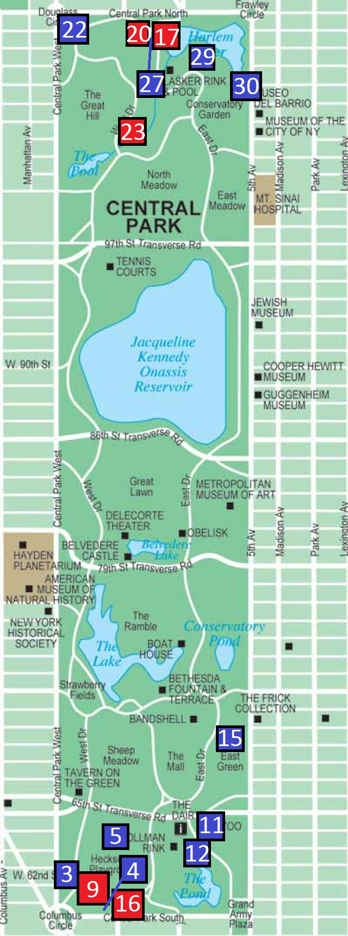
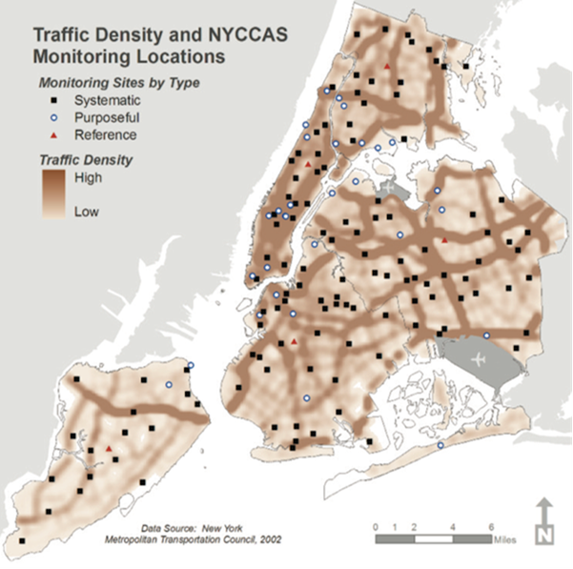
Metadata Analysis of the Correlation Between NO_{x} Compounds
and SO₂ Air Pollution in Central Park through DNA Barcoding
of Key Indicator Lichen Specimens
Authors: Jai Yoon Chung^{1,2}, Kaitlyn Espiritu^{1,2}, William Goldman^{1,2}, Bryant Lee^{1,2}
Mentors: Melissa Lee², Christine Marizzi², Helen Coyle¹
¹ Tenafly High School; ² Cold Spring Harbor Laboratory’s DNA Learning Center
Abstract
Discussion
The sulfur dioxide (SO₂) and harmful nitrogenous compounds (NO_{X}) in Central Park were assessed using lichens as indicator organisms. Both compounds very harmful, with long term exposure to NO_{X} causing respiratory problems, increased sensitivity to pollen and other inhaled allergens, especially in children. Sulfur dioxide can also cause a variety of detrimental effects on humans such as bronchitis, emphysema, and even premature death. Lichens are known index organisms of SO₂ pollution and NO_{X} pollution. Lichen samples were collected from Central Park and looked at their tolerances to both types of pollution, with part of the data taken from our previous study, Assessment of Sulfur Dioxide Air Pollution in Central Park through DNA Barcoding of Key Indicator Lichen Specimens. It was found that the level of sulfur dioxide and other harmful nitrogenous compounds are low enough to support lichens that exhibit low tolerance to pollutants.
The data from Assessment of Sulfur Dioxide Air Pollution in Central Park through DNA Barcoding of Key Indicator Lichen Specimens showed very few sensitive lichens in the southern areas of Central Park.
The higher amounts of pollutants shown from our data accounts for the rising prevalence of respiratory diseases as well as Alzheimer’s and dementia-related diseases in the NYC area.
A possible explanation for the discrepancy in lichen species is that the American Forest Service doesn’t specify the particulate matter size when defining lichen tolerance.
While it is evident that there is more sulfur dioxide and NOx compounds in the southern side of Central Park, there isn’t as much of a discrepancy between the two sides as originally seen in our previous study.
Methodology
Results
Part 1: Collection of lichens
30 lichen samples were collected from Central Park, NYC.
Samples were scraped into individual plastic bags with scalpels which were cleaned with alcohol between each sample to avoid cross contamination.
Part 2: Preparation of PCR
Lysis solution was added to break down the cell walls and to allow us to access the DNA.
The samples in solution were then incubated for 10 minutes at 65°C.
Silica resin was added to separate the DNA.
The lichens were centrifuged at 13,400 rpm for 1 minute multiple times to separate the DNA from the contaminants.
Wash buffer was added to remove impurities.
The fungal primer (ITS), base nucleotides, and Taq polymerase were mixed.
The mixture was placed in a thermal cycler for PCR.
Gel electrophoresis was used to determine whether samples had sufficient quality to be sequenced.
Part 3: Sequencing and Analysis
Successful samples were for sequencing.
DNA Subway was used to trim sequences and form a consensus sequence.
Various gene databases, such as GeneBank and BOLD Systems, were used to determine lichen species.
The successful specimens were mapped on a map of Central Park with previous data.
The successful specimens’ tolerance to SO2 and NOx compounds were determined.
Sample # | Species | Tolerance to SO₂ | Tolerance to NO_{x} compounds | Percent Divergence
1-3 | Lepraria lobificans | tolerant | tolerant | 1.05%
1-4 | Lepraria lobificans | tolerant | tolerant | 1.00%
1-5 | Phaeophyscia pyrrhophora | intermediate to tolerant | sensitive | 0%
1-11 | Candelaria concolor | sensitive | tolerant | 7.40%
1-12 | Hyperphyscia adglutinata | tolerant | sensitive | 0.40%
1-15 | Candelaria concolor | sensitive | tolerant | 5.93%
1-22 | Phaeophyscia pyrrhophora | intermediate | sensitive | 0.88%
1-27 | Punctelia rudecta | intermediate | tolerant | 0%
1-29 | Lepraria lobificans | tolerant | tolerant | 2.55%
1-30 | Xanthoparmelia plittii | sensitive | tolerant | 0.38%
2-9 | Candelaria concolor | sensitive | tolerant | 0%
2-16 | Phaeophyscia pyrrhophora | intermediate to tolerant | sensitive | 2.63%
2-17 | Candelaria concolor | sensitive | tolerant | 0.78%
2-20 | Flavoparmelia caperata | tolerant | tolerant | 4.01%
2-23 | Lepraria finkii | tolerant | tolerant | 0.91%
Introduction
A major constituent of air pollution is sulfur dioxide, which is emitted from burning fossil fuels.
Nitrogen deposition is the addition of reactive nitrogen (N) into the atmosphere. This reactive nitrogen will easily form nitrogenous compounds, such as NO2 and NO3 that can be harmful to the environment.
The more automobile traffic there is in an area, the higher the sulfur dioxide concentrations, as cars are major producers of sulfur dioxide.
Sulfur dioxide can cause respiratory diseases in humans and have carcinogenic effects on animals, which is why it is imperative to make sure the sulfur dioxide levels in the New York City area are below the health limit of 30 ppb.
Once sulfur dioxide levels rise above this concentration, respiratory diseases become more common and affect more people
A lichen is a composite organism formed by the mutualism between a fungal species and a photobiont that can be either algae or cyanobacteria.
The fungal, or mycobiont, components of lichens are inseparable from the photobiont components.
Sulfur dioxide is detrimental to lichens because it:
inhibits nitrogenase functioning of lichen photobionts, thereby interfering with their ability to convert atmospheric nitrogen into usable forms that can be incorporated into organic molecules like amino acids.
It is an ideal index organism for gauging air pollution as each lichen population can only tolerate a specific level of sulfur dioxide.
Conclusion
Lichen samples from throughout Central Park were collected and identified in order to assess sulfur dioxide and NOx compound levels.
It was shown that there is more sulfur dioxide and NOx compounds in the southern side of Central Park and more NOx compounds in the northern part of Central Park.
Acknowledgments
We would like to thank our families for supporting us throughout this experience, our teachers - Ms. Coyle for motivating us, Melissa Lee for helping us learn more about DNA barcoding, and Cold Spring Harbor Laboratory for funding us.
Table 1: Data showing lichen species name and tolerances SO2 and NOX compounds along with percent divergence of DNA from sequencing
References
Cold Spring Harbor Laboratory DNA Learning Center. 2014. Using DNA Barcodes to Identify and Classify Living Things. Cold Spring Harbor, NY
Finger, J. [December 18, 2013, May 9, 2015] Available from: http://fingerfood.typepad.com/
Geiser. United States Forest Service [Internet]. [2009, May 10, 2015] Available from: http://gis.nacse.org/lichenair/?page=sensitivity
NYC Environmental Protection [Internet]. New York City, NY: The Official Website of the City of New York; [2015; May 10, 2015] Available from: http://www.nyc.gov/html/dep/html/air/index.shtml
NYC Health. New York City Trends in Air Pollution and its Health Consequences [Internet]. [May 9, 2015]. Available from http://www.nyc.gov/html/doh/downloads/pdf/environmental/air-quality-report-2013.pdf
Oxford Journals [Internet]. Surface Hydrophobicity causes SO₂ Tolerance in Lichens. [March 11, 2015]. Available from: http://aob.oxfordjournals.org/content/101/4/531.full.pdf
The Concord Consortium [Internet]. Concord, MA: [1997; May 10, 2015] Available from: http://staff.concord.org/~btinker/GL/web/air/bioindicators/whatlichens.html
United States Environmental Protection Agency [Internet]. [March 25, 2015; May 10, 2015] Available from: http://www.epa.gov/air/sulfurdioxide/health.html
Untapped Cities. Fun maps: NYC Community Air Survey Indicates We Have Clean Air But Moving to Staten Island is a Good Idea [Internet]. [May 9, 2015]. Available from: http://untappedcities.com/2014/03/19/fun-maps-nyc-community-air-survey-indicates-we-have-clean-air-but-moving-to-staten-island-is-a-good-idea/
Figure 1: Map of locations where each lichen specimen was found. Each number corresponds with a sample number and the color indicates when the sample was collected. Blue indicates collection in previous study and red indicates collection in current study.
Hypothesis
It was hypothesized that there will be a significant amount of NOx compounds in the same areas where there were high levels of SO2 according to our previous project.

