Slide 1
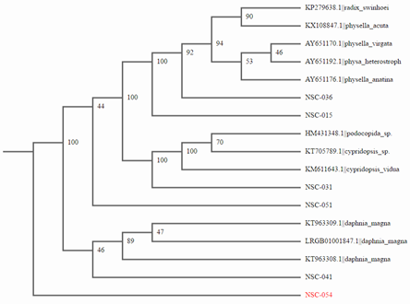
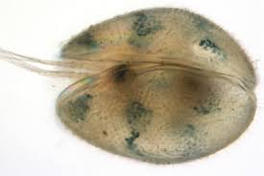
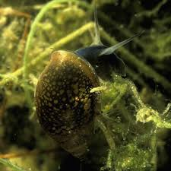
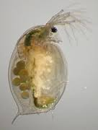
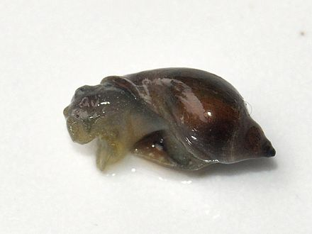
Identifying Species In The Peconic River Using DNA Barcoding Method
Abstract
We collected 20 samples of invertebrates from the Peconic River on Long Island. After extracting the DNA, isolating the CO1 gene using PCR, and sequencing samples, we obtained barcodes for Daphnia magna, Physella (snails), and interestingly identified a snail that was originally classified as two species, Radix swinhoei and Phsella acuta. These are the same species of snail classified in different locations (Asia and North America). These snails are carriers of parasitic flatworms and are indicative of poor water quality.
Damien Edele, Christopher Jannotta, Joseph Orenstein
Eastport South Manor Junior-Senior High School
Mentor: Mr. Robert Bolen
Methods and Materials
We collected water samples with some biotic factors from the peconic river such as leaves, twigs, and small plants found in the water.
We stored our samples at the ESM high school and kept them in ethanol and kept them frozen.
We used DNA Barcoding to identify the Species we have collected from the Peconic River. We extracted the DNA and used PCR to replicate the collected DNA.
We used the insect CO1, RbCL, and Fungus/Plant it's on our samples when added to the PCR for replication.
We checked to see what samples had good results using the Gel Electrophoresis method and then compared to see how similar our samples were to each other.
After sending the DNA to Cold Spring Harbor to let them PCR it again to confirm results we put the organism's genetic sequence into the DNA subway database.
Once we cut the bad parts of the sequences we compared them on GenBank and researched the results to see if the organisms were invasive or not.
Introduction
Biodiversity is the variation among living things in an environment.
Many species are invasive, or come from foreign areas, and overpopulate areas.
DNA barcoding is the process of extracting DNA from an organism, and compiling it into into bars to specify the nucleotide bases that constitute a gene.
Through DNA barcoding, we have the potential to identify non-native species which could have a negative impact on the ecosystem and human health.
We plan to measure species biodiversity in this section of the Peconic River by comparing the differences in the CO1 gene sequences of our invertebrate samples.
CO1 is a gene that shopws high variability and evolved rather quickly which makes it an excellent choice for determining species, relationships.
Discussion
Our results have been that from all collected 20 samples, only 5 were able to produce quality sequences. These five samples were composed of multiple different organisms with most samples being snails, which have been found to be in the Physella genus. We also identified a Podocopida/Cypridopsis and Daphnia magna which have both been researched and found to be aquatic freshwater organisms that would likely live in the peconic river. Interestingly enough when we viewed the Snails sequence and compared it using GenBank the top two results were the Physella acuta and the Radix swinhoei, which both had the same exact CO1 gene sequence and the same bit score of 1150, same Aln. Length of 637, and both had no mismatches. We have researched both the species and the only differences being that the Radix s. was located in Asia and North Africa while the Physella a. was found in europe and North America. The Radix s. also is a known carrier for the parasitic Trichobilharzia r., which is known in Asia and Europe especially to cause Cercarial Dermatitis in humans and also it has been found in Birds. It also causes Schistosomiasis. The Trichobilharzia is most likely also associated with the Physella Genus because where the Physella is located Schistosomiasis is also prevalent. Although more research must be conducted our observations and research have showed that the snails of Physella acuta and Radix swinhoei are actually the same species organism.
Resources
1. Semple, K. (2015). Long Island Sees a Crisis as It Floats to the Surface. Retrieved December 13, 2016, from
http://www.nytimes.com/2015/06/06/nyregion/long-island-sees-a-crisis-as-it-floats-to-the-surface.html
2. State DEC targets invasive weed in Peconic River. (2016). Retrieved December 13, 2016, from http://longisland.news12.com/news/state-dec-targets-invasive-weed
-in-peconic-river-1.12034539
3. Department of Environmental Conservation. (n.d.). Retrieved December 01, 2016, from http://www.dec.ny.gov/animals/50272.html
4. Non-native Invasive Freshwater Plants. (n.d.). Retrieved December 01, 2016, from http://www.ecy.wa.gov/programs/wq/plants/weeds/egeria.html
5. Radix swinhoei - Overview. (n.d.). Retrieved June 01, 2017, from http://eol.org/pages/4803259/overview
6. (n.d.). Retrieved June 01, 2017, from http://www.molluscs.at/gastropoda/index.html?%2Fgastropoda%2Ffreshwater%2Fphysidae.html
Podocopia
Physella acuta
Our Snail Sample
Acknowledgements
We would like to thank Mr. Bolen and Dr. Spata. We would also like to thank Dr. Perez for her continued support in the program and helping our group at the BNL open lab. Sharon Pepenella at the DNALC for picking up and dropping off samples and running PCR for our group a second time. We also thank Mr. Doyle for helping print out the posters.
Radix swinhoei
Daphnia magna

Slide 2
b) Abstract: A summary of your project An abstract is a one-paragraph summary of a research project – maximum 150 words – that allows readers to quickly scan the major ideas and findings from your project. Abstracts precede papers in research journals and appear in programs of scholarly conferences and only include essential information: The most important background information (1-2 sentences) Research question and/or hypothesis (1 sentence) Objectives (1-2 sentences) Most essential Materials and Methods (1-2 sentences) Describe your results (2-3 sentences) Interpret your results (2-3 sentences) Conclude with a final statement on the most important finding (1 sentence)

