Slide 1
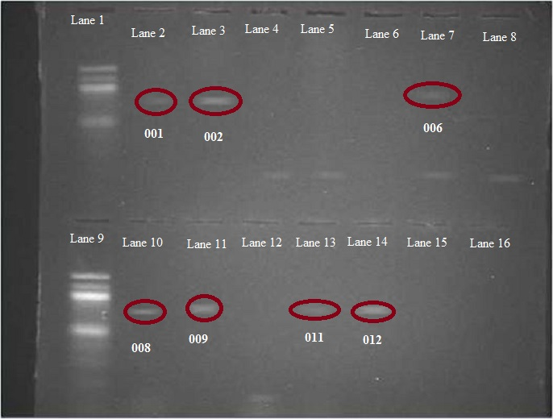
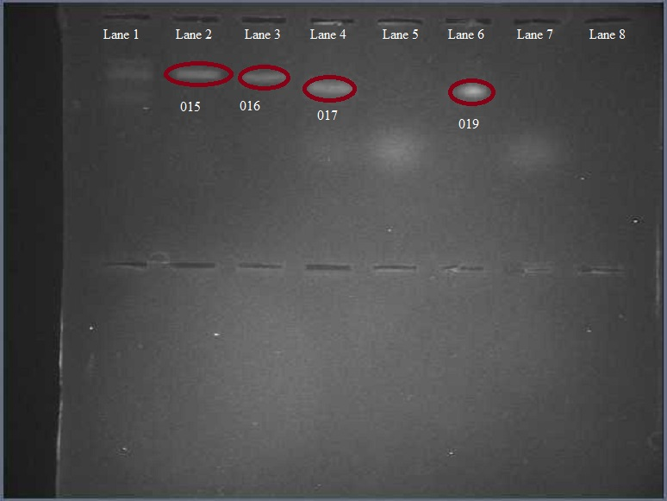
Abstract
Dragonfly larvae were taken from the Peconic River estuary and sequenced so that their barcodes could be examined. After initial sequencing, it was found that the dragonfly larvae samples were competent and correlated to three different species of dragonfly. Two samples had top BLAST hits that corresponded to the Pseudomonas bacterial genus. Although these samples were high percentage matches, they were resequenced for validation of the bacterial DNA using the gene for the 16s ribosomal subunit. After resequencing it was still inclusive if the samples were related to different strains of bacteria, but matching percentages indicated that the dragonfly related samples do not match the bacteria related samples, and that most likely the bacteria related samples were contaminated. The three species that were positively identified in the sample were Gomphus exilis (common name the Lancet Clubtail), Basiaeschna janata (common name Springtime Darner), and Pachydiplax longipennis (common name Blue Dasher).
Dragon Fly Larvae Genetic Barcoding
Methods
Our dragonfy samples were extracted from the Peconic River Estuary
The samples were stored in a non-freezing refridgerator
Tissue samples were initially taken from the abdomen, but then taken from the gut or legs during other rounds of sequencing
Primers were used to isolate the COI(cytochrome oxidase 1) gene
Primers were used to isolate the 16S gene in later sequencing rounds to determine if bacteria contamination occured
All techniques were performed using equipment from CSHL and BNL and protocols were followed
After sequencing, our samples were compared to other species via BLAST and the DNA Subway
Thomas Feil¹ Brett Biersach¹
Christopher Tapia¹ Joseph Vultaggio¹
Mr. Robert Bolen¹ Mr. James Ostensen¹
ESM Science Research
1: Eastport South Manor Jr/Sr High School
Above: Gel electrophoresis results confirming the viability of our COI gene DNA. Ladder is spaced by hundreds. Samples 1-12 on the left, and 13-20 on the right. Samples circled are the ones that proved to be the most viable.
Conclusion/Discussion
Our barcode results align with other dragonfly barcodes, so it is likely they have been sequenced this way before
Two samples. 17 and 19, were said to be related to bacteria via BLAST
After sequencing with the 16S gene, homo sapien DNA was evident, which indicates contamination
Our experiment however did confirm biodiversity as the larvae match multiple dragonfly species
Future Studies
Further analysis by a taxonomist and gene analysis is necessary to conclude if this finding is accurate
Additional sequencing is necessary to see if these larvae would be related to anything dissimilar
Introduction
Biodiversity, the variety of life on Earth, is intrinsic to the Peconic River as well as every ecosystem.
An increase in genetic diversity increases environmental stability
In contrast as biodiversity decreases, the risk of inbreeding and genetic defects increase. Moreover species often go extinct or become endangered due to these factors.
Dragonflies have a significant and positive influential role in maintaining ecological homeostasis.
Being extremely skilled fliers and having almost a complete 360 view, they control the population of disease carrying vectors such as mosquitos and horse flies
The presence and biodiversity of dragonflies is indicitave of ecosystem stability
A pipeline can be described as a set of tools necessary to analyze and process sequence data..
Pipeline consists of specimen collection, DNA extraction, gene amplification and subsequent analysis. The database BLAST is used to compare our sequences to that of known ones.
This helps us to identify differences and determine if we have a novel sequence.
Objective
The objective of determine the biodiversity of the Peconic estuary
A secondary goal would be to log a novel barcode for dragonflies
Above: Barcodes of different species of dragonfly and bacteria interspersed with barcodes from our samples
References
What is DNA barcoding? (2015) Retrieved from http://www.barcodeoflife.org/content/about/what-dna-barcoding(n.d.). Retrieved December 3, 2015, from https://www.dnalc.org/websites/dnabarcoding101.html?gclid=CKjsyMvUzMkCFYIlHwodCz0ANg
McAllister, K., & Pingree, S. (2008). Peconic River Habitat Health.Baywatch, 08-09. Retrieved December 2, 2015, from http://www.peconicbaykeeper.org/siteFiles/News/901176F0FD67C333EE9CEFC31D9B097C.pdf
Suffolk County Government Departments Health Services Environmental Quality Ecology Marine Water Quality Monitoring Peconic Estuary Program. (n.d.). Retrieved December 4, 2015,frhttp://www.suffolkcountyny.gov/Departments/HealthServices/EnvironmentalQuality/Ecology/MarineWaterQualityMonitoring/PeconicEstuaryProgram.aspx
Marjorie D. Matocq and Francis X. Villablanca. "Low genetic diversity in an endangered species: recent or historic pattern?"Biological Conversation 98.1 (2001): 61-68.
Top: Similarity chart between different species and samples
Bottom: Phylogenetic tree between all samples, different types of bacterial species and dragonfly species

