Slide 1
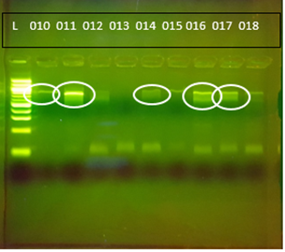
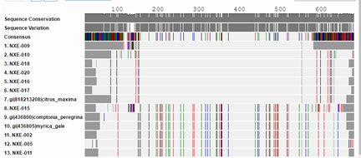
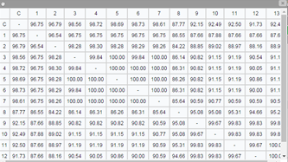
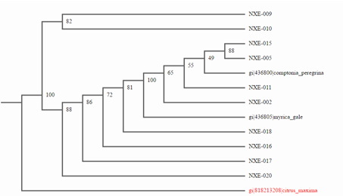
Plant Biodiversity in the Peconic River
Authors: Jamie Margiotta, Erin McCallion, Isabella Ortolan, Melanie Turner
Teacher: Robert Bolen
Eastport South Manor Junior-Senior High School
Abstract
In order to obtain the samples we went to the Peconic River and collected our samples at Otis Pike Preserve. Our hypothesis is that there is an abundance of biodiversity in the Peconic River. Our objective is to identify the species of our samples, and to examine if we found a new species or not. We conducted DNA extraction, PCR analysis, and DNA sequencing at Stony Brook lab in order to achieve our objective. In our results we came to the conclusion that our sample is Comptonia peregrina also known as a sweet fern. On the other hand, some of the samples came back as a Citrus Maxima. This could mean that they had a common ancestor and during the evolution this gene didn’t change very much between these two species.
Results
Discussion
Our results display that the Comptonia peregrina does not have much genetic diversity, but could have a common ancestor to the Citrus Maxima. . Some implications in the process of DNA barcoding during the first of our two trials were throwing out the extra DNA needed if there were no results after running gels, and the RBCL primer not being added before PCR in which resulted in no DNA. Our results are important because the objective was reached in identifying the species of our sample, the Comptonia peregrina in which adds the the biodiversity in the Peconic River. The attained results of our study did not work as we originally hypothesized in that four of the ten samples sequenced after blasting were found closest to the Citrus Maxima which is a fruit, and the sample we collected displayed the traits of a fern like plant later found to be the Comptonia peregrina.
Figure 1:
Gel electrophoresis results of samples 1-20
Methods
First, 20 leaf samples from the Peconic River Otis Pike Preserve were collected. All the samples are from the same specific location. These samples will be frozen and stored at Eastport South Manor Jr.- Sr. High School.
To process the DNA from our sample, standard DNA extraction techniques and equipment from SUNY Stony Brook or Brookhaven National Laboratory was used.
DNA extraction and PCR analysis at BNL were conducted. After DNA extraction and PCR analysis, the samples can be sequenced in agreement with CSHL protocols.
After the DNA from the samples is sequenced, it will be compared to native plant species of the Peconic River. This will tell us what species our plant is and if all the samples are the same species. This will also help determine the amount of biodiversity of the Peconic River.
Results
In all a total of twenty leaf samples were collected, but only ten had high enough quality amplification to produce quality sequences used for barcoding. After the processes of DNA extraction, PCR analysis, DNA sequencing, and running the sequences through BLASTN the results indicated that that the samples’ DNA is most similar to the DNA of the Comptonia peregrina and may potentially be related to the Citrus Maxima . Six of the ten sample were most closely related to the Comptonia peregrina and four were most closely related to Citrus maxima. In addition, some of the samples DNA sequence had close matches with Myrica gale, having a high bit score and only one mismatch for that species. Based on the physical characteristics of the plant samples, the closest match is to Comptonia peregrina. The similarity in the DNA of our samples varied from a minimum of 82.44%, and a maximum of 100% similarity.
TOP: Figure 2: Barcode showing the species collected and the correlation to the top BLAST hits.
MIDDLE: Figure 3: Sequence similarity chart indicating the relationships between different samples.
Introduction
Biodiversity is the variability among living organisms from all sources. With the loss of biodiversity and problems in the Peconic River, such as brown tide and lack of nutrients, food chains can be crippled, affecting food supplies for every living organism. Barcoding can help us identify these species and discover what in particular is killing them off. Barcoding also allows us to determine relationships between these species, relationships between plants and insects of the Peconic River, identify invasive species, and compare the ecosystems of the north and south shores of Long Island. Barcoding can address the issue that no one knows how many species there are and that traditional taxonomic identification methods may be too slow to capture vanishing genetic diversity. This process, created by Paul Herbert of the University of Guelph in Ontario, Canada, uses the rbcL gene when working with plants. By using barcoding, we can analyze the rbcL gene in our alleged fern sample to obtain its DNA barcode sequence. The DNA sequence is then transferred to a database where it is further analyzed, and matched to the closest matching reference record in the database. Thus, identifying the specimen through the process of DNA barcoding
References
1."Biodiversity." The Encyclopedia of Earth. N.p., 2014. Web. 17 Nov. 2015. <http://www.eoearth.org/view/article/150560/>.
2."Nitrogen." Peconic Estuary Program. N.p., 2015. Web. 17 Nov. 2015.
<http://www.peconicestuary.org/issues.php?issue=Nitrogen>.
3. "Peconic Estuary Program." New York State of Environmental Conservation. N.p.,
n.d. Web. 17 Nov. 2015. <http://www.dec.ny.gov/lands/31842.html>.
4. "How Does Biodiversity Loss Affect Me and Everyone Else?" WWF. N.p., n.d. Web. 25 Nov. 2015. <http://wwf.panda.org/about_our_earth/biodiversity/biodiversity_and_you/>.
5."What Is DNA Barcoding?" « Barcode of Life. N.p., n.d. Web. 25 Nov. 2015. <http://www.barcodeoflife.org/content/about/what-dna-barcoding>.
BOTTOM:Figure 4: Phylogenetic tree showing the relationship between the samples and the top BLAST
hits
Acknowledgements
Dr. Sharon Pepenella at Cold Spring Harbor Lab for guidance during the entire process; Dr. Aleida Perez and Mr. Daniel Willams for support at the BNL Open Labs; Dr. Daniel Moloney at SUNY Stony Brook for his support at the Open Labs; Mr. Michael Doyle for printing our posters at the school, Our Teacher mentors: Mr. Bolen, Mr. Hughes, Mr. Ostensen,, Dr. Spata.

