Slide 1
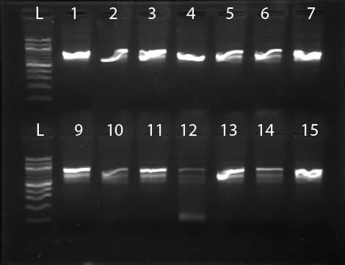
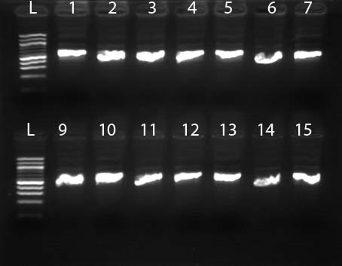
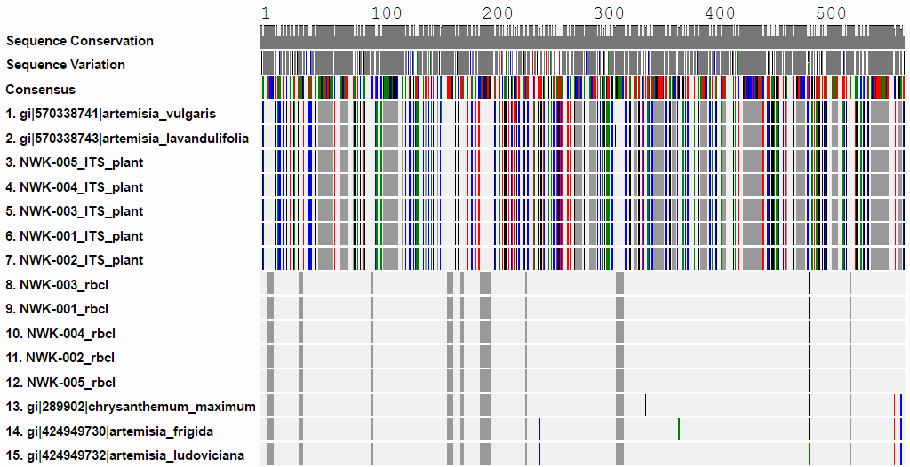
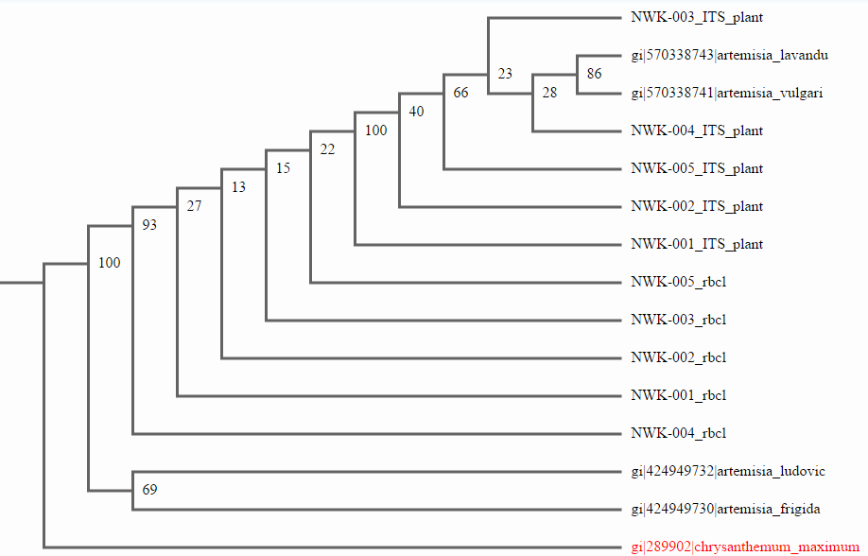
Peconic River Autotrophic Biodiversity
Authors: Kenan Azizi, Bernadette Blackford, Courtney Cummings, Paige Vinch
Teacher: Robert Bolen
Eastport South Manor Jr. Sr. High School
Abstract
This investigation involved the analysis of 17 samples of plants that resembled each other and may belong to several species of mugwort. One of the objectives was to determine if and how closely related the samples were to Mugwort, as well as contributing to a larger goal of providing DNA sequences for the determination of the overall biodiversity of the Peconic River. DNA barcoding with both the rbcL gene and the ITS gene revealed 4 similar species that correlated with the sample sequences. the closest sequence matches were: Artemisia vulgaris (common wormwood), Artemisia lavandulifolia, Artemisia frigida (prairie sagewort), and Artemisia ludoviciana (white sagebrush). .
Methods and Materials
The samples will be frozen and stored in a non-defrosting freezer in Eastport South Manor Jr.-Sr. High School
Standard DNA extraction techniques, procedures, and laboratory equipment will be used and provided by (Micro-Pipettes, Incubators, gloves, goggles, centrifuge, and etc.) SUNY Stony Brook.
DNA is extracted by placing tissue of unknown autotroph into a lysis solution, while grinding it
DNA is mixed with primers that bonded to the rbCL gene
Electrophoresis determines if the PCR amplified genes were successfully copied and extracted
Sequences will be barcoded by DNA subway and compared to the known barcode of the DNA of Mugworts using the NCBI BL:AST tool.
Figure 1: PCR results depicting the high quality amplified rbcL genes (left) and ITS (right) selected for sequencing
Introduction
In the Peconic River, biodiversity is a vital aspect of the environment which eminently contributes to the net productivity of the ecosystem. The greater the total amount of genetic diversity within a specific population, the larger the complete range of genetic traits a population will possess. In unfortunate cases such as natural disasters, a more diverse ecosystem possesses a higher probability to recover and flourish, since more individuals will have the attributes required to survive the cataclysm. Overall, as the gene pool diversity steadily increases, the gamble of inbreeding and genetic defects decreases. This is an example of a prominent part in the journey to extinction and is often seen in endangered species who have difficulty re-sustaining and stabilizing their populations. The Peconic has issues in terms of human interruption including dredging, filling, and clearing for agriculture/development however, the preservation of biodiversity will continue if barcoding is utilized.
Figure 2: Example of BLAST search results with high Bit scores, e-values, and mismatches
Discussion
The DNA sequence data indicates that the samples selected are in fact members of the genus Artemisia. There are four possible species present in the samples we obtained: Artemisia vulgaris (common wormwood), Artemisia lavandulifolia, Artemisia frigida (prairie sagewort), and Artemisia ludoviciana (white sagebrush). The ITS and the rbcL sequencing all suggest these four species based upon the to NCBI BLAST results. The rbcL sequences results all demonstrated high BIT scores (1000+) and large sequences lengths (500+bp). Additional ITS sequences correlated to bacterial species and upon closer analysis these are short sequences with low BIT scores and high e-values. Additional gene studies are needed to narrow the exact species identification. The objectives of this investigation were achieved because the species were identified and there is a possibility of mote than one species of mugwort/sagewort inhabiting the area.
References
“A DNA Barcode for Land Plants.” A DNA Barcode for Land Plants. N.p., n.d. Web. 25 Nov. 2015.
“DNA Barcoding.” Consortium for the Barcode of Life. Smithsonian Institution. N.d. Web. 17 Nov. 2015.
Hanrahan, Clare, and Rebecca Frey. “M2013 37” pag. Web. 9 Nov. 2015.
Puente, Caroline, John W. Kress, and Ida Lopez. "Plant DNA Barcode Project." Smithsonian National Museum of Natural History. N.p., n.d. Web. 25 Nov. 2015.
Stemley, LaTonya, Murty S, Kambhampati, Ph.D, Ha’Wanna St. Cyr, and Timothy Green, Ph.D. “ABSTRACTS.” Mifgash: Journal of Social-Educational Work Web. 25 Nov. 2015
Figure 3: DNA barcode illustrating similarities to the four top BLAST hits and among the samples for rbcL and ITS.
Acknowledgements
Dr. Sharon Pepenella at Cold Spring Harbor Lab for guidance during the entire process; Dr. Aleida Perez and Mr. Daniel Williams for support at the BNL Open Labs; Dr. Daniel Moloney at SUNY Stony Brook for his support at the Open Labs; Mr. Michael Doyle for printing our posters at the school; Our teacher mentors: Mr. Bolen, Mr. Hughes, Mr. Ostensen, Dr. Spata
Figure 5: Phylogenetic tree illustrating the relationships between the samples and the top BLAST hits
Figure 4: Sequence similarity chart for Figure 1 barcodes.

