Slide 1
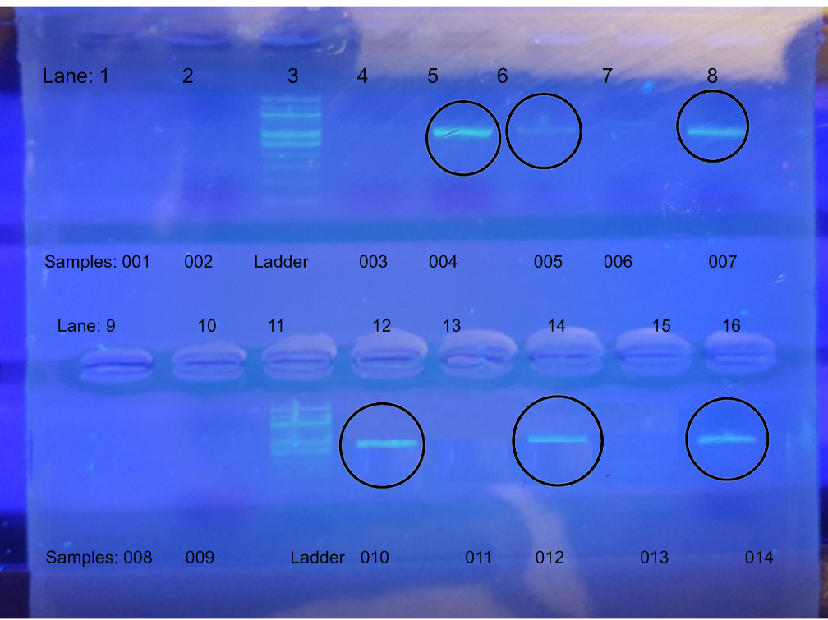
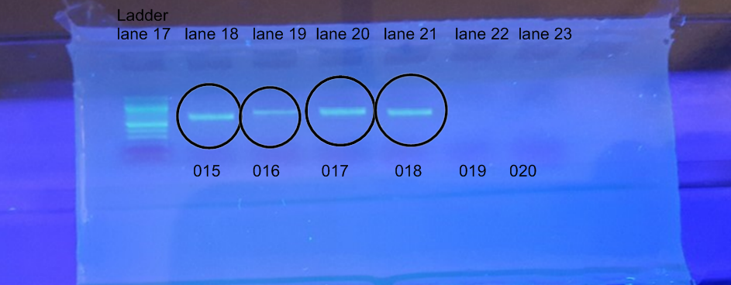
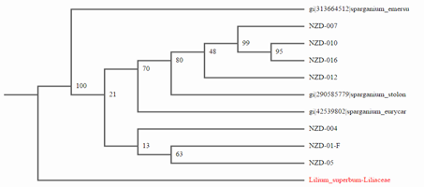
Unidentified Flora of the Upper Peconic River
Authors: Angela Blangiforti, Theresa Blangiforti Sabrina Sauerwald, Edward Spagnuolo
Teachers: Robert Bolen, William Hughes, Dr. Natale Spata
Eastport South Manor Junior-Senior High School
Cold Spring Harbor Laboratory:
DNA Learning Center
Results
Materials and Methods
Twenty samples from water-dwelling plant species from the headwaters of the Peconic River with permission from NYSDEC as part of the Day in the Life of the Peconic River program. After we collected the unknown plant species, we preserved the plants in a non-defrosting, deep- freezer. The samples were prepared and processed using standard DNA extraction techniques PCR and genetic sequencing provided by Cold Spring Harbor Laboratory. We anticipate utilizing laboratory time and space was utilized at Brookhaven National Laboratory for DNA extraction and PCR analysis. The samples were sequenced and barcoded to determine the name of this species and whether each sample if it is invasive or native.
Discussion
After sequencing, the resulting DNA barcodes and sequence similarities indicate that the unidentified species of plant is one of three potential species of Burr plant. The sequences were all of high quality as indicated by high BIT scores and low e-values (all had values of 0.00). Although the exact species can not be determined, the NCBI BLAST results suggest several possible species in the genus Sparganium. The two closest BLAST hits S. emersum and S. eurycarpum, are native to North America. The species S. stoloniferum is native to Asia, but certainly could survive as a transplanted species in North America as these are all temperate plants. The sequence comparison using the rbcL gene is only reliable to compare genus to genus; differentiating between closely related species is not possible with this one gene locus. Additional students will require the use of other genes, such as ITS, to better differentiate between the three species. Originally the hypothesis was that this plant was a species of lily that was probably invasive to this region - the data clearly do not support this hypothesis.
.
Abstract
The purpose of this project was to identify the species of water-dwelling plants that have a similar physiology to species of water lilies. Specimens were collected in mid-Autumn, and did not display any flowers, so identification based on physical attributes was not likely to be exact. The barcode results indicate that our samples represent several species of Bur plant. The species are Sparganium emersum, Sparganium stoloniferum, and Sparganium eurycarpum.
Introduction
Biodiversity is the variety of life on Earth, including species such as plants, animals, and microorganisms, and the different ecosystems they inhabit. [1] Genetic biodiversity is the variation in genes that exists within a species, which can arise as a subspecies. The purpose of barcoding the specimens found in the Peconic River is to record the biodiversity of this environment. Barcoding is quite effective in objectively identifying species even from small, damaged, or industrially processed material. Barcoding is a gift to scientific taxonomy because it elucidates new ways to distinguish and identify organisms using their chromosomal blueprints. [2] A biodiversity bottleneck occurs when a sharp reduction in the size of a population due to catastrophic environmental events (such as earthquakes, floods, fires, disease, or droughts) or human activities, threaten a native environment. [3] When genetic diversity increases, long term survival also increases. As population size decreases, the diversity of organisms, both genetic and ecological, decreases. The plant specimens in this study are from samples taken from the headwaters of the Peconic River as part of the “Day in the Life of the Peconic River Estuary Program”. The plant that was obtained grows to heights approximately 1 meter tall, with dark green sword-shaped leaves. They were found in the shallow non-estuarine waters of the Peconic River.
Figure 1: These gels show the most promising samples. Lanes: 5,6,8,12,14,and 16.
Figure 2: These gels show the most promising samples in lanes 18,19,20,and 21.
Figure 3: This chart shows the direct correlation between our barcoding results and other species that are closely related
Figure4: This cladogram shows the same species from figure 3 and articulating their direct linage and common ancestry.
References
What is Biodiversity? - National Wildlife Federation. (n.d.). Retrieved November 25, 2015, from http://www.nwf.org/Wildlife/Wildlife-Conservation/Biodiversity.aspx
DNA barcoding reveals extent of arthropod biodiversity. (n.d.). Retrieved November 25, 2015, from http://www.biodiversityscience.com/2013/12/03/dna-barcoding-arthropod-biodiversity/
Retrieved November 25, 2015, from http://www.dec.ny.gov/lands/31842.html
Acknowledgements
Dr. Aleida Perez from Brookhaven National Laboratory, Mr. Daniel Williams from Barcode Long Island, and Dr. Sharon Pepenella from Cold Spring Harbor Laboratory

