Slide 1
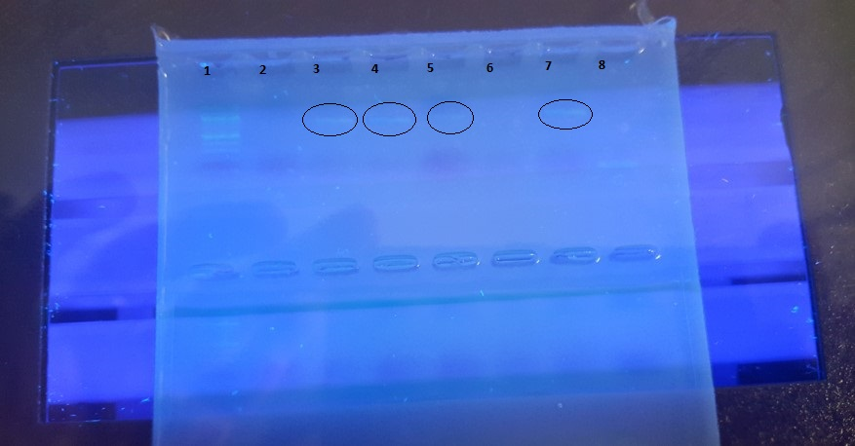
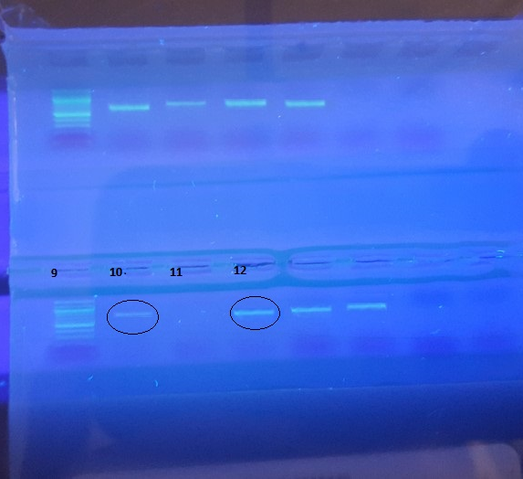
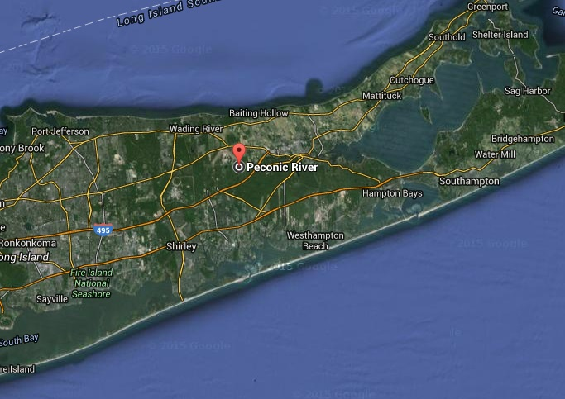
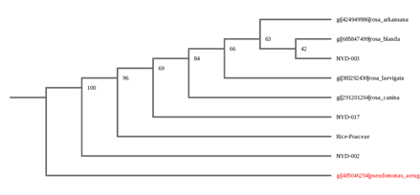
Calculating Trees
Abstract
The objective of this project was to determine the genus, and if possible the species, of several berry-bearing trees growing in the Peconic River System by properly barcoding the leaves and berries and and compare the results using the DNA Subway website and the NCBI BLAST tool . Out of the 17 samples that were processed, only 3 of them were sequenced well enough to be able to compare DNA sequences of the rbcL gene on the DNA Subway site. The best sample, NYD-003, correlated to four different species of rose plant: Rosa arkansana, Rosa blanda, Rosa laevigata, and Rosa canina. Analysis of the BLAST hits, bit scores, and mismatches, as well as the physical characteristic of the sample suggests that Rosa blanda is most similar to the sample, NYD-003, but rbcL analysis only resolves to the genus level so differentiation of species is not possible without further differential gene analysis.
Materials and Methods
The collection of 20 different tree leaves from 20 different trees in a specific confined area were obtained at the Peconic River as part of the Day in the Life of the Peconic River Program. Once retrieved from the river and placed in plastic bags they were returned to Eastport South Manor Junior-Senior High School and placed in a freezer. To process the DNA, DNA extraction tools and techniques readily available at Brookhaven National Laboratory. The DNA was extracted from the specimens by grinding up said specimen into microscopic pieces. The pieces, suspended in a solution, were then collected with a micropipette where it could then be transferred to a machine to perform PCR(Polymerase Chain Reaction) where a specific gene sequence was amplified billions of times by heating and cooling in just a few short minutes. Once the DNA was extracted, it was sent for sequencing and then compared to other known to determine the species of the plant. Once the analysis of the DNA of the plant completed it was compared to known DNA sequences using BLAST to determine if there is any genetic variation in the plant species at the river and to positively identify the species of trees.
Authors: Michael Bianco, Wei Chen
Teacher: Robert Bolen
Eastport South Manor High School
Figure 3:Location of where the samples were collected
Figure 1 and 2:The circled samples represent the samples that went out for sequencing. Samples number 2, 3, 4, 6, 15 and 17
Introduction
Biodiversity, in the simplest terms, means variation in living systems and that is extremely important to any habitat that wants to continue to survive and grow. Biodiversity is important because it boosts ecosystem productivity. Examples of this include how if there are more variety of a certain species there is more of a likelihood that they would be able to survive a large scale natural disaster. After the disaster, the group who had the specific gene that enabled them to survive will eventually reproduce and produce offspring who will procure that same trait. Furthermore, survival of the fittest goes hand in hand with biodiversity, organisms who can adapt to the changes of the environment tend to survive and reproduce in greater number than others. Though members of a particular species will fight against each other to get to the top, they often depend on other species to maintain a balanced ecosystem.
DNA barcoding is a new revolutionary technique of identifying species for both experts and non-experts which was introduced by Paul Herbert from University of Guelph in Ontario, Canada. DNA barcoding uses a short genetic sequence from a specific genome to specify a certain member of a species. The specific gene sequence we will be using is rbcL because it has been accepted in the scientific community as acceptable. The rbcL gene segment is better to use than CO1 because it provides a better differentiation between species. It works exactly the same way a scanner at a grocery store does scanning the UPC to distinguish between different products. The barcoding project consists of four separate parts: the specimen collection, DNA extraction, DNA sequencing, and analysis of sequences using databases such as BLAST.
Discussion
The results indicate that determining the exact species is not possible due to the lack of more sequenced samples. In future studies additional sequencing and sampling can be done using more plant samples and possible a different gene, such as the IST gene. . The phylogenetic tree shows the similarities of the known species of rose bushes to the sample, NYD-003 that we sampled. When some species branches off that is when it can be determined that a species has diverged, or evolved. So by looking at the phylogenetic tree we can see that the species that diverged last was the Rosa blanda. Though the Rosa blanda diverged last there is no way of telling which is most similar because the ability of the rbcL gene analysis can only differentiate between organisms in different genus, not species.
Figure 4: Barcode shows similarities between the genes of our samples and that of some known species.
References
Why Is Biodiversity Important? Who Cares? (2014) Retrieved from http://www.globalissues.org/article/170/why-is-biodiversity-important-who-cares
What is DNA Barcoding? (2015) Retrieved from
http://www.barcodeoflife.org/content/about/what-dna-barcoding
Significant Habitats And Habitat Complexities Of The New York Bight Watershed Retrieved from
http://nctc.fws.gov/resources/knowledge-resources/pubs5/web_link/text/li_pine.htm
Figure 5: Sequence similarities between species in the barcode above.
Figure 6: Phylogenetic tree shows our species is very close to four different rose bushes that are very close to each other.
Acknowledgements
Dr. Sharon Pepenella at Cold Spring Harbor Lab for guidance during the entire process; Dr. Aleida Perez and Mr. Daniel Willams for support at the BNL Open Labs; Dr. Daniel Moloney at SUNY Stony Brook for his support at the Open Labs; Mr. Michael Doyle for printing our posters at the school. Our Teacher mentors: Mr. Bolen, Mr. Hughes, Mr. Ostensen, Dr. Spata

