Slide 1
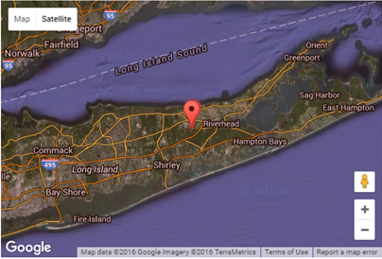
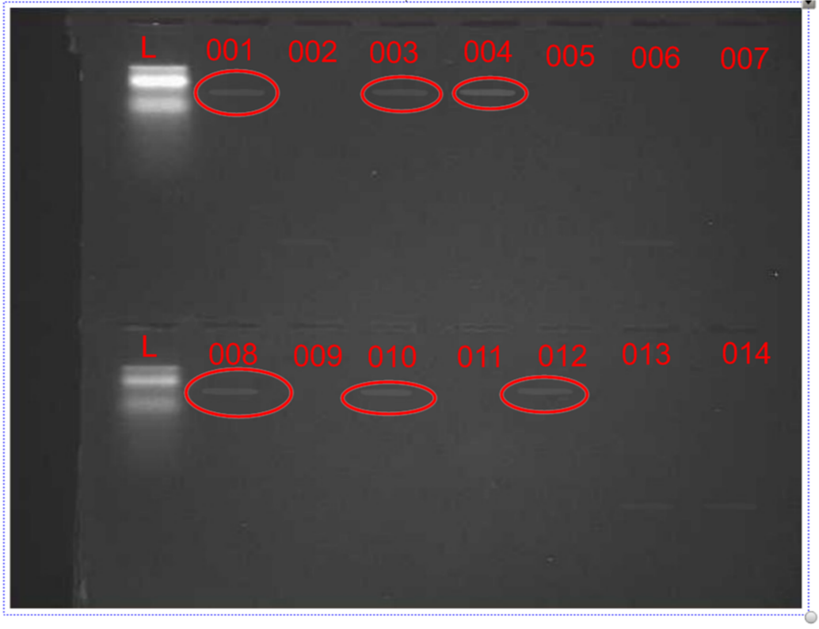
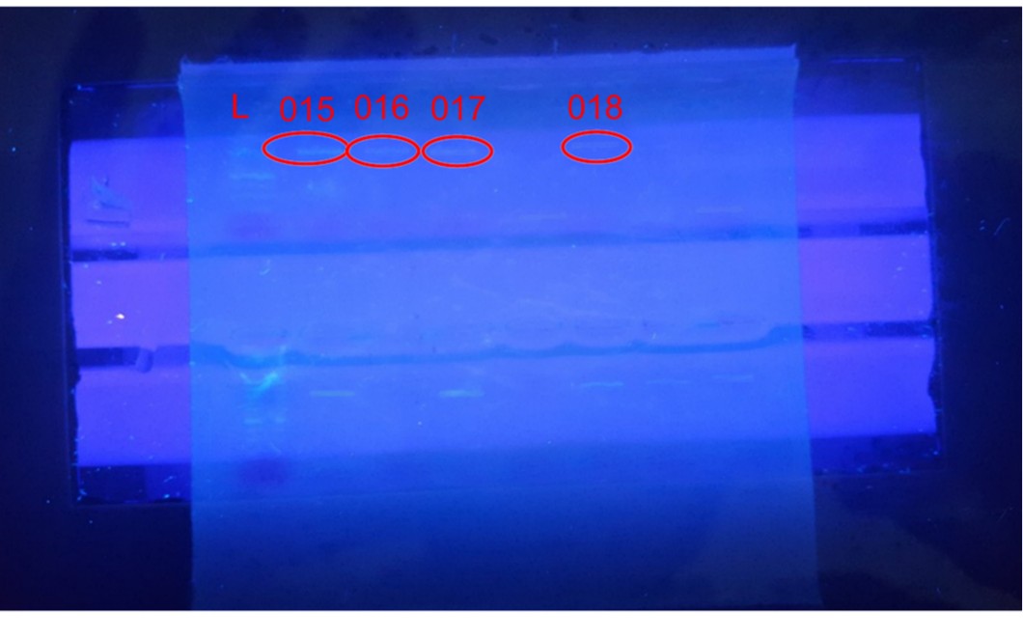
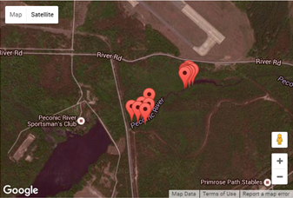
Measuring Freshwater Clam Biodiversity in the Peconic Estuary
Authors: Victoria Friedel¹, Ashley Jordan¹, Delaney Schappert¹
Teachers/Mentors: Mr. Bolen¹, Mr. Ostensen¹
Eastport South Manor Jr. Sr. High School¹
Abstract
Our objective was to Identify the specific species of freshwater clams we found based upon the barcode information of our samples compared to the known species of clam in a DNA database (DNA Subway). We then aimed to compare the freshwater clam samples to each other to determine the biodiversity within the samples we collected. Also, we compared the genetic diversity between the clams we found and also to other sequences of freshwater clams in the BLAST database. We also wanted to compare the freshwater clams we found to saltwater clams in the BLAST database and see how they differ genetically. Once our samples were collected, we extracted the DNA, ran PCR to amplify the CO1 gene, we ran gel electrophoresis, and then sent in our samples for sequencing. Out of 18 samples, 10 samples were able to be used for sequencing. We obtained BLAST results from 2 of the 10 sequences.
Materials and Methods
18 samples of freshwater clams were obtained from the Peconic River Otis Pike Preserve through the permission from NYSDEC as a part of the “Day in the Life of the Peconic River Program sponsored by Brookhaven National Laboratory.
Samples were frozen and stored at Eastport South Manor Jr. Sr. High School.
Standard DNA extraction techniques provided by the Cold Spring Harbor Laboratory (CSHL) were used.
Laboratory time and space at the Brookhaven National Laboratory were used where conducting DNA extraction and PCR analysis occurred.
Following the DNA extraction and PCR analysis, samples were sequenced following CSHL protocols.
Small pieces of DNA from each sample were isolated and extracted to be used for PCR analysis and sequencing. Through the PCR process, genes were targeted by primers and then are amplified to make millions of copies of the desired gene.
The Cytochrome-c Oxidase 1 (CO1) gene was used for barcoding.
Results
Figure 2: Gel Results of PCR. Samples that received results of the PCR were Samples 1, 3, 4, 8, 10, 12, 15, 16, 17, 18.
Figure 1: Location of freshwater clam samples. Samples were obtained from the shores of the Peconic River in Calverton, LI.
Introduction
Biodiversity is essential to the well-being of the Peconic estuary. The amount of biodiversity present will tell us what the future may hold for the Peconic river. If we can conclude that our clam samples have significant biodiversity, we can determine that the freshwater clam population in the Peconic will be successful. All of the forms of life found at the Peconic estuary are vital for the function of its ecosystem. These forms of life and the genetic biodiversity within each species provide stability within the Peconic Estuary. DNA barcoding is a method used to identify specific species using short sequences of DNA and a specific gene in the genome. The gene used for barcoding invertebrates is located in the mitochondrial genome. The Cytochrome-c Oxidase 1 (CO1) gene is an ideal barcoding gene for animals. It evolves quickly and can show diversity among closely related species. The barcode DNA sequences from samples taken from the Peconic River will be compared to DNA in known databases using the NCBI BLAST website. Using the database, the barcodes and DNA sequences of organisms can determine the relationship between species, identify new species, invasive species, and perform comparative studies between different ecosystems of different locations.
Discussion
The data indicates a lack of biodiversity. The samples are all closely related to the BLAST reference and to each other, there was a minimal amount of variation. Our sequences showed that we found a possible 2 species of clams that cannot be differentiated because they had such a high sequence similarity to each other. The two species, Corbicula fluminea and Corbicula leana, appear to be sympatric species introduced from Asia. These clams are endangered in NY.
Figure 4: Barcode alignments of three samples, and the top three BLAST hits.
Figure 3:
This is our blast table results of Sample 1, it shows how there are two possible results of our clams and what species they are.
References
Peconic Estuary Program - Work. (2015). Retrieved November 17, 2015, from
http://www.peconicestuary.org/work.php?type=Restoration
2) What Is DNA Barcoding? (2010). Retrieved November 17, 2015, from
http://www.barcodeoflife.org/content/about/what-dna-barcoding
3) The ideal barcoding gene | Biotech Learning Hub. (2009, June 24). Retrieved November 17, 2015, from
http://biotechlearn.org.nz/themes/barcoding_life/the_ideal_barcoding_gene
4) MT-CO1 gene. (2015, November 9.). Retrieved November 17, 2015, from http://ghr.nlm.nih.gov/gene/MT-CO1
Environmental Benefits - Florida Shellfish Aquaculture Online Resource Guide. (2015) Retrieved November 20,
2015, from http://shellfish.ifas.ufl.edu/environmental-benefits/
6) Population bottleneck. (n.d.). Retrieved November 20, 2015, from
http://www.nature.com/scitable/definition/population-bottleneck-300
Acknowledgements
The Brookhaven National Lab for funding and supplying us with materials needed for our project. Mr. Bolen, ESM Science Research Teacher for guiding and mentoring us throughout this project and providing us with the tools needed as well. Dr. Greene for allowing us to take samples of the clams at the Peconic River.

