Slide 1
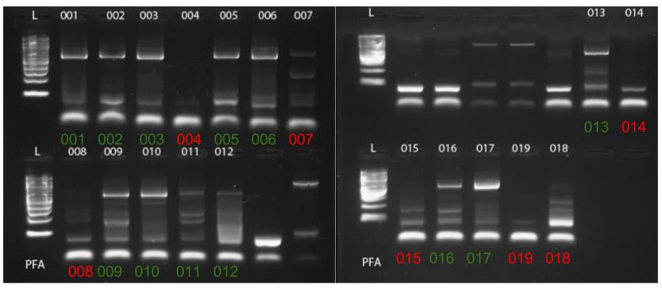
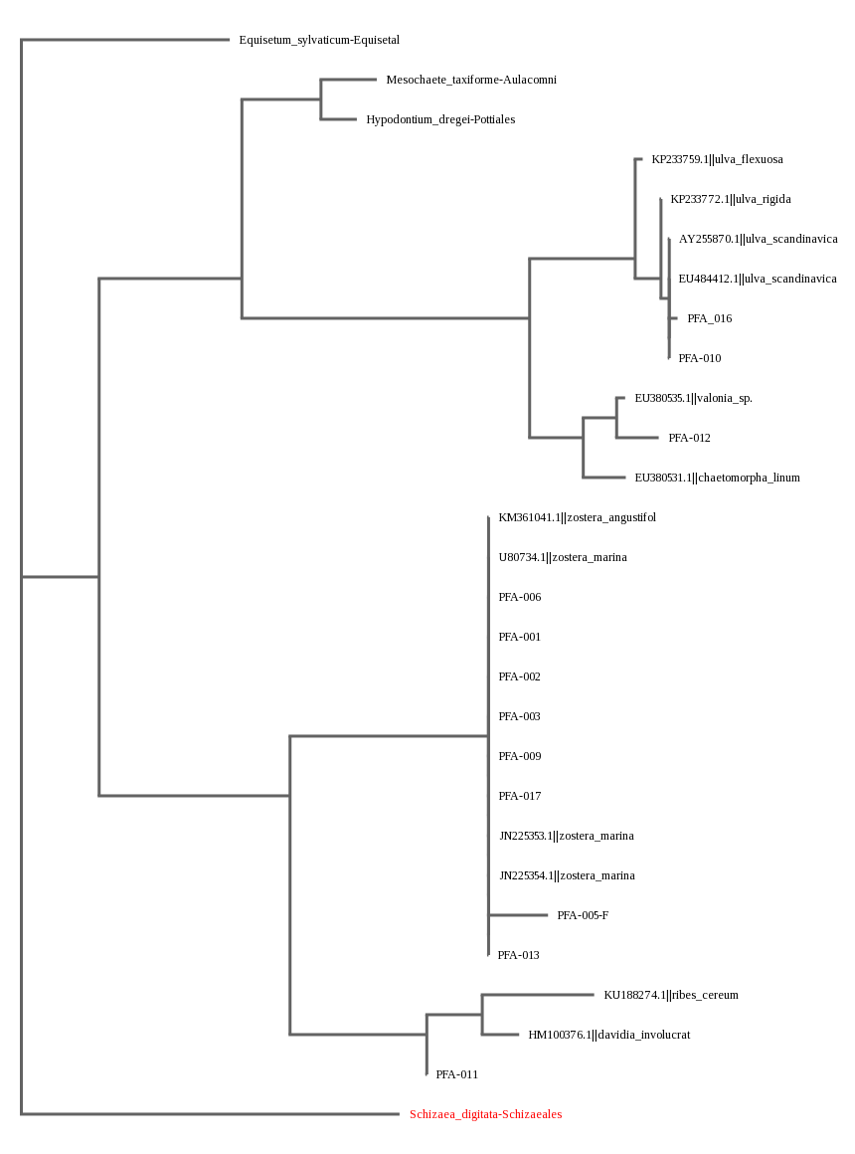
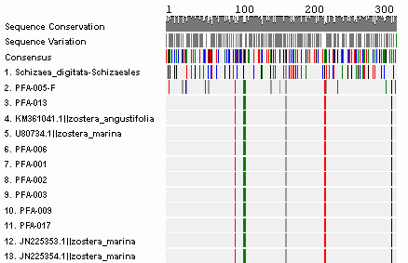
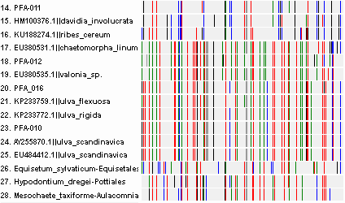
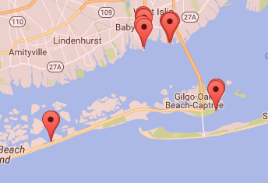
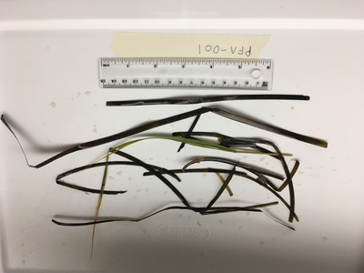
Biodiversity of Seaweed on Long Island
Authors: Ryan Marrone, Matthew Ficken
Teacher: Claire Birone
Babylon Jr. Sr. High School
Abstract:
This project cataloged which species of seaweed are found off of the South Shore of Long Island. Samples were be collected from this area. The DNA was extracted and amplified through PCR. The DNA was then put through the process of gel electrophoresis to make sure the correct gene was amplified. After this the DNA was sent to GeneWiz to be sequenced. Once the sequences were received they were be compared to a national database to determine the genus and species of the sample based on the 500-600 nucleotide barcode sequence.
Methods and Materials:
At Gilgo we went along a floating dock and collected seaweed from along the sides. Each sample was about 2-8 inches long. We then followed Cold Spring Harbor Procedures for extracting, isolating and sequencing the DNA.
From here we looked at the samples for genetic differences and similarities in DNA subway to analyze the biodiversity of seaweed in the Great South Bay. With these results we created the barcodes and Phylogenetic tree shown on the left (Figure 3).
Figure 2: Gel electrophoresis of samples indicating which PCR was successful enough for samples to be sequences (red = unable to be sequenced, green = able to be sequenced via GeneWiz)
Introduction:
Seaweed is very important to many ecosystems because it is at the bottom of the food chain. As a producer it is necessary that it creates a constant source of food for other species in the ecosystem. Many different species rely on it as a constant source of food. It eventually works its way up the ecosystem to the fish. This connects to humans because fishermen who rely on fish as a source of income and food would lose so much without the fish.
Due to the aforementioned properties of seaweed, it is necessary to catalog which species of seaweed are found off of certain areas of Long Island. The goal of the project was to analyze different species of seaweed found around Long Island. This was achieved by examining differences in color, size and structure. Looking at the differences between the samples found in areas of different currents, locations and bodies of water is also necessary. This project will helped gather information about the biodiversity of seaweed across Long Island and help establish a better understanding of where certain types of seaweed are found. As a control factor, all samples were collected from within six inches of a post, dock piling, or buoy.
Discussion:
Overall, many of our samples belonged under the same genus and species. Although there were some samples that fell under different genuses, even these genuses were very genetically similar, branching off very close to each other. Some of our samples were very genetically different, but many of them had low quality sequences and very low Phred scores so we did not put a lot of weight on these samples.
Our results suggest that seaweed on the South Shore of Long Island is not very genetically diverse. However, this could be due to us not collecting samples from a large enough area, or could be due to the fact that many of our more interesting looking samples did not have good sequence, which could have resulted from the primers not bonding to the DNA properly. This data is important because many animals, such as crustaceans and small aquatic animals, feed off seaweed, making it an important part of the food chain. Some ways this study could be expanded is by collecting seaweed from a greater area, such as collecting samples from the North Shore of Long Island and comparing them to the samples we found on the South Shore.
Figure 3: Phylogenetic tree of samples compared to common grasses, mosses, ferns and allies due to similar lineage.
Figure 4: DNA Barcode indicating the genetic sequence relationships between samples and the BLST results obtained. Matching patterns indicate similarities between sequences.
References:
Guide to some common seaweeds of Long Island Sound's rocky shore. CT State Library. Retrieved from the world wide web on November 9, 2016. http://www.seagrassli.org/ecology/fauna_flora/seaweed.html
Seaweed and Algal Q and A. The Seaweed Site. Retrieved from the world wide web on September 28, 2016. http://www.seaweed.ie/qanda/index.php
Seaweed. Encyclopedia.com. Retrieved from the world wide web on
October 24, 2016. http://www.encyclopedia.com/plants-and-animals/microbe
s-algae-and-fungi/moneran-and-protistan/seaweed
What is seaweed? National Ocean Service. Retrieved from the world wide web on
September 27, 2016. http://oceanservice.noaa.gov/facts/seaweed.html
Figure 5: (LEFT) Image of samples PFA-001,identified as Zostera marina, or eel grass. (RIGHT) Sample PFA-012, identified as either Chaetomorpha linum (spaghetti algae) or Valonia sp. (a type of green algae).
Figure 1: Map indicating various collection sites within the Great South Bay

