Slide 1
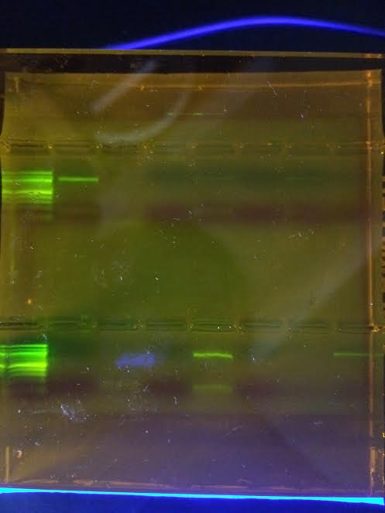
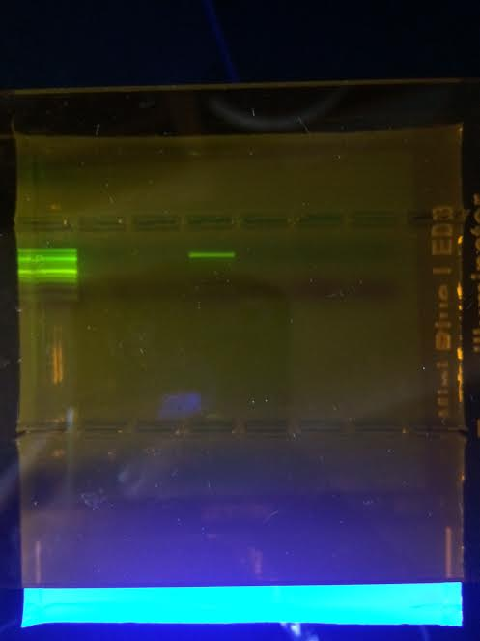
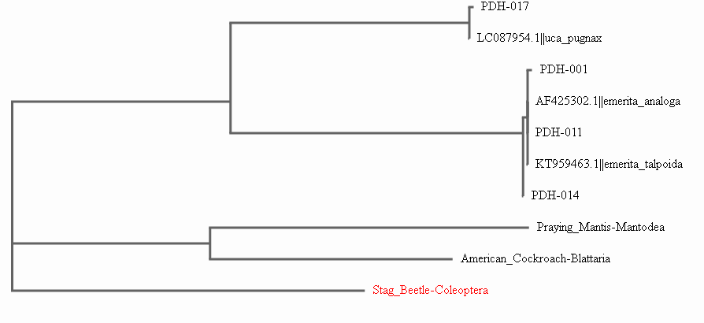
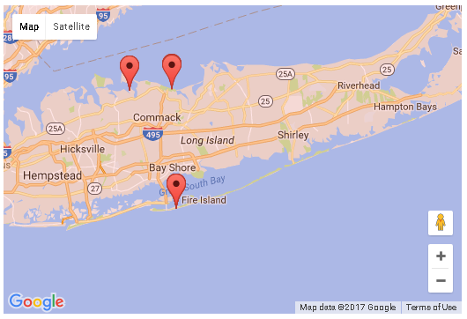
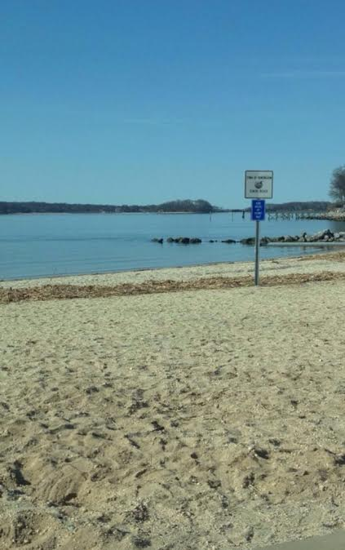
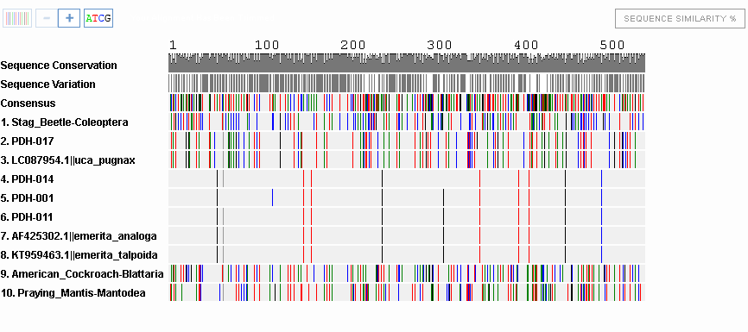
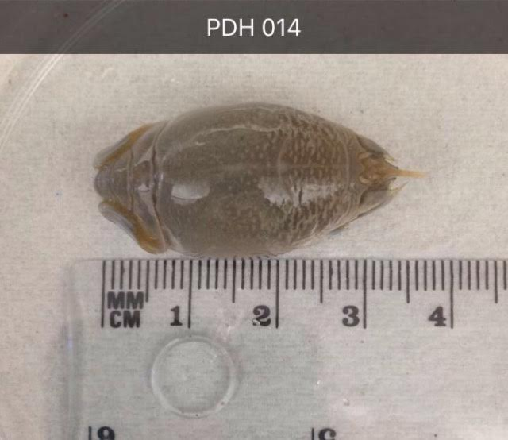
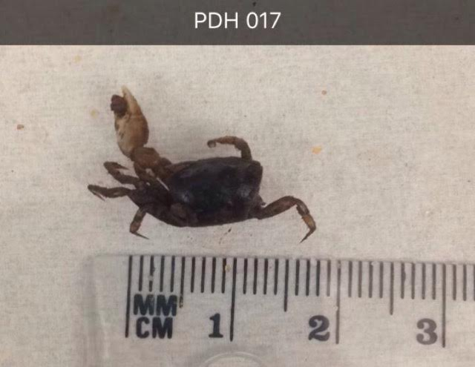
The Biodiversity of North Shore vs. South Shore Crabs on Long Island
Authors: Julia Minicozzi and Kaitlyn Tourin
Teacher: Claire Birone
Abstract
Methods
In this project, the genetic differences will be analyzed between North and South Shore Crabs. The gene that will be looked at is the COI gene, which regulates cellular respiration in the mitochondria. The purpose of this project is to analyze the various differences between species of crabs on the North Shore and South Shores of Long Island. To complete this project, crabs were collected from different beaches, their DNA was sequenced. The DNA was amplified and copied before being sent to GeneWiz, where the number of base pairings can be compared.
Ladder
001
002
003
004
005
006
007
Use a shovel to collect crabs within 6 inches of a man-made post. These posts can include a flag pole, a lifeguard stand, fence, etc. then stored in a freezer until the extraction. Cold Spring Harbor extraction and PCR protocol will be followed for each of the 20 samples collected. Gel electrophoresis is the final step. This is important because it will show whether or not he PCR worked. The samples can now be sent to GeneWiz to analyze sequence similarities within the CO1 gene. Once sequenced, the CO1 genes from both the North Shore organisms and the South Shore organisms were able to be compared to one another. These results help to illustrate the biodiversity of sand organisms on Long Island from both the North and South shore.
Ladder
015
016
017
018
019
020
Ladder
008
009
010
011
012
013
014
Introduction
Figure 1: Gel image. Samples 001, 011, 014 and 017 were sequenced.
This project aims to study the biodiversity between sand-dwelling invertebrates between the North and South Shores of Long Island. On the North Shore, some documented species of crabs include the Asian Shore Crab and the Green Crab. This are both invasive species that has built up a strong population in rocky terrains. The North Shore Crab is a hermit crab with a South Shore that is native to Long Island.
On the South Shore, the easiest type of crab to find is the Sand Crab. These are small crabs, ranging from 3mm to 50mm, with a soft shell and enjoy burrowing in the sand. The Sand Crabs have very small antennae that they use to filter out the ocean water in order to eat.
Sand-fleas are very small animals that can bite and leave welts on the skin. These have been found on both the North and South Shores, and their genetic variations will be analyzed in this project.
The crabs were collected from 3 different locations across Long Island. The North Shore Crabs were collected from Centerport Beach and Sunken Meadow. Centerport Beach is a private beach just north of the Vanderbilt Museum. During the fall collection, there was a small moat on the beach. The crabs were found there, as they were safe from the rocky area and the waves. Due to the rocky terrain of the Sunken Meadow Beach, we went towards the back by the bridge to collect crabs that dwelled in brackish water. The Sound Connects to this river, which flows to the brackish part of Sunken Meadow and will eventually reach Smithtown Bay. The South Shore crabs were collected from Robert Moses Field 5 on Fire Island. The sand was soft and not rocky, making crab collection very easy.
Results
Based on Figures 2 and 3, it can be concluded that the four samples all had genetic similarities. PDH-017, was identified as an Atlantic marsh fiddler crab, or Uca Pugnax. PDH-01 was identified as a Western North American Sand crab, or Emerita Analoga. PDH-011 and PDH-014 were both identified as Emerita Talpoida, or Eastern North American Sand crabs. PDH-017 was a sample taken from the North Shore, while samples PDH-001, PDH-011 and PDH-014 were samples taken from the South Shore. The Praying Mantis, American Cockroach and Stag Beetle were shown as comparisons due to having a remotely similar body layout.
PDH-001, PDH-011, PDH-014 and PDH-017 were the only samples that had positive readings, and therefore were the only ones that could be sequenced out of 20. This cannot accurately describe the biodiversity of sand crabs, it simply shows some of the species present. A greater sample size would be required in order to better describe the biodiversity of both ecosystems.
Figure 2: This phylogenetic tree shows the evolutionary relationships between the crabs and other species. All of our sequenced samples were able to be identified easily using DNA Subway.
Figure 6: This map shows the location of sample sites
Figure 7: Centerport Beach where samples were collected
References
1. Burlese Funnels. Mississippi Entomological Museum. Retrieved from the World Wide Web.
http://mississippientomologicalmuseum.org.msstate.edu/collecting.preparation.methods/Berlesefunnel.htm#.WBoqNyvD_iw
2. Invasive Species of the Long Island Sound. Connecticut Sea Grant.
Retrieved from the World Wide Web on September 29, 2016.
http://seagrant.uconn.edu/whatwedo/ais/listour.php
3. Sand Crabs. Monterey Aquarium. Retrieved from the World Wide Web on October 1, 2016
https://www.montereybayaquarium.org/animal-guide/invertebrates/sand-crab
4. Sand Crabs. Sand Crabs on the Outer Banks. Retrieved from the World Wide Web on
September 29, 2016. http://www.outerbanks.com/sand-crabs.html
5. Sand Flea Bites on Humans. Retrieved from the World Wide Web on November 9, 2016.
http://www.fleabites.net/sand-flea-bites-on-humans-pictures-treatment-and-prevention/
6. DNA Barcoding. Retrieved from the World Wide Web on November 9, 2016.
http://www.dnabarcoding101.org/
Figure 4: Sample PDH-014, Emerita Talpoida
Figure 5: Sample PDH-017, Uca Pugnax
Figure 3: The barcode shows the different base pairings between the samples and other species.. Matching banding patterns indicate sequence similarities between our collected samples and the reference data.

