Slide 1
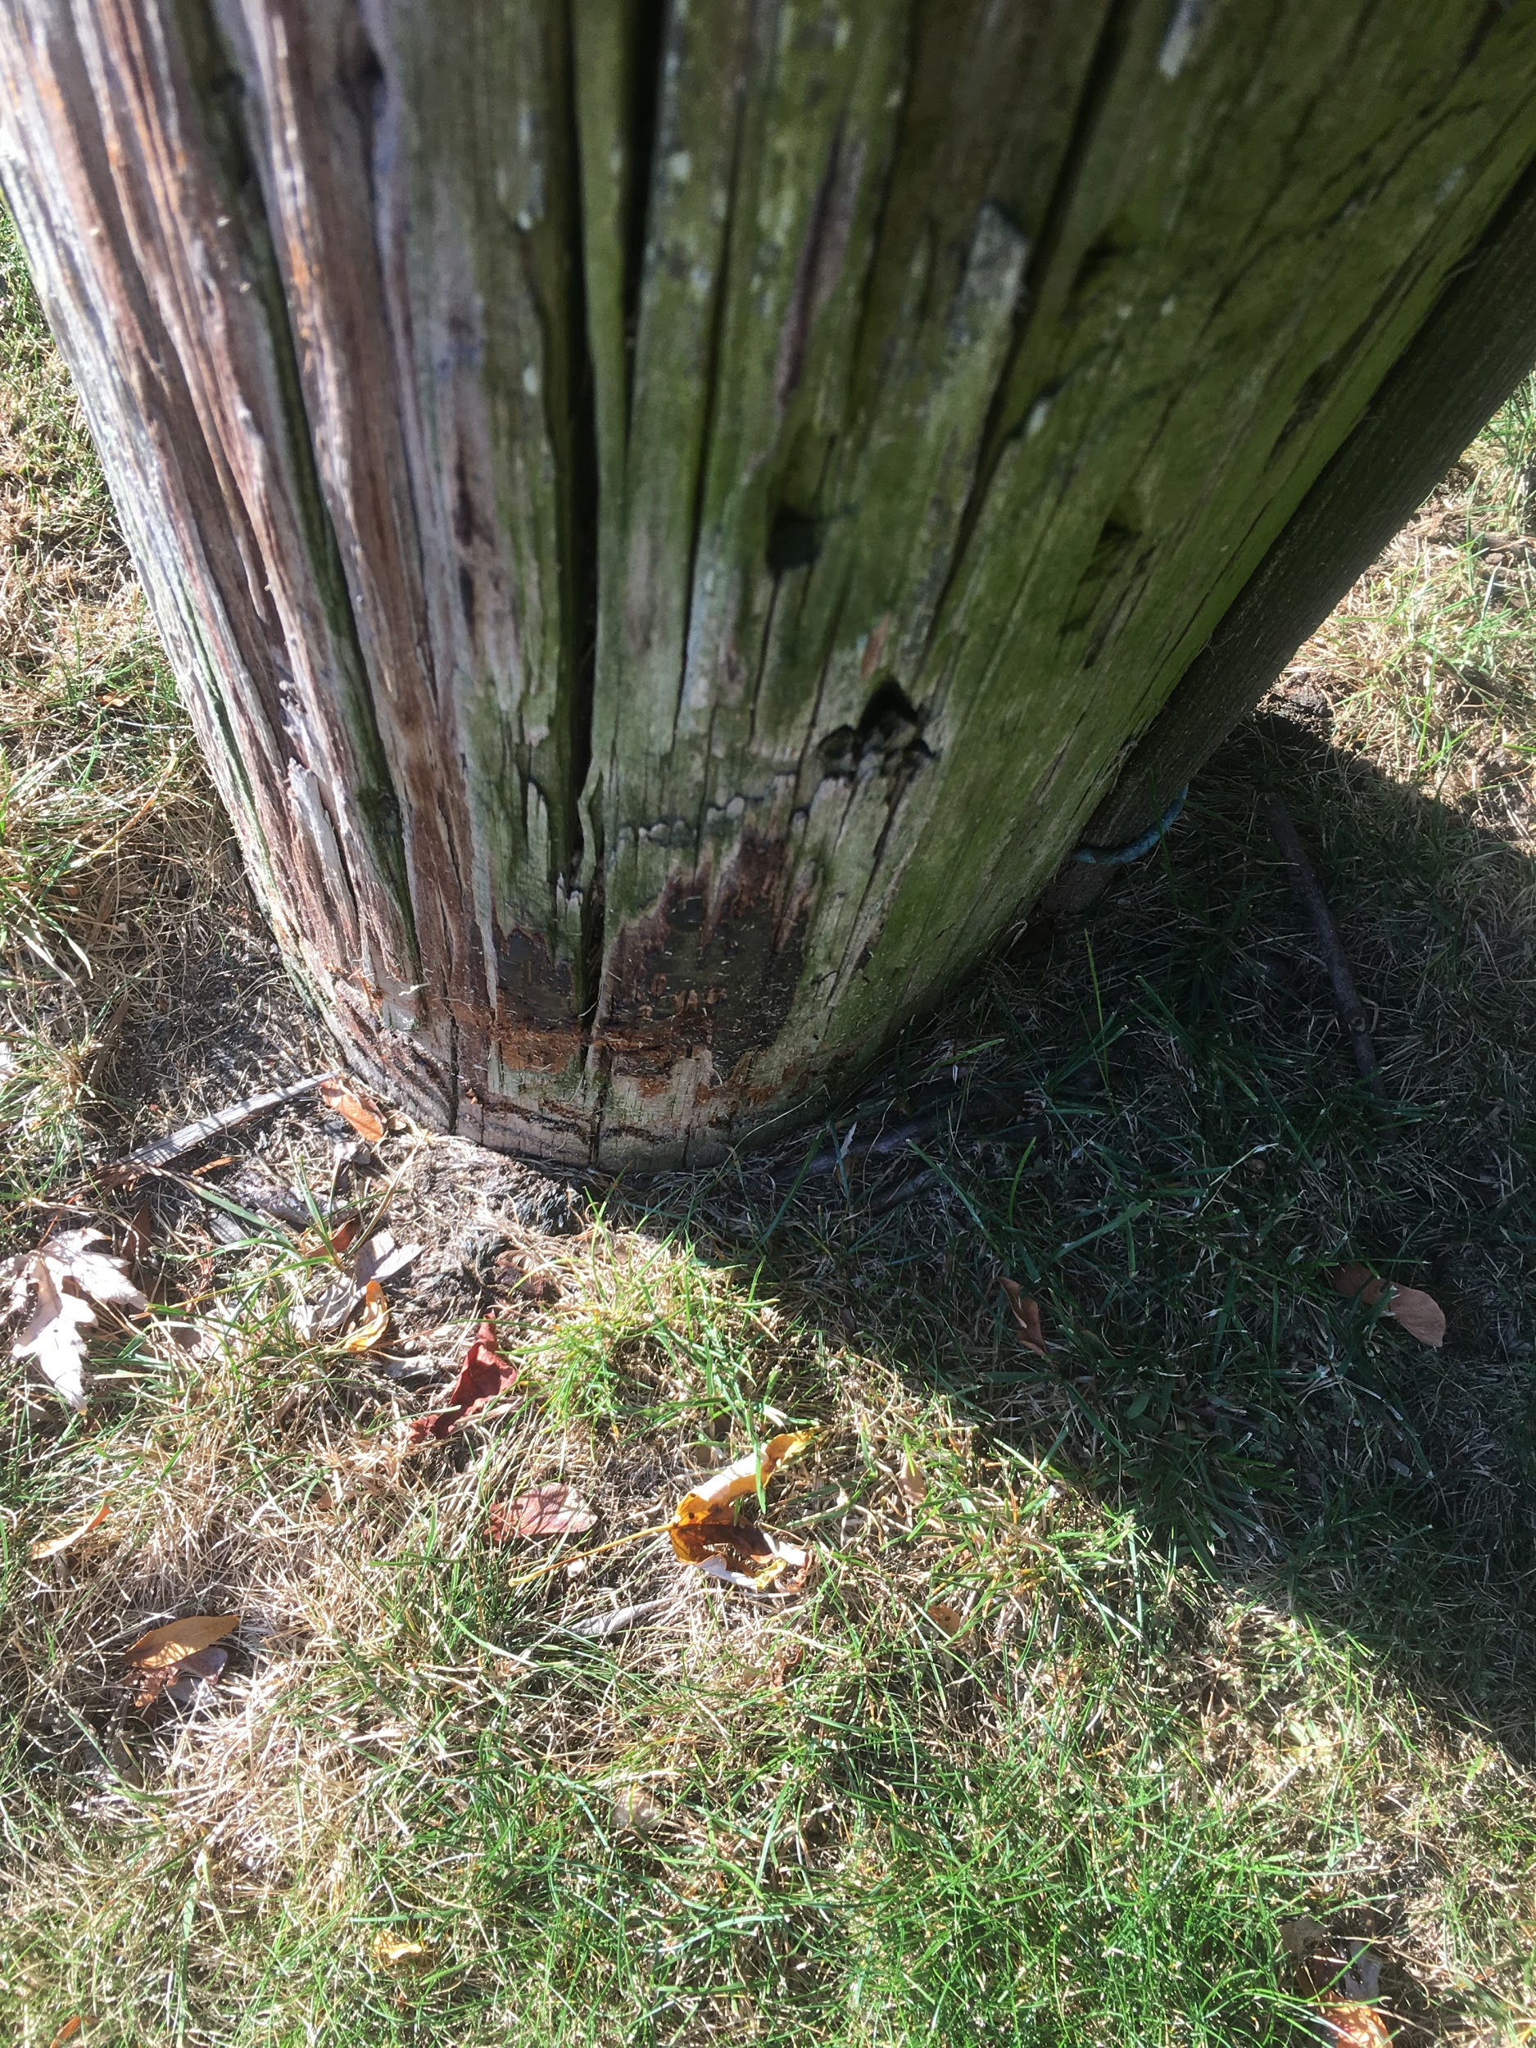
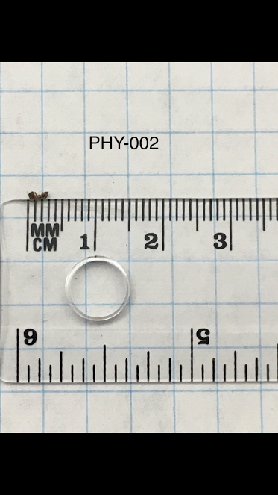
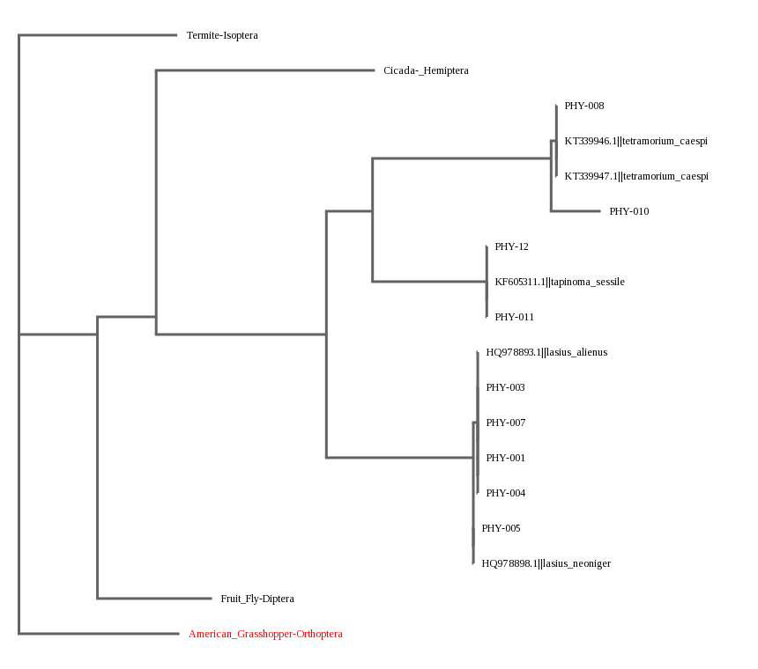
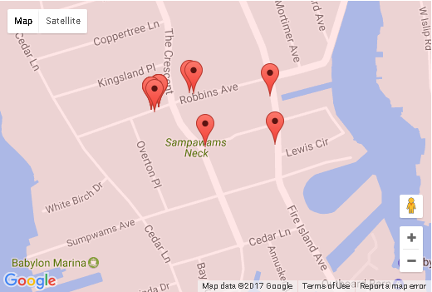
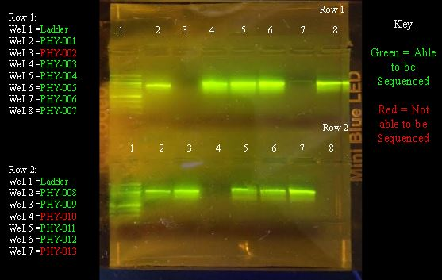
Analyzing the diversity of ants between ant hills in the Village of Babylon
Authors: Danish Farooq, Gregory Kowalczyk, Michael Steffanetta
Teacher: Claire Birone
Babylon Jr-Sr High School
Abstract
As with many suburban towns, the Town of Babylon contains many ant colonies. Ants are used as an bioindicator of the state of the current environment, as they are a common insect throughout the United States. The ants used in this procedure were collected from different ant hills throughout the village, and some were collected domestically inside homes. Most of the necessary materials for this procedure were be provided by Cold Spring Harbor Labs. Based on, our results, there are three species of ants that were classified: Tetramorium caespi, Tapinomi sessile, Lasius Alienus, and Lasius neoniger. These results show how the Town of Babylon has a diverse ecosystem in comparison to the subsystems that compose it.
Materials & Methods
The group collected ants from all around the Village of Babylon. Sampling was performed on 13 total ants from 4 different locations in the Village of Babylon to find a wider variety of species. Using a smartphone, ant hills within six inches of a pole were be geo-mapped.These ants were collected by using a spoon or other object to help place them in a bag. Ants were collected near their hills.
This year, the plan was to use standard DNA Barcoding Procedure to analyze the ants DNA. The materials used for the DNA Barcoding Procedure were supplied by CSHL. The CO1 gene sequence found in the various ants was used in order to find the diversity between them. It followed the standard DNA extraction techniques and was then sequenced.After the sequencing of the DNA is done, a comparison of genetic sequences of the various ants was made. It showed how similar the ants of varying species were.
After following standard DNA sequencing procedure. The gel was ran and the DNA was compared against each other, the samples were then sent off to be sequenced through the DNA Subway.
Results
A
B
Introduction
Ants play a key role in their environment, most importantly through their nest building and diet. When building nests, ants spread out the soil and making it more nutrient rich by decomposing organic matter, providing better soil for plant growth (3). Another key role ants play is in seed planting, because seeds are waste from their food. (3).This study assessed the different species of ants found in the Babylon Village and how they affect the ecosystem. Different ant species have completely different types of behavior. They eat different substances and can hunt in large numbers or small packs depending on the type of ant. The ants were located in close proximity to poles for the project. The reasoning behind this is because it is believed poles can have an impact on the ecosystem. The poles can be used as places for hunting grounds or to call home, as well as being easier to geomap. The poles from which they were collected from were all made of wood.
DNA Barcoding is a technique that has revolutionized in the field of taxonomy, or the classification of species. It uses each species’ own DNA to classify it instead of analysis based on physical traits alone. It is revolutionary due to the fact that it shows that each species has a precise code, and see the relationship between each organism. DNA barcoding can be used here to see the different ant species in the community. This also can help identify if there are any invasive species by comparing them to a list of native species. It would also help us see if there might be a novel sequence in the local area. In DNA barcoding, the CO1 gene is compared, because it is present in all animals, and set a baseline for the comparison of the diversity between the ant species.
Discussion
The results did indeed indicate that there is a diversity of ant species in the region.Based on, our results, there are three species of ants that were classified: Tetramorium caespitum, Tapinoma sessile, Lasius alienus, and Lasius neoniger. These results help show how the Town of Babylon has a diverse ecosystem in comparison to the subsystems that compose it. There was diversity even on a smaller scale. It was shown that there were different species present in the samples that were sampled directly from anthills, and there was also diversity in samples taken domestically as well. As the size of a biome is increased, so is its biodiversity, and since there was strong diversity present in the Town of Babylon, it helps support the hypothesis that there is a high level of biodiversity in the town. Further research with larger sample size and more accurate sequencing would confirm this.
Figure 1: A: The sample picture of PHY-002 in the lab B: The sample in the area near Lewis Circle.
Figure 3: The ML phylogenetic tree with the sequenced Tetramorium caespi, Tapinoma sessile, Lasius alienus and Lasius neoniger compared to common species. The American Grasshopper-Orthoptera served as the outgroup because its genetic sequence is so diverse from ants.
Resources
Ants’ ecosystem role is ‘key’ (2011) Retrieved from
http://phys.org/news/2011-01-ants-ecosystem-role-key.html
2) Ants have big impact on environment as ‘ecosystem engineers’ (2011) Retrieved from https://www.sciencedaily.com/releases/2011/01/110131133227.htm
3) Ants of the North Quabbin Region (2016) Retrieved from
http://harvardforest.fas.harvard.edu/ants/ecological-importance
4) Can Ants Harm Health? (2016) Retrieved from
http://www.berkeleywellness.com/self-care/preventive-care/article/ants
5) Genus Camponotus - Carpenter Ants (2004) Retrieved from
http://bugguide.net/node/view/354
6) School of Ants (2011) Retrieved from http://www.schoolofants.org/
Figure 2: The locations in which the samples were located and collected. Locations varied from inside homes to anthills by telephone poles outside.
Figure 4: The gel with the extracted CO1 gene that underwent gel electrophoresis. This picture shows that most sequences other than PHY-002, PHY-010 and PHY-013 were all able to be sequenced because of strong banding and sequences.

