Slide 1
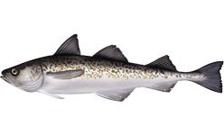
By: Jason Massry and Joey Cohen
Pollock Pros
Theragra Chalcogramma, commonly known as “Alaskan Pollock”

Slide 2
Abstract
In this Urban Barcoding Project, our group has genetically barcoded Theragra Chalcogramma successfully. Our aim for the project is to research Theragra Chalcogramma characteristics and their way of life to get a better understanding of what we are barcoding. Our reason is because barcoding the Theragra Chalcogramma will help scientists who are in a situation where they have piece of DNA but don't know what specimen it is from. Now they can identify it by looking it up in the barcode library to see if their specimen matches the characteristics of the barcoded Pollock.

Slide 3
Introduction
Theragra Chalcogramma, also known as walleye pollock, is a type of cod coming from the Gadidae family.
³When they are young they feed on Krill, Zooplankton and other crustaceans. As they increase in size they start eating their own kind which are juvenile pollock and other small fish such as herring, sand lance, shrimp, cod, haddock, and hake.
The reason why
Pollock is so unique is because it is the only type of fish that is considered a cod fish but is not called one.
Theragra Chalcogramma has speckles that are colorful, which helps them because they hide under the sandy ocean floors and predators cannot identify them.
⁴Even though there are sometimes a depletion of pollock in the eastern Bering Sea as a result of commercial exploitation, pollock have the ability to repopulate areas very quickly.
¹Pollock are considered a relatively fast growing and short-lived species and are a major biological component of the Bering Sea.

Slide 4
Introduction
The Theragra chalcogramma is known to have the largest population of any other edible fish.
About three million Theragra chalcogramma are caught each year.
²The fish has many health benefits such as very low fat, and carbohydrates.
Health
Benefits
²The Theragra chalcogramma is also a great source of protein and is a great addition to a healthy diet.
Its liver is processed to make cod liver oil, which is an important source of Vitamin A, Vitamin D, and Vitamin E.

Slide 5
Methods
Grind the sample in 300 µL of lysis solution
Incubate for 10 minutes
Transfer 150 μL of the supernatant
Incubate for 5 minutes. Centrifuge for 1 minute
Add 100 μL of dH20
Transfer 150 μL of the supernatant
Incubate for 5 minutes. Centrifuge for 1 minute
Remove the supernatant and add 500 μ of wash buffer.
Incubate for 5 minutes a 57⁰C
Transfer the supernatant into a fresh tube and store at -20^{c}

Slide 6
Methods (continued)
Put 23 µL of primer dye and COI primers so it can dissolve into the DNA.
The sample is placed on ice and amplified in a thermal cycler
Perform the bioinformatics online in order to further study the phylogeny of the fish.
Store at -20⁰C and 2% of agarose is poured into a gel box
Sent for DNA sequencing
Agarose is then placed into an electrophoresis chamber at 130 volts for 30 minutes
We used DNA Subway to analyze and generate a phylogenetic tree.
The DNA sequence was then trimmed
We then blasted the finalized DNA sequence and uploaded the data.
The phylogenetic tree was then generated showing similar fish with the same similarities and characteristics.
Export to Genbank

Slide 7
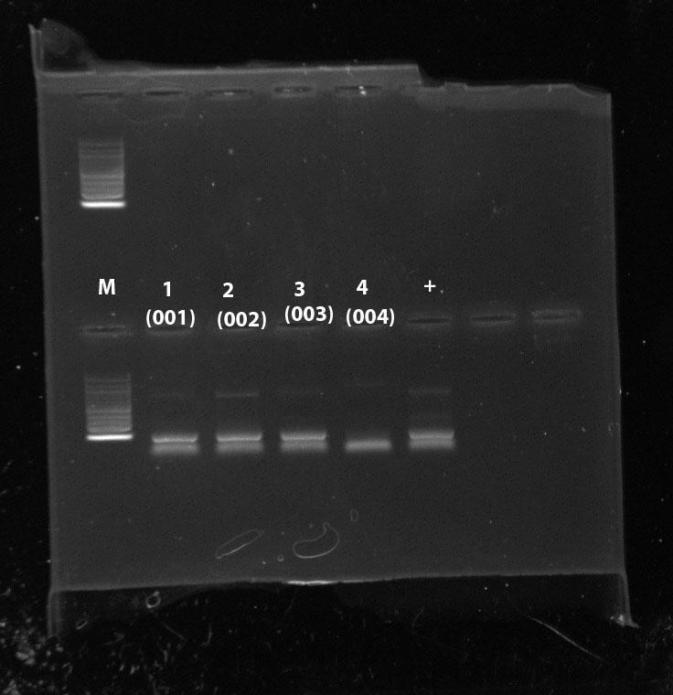
Results
A print out of our phylogenetic tree will be included on our poster.
This is a picture of the results of our gel after running it through the PCR machine. The first lane contains the marker, while lanes 1-4 includes our specimen tissues. Lane “+” contains the positive control.
Theragra Chalcogramma, commonly known as “Alaskan Pollock”

Slide 8
Conclusion
After analyzing our phylogenetic tree, we came to the the conclusion that there are organisms that are similar to Theragra Chalcogramma by family class, diets,location, and health benefits, as well as physical similarities. An example of an organism that shares the same diet as Theragra Chalcogramma is the Plesio batis Daviesi, they both eat crustaceans and bony fish. Another example of an organism is the Oncorhynchus mykiss, which is found in the same location where Theragra Chalcogramma inhabits, as well as sharing a similar diet. Our results show a tree of a few organisms similar to Theragra Chalcogramma based on the same family class, such as Haddock-Gadidae and Atlantic cod-Gadidae. What you can deduce from analyzing the tree, is that our specimen has a large list of relatives with similar characteristics.

Slide 9
Discussion
Our results are crucial because we now know of other organisms with the same characteristics which is crucial for scientists who are researching those organisms. By examining similarities in their DNA, they can find out what other similar benefits they contain: for example: health benefits, physical characteristics and living environments that they share. Health benefits based on their diets can now be also studied and further researched.
Now that we have generated the phylogeny, we could conduct further studies in order to research other organisms in the same family and genus that possess similar health benefits as Theragra Chalcogramma. Alaskan Pollock is not in the Pollachius genus, but in the Atlantic family, so we would like to conduct further research to see if there are any other fish in the Atlantic family that have similarities to Alaskan Pollock. We would also like to see if there are other organisms that belong to the Atlantic family but are not members of the Pollachius genus, similar to Theragra Chalcogramma. This could help identify organisms with similar physical characteristics to Theragra Chalcogramma who are in the same Atlantic family but different Pollachius genus.

Slide 10
Bibliography
¹Seafood Health Facts: Making Smart Choices. (n.d.). Retrieved October 13, 2016, from http://www.seafoodhealthfacts.org/description-top-commercial-seafood-items/alaska-pollock
²Genuine Alaska Pollock:. (n.d.). Retrieved October 13, 2016, from http://www.greatfishforgreatkids.org/fishHealthNutrition.htm
³Family, By. "AFSC Walleye Pollock Research." Alaska Fisheries Science Center. N.p., n.d. Web. 13 Oct. 2016. <http://www.afsc.noaa.gov/species/pollock.php>
⁴Dfg.webmaster@alaska.gov. "Walleye Pollock Species Profile, Alaska Department of Fish and Game." Walleye Pollock Species Profile, Alaska Department of Fish and Game. N.p., n.d. Web. 13 Oct. 2016. <http://www.adfg.alaska.gov/index.cfm?adfg=walleyepollock.main>
We would like to thank Ms. Ashkenazy for her continued support and devotion throughout the Urban Barcode Project.
We would also like to thank Melissa Lee and staff at the DNALC labs for all the support we received for the Urban barcode project.
And thank Cory Schneer, the IT director at our school, for helping us with some of our technological difficulties as well as making our Wooden board.
Acknowledgements

