Slide 1
Abstract:
The barcoding project helps identify all the organisms in our world. Barcoding Aloe vera will help scientist determine the difference between Aloe Vera and other plants. Aloe Vera has numerous benefits. Having the plant barcoded can change the way scientists make use of this plant by understanding its phylogeny.

Slide 2
Introduction:
Helps heal cuts
Aloe is a
very unique plant that has a lot of benefits:
Removes makeup
Prevents swelling
Natural remedy for
asthma and diabetes
Improve one ’s diet
maximize weight -loss

Slide 3
Collect the specimen and take a picture.
Get the exact coordinates using a phone.
Share location by dropping a pin in google maps.
Methods
Isolate DNA from plant, obtain plant tissue, be careful not to cross contaminate specimen.
Document the specimen and identify the type of specimen using the UBP Sample Database.
Use tweezers, scissors, or a scalpel to collect small data tissue.
Put the sample in a 1.5mL tube marked with an ID number and added 300 μL of lysis solution to every tube.
Incubate the solution for 10min at 65 ºC then place in centrifuge for 1min.
Transfer supernatant to a fresh tube add silica resin and mix.

Slide 4
Remove supernatant once again. Add wash buffer and place on the vortex, after placing on centrifuge for 30sec.
Remove the supernatant. Add to wash buffer and put on the vortex, after place it on the centrifuge for 30 seconds.
Incubate solution for 5 minutes at 57⁰C then place in the centrifuge for 30 seconds.
Remove remaining supernatant add dH₂O. Mix by pipetting the mixture in and out.
Incubate it for 5 minutes at 57⁰C then place in the centrifuge for 30 seconds.
To amplify with PCR first add primer mix then add DNA and add mineral oil if necessary.
Transfer supernatant to fresh tube.
Amplify in thermal cycler and store at 20⁰C.

Slide 5
Then load the get and connect to electrophorese at 130 volts for 30min.
Pour the gel and let it set for 20min.
After check for DNA result and finally send it for sequencing.
On DNA Subway we trimmed our DNA sequence.⁽³⁾ With the new trimmed sequence we paired the base pairs of DNA in the sequence. Then we blasted the sequence, which generated a phylogenetic tree.
We then studied and analyzed the phylogenetic tree and uploaded our new findings to GenBank.
Then do the steps necessary for the bioinformatics, using the DNA Subway website, which will generate the phylogeny.

Slide 6
Results: We plan to insert a print out of our phylogenetic tree here.
After conducting the experiment, all of the lanes in the agarose gel showed the presence of DNA. Having sequenced the DNA, we got reliable and accurate data about our plant’s phylogeny.
(Going from right to left of the gel we have the positive control, the marker, sample 1, sample 2, sample 3, sample 4, sample 5, sample 6, and sample 7)
(our gel)

Slide 7
Conclusion:
All these plants that are related to Aloe have medicinal properties!
Agave ghiesbreghtii:
weight loss,
heals wounds, immune
System -boosting properties, etc...
Pandanus tectorius:
used as floss, clothing, sweetens, etc…
Coffee:
cuts pain, lowers
risk of heart disease, reduces risks of suicide, etc...

Slide 8
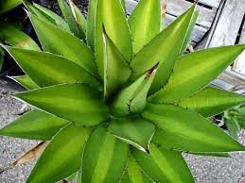
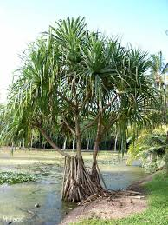
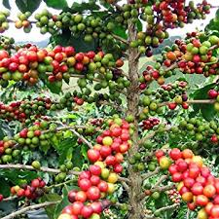
Conclusion:
Agave ghiesbreghtii
Pandanus tectorius
Coffee
People are trying to lose weight by drinking aloe because it speed up metabolism and agave also helps with weight lose .
Some people put aloe in clothing to rejuvenates skin cells. ⁽²⁾Hinano (hawaiian clothes) are made from Pandanus tectorius. ⁽¹⁾
Aloe reduces blood sugar levels which helps with diabetes and coffee also reduces diabetes reduced levels of interleukin and isoprostane.⁽³⁾ ⁽⁴⁾

Slide 9
Bibliography
(1)http://nativeplants.hawaii.edu/plant/view/Pandanus_tectorius
(2)http://www.fibre2fashion.com/industry-article/3225/aloe-vera-apparels
(3)https://dnasubway.cyverse.org/project/phylogenetics/console.html?pid=96118
(4)http://www.newsmax.com/Health/Health-News/aloe-vera-benefits-diabetics/2016/07/01/id/736642/
(5)http://www.livestrong.com/article/241466-what-are-the-health-benefits-of-coffee-beans/

Slide 10
Acknowledgements
Firstly, we want to thank Mrs. Michal Askenazy, our Bio Technology teacher, for giving us an opportunity to participate in something very special.
We want to thank Mrs. Bianca Lupa for helping us in school when Mrs. Askenazy wasn’t here.
We want to thank Ms. Melissa Lee and the scientists at the Urban Barcode project.
We are also very grateful for Mr. Corey Shneer and Mr. Daniel Kamelhar for helping us upload our phylogenetic tree onto our proposal and answering any questions about technology.
We enjoyed the fact that this project gave us an opportunity showcase our intelligence, our research skills, and as well our creativity.

