Slide 1
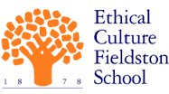
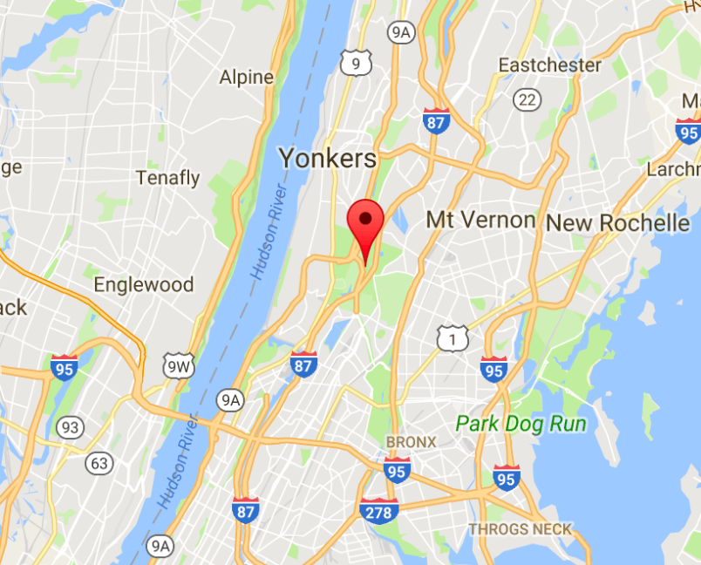
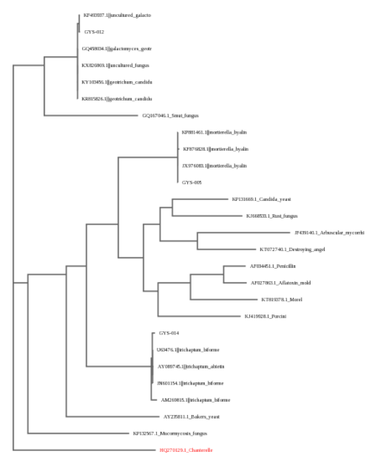
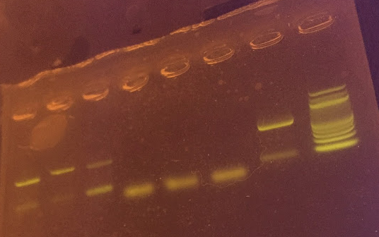
Not Mushroom for Error
Megan Rogers¹, Maggie Weisblum¹, Serena Zhang¹
¹Fieldston School
Abstract
Van Cortlandt Park is a public park located in the North Bronx, and is home to 49 known species of fungi. Fungi are an essential component of most ecosystems, as they help decompose organic matter and can be a source of food for some organisms. Additionally, certain fungal species can be indicators of environmental conditions such as soil acidity or mineral composition. The research question is: What characterization of mushroom species be found in Van Cortlandt Park? The goal of this research project was to collect data that could provide insight about the types of mushrooms that reside within the park. After collecting samples, the lab was performed following the bioinformatics protocol provided by UBP. Six samples were sent to be tested and three samples had sequencing results, showing strong indications of belonging to the Mortierella, Geotrichum, and Trichaptum genera of fungi. Though in Van Cortlandt Park or its compost, since only three samples had sequencing results.
Introduction
Located in the North Bronx area, Van Cortlandt Park is the third largest public park in New York City, claiming 1,146 acres in of land. Approximately 42 species of mushrooms are estimated to reside within the park. Mushrooms belong to the kingdom Fungi and typically fall under the phylum Basidiomycota. They are incredibly diverse, with as many as 5.1 million species living on Earth. Mushrooms, which are heterotrophic eukaryotes, reproduce when spores released by another mushroom grow to form hyphae, and later a flowering body.
Mushrooms play a vital role in most ecosystems. Most fungi help to decompose dead organisms, along with bacteria. Without the aid of mushrooms, there would be a much larger buildup of dead organisms almost everywhere. Most mushroom species that grow on the ground also form symbiotic relationships with trees by growing very close to the root system of a vascular plant. This relationship, known as mycorrhiza, helps the exchange of nutrients between the two organisms because the mushroom helps the tree take up nutrients and water from the soil, while the tree provides the fungus with carbohydrates in the form of sugars.
Certain species of mushrooms are also notable sources of nutrition for many animal species. In addition, the species of mushrooms growing in a particular environment can be an indicator of certain soil qualities such as acidity and fertility. For instance, if mushrooms that thrive in acidic soils are found significantly more frequently than mushrooms that prefer a more neutral or calcareous environment, then it can be inferred that the soil in that particular area is acidic. This application can also be used in the reverse direction; if certain types of mushrooms are more abundant and certain soil qualities are measured, then a link can be drawn between that species of mushroom and the environment in which it grows.
In this experiment, we aim to measure the diversity of mushrooms in Van Cortlandt Park and its compost. We want to have a deeper understanding of the mushroom demographic and diversity in both areas.
Materials & Methods
All of the 20 samples were collected on October 20, 2016 in Van Cortlandt Park. We obtained our samples on the Van Cortlandt Park grounds and in its compost. We chose these two areas because we knew beforehand that these large grounds contained many identified fungal species already, and that fungi were most likely to grow in the compost piles.
On the park grounds, we collected small samples of each visible mushroom, as well as a sample of the soil surrounding the mushroom to analyze further in the lab. However, we made sure not to remove all of the mushrooms in one particular area. For the park compost, we took samples from each bin: if there were visible mycelia, a sample of it was removed from the compost along with a sample of the composting materials; if there were no visible mycelia, a compost sample was collected. Wearing gloves, we removed all the visible mushrooms carefully with our hands, and we collected compost and soil samples using metal scoop shovels.
This lab was completed using the UBP protocol and the bioinformatics protocol. There was only one modification made to the protocol. Because visible mycelia were not seen in many of the compost and soil samples, it was necessary to cultivate the fungal species of the soil on potato dextrose agar plates in order to obtain a sufficient sample of the organism in question. This entailed sterilizing a pair of metal forceps by holding it over a flame until white hot. Once cooled down by dipping it into the agar, the forceps were used to transfer the mycelium growing in the soil sample– which was stored in a plastic bag– directly onto the agar. After one to two weeks, there was enough mycelium growth to use in the standard DNA extraction process.
Results
Among the six total samples that were sent to be tested, three samples had sequencing results. The three samples show strong indications of belonging to the mortierella, geotrichum, and trichaptum groups of mushrooms, respectively. While there were some other groups of mushrooms, some specific and others general (such as “uncultured zygomycota”), these groups were ultimately determined insignificant. This was determined because the previously mentioned groups (mortierella, geotrichum, and trichaptum) had, the DNA Subway determined, the least amount of errors, and the sequences already in the database bore very similar DNA sequences to those collected. However, many parts of the genome were inconclusive, showing the letter “N” where a nucleotide letter should have been.
Discussion
The original goal was to DNA barcode fungi in Van Cortlandt Park– including compost– to record the types of mushrooms in these areas. Though only three samples were analyzed and identified, the data collected during this project can still contribute to a knowledge base of fungi in Van Cortlandt Park.
Strains of Mortierella are known to play an important role in the decomposition of organic matter. Though it is an organism that is relatively common in soil, the presence of Mortierella is a promising indication that matter is being broken down in Van Cortlandt Park, especially the compost area where this sample was found. Unfortunately, Geotrichum, which was also found in Van Cortlandt Park’s compost, is an extremely common phyletic grouping of fungi. Its presence will not give much indication about the ecosystem of the compost. The third genus, Trichaptum, is a species of fungi that decomposes hardwood stumps and logs. This was not a surprise because the sample that was identified as Trichaptum was found on a log at Van Cortlandt Park.
Only three samples had sequencing results. However, it was interesting to see that each returned sample was determined to be a different species. Because two of the samples were from two different compost bins at Van Cortlandt, these data could indicate that the park composts, as well as the park itself, contains a diverse array of fungi species. Additionally, because the compost samples were determined to be different species from the sample on the log, which could be an indicator that different species of fungi grow in the compost piles and the park.
This DNA Barcoding project is also part of a larger initiative; the goal of which is to still identify the fungi species. The majority mushrooms in Van Cortlandt Park have only been identified based on its morphology instead of its genome, but the ability to sequence the genome of some of these organisms can change this problem. In a collaboration with members of Friends of Van Cortlandt Park, some mushrooms are being tested for their ability to decompose asphalt. Knowing about the fungal diversity in the park gives valuable insight as to how the tested species will interact in a non-lab environment.
Further research can be done to build on the minimal findings of this project. For example, more samples can be collected and sequenced to add to a growing knowledge base of the ecosystem of the park. Additionally, this data can eventually be used to measure the frequency at which these mushroom species grow within the park, which can give even more detailed information about the ecology of the area.
References
The Importance of Fungi. N.p., n.d. Web. 9 Oct. 2016.
“Mushrooms of Van Cortlandt Park.” Mushroom Observer. N.P., n.d. Web. 8 Oct 2016
“New York City Compost Project” New York City Compost Project.
N.P., n.d. Web. 10 Oct 2016
"New York City Department of Parks & Recreation." New York City Department of Parks & Recreation. N.p., n.d. Web. 8 Oct 2016.
Acknowledgements
We would like to acknowledge Dr Andrade for her mentorship, the Ethical Culture Fieldston School for offering this scientific research class, and Friends of Van Cortlandt Park for helping us work towards ways to further this research outside of the classroom.
Specimen Collection | DNA Extraction | DNA Analysis
Gloves were not switched between collecting each sample Samples were not washed after being taken back to the classroom, possibility of contamination from bacteria or other fungi | The agar plate was not physically split up into sections, but simply labeled with Sharpies. Therefore, as the fungi were being cultured, there may have been some mixing of fungal spores, which later would have led to possibly different, ambiguous results. The organisms may not have been sufficiently ground up | Some labels rubbed off the PCR tubes, and based off positioning and small marks, some numbers were guessed. The PCR program could have been using the incorrect time intervals
Figure: GYS-005 (Compost Bin 3) Sequencing Results– Mortierella
Figure: GYS-012 (Compost Bin 1) Sequencing Results– Geotrichum
Figure (above): Map of where samples were collected in New York City
Figure: GYS-014 (Log 1) Sequencing Results– Trichaptum
Figure (above): Picture of DNA gel electrolysis results
Figure (above): Phylogenetic Tree showing the relationship between fungal species found in Van Cortlandt Park

