Slide 1
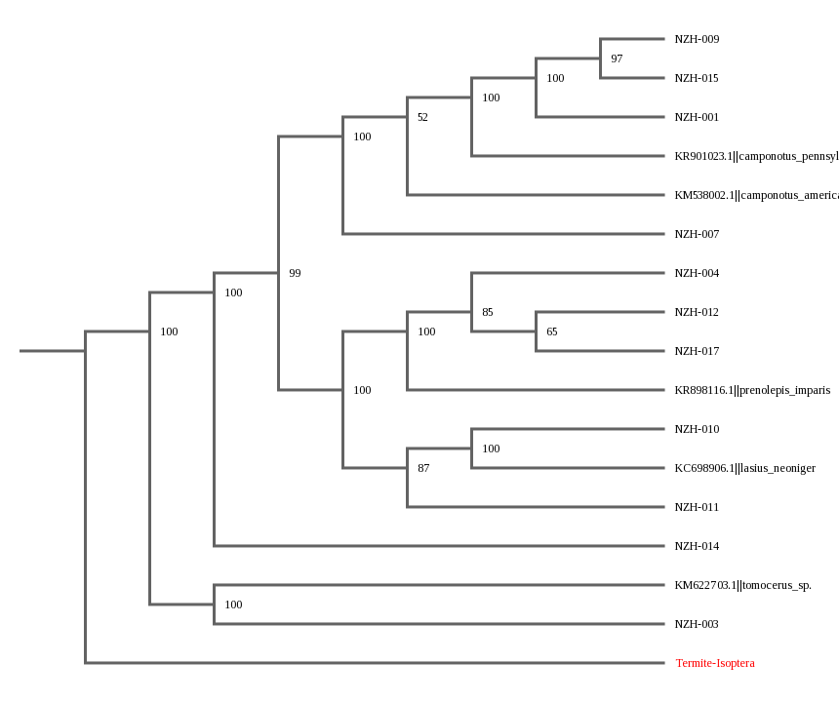
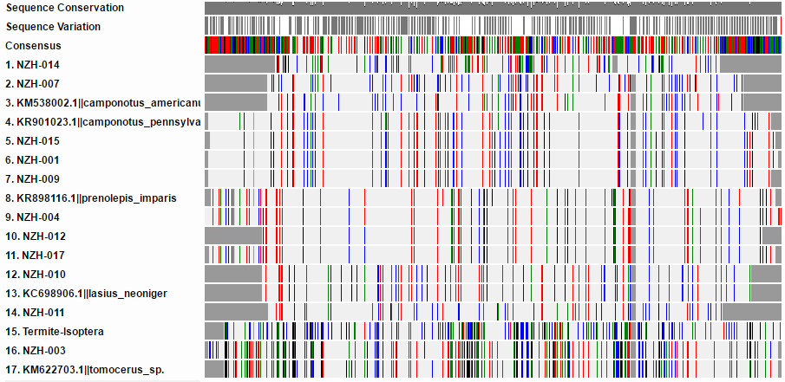
Ants as Indicators of Salt
By Thomas Coor and Rachel Sabatello
Oyster Bay High School
Alignment
Data on Animal Specimens
Cladogram of Organic Samples
Abstract
We attempted to determine if soil salinity affects the type of organisms that might live in that environment, using ants as an indicator. We were unable to determine if such a correlation exists.
Introduction
Salts are laid out on many roads throughout the world in order to melt any ice that my have formed on its surface. It is estimated that between two and twenty tons of salts may be laid on a kilometer of road per year, much of which would be washed into nearby soil. We predict this increase in salinity can destabilize soil ecosystems
Materials & Methods
We took ant and soil samples from two different sites, one next to our High School’s parking lot, the other off a trail in Muttontown Preserve. We successfully extracted genetic information from 11 ants, all of which came from the parking lot. DNA subway was used to determine the evolutionary relationship between the samples. To find the salinity of the soil, we added distilled water to the soil and measured conductivity.
Results
We measured the conductivity of soil samples using an conductivity meter. The results of which are displayed in the chart above. We also determined how related certain species of ants are to each other.
Sample | Nearest match (BLASTN) | Mismatches | Aln. Length | Bit Score | Common Name
NZH-001 | Camponotus sp.* | 0 | 650 | 1173 | Carpenter Ant
NZH-003 | Tomocerus sp. | 20 | 632 | 1050 | Springtail Ant
NZH-004 | Prenolepis imparis | 0 | 654 | 1171 | Winter Ant / False Honey Ant
NZH-007 | Camponotus americanus | 0 | 543 | 980 | Carpenter Ant
NZH-009 | Camponotus chromaiodes | 0 | 642 | 1159 | Carpenter Ant
NZH-010 | Lasius neoniger | 0 | 558 | 1007 | Cornfield Ant
NZH-011 | Lasius claviger | 3 | 518 | 921 | Smaller Yellow Ant
NZH-012 | Prenolepis imparis | 0 | 571 | 1031 | Winter Ant / False Honey Ant
NZH-014 | Augochlora pura** | 0 | 507 | 915 | Sweat Bee
NZH-015 | Camponotus chromaiodes | 0 | 645 | 1164 | Carpenter Ant
NZH-017 | Prenolepis imparis | 1 | 646 | 1160 | Winter Ant / False Honey Ant
Soil Conductivity
(Baseline of 28 ppm)
Soil Sample I.D. | Conductivity
Soil 1 (preserve) | 36 ppm
Soil 2 (preserve) | 103 ppm
B5 (Parking Lot) | 83 ppm
B6 (Parking Lot) | 27 ppm
* Either Camponotus americanus or Camponotus chromaiodes
**Sweat Bee
Discussion
Based on the data we collected, we could not draw any correlations between the amount of salt within an ants environment an ant biodiversity. The experiment was inconclusive due to a vast spread of data in salinity tests and lack of data to use as a control. We found little dissolved salt in the soil, which is partially due to the fact that we collected in October, prior to the salting of the roads. In addition, we only successfully extracted DNA from samples located near salted roads and were unable to barcode ants from the pristine location.
References
Lashmet, M. H. (n.d.). Snow and Ice Control. Revised January 2012, from
https://www.dot.ny.gov/divisions/operating/oom/transportation-maintenance/snow-and-ice
Lobry De Bruyn, L. (1999). Ants as bioindicators of soil function in rural environments, Agriculture Ecosystems and Environment. Uploaded July 10, 2014 from https://www.researchgate.net/profile/Lisa_De_Bruyn/publication/223348154_Ants_as_bioindicators_of_soil_function_in_rural_environments/links/0a85e53be322d3ab47000000.pdf
Potter, M. (1997). Carpenter Ants, University of Kentuky. Retrieved December 16, 2016, from https://entomology.ca.uky.edu/ef603
Tanji, K. K. (n.d.). Salinity Management Guide. WateReuse Foundation Retrieved December 16, 2016, from http://salinitymanagement.org/Salinity%20Management%20Guide/le/le_2.html
Thompson, J., Rutter, A., & Ridout, P. (1986). The Salinity of Motorway Soils. I. Variation in Time and Between Regions in the Salinity of Soils on Central Reserves. Journal of Applied Ecology, 23(1), 251-267. doi:10.2307/2403095
Acknowledgements
Special thanks to Brett Curlew for guidance and letting us use his testing equipment.

